Slide 1
DESIGN THINKING AND PRODUCT INFORMATION

Slide 2

Present by 24KD1A0294-p.keerthi 24KD1A0298-p.Hemanth sai 24KD1A0299-Koteswar rao 24KD1A02A1-p.Abilash 24KD1A02A3-R.Tejaswan 24KD1A02A5-R.Sowjanya 24KD1A02A6-R.Uma mahesh

Slide 3
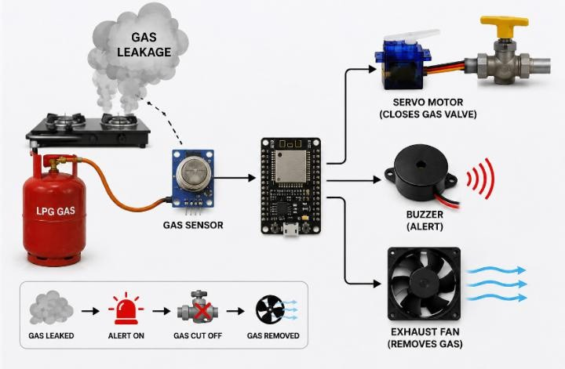
Smart Gas Leakage Detection and Safety System

Slide 4






CONTENT
Introductiontodesign thinking problem statement
Empathy Define Ideate
story bording proto type
Proto type explanationstory conclusion

Slide 5

WHAT IS DESIGN THINKING AND INNOVATION
Design Thinking is ahuman-centeredapproach to innovationthat integrates customeremotion and empathy, thepossibilities of digital techand analytics, and therequirements for business success.

Slide 6

DESIGN THINGS PROCESS

Slide 7
PROBLEM STATEMENT
LPG gas leakage is a serious safety issue that can cause fires, explosions, and health hazards. Most people detect gas leaks only by smell, which is not always reliable. Therefore, a Smart Gas Leakage Detection and Safety System is needed to detect gas leakage early, alert nearby people, automatically cut off the gas supply, and remove leaked gas to prevent accidents.

Slide 8



EMPATHY
5 why's
persona'sInterview Ǫuestions Empathy map
Experience Map

Slide 9


PRINCIPAL OF DESIGN THINKING
Desirability(human):meets the user needs Feasibility (Tech): can be built Viability(Business ): makes business sense

Slide 10
EMPATHY LEVEL (5WHY'S)
Gas Leakage Causes Accidents
↓ (Why?)
Gas leakage is not detected early
↓ (Why?)
People rely only on the smell of gas
↓ (Why?)
The smell may not be noticed immediately or when no one is nearby
↓ (Why?)
There is no automatic detection and alert system
↓ (Why?)
Need for a Smart Gas Leakage Detection and Safety System

Slide 11
OUR THOUGHTS ON 5WHY'S
1. Tejaswani
Why do gas leakage accidents occur? Ans: Due to damaged gas pipes and loose connections.
Why are gas leaks not detected early?
Ans: There is no continuous gas monitoring.
Why is continuous monitoring important?
Ans: It detects leaks before they become dangerous.
Why should an alarm be activated?
Ans: To alert people immediately.
Why is this system necessary?
Ans: To prevent accidents and save lives.
2.sowjanya
Why do LPG leaks become dangerous?
Ans: Gas accumulates in closed spaces.
Why do people fail to notice the leak?
Ans: They may not recognize the smell in time. Why is automatic detection needed?
Ans: It provides faster warning than humans.
Why should the gas supply be stopped?
Ans: To avoid fire and explosions.
Why is automation important?
Ans: It increases safety and reduces risk.

Slide 12
Why do gas leaks cause explosions?
Ans: Gas comes in contact with a spark or flame.
3.Keerthi
4.Abhilash
Why do industries need gas detection?
Ans: To protect workers and equipment.
Why is manual inspection not enough?
Ans: It cannot monitor continuously.
Why use real-time monitoring?
Ans: To detect leaks instantly.
Why is quick action required?
Ans: To reduce the chance of an explosion.
Why use a gas sensor?
Ans: To detect gas concentration accurately.
Why should notifications be sent?
Ans: To inform users even when they are away.
Why is IoT useful?
Ans: It enables remote monitoring.
Why should emergency alerts be given
Ans: To enable quick evacuation.
Why is this project beneficial? Ans: It improves workplace safety.

Slide 13
4.Hemanth Sai
5.Uma Maheshwara Rao
Why is early gas detection important?
Ans: It prevents major accidents.
Why should homes have gas leakage detection?
Ans: To ensure family safety.
Why do leaks remain unnoticed?
Ans: Small leaks are difficult to identify.
Why should alarms be loud?
Ans: To warn everyone nearby.
Why should the system work automatically?
Ans: To reduce human error.
Why is emergency response necessary?
Ans: To minimize damage.
Why use IoT technology?
Ans: For instant data transmission.
Why should maintenance be done regularly?
Ans: To prevent unexpected leaks.
Why is this system reliable?
Ans: It provides continuous monitoring.
Why is prevention better than repair?
Ans: It saves lives and property.

Slide 14
7.Koteswara Rao
Why should smart safety systems be adopted?
Ans: To improve accident prevention.
Why integrate sensors with IoT?
Ans: To provide real-time monitoring and alerts.
Why is remote access useful?
Ans: Users can monitor gas status from anywhere.
Why is fast notification important?
Ans: It enables immediate action.
Why is this project valuable?
Ans: It enhances public safety and reduces losses.

Slide 15



INTERVIEW QUESTIONS
What is the main objective of your gas leakage detection project? Which gas sensor did you use, and why did you choose it?
How does the gas sensor detect gas leakage?
What is the role of the microcontroller (ESP32/Arduino/NodeMCU) in your project?
How does IoT improve the gas leakage detection system?
What happens when the gas concentration exceeds the threshold value? How are alerts sent to the user during a gas leak?
What are the advantages of your proposed system over traditional gas leak detection methods?
What are the limitations of your project, and how can they be improved in the future?
Where can this gas leakage detection system be used in real life?

Slide 16

PERSON -1
Pain Point:-
Gas leaks are difficult to detect in the early stage. Depending only on the smell of LPG can delay action, increasing the risk of fire, explosion, and harm to people.
Name: R. Sandhya Rani Job: Home Maker
Hobbies: Cooking, Gardening, Reading books
Ǫ1. How do you currently detect a gas leakage?
Ans: I usually identify a gas leak by smelling LPG or checking the gas stove and cylinder connections.
Ǫ2. Have you ever experienced or witnessed a gas leakage incident?
Ans: Yes. Once I noticed the smell of gas in my kitchen, and it made everyone alert until the leak was fixed.

Slide 17
Ǫ3. Do you think it is difficult to identify a gas leak before it becomes dangerous?
Ans: Yes. Small gas leaks are not always easy to notice immediately.
Ǫ4. Would an automatic gas leakage alert system improve safety? Why?
Ans: Yes. It can provide an instant alert, helping us take quick action and prevent accidents.
Ǫ5. Do you think a smart gas leakage detection system can help prevent accidents and save lives?
Ans: Yes. Early detection and timely alerts can prevent fires, explosions, and protect lives and property.

Slide 18

PERSON -2
Pain Point
Gas cylinders are used daily, so even a small unnoticed gas leak can lead to serious accidents, fire hazards, and financial loss.
Name: Veni Job: Housewife
Hobbies: Cooking, Gardening
Ǫ1. How do you currently detect a gas leakage?
Ans: By smelling LPG gas.
Ǫ2. Have you ever experienced a gas leakage?
Ans: Yes, once.
Ǫ3. Is it difficult to detect a gas leak early?
Ans: Yes, it is.
Ǫ4. Would an automatic gas leakage alert system improve safety?
Ans: Yes, it gives instant alerts.

Slide 19

PERSON -3
Pain Point
Gas cylinders are used daily, so even a small unnoticed gas leak can lead to serious accidents, fire hazards, and financial loss.
Name: Eswaramma Job: Restaurant Owner
Hobbies: Cooking, Reading newspapers
Ǫ1. How do you currently detect a gas leakage?
Ans: By smelling LPG gas.
Ǫ2. Have you ever experienced a gas leakage?
Ans: Yes, once.
Ǫ3. Is it difficult to detect a gas leak early?
Ans: Yes, sometimes.

Slide 20
Ǫ4. Would an automatic gas leakage alert system improve safety?
Ans: Yes, it gives quick alerts.
Ǫ5. Can a smart gas leakage detection system prevent accidents?
Ans: Yes, it helps prevent accidents and saves lives.

Slide 21

PERSON -4
Name: Shankar Job: Shop Owner
Hobbies: Reading Newspapers, Farming
Pain Point:
Gas leaks can cause damage if they are not detected on time.
Ǫfi. How do you currently detect a gas leakage?
Ans: I check the gas cylinder and pipe connections.
Ǫ2. Have you ever experienced a gas leakage?
Ans: No, but I have seen one nearby.

Slide 22


Ǫ3. Is it difficult to detect a gas leak early?
Ans: Yes, small leaks are hard to notice.
Ǫ4. Would an automatic gas leakage alert system improve safety?
Ans: Yes, it warns us immediately.
Ǫ5. Can a smart gas leakage detection system prevent accidents?
Ans: Yes, it reduces the risk of fire and explosions.

Slide 23

PERSON -5
Name: Satyavathi Job: Tailor
Hobbies: Stitching, Cooking
Pain Point:
Gas leaks are not always noticed quickly, which can lead to unsafe situations.
Ǫfi. How do you currently detect a gas leakage? Ans: I listen for a hissing sound and check for the smell.
Ǫ2. Have you ever experienced a gas leakage?
Ans: Yes, a small leak at home.

Slide 24
Ǫ3. Is it difficult to detect a gas leak early?
Ans: Yes, especially if the leak is small.
Ǫ4. Would an automatic gas leakage alert system improve safety?
. Ans: Yes, it gives early warning.
Ǫ5. Can a smart gas leakage detection system prevent accidents?
Ans: Yes, it helps avoid dangerous situations.

Slide 25

PERSON -6
Name: Ajay
Job: College Student Hobbies: Playing Cricket, Learning
Technology
Pain Point:
Many people are unaware of gas leaks until they become dangerous
Ǫfi. How do you currently detect a gas leakage?
Ans: I check for the smell of LPG.
Ǫ2. Have you ever experienced a gas leakage?
Ans: No, but I know it is dangerous.
Ǫ3. Is it difficult to detect a gas leak early?
Ans: Yes, without a detector.

Slide 26
Ǫ4. Would an automatic gas leakage alert system improve safety?
Ans: Yes, it provides instant notifications.
Ǫ5. Can a smart gas leakage detection system prevent accidents?
Ans: Yes, it helps people take quick action.

Slide 27

PERSON -7
Name: Guna Srinivas
Occupation: Aircraft Maintenance Technician (AMT) Hobbies: Reading Technical Books, Traveling
Pain Point:
Gas leaks are difficult to identify quickly and may lead to serious hazards.
Ǫfi. How do you currently detect a gas leakage?
Ans: I inspect gas connections regularly.
Ǫ2. Have you ever experienced a gas leakage?
Ans: No, but I know the risks.

Slide 28
Ǫ3. Is it difficult to detect a gas leak early?
Ans: Yes, without proper sensors.
Ǫ4. Would an automatic gas leakage alert system improve safety?
Ans: Yes, it provides early warnings.
Ǫ5. Can a smart gas leakage detection system prevent accidents?
Ans: Yes, it helps avoid dangerous situations and improves safety.

Slide 29
Empathy Map – Smart Gas Leakage Detection and Safety System
Says (What they express) "I want my home to be safe from gas leaks." "The system should alert me immediately if gas leaks." "It should be easy to use and affordable." "It should help prevent accidents before they happen." | Feels (Emotions) Worried about gas leakage and fire accidents. Wants safety and peace of mind. Feels secure with automatic gas detection. Confident if instant alerts are received.
Thinks (What's on their mind) Is there a reliable way to detect gas leaks early? Will the system alert me on time? Can it protect my family and property? Will it reduce the risk of explosions and fire? | Does (Actions & Behavior) Checks the gas cylinder and stove regularly. Turns off the gas supply after use. Opens doors and windows if gas smell is detects

Slide 30
Empathy Map for Environment / Users
(Home Users, Families, Restaurants, Hotels, and Industries Using LPG Gas)

Slide 31
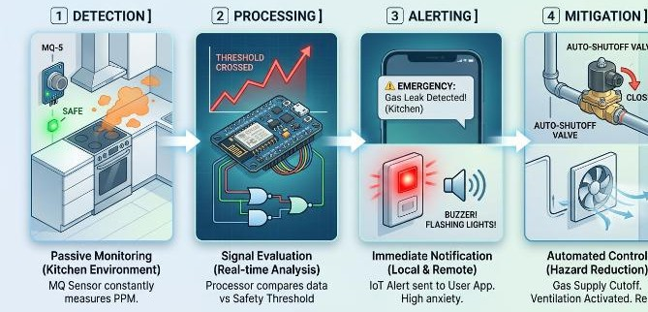
EXPERIENCE MAP

Slide 32
UNDERSTANDING
fi.Gas leakage is a major cause of fires, explosions, and health hazards.
Early detection of gas leaks is essential to prevent accidents.
Many homes and industries lack affordable automatic gas safety systems.
4.A smart monitoring system can detect leaks continuously and provide instant
alerts.
.
5 .Automatic safety actions, such as turning off the gas supply or activating an exhaust fan, can reduce damage and save lives.
.
6.The project aims to improve safety, reduce risks, and provide a reliable gas leakage monitoring solution.

Slide 33
DEFINE
Who was involved?
ANS: House owners, families, restaurant staff, industries, LPG users, and maintenance personnel.
What happened?
ANS: Gas leakage may occur due to damaged pipelines, loose cylinder connections, or faulty gas appliances, creating a serious safety risk.
When did it occur?
ANS: During cooking, gas cylinder replacement, equipment failure, or accidental leakage at any time.
Where did it happen?
ANS: Homes, hotels, restaurants, laboratories, industries, and commercial buildings where LPG or other gases are used.

Slide 34

IDEATION
Brain writing Brine stroming Dot voting

Slide 35
BRAIN WRITING
Collect data from team memberson improving the way computers and presentation controlled without touching devices
The focus was on creating a smart and touching interaction system using hand gesture
BRAIN STORMING
Discussed multiple solutions such as gesture -based cursor control ,swip gesture for slide change,zoom using fingure movements
DOT VOTING
Select the best solution -AI based gesture control system for computers and presentations based on innovation, feasibility and ease of use

Slide 36

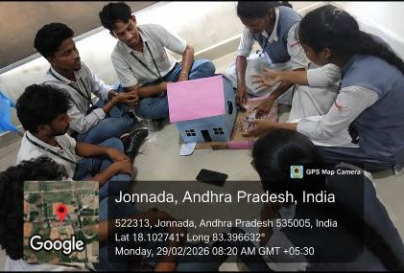
BRAIN STORMING SESSION

Slide 37
IDEATION
Develop a smart system to detect gas leakage in real time. Use a gas sensor to continuously monitor gas concentration. Trigger a buzzer and LED immediately when a leak is detected. Automatically switch ON an exhaust fan to remove leaked gas.
Send instant alert notifications to the user through a mobile app/SMS. Automatically shut off the gas supply using a solenoid valve (optional feature).
Ensure the system is low-cost, reliable, and easy to install in homes and industries.
Design the system to operate continuously with minimum maintenance.

Slide 38
PROPOSED SOLUTION
The Smart Gas Leakage Detection and Safety System is designed to detect gas leaks at an early stage and prevent accidents. The system uses a gas sensor to continuously monitor the surrounding air for the presence of LPG or other combustible gases. When the gas concentration exceeds a safe limit, the system immediately activates a buzzer and LED to alert nearby people.
At the same time, it automatically turns ON an exhaust fan to remove the leaked gas and sends an alert notification to the user's mobile phone. The system can also automatically shut off the gas supply using a solenoid valve (if included). This smart solution improves safety, minimizes the risk of fire and explosions, and helps protect lives and property.

Slide 39
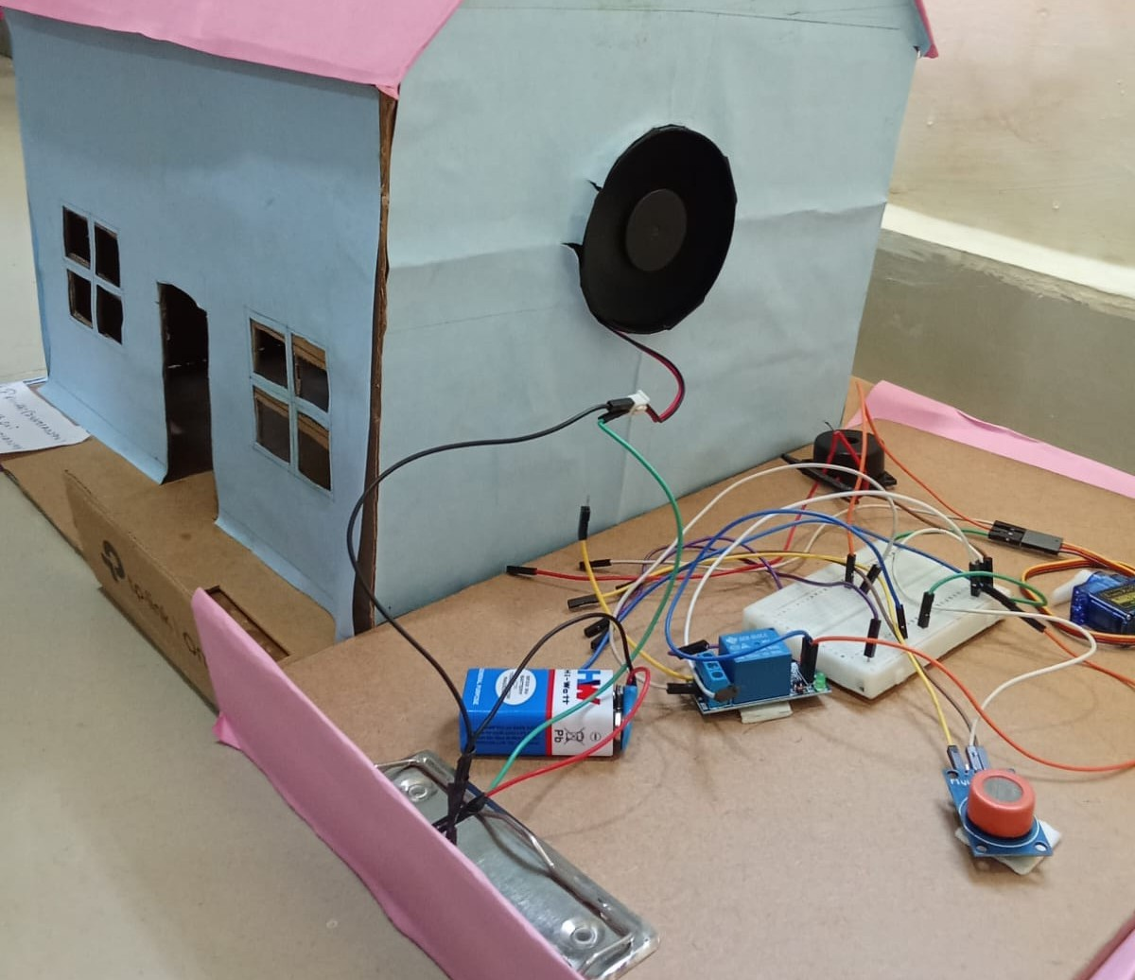
PROTOTYPE

Slide 40


REǪUIRED MATERIAL
Mq sensor Esp 32 Servo motor Buzzer Exhaust fan

Slide 41

MǪ SENSOR
When gas is present, its resistancechanges
It gives signal (analog/digital) toESP32 Detects gas leakage in the air
Sends alert signal to ESP32
It continuously monitors theenvironment

Slide 42
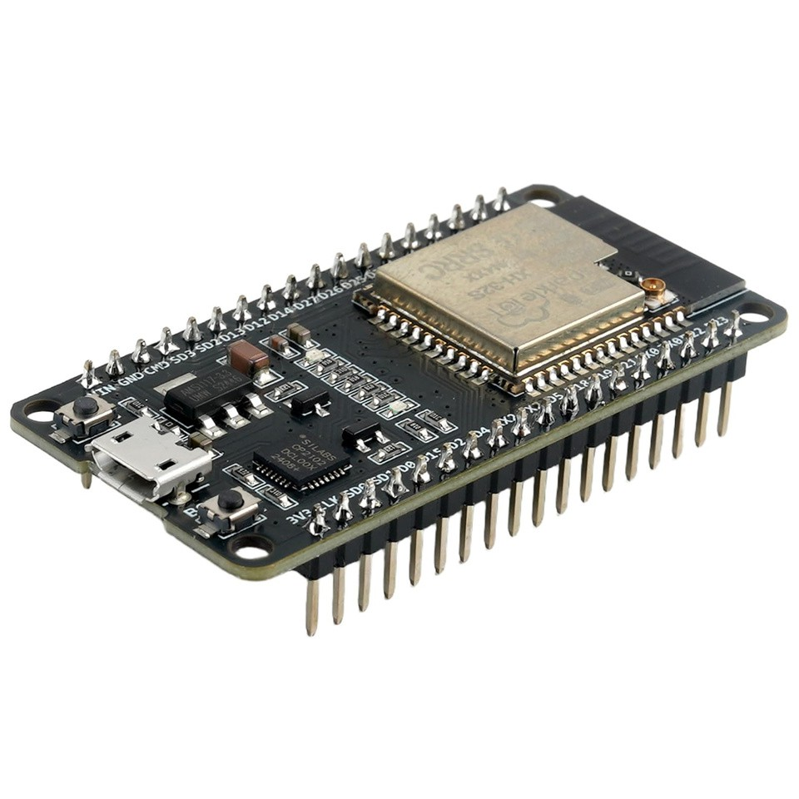
ESP32
ESP32 is a small microcontroller(brain of the system) with built-inWiFi and Bluetooth.
It receives input from the MǪsensorIt processes the data
It sends output signals to servomotor,
buzzer, and fanControls all componentsMakes decisions (ON/OFF) basedon gas detection

Slide 43
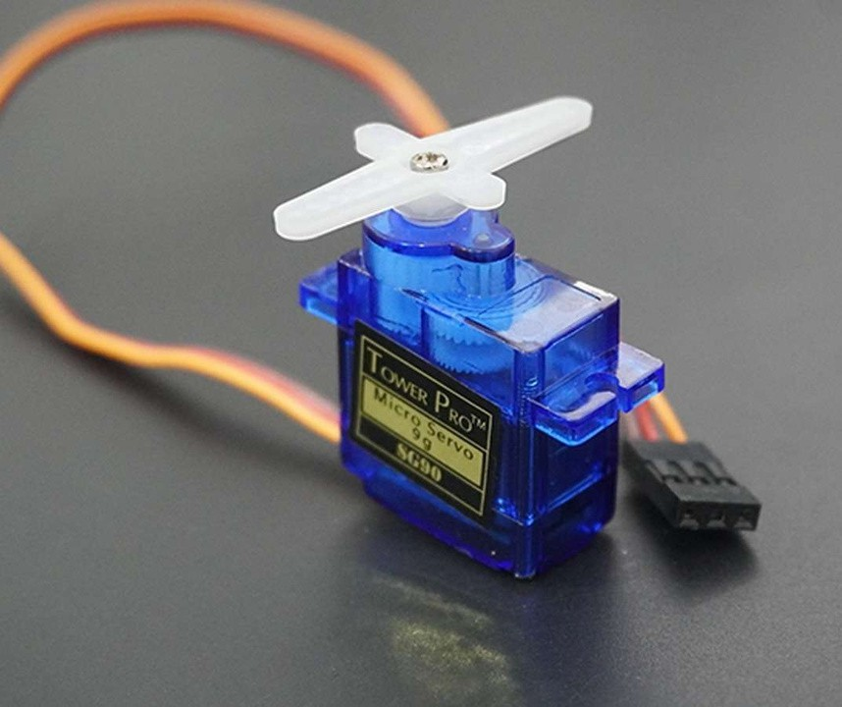
SERVO MOTOR
A servo motor is a motor used for precisemovement (exact angle control).
It receives signals from the ESP32Based on the signal, it rotates to a fixed angle (like0°, 90°, fi80°) It is connected to the gas knob/valveWhen gas leakage is detected, it automaticallyrotates and closes the valve🔸
ExampleIf leakage happens → servo rotates → gas supply stops

Slide 44

BUZZER
A buzzer is a sound-producing device
When it gets power, it produces a beepsoundGives warning alert when gas leakageoccurs
Helps people know danger quickly

Slide 45


EXHAUST FAN
A small fan used to remove air/gasWhen turned ON, it pushes out theair
Removes leaked gas from the room Reduces risk of fire or explosion

Slide 46
FEEDBACK
Persona fi – R. Sandhya Rani (Home Maker) Feedback:
"I think this system is very useful for homes. Instant alerts will help families prevent accidents."
Persona 2 – Eswaramma (Restaurant Owner) Feedback:
"This project will improve safety in commercial kitchens. Mobile alerts and alarms are very helpful."
Persona 3 – Veni (Housewife) Feedback:
"I like the idea of automatic gas leak detection. It gives peace of mind while cooking."

Slide 47
Persona 4 – Shankar (Shop Owner) Feedback:
"This system can reduce the risk of fire. It should be simple to install and easy to use."
Persona 5 – Satyavathi (Tailor) Feedback:
"I feel this device is useful for every home. It should detect even small gas leaks accurately."
Persona 6 – Ajay (College Student) Feedback:
"This is a smart and innovative idea. Real-time notifications will make the system more effective."
Persona 7 – Guna Srinivas (Aircraft Maintenance Technician) Feedback:
"The project has good safety potential. It should be reliable, accurate, and provide quick alerts during emergencies."

Slide 48
CONCLUSION
The Smart Gas Leakage Detection and Safety System provides an effective and reliable solution for detecting gas leaks and preventing accidents. By continuously monitoring gas levels, giving instant alerts, and automatically activating safety measures, the system enhances the safety of homes, industries, and commercial spaces. It is cost-effective, easy to use, and helps protect human lives and property by reducing the risk of fire, explosions, and gas-related hazards.

Slide 49

THANK YOU

