Slide 1

DESIGN THINKING AND INNOVATION
Presented By
A.Rupa Rani 24KD5A0202
D. Lasya 23kd1a0230L
M.Prabhukumar 23kd1a0262
K.venkatalakshmi 23kd1a0247

Slide 2
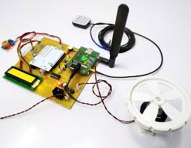
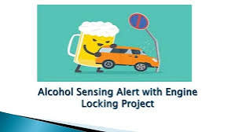
ALCOHOL DETECTION
AND
ENGINE LOCKING SYSTEM
UNDER THE GUIDENCE OF
Mr.B.RAM VARA PRASAD,(Ph.D)
Assistant professor,
Department of EEE, LIET(A).

Slide 3

INTRODUCTION TO DESIGN THINKING
PROBLEM STATEMENT
EMPATHY
CONTENTS
DEFINE
IDEATE
PROTOTYPE EXPLANATION
CONCLUSION

Slide 4
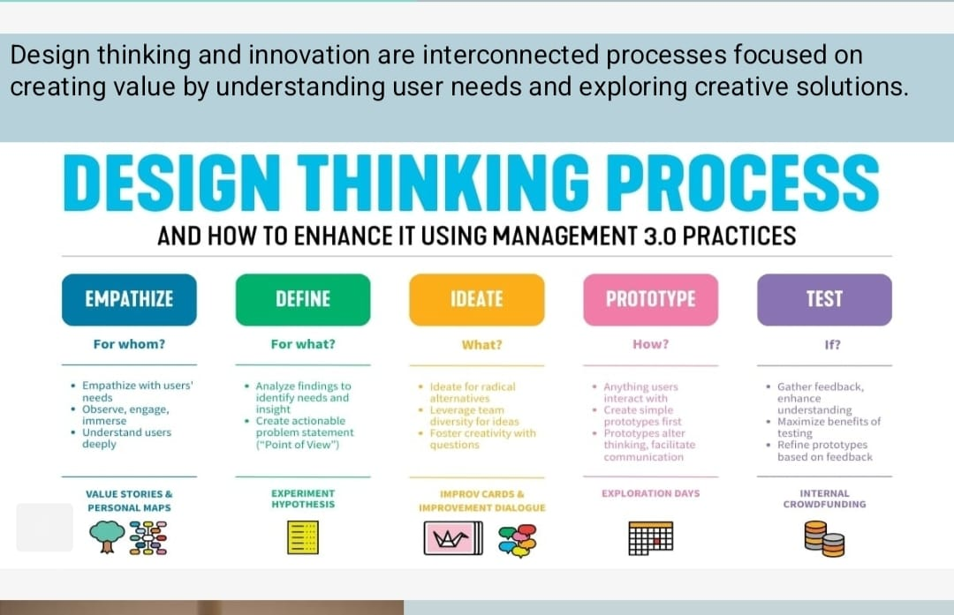

Slide 5
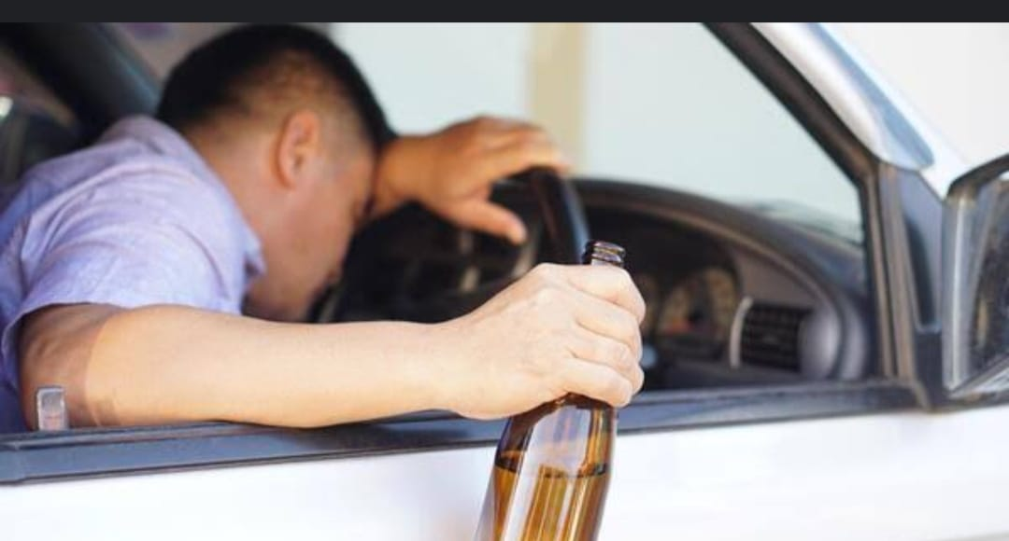
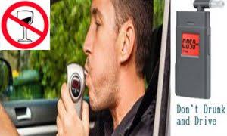
INTRODUCTION
Say NO to drunk and drive
Say NO to rash driving
Say NO to accidents
Drive SAFE
SAVE your life
SAVE the world.

Slide 6
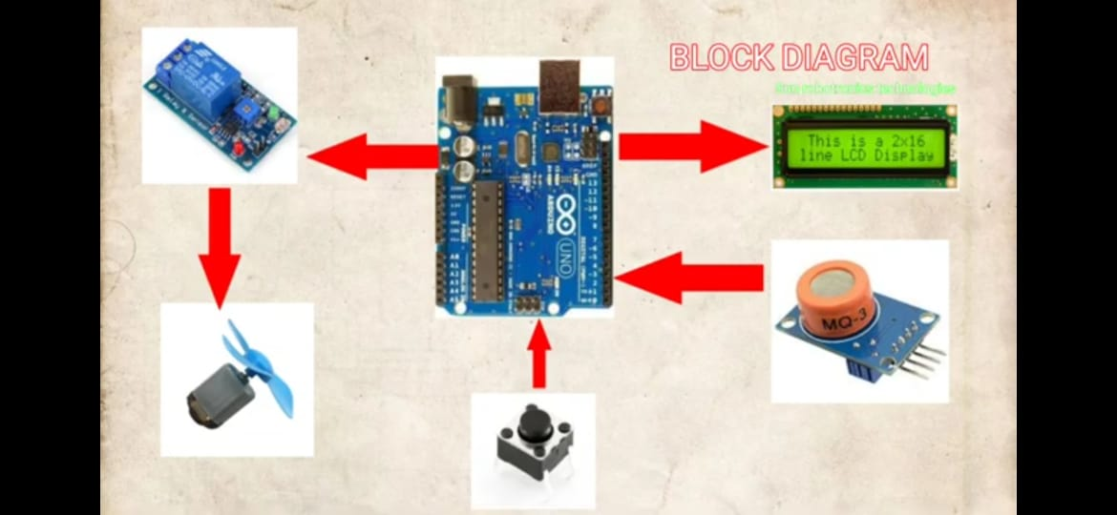
Arduino is interfaced with piezo electric sensor to detect accidents.
GSM is interfaced to Arduino to send notification messages to Authorized users.
Buzzer is interfaced with Arduino to alert accidents.
ABSTRACT
The main objective is to reduce road accidents caused by drunken drivers, To avoid this problem, we want to develop an automatic en locking system. That is if a person(driver) tries to drive a vehicle al consumption of alcohol, The engine of the vehicle will automaticall locked precisely. By using GPS module we can track the position of the vehicle and it also sends a message by using GSM to the registered number.
MOTIVATION
About 1.24 million people die each year as a result of road traffic crashes.
Without action, road traffic crashes are predicted to result in the deaths of around 1.9 million people annually by 2020.
Decade of Action for Road Safety (2011-2020) with the aim of saving millions of lives by improving the safety of roads, vehicles and improving emergency services.

Slide 7
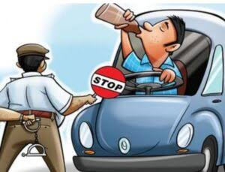
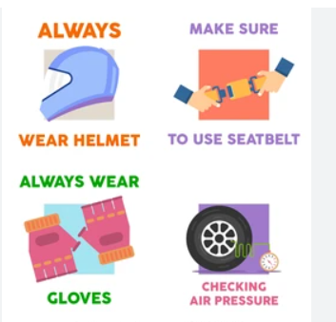
Problem Statement
LEADING OF ACCIEDENTS
TESTING METHODOLOGY
INCREASING RATE OF TRAFFIC
WIDENING OF ROADS
HELMET AND SEAT BELT
Problem statement is a clear, concise description of the issue that needs to be addressed by a project. It identifies system can enhance road safety by preventing drunk driving accidents, reducing the risk of injuries and fatalities, and promoting responsible behavior among drivers.

Slide 8
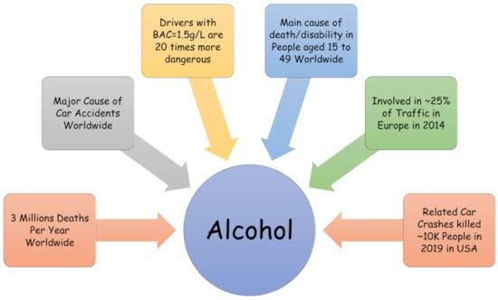

Slide 9
EMPATHY
Empathetic Design Elements
Non-Invasive Detection
Use contactless sensors (e.g., infrared sensors in the steering wheel or ambient air sensors) instead of requiring a breath test each time.
This respects privacy and avoids making the user feel criminalized.
Gentle Feedback
If alcohol is detected, the system responds with calm, non-judgmental messages like: “It seems you may have consumed alcohol. For your safety, the engine will remain off. Would you like us to call a ride for you?”
Avoids shaming the user and focuses on care and safety.
Emergency Override with Safeguards
Allow override in genuine emergencies (e.g., medical situations), but require double confirmation or a remote call center to verify.Shows that the system values human judgment when needed.

Slide 10
Supportive Features
Suggests alternative options like:
Call a friend
Order a ride-share
Activate a “safe wait” timer that rechecks BAC after a period.
Respecting Special Circumstances
For vehicles used by multiple drivers, ensure that detection doesn't falsely accuse a sober user due to residual alcohol in the cabin.
Empathy here means accuracy to avoid undue stress or inconvenience.
Learning from Behavior
If the system notices repeated activations, it could gently offer:“We noticed this has happened a few times recently. Would you like help finding support resources?”
Empathizes with underlying problems like alcohol dependence.

Slide 11
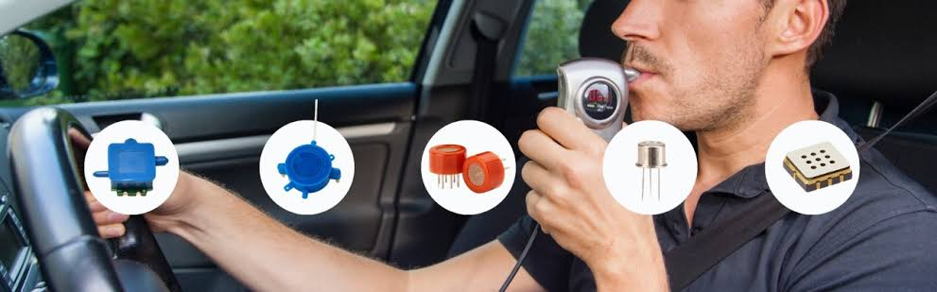
DEFINE
An alcohol detection and engine locking system is a safety feature designed to prevent individuals from operating a vehicle under the influence of alcohol. It works by using an alcohol sensor to measure a driver's breath alcohol content (BAC) and, if the BAC exceeds a predetermined limit, it disables the vehicle's ignition, preventing the engine from starting.

Slide 12
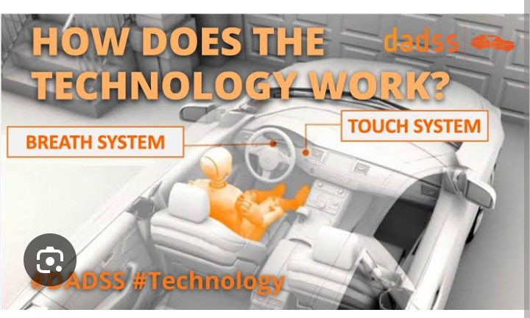
IDEATE
Alcohol detection
BAC measurement
Engine locking
Audible alarme
GPS tracking
GSM communication

Slide 13
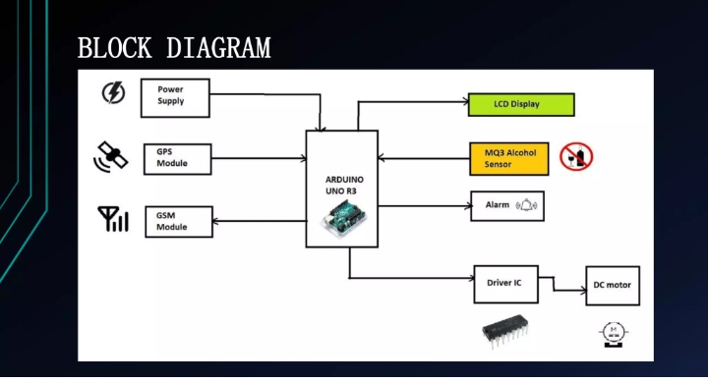
PROTOTYPE EXPLINATION

Slide 14
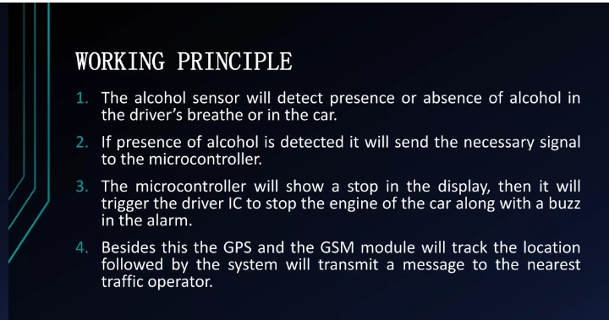

Slide 15
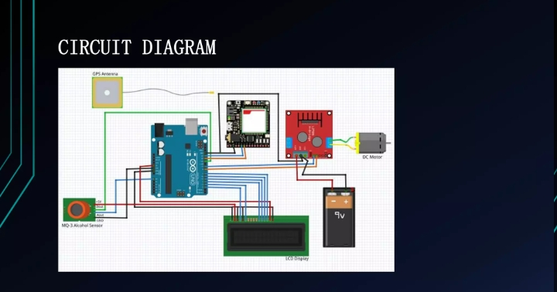

Slide 16
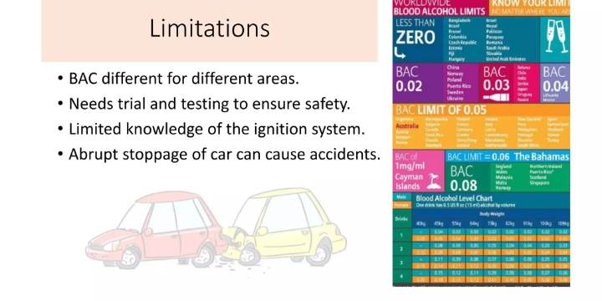

Slide 17
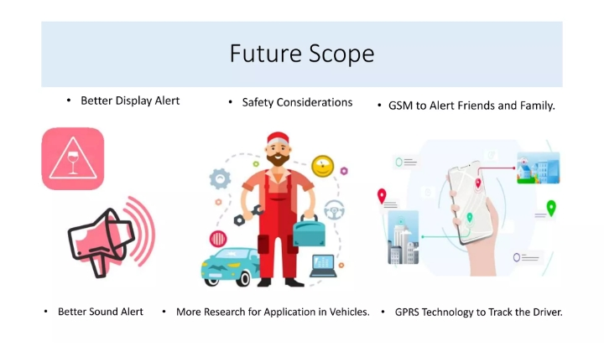

Slide 18
Conclusion
DRIVE SAFE & LIVE SAFE
We conclude that, in our project we are working on a real time model that can automatically lock the engine when a drunken driver tries t drive a car. Nowadays car accidents are mostly seen. By fitting this alcohol sensor into the car, we can save guard the life of the driver a.... also the remaining passengers.

Slide 19

THANK YOU

