Slide 1

DESIGN THINKING AND INNOVATION
PRESENTED BY :
G.KAVITHA (23KD1A0239)
G.SANDHYA (23KD1A0236)
K.LAKSHMAN KUMAR (23KD1A0256)
A.SAI MOUNIKA (23KD1A0205)

Slide 2
SMART
PARKING
SYSTEM
UNDER THE GUIDENCE OF:
MR. B. RAM VARA PRASAD,(Ph.D)
Assistant professor,
Department of EEE

Slide 3
CONTENTS
INTRODUCTION TO DESIGN THINKING
PROBLEM STATEMENT
DESIGN THINKING AND INNOVATION STEPS
OBJECTIVE
STEP - BY - FUNCTIONALITY
COMPONENTS
ADVANTAGES
CHALLENGES
REAL TIME EXAMPLES
CONCLUSION
THANKYOU

Slide 4
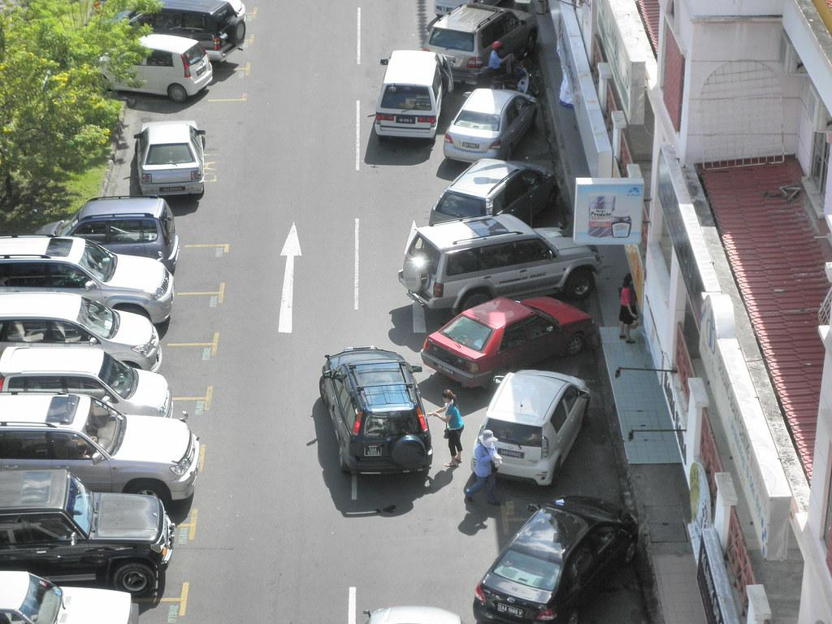
PROBLEM STATEMENT :
Urban areas face parking issues due to lack of real time monitoring
and inefficient space usage. This project aims to build a low-cost ,
AI-based smart parking system using the ESP32-CAM to detect and
manage parking space occupancy effectively.

Slide 5
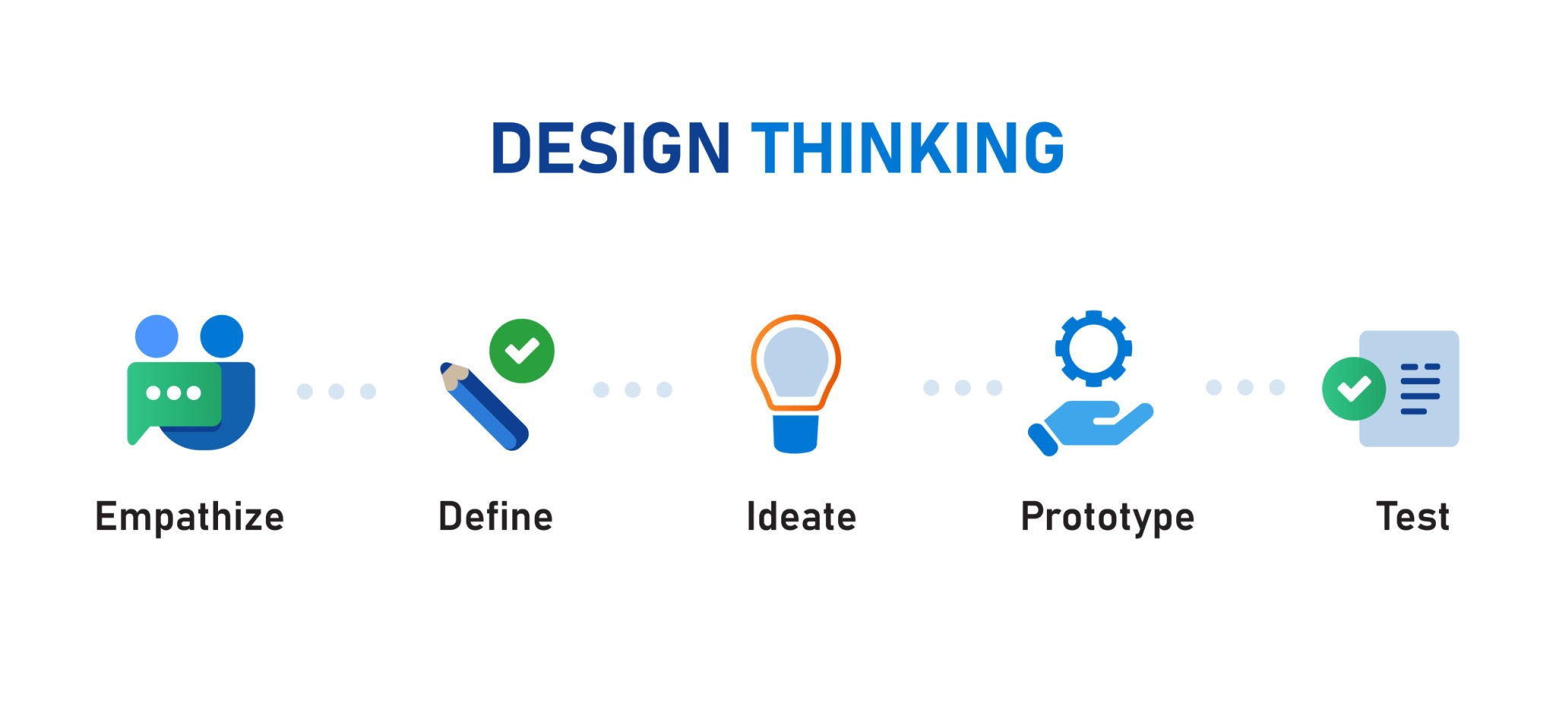

Slide 6
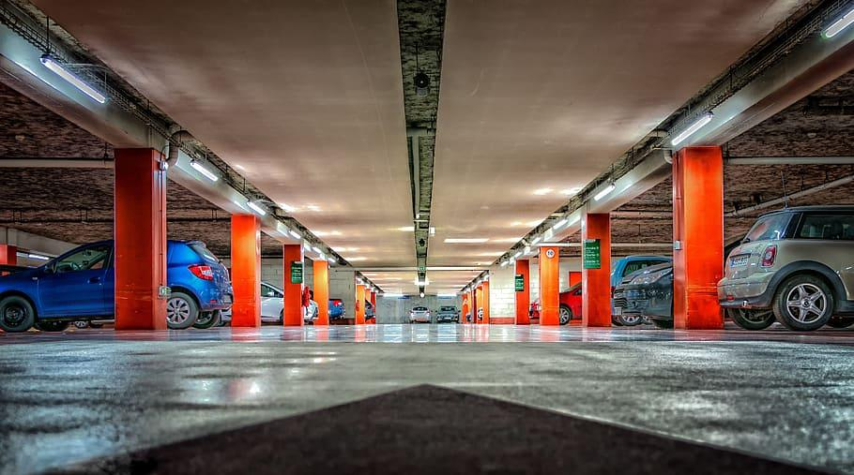
Empathize
In the Empathize stage of developing a Smart Parking System, we focused on understanding the real needs and challenges of users such as daily commuters, tourists, delivery drivers, and people with disabilities. Through interviews, surveys, and field observations, we identified common pain points including difficulty finding available spots, time wasted searching, and frustration from unclear signage and outdated payment methods. Emotional responses like stress, anxiety, and confusion were frequently expressed, especially in busy urban areas. Additionally, we noted environmental concerns such as increased emissions from circling vehicles and accessibility issues for differently-abled users. This deep understanding will guide user-centered design solutions in the next stages.

Slide 7
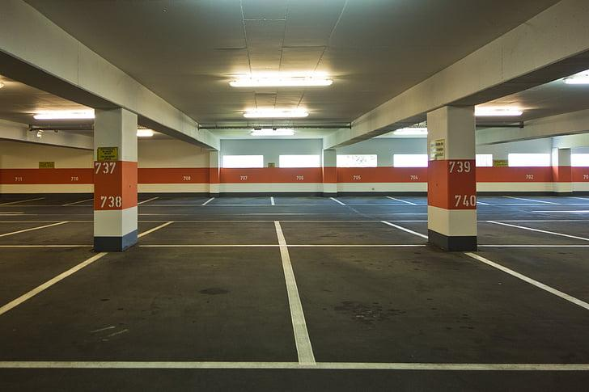
Define
In the Define stage, we synthesized insights gathered during the Empathize phase to clearly articulate the core problems users face with current parking systems. We identified the central need as a smart, real-time solution that helps drivers find available parking quickly and easily while reducing stress, time loss, and environmental impact. Our problem statement centers on improving parking efficiency by addressing poor availability visibility, inconvenient payment options, and lack of support for special user groups like people with disabilities. This user-centered problem definition will serve as the foundation for ideating effective and practical solutions.

Slide 8
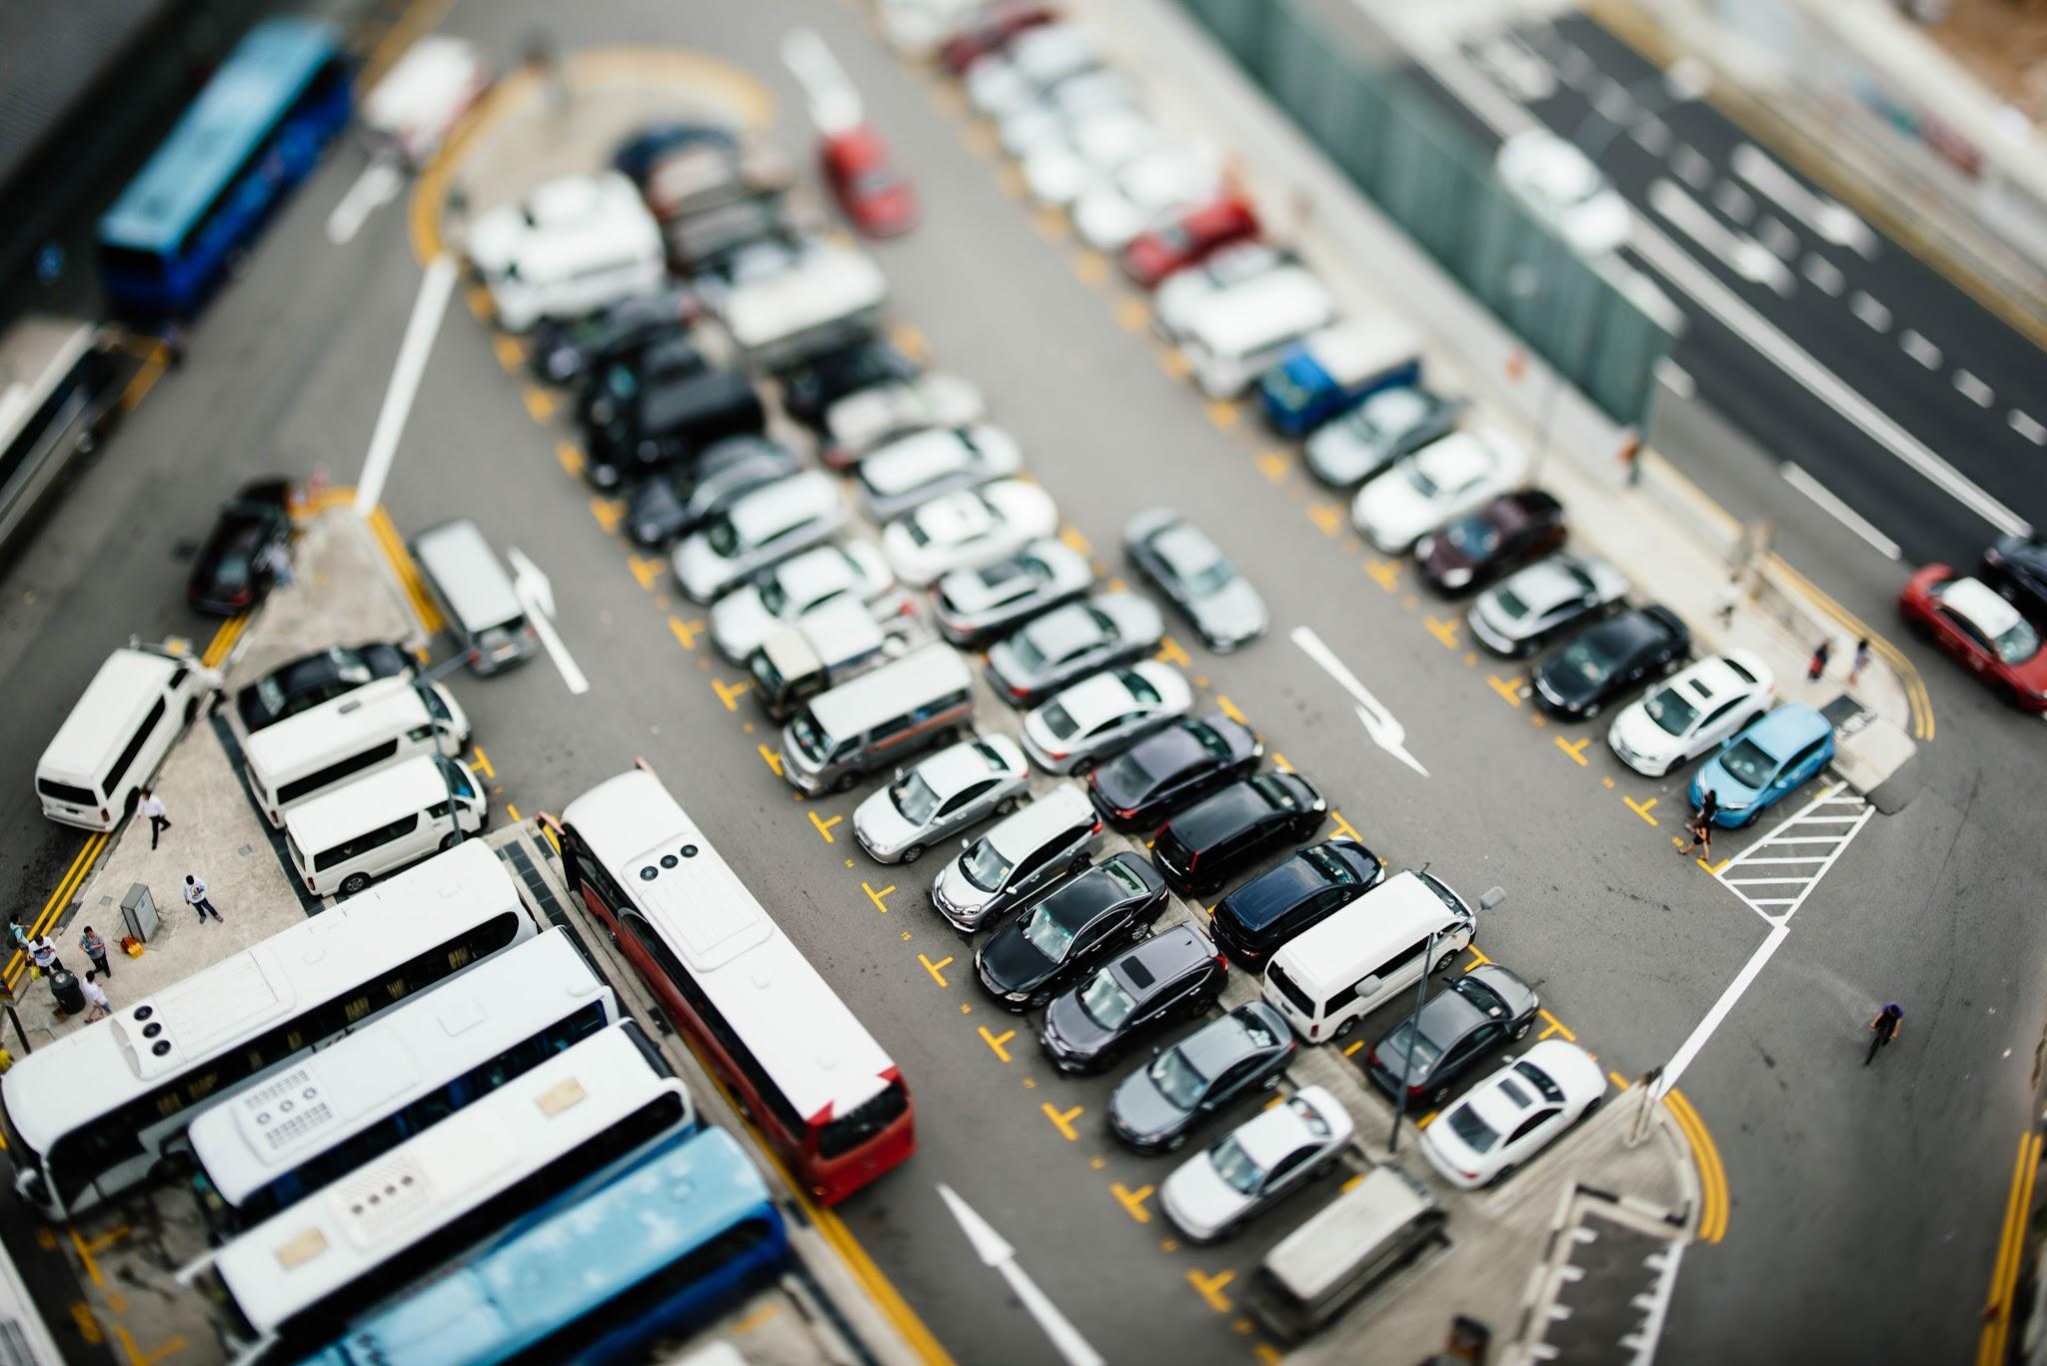
Ideate
In the Ideate stage, we generated a wide range of creative solutions to address the core parking challenges identified in the Define phase. Focusing on real-time availability, convenience, and user inclusivity, ideas included an AI-powered mobile app that shows live parking spot availability, smart sensors in parking lots, dynamic pricing to reduce congestion, and a reservation system for guaranteed spots. We also considered features like voice-guided navigation to the nearest space, integration with digital payment platforms, and special accommodations for disabled users. These ideas aim to transform parking into a faster, smoother, and more user-friendly experience.

Slide 9
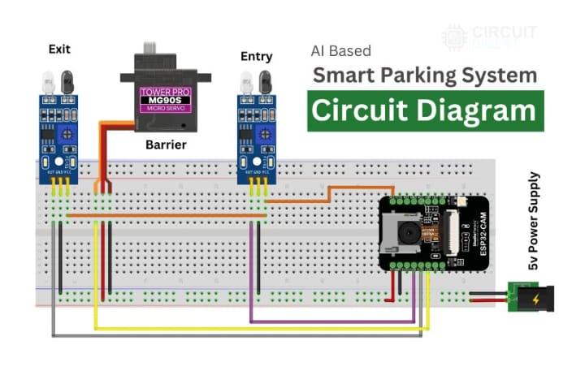
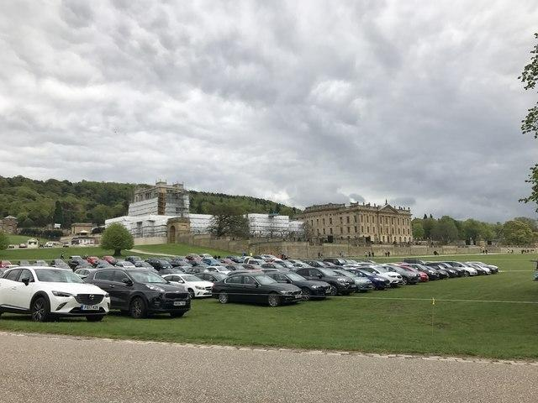
Prototype

Slide 10
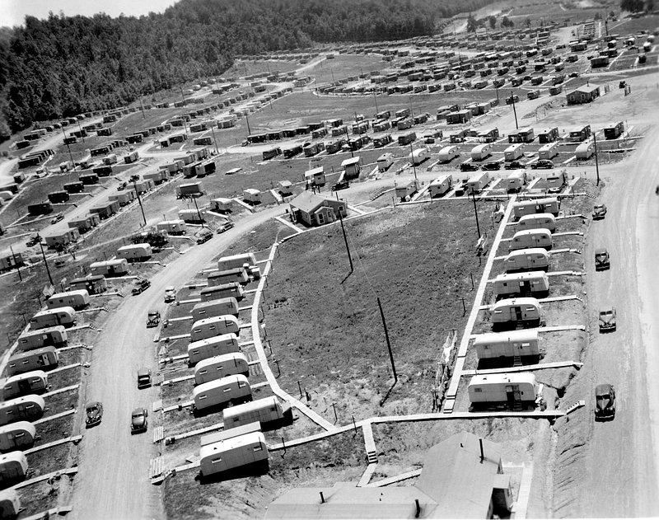
OBJECTIVE :
To create an intelligent ,low-cost smart parking solution using the ESP32-CAM and AI that automatically detects vacant parking spots in real-time , aiming to reduce traffic , save time , and improve urban mobility.

Slide 11
STEP BY STEP FUNCTIONALITY :
Real - Time image capture
AI - Based object detection
Occupancy status update
Data transmission
User interface

Slide 12
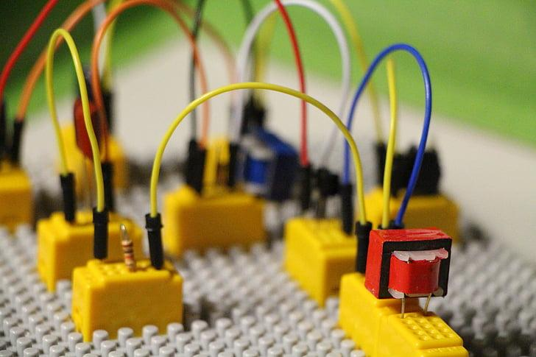
COMPONENTS :
ESP32 CAM
SERVO MOTOR
IR SENSOR MODULE
BREADBOARD
USB TO UART CONVERTER
JUMPER WIRES

Slide 13
ADVANTAGES :
Real - time monitoring
Reduces traffic and fuel consumption
Low - cost and scalable
Easy cloud integration
Enhances smart city planning

Slide 14
CHALLENGES :
Lightning and weather conditions affecting detection
Limited processing power of ESP32 - CAM
AI model optimization for embedded systems
Network reliability
N

Slide 15
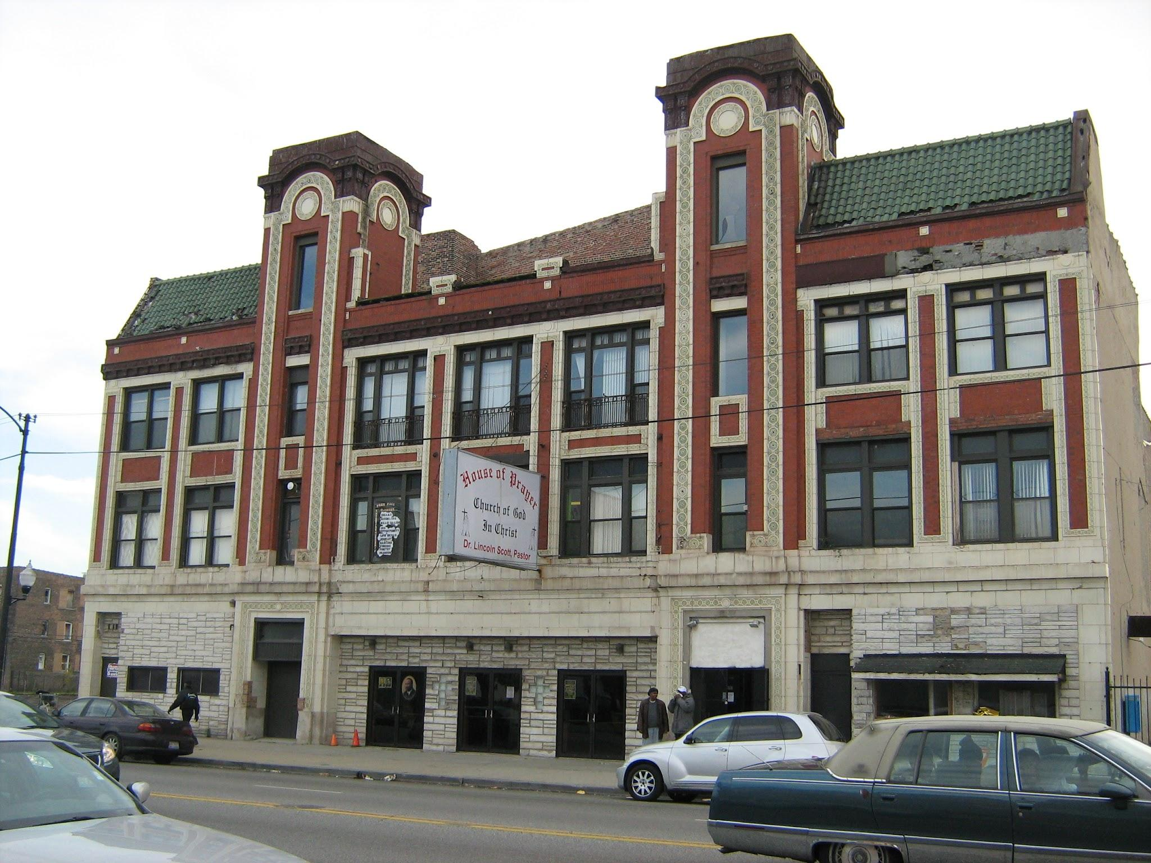

REAL TIME EXAMPLES :

Slide 16

CONCLUSION :
The AI-based smart parking system using ESP32-CAM offers a smart, affordable, and scalable solution to modern urban parking challenges. By integrating AI with real-time image processing and IoT, the system enhances parking efficiency, reduces traffic congestion, and supports sustainable smart city development. With further improvements, it has the potential to revolutionize how we manage parking in public and private spaces.

Slide 17
Questions
1. What challenges do you face while finding parking in busy areas?
2. Have you ever used a smart parking system or app before?
3. How do sensors detect the presence of a vehicle?
4. Which communication method is best for real-time updates: Wi-Fi, Bluetooth, or RFID?
5. What key feature would you want in a smart parking system?
6. Do you think this system could work well in your city or area? Why or why not?
7. How could AI improve the effectiveness of smart parking in the future?

Slide 18


