Slide 1
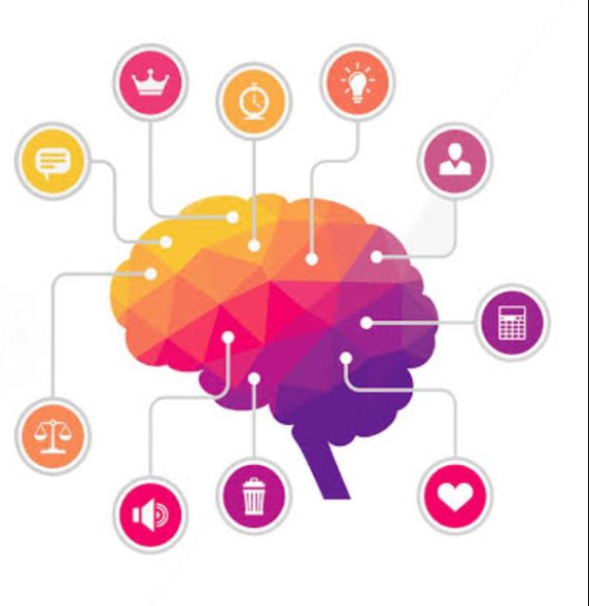
Design thinking and innovation
Presented by
G.anjali-23kd1a0233
K.lathika-23kd1a0249
L.tripathi-23kd1a0258
B.ganesh-23kd1a0210

Slide 2
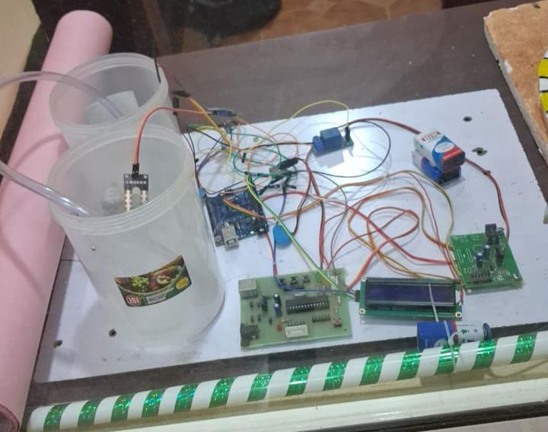
Automatic plant watering system using solar panel
UNDER THE GUIDENCE OF :
Mr. B. Ram Vara Prasad,(ph.d)
Assistant professor,
Department of EEE,
LIET(Autonomous).

Slide 3

Contents
INTRODUCTION TO DESIGN THINKING
PROBLEM STATEMENT
EMPATHY
APPLICATIONS
FUTURE ENHANCEMENT
CONCLUSION

Slide 4
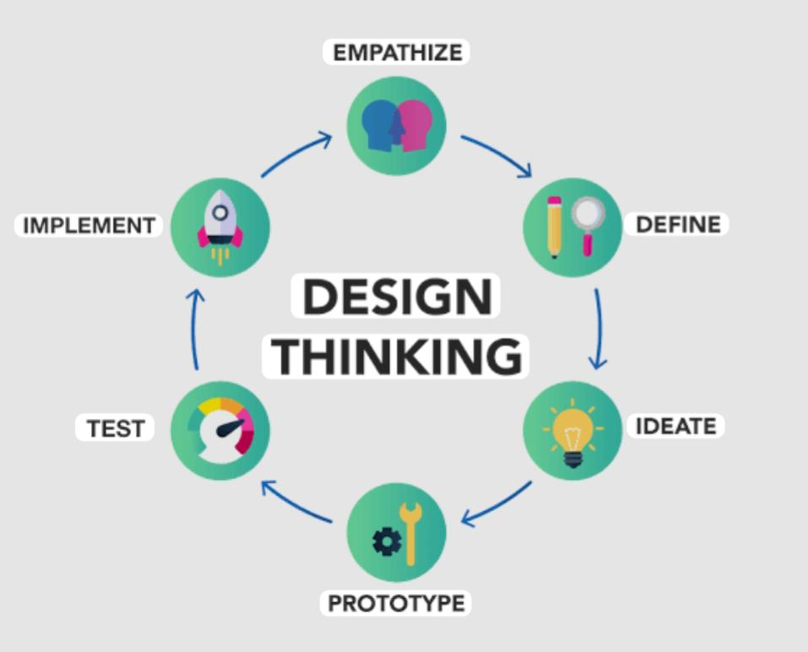
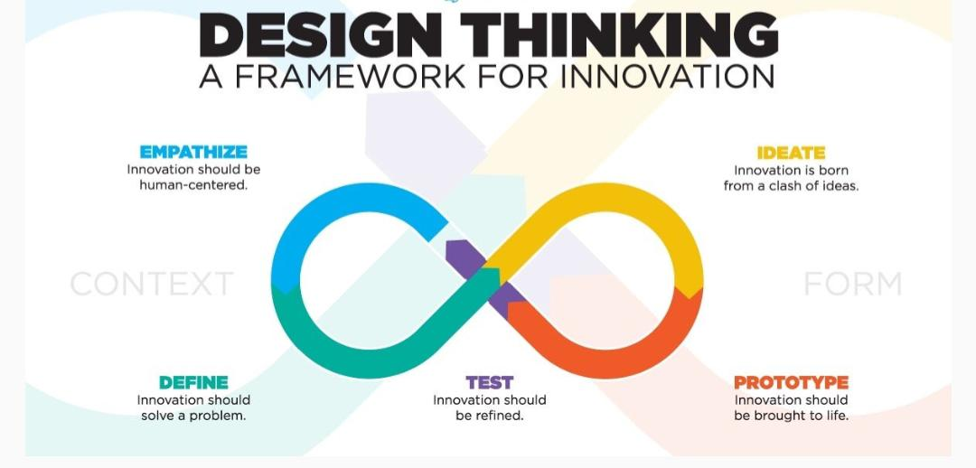
What is meant by design thinking and innovation?

Slide 5
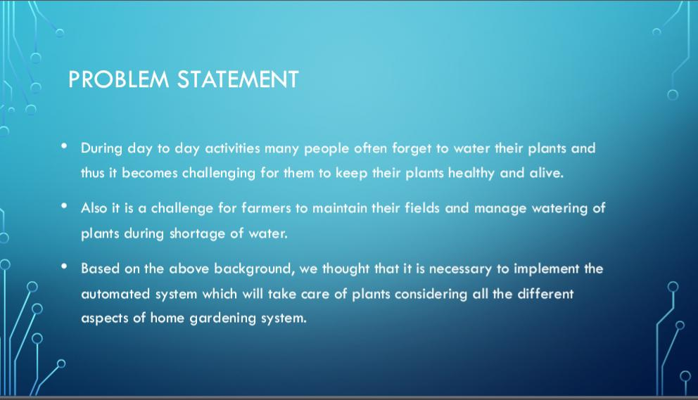

Slide 6

Empathy
PLANTCARE CHALLENGES
INTERVIEW QUESTIONS
PERSON’S FEEDBACK

Slide 7
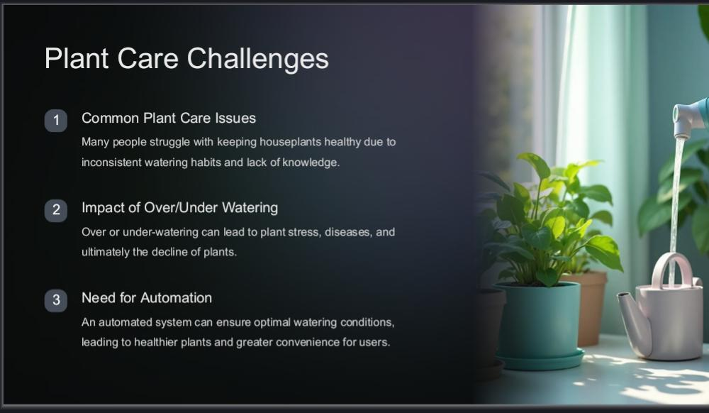

Slide 8

Interview Questions
What type of garden do you maintain?
How often do you water your plants?
What time of the day do you usually water your plants?
How much water do you usually apply to each plant?
What method do you use for watering?
How do you decide when a plant needs water?
Have you faced any challenges with watering?

Slide 9
PERSON’S FEEDBACK PERSON-1
I maintain a flower gardening.
I water my plants every other day.
I usually water my plants in the early morning.
I apply about a one liter of water to every plant.
I use a watering can With a long spout.
I decide based on the soil moisture.
Yes I have faced challenges With overwatering during rainy season.

Slide 10
PerSon-2 Feedback
Maintains a terrace gardening.
Depends upon the weather twice a week.
Usually water the plants in the late afternoon.
Quarter liter of water to small plants.
Normal process.
Based upon the plants appearance and soil conditions.
Faced challenges With underwatering during summer season.

Slide 11
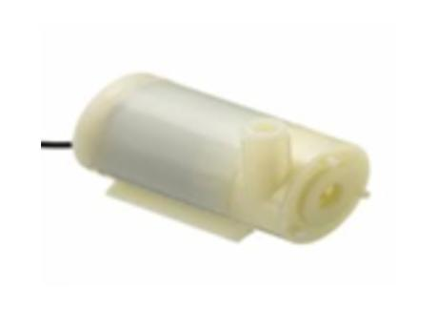
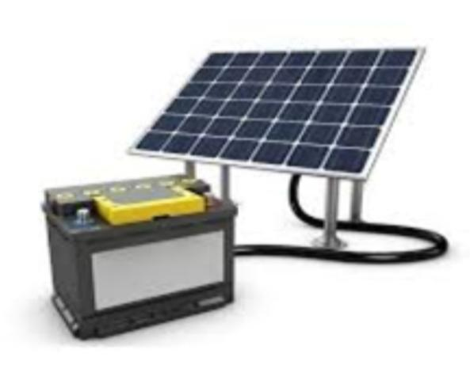
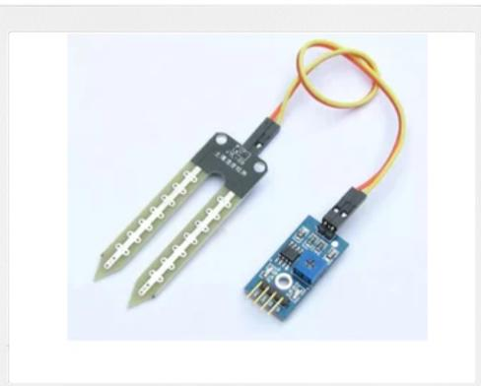
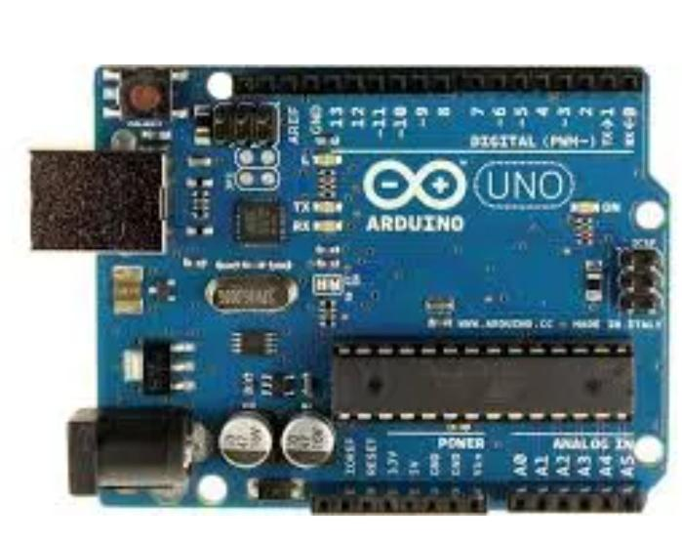
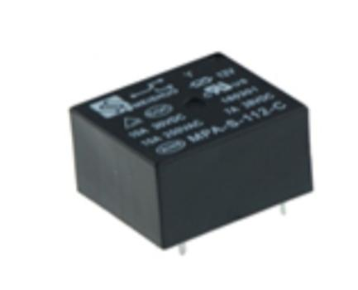
Components SELECTION

Slide 12
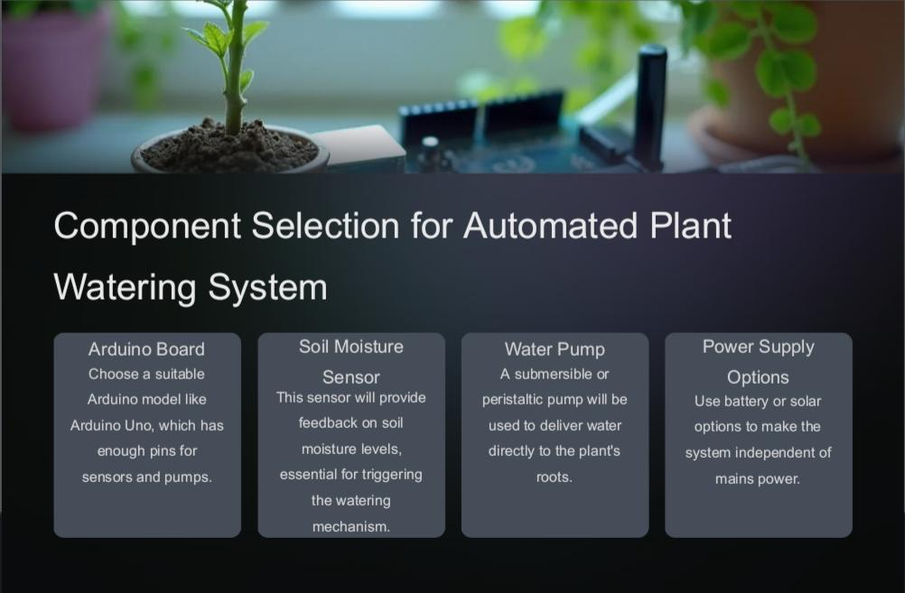
FUNCTION OF COMPONENTS

Slide 13
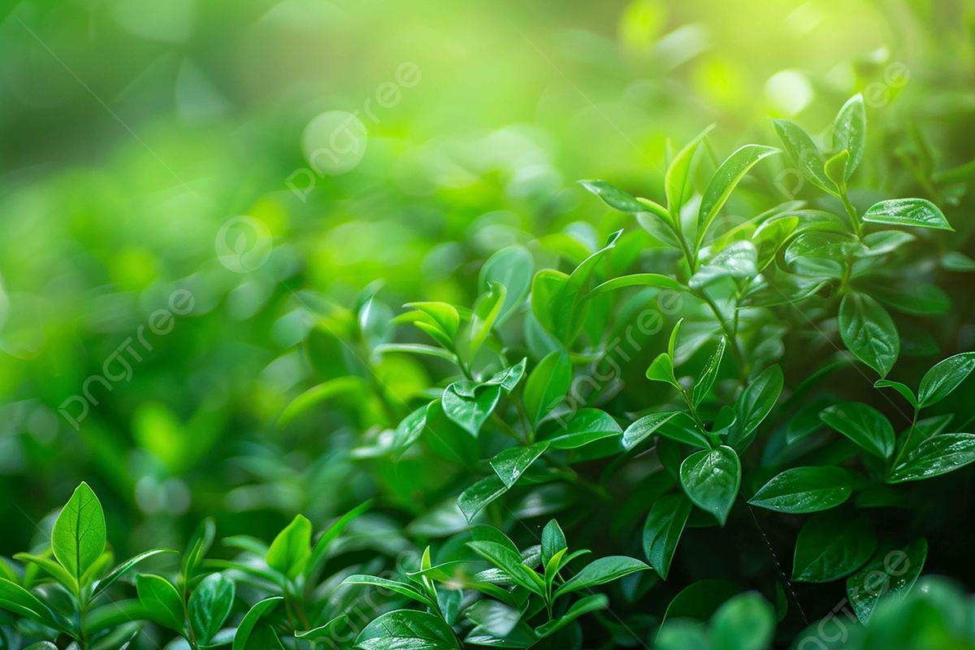
Applications
These system used in ::
Large Farms
Gardens-Balcony gardens
Nurseries
Agriculture farms
Green Houses
Smart and Drip irrigation systems

Slide 14
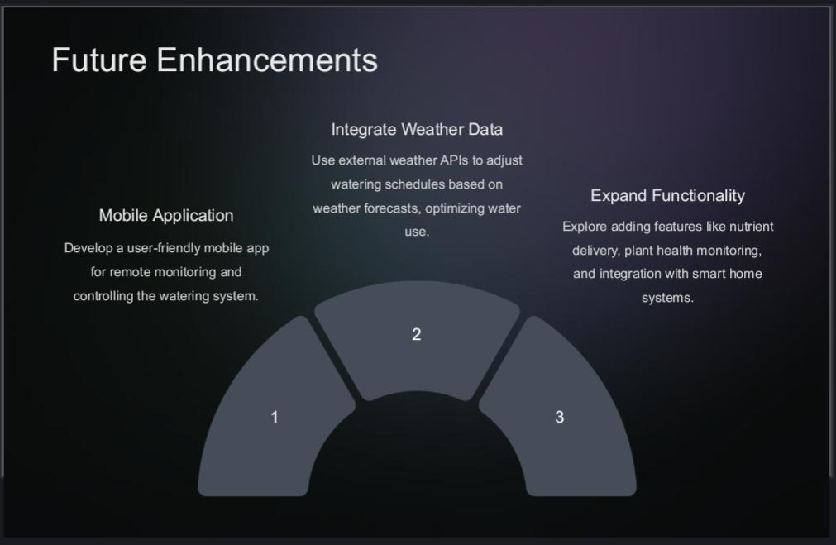

Slide 15

Conclusion
A solar-powered automatic plant watering system, powered by a solar panel, offers a reliable, cost-effective, and environmentally friendly solution for plant irrigation. It automates the watering process based on soil moisture levels, reducing manual effort and promoting efficient water usage. This system minimizes water waste, enhances plant health, and can be particularly useful for remote or inaccessible locations.

Slide 16


