Slide 1
Task- 0 create table query
1
------ create table ipl_ball
create table IPL_Ball
(id int, inning int, over int, ball int, batsman varchar, non_striker varchar, bowler varchar, batsman_runs int,
extra_runs int, total_runs int, is_wicket int, dismissal_kind varchar, player_dismissed varchar, fielder varchar, extras_type varchar, batting_team varchar,
bowling_team varchar);
----- Import data from csv
copy ipl_ball from 'C:\Program Files\PostgreSQL\16\data\data_copy\IPL_Ball.csv' delimiter','csv header;

Slide 2
Task- 0 create table query
2
------ create table IPL_matches
create table IPL_matches
(id int, city varchar, date date, player_of_match varchar, venue varchar, neutral_venue int, team1 varchar, team2 varchar, toss_winner varchar,
toss_decision varchar, winner varchar, result varchar, result_margin int, eliminator varchar, method varchar, umpire1 varchar, umpire2 varchar);
----- Import data from csv
copy IPL_matches from 'C:\Program Files\PostgreSQL\16\data\data_copy\IPL_matches.csv' delimiter','csv header;

Slide 3
Task- 1 Your first priority is to get 2-3 players with high S.R who have faced at least 500 balls.And to do that you have to make a list of 10 players you want to bid in the auction so that when you try to grab them in auction you should not pay the amount greater than you have in the purse for a particular player. (strike rate is total runs scored by batsman divided by number of balls faced but remember when extras_type is 'wides' it is not counted as a ball faced neither counted as batsmen runs)
3
select batsman,
round((sum(batsman_runs)*1.0/count(ball)*1.0)*100,2)as strike_rate,
sum(batsman_runs) as batsman_totoal_run,
count(ball) as batsman_faced_ball
from ipl_ball
where not extras_type = 'wides'
group by batsman
having count(ball) >= 500
order by strike_rate desc
limit 10;

Slide 4
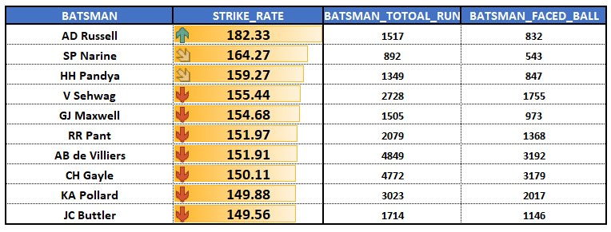
Task- 1 OUTPUT top 10 player with high strike rate
4

Slide 5
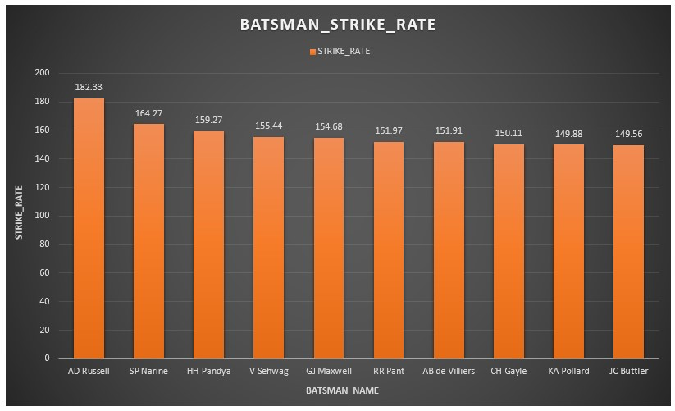
Task- 1 OUTPUT top 10 player with high strike rate
5

Slide 6
Task- 2 Now you need to get 2-3 players with good Average who have played more than 2 ipl seasons. And to do that you have to make a list of 10 players you want to bid in the auction so that when you try to grab them in auction you should not pay the amount greater than you have in the purse for a particular player. (Average is calculated as total runs scored divided by number of times batsman has been dismissed which can be calculated using wicket_ball field as 1 indicates out and 0 indicates not out, a batsman should’ve been dismissed at least once to calculate the sr i.e., you can exclude those players who have not been dismissed once)
6
select batsman,
round(sum(batsman_runs)*1.0/sum(is_wicket)*1.0,2) as average_performance,
count(distinct id) as Played_matches,
sum(batsman_runs) as total_runs,
sum(is_wicket) as out_sum
from ipl_ball
group by batsman
having count(distinct id) >28
order by average_performance desc
limit 10;

Slide 7
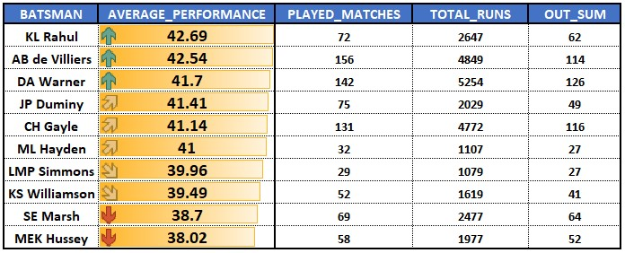
Task- 2 OUTPUT top 10 player with good average batsman
7

Slide 8
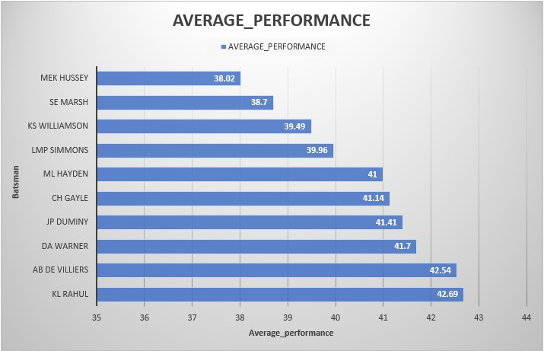
Task- 2 OUTPUT top 10 player with good average batsman
8

Slide 9
Task- 3 Now you need to get 2-3 Hard-hitting players who have scored most runs in boundaries and have played more the 2 ipl season. To do that you have to make a list of 10 players you want to bid in the auction so that when you try to grab them in auction you should not pay the amount greater than you have in the purse for a particular player. (only 4 and 6 will be counted as boundaries so calculate how many 4 and 6 has been hit by each batsman and also calculate total runs scored to get the output as boundary percentage which will be runs in boundary divided by total runs scored)
9
select batsman,
round((sum(case when batsman_runs=4 then 4
when batsman_runs=6 then 6
else 0 end)*1.0/sum(batsman_runs))*100,2) as boundries_percentage,
sum(case when batsman_runs= 4 then 4
when batsman_runs= 6 then 6 else 0 end) as boundary_total_run,
sum(case when batsman_runs = 4 then 1 else 0 end) as four_by_batsman,
sum(case when batsman_runs = 6 then 1 else 0 end) as six_by_batsman,
sum(batsman_runs) as batsman_total_run
from IPL_ball
group by batsman
having count(distinct id)>28
order by boundries_percentage desc limit 10;

Slide 10
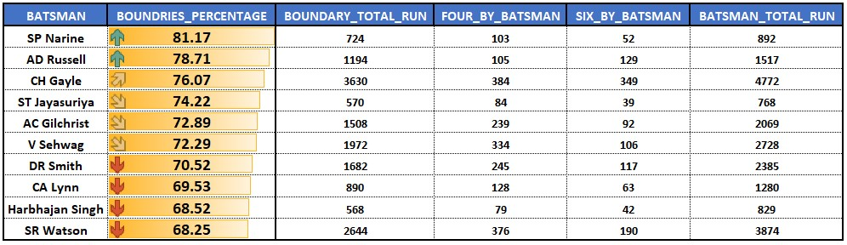
Task- 3 OUTPUT top 10 Hard-hitting players
10

Slide 11
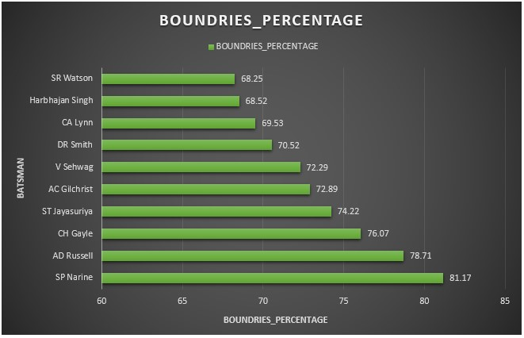
Task- 3 OUTPUT top 10 Hard-hitting players
11

Slide 12
Task- 4 Your first priority is to get 2-3 bowlers with good economy who have bowled at least 500 balls in IPL so far.To do that you have to make a list of 10 players you want to bid in the auction so that when you try to grab them in auction you should not pay the amount greater than you have in the purse for a particular player.(economy can be calculated by dividing total runs conceded with total overs bowled)
12
select * from
(select bowler, round((sum(total_runs)*1.0/(count(ball)/6.0)*1.0),2) as economy,
sum(total_runs) as total_runs,
count(ball) as total_balls_throw,
count(ball)/6 as total_over
from ipl_ball group by bowler) as a
where a.total_balls_throw >= 500
order by a.economy desc
limit 10;

Slide 13
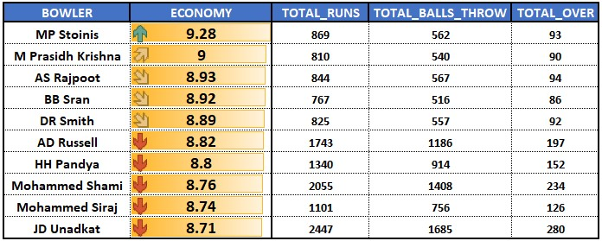
Task- 4 OUTPUT top 10 bowler with good economy
13

Slide 14
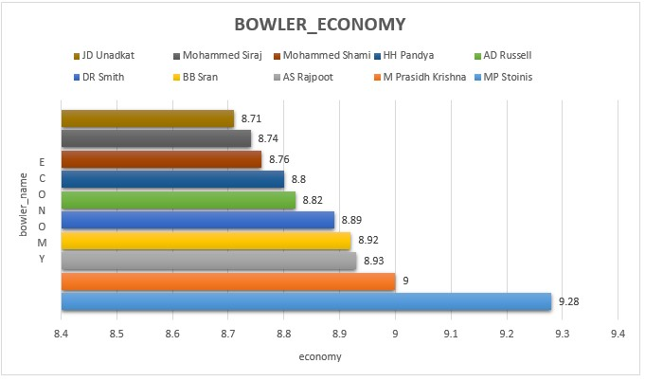
Task- 4 OUTPUT top 10 bowler with good economy
14

Slide 15
Task- 5 Now you need to get 2-3 bowlers with the best strike rate and who have bowled at least 500 balls in IPL so far.To do that you have to make a list of 10 players you want to bid in the auction so that when you try to grab them in auction you should not pay the amount greater than you have in the purse for a particular player. (strike rate of a bowler can be calculated by number of balls bowled divided by total wickets taken )
15
select * from
(select bowler, round((count(ball)*1.0/sum(is_wicket)*1.0),2) as bowler_strike_rate,
count(ball) as total_bowled,
sum(is_wicket) as total_wicket
from ipl_ball group by bowler) as a
where a.total_bowled >= 500
order by a.bowler_strike_rate desc
limit 10;

Slide 16
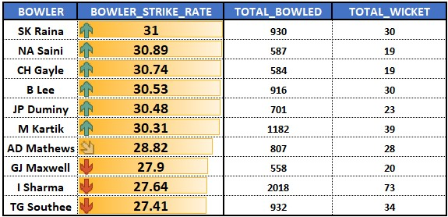
Task- 5 OUTPUT top 10 bowler with best strike rate
16

Slide 17
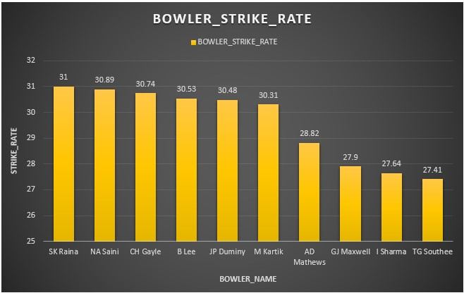
Task- 5 OUTPUT top 10 bowler with best strike rate
17

Slide 18
Task- 6 Now you need to get 2-3 All_rounders with the best batting as well as bowling strike rate and who have faced at least 500 balls in IPL so far and have bowled minimum 300 balls.To do that you have to make a list of 10 players you want to bid in the auction so that when you try to grab them in auction you should not pay the amount greater than you have in the purse for a particular player. ( strike rate of an all rounder can be calculated using the same criteria of batsman similarly the bowling strike rate can be calculated using the criteria of a bowler)
18
select a.bowler as player, b.strike_rate as batsman_strikerate, a.strike_rate as bowler_strikerate,
a.total_ball from (select bowler, count(ball) as total_ball,
round((count(ball)*1.0/sum(is_wicket)*1.0),2) as strike_rate from ipl_ball
group by bowler having count(ball)>=300 order by strike_rate asc) as a
inner join (select batsman, round((sum(batsman_runs)*1.0/ sum(ball)*1.0)*100,2) as strike_rate from ipl_ball
group by batsman
having count(ball)>=500) as b
on a.bowler=b.batsman
order by batsman_strikerate desc, bowler_strikerate desc
limit 10;

Slide 19
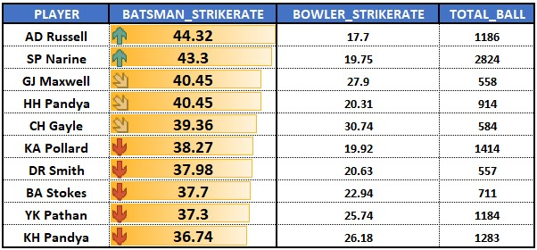
Task- 6 OUTPUT top 10 All_rounders
19

Slide 20
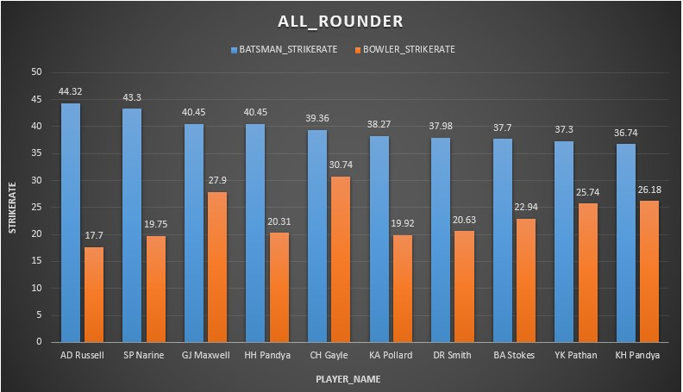
Task- 6 OUTPUT top 10 All_rounders
20

Slide 21
:: Additional Questions :: 01. Get the count of cities that have hosted an IPL match
21
select
count(distinct city) as match_hosted_city
from ipl_matches;

Slide 22
:: Additional Questions :: 02. Create table deliveries_v02 with all the columns of the table ‘deliveries’ and an additional column ball_result containing values boundary, dot or other depending on the total_run (boundary for >= 4, dot for 0 and other for any other number) (Hint 1 : CASE WHEN statement is used to get condition based results) (Hint 2: To convert the output data of the select statement into a table, you can use a subquery. Create table table_name as [entire select statement].
22
create table deliveries_v02 as
(select *, case when total_runs >= 4 then 'boundary'
when total_runs = 0 then 'dot' else 'other' end as ball_result from ipl_ball);

Slide 23
:: Additional Questions :: 03. Write a query to fetch the total number of boundaries and dot balls from the deliveries_v02 table.
23
select ball_result,
count(ball_result) as total_number
from deliveries_v02
where ball_result in ('boundary', 'dot')
group by ball_result;

Slide 24

Additional Questions Q3. number of boundaries and dot balls
24

Slide 25
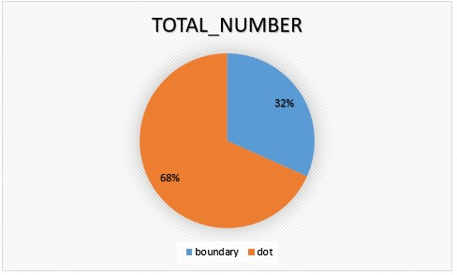
Additional Questions Q3. number of boundaries and dot balls
25

Slide 26
:: Additional Questions :: 04. Write a query to fetch the total number of boundaries scored by each team from the deliveries_v02 table and order it in descending order of the number of boundaries scored
26
select distinct batting_team, count(ball_result) as count_boundaries
from deliveries_v02
where ball_result = 'boundary'
group by batting_team
order by count_boundaries desc;

Slide 27
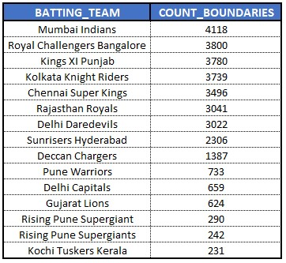
Additional Questions Q4. total number of boundaries scored by each team
27

Slide 28
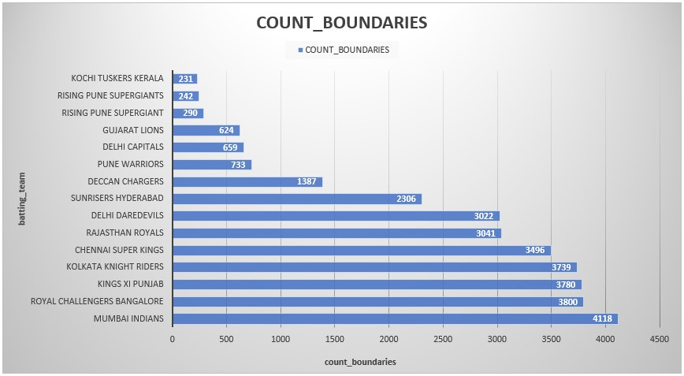
Additional Questions Q4. total number of boundaries scored by each team
28

Slide 29
:: Additional Questions :: 05. Write a query to fetch the total number of dot balls bowled by each team and order it in descending order of the total number of dot balls bowled.
29
select distinct bowling_team, count(ball_result) as total_dot_ball
from deliveries_v02
where ball_result = 'dot'
group by bowling_team
order by total_dot_ball desc;

Slide 30
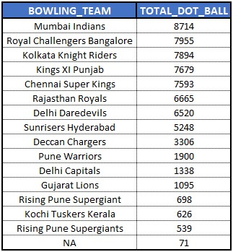
Additional Questions Q5. total number of dot balls bowled by each team
30

Slide 31
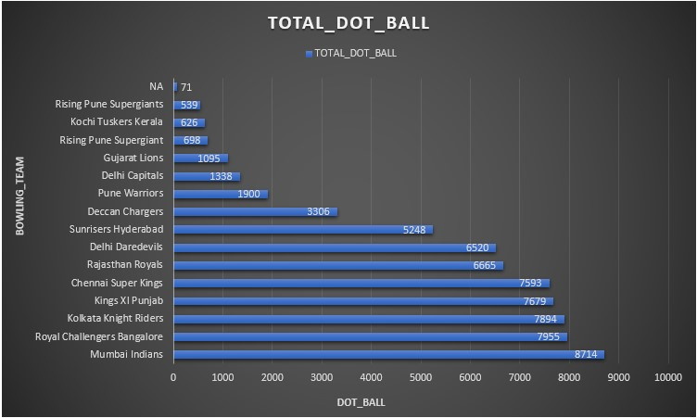
Additional Questions Q5. total number of dot balls bowled by each team
31

Slide 32
:: Additional Questions :: 06. Write a query to fetch the total number of dismissals by dismissal kinds where dismissal kind is not NA
32
select dismissal_kind, count(dismissal_kind) as count_of_dismissals
from deliveries_v02
where not dismissal_kind = 'NA'
group by dismissal_kind
order by count_of_dismissals desc;

Slide 33
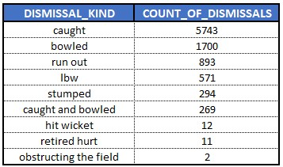
Additional Questions Q6. total number of dismissals by dismissal kinds
33

Slide 34
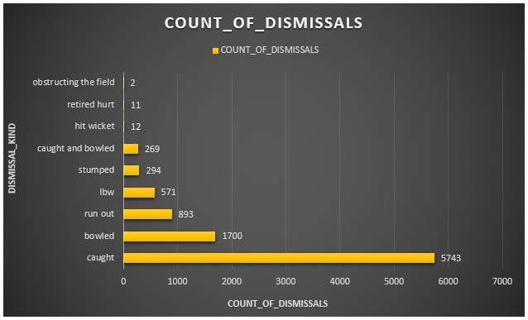
Additional Questions Q6. total number of dismissals by dismissal kinds
34

Slide 35
:: Additional Questions :: 07. Write a query to get the top 5 bowlers who conceded maximum extra runs from the deliveries table
35
select distinct bowler, sum(extra_runs) as maximum_extra_runs
from deliveries_v02
group by bowler
order by maximum_extra_runs desc
limit 5;

Slide 36
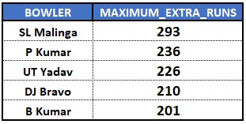
Additional Questions Q7. top 5 bowlers who conceded maximum extra runs
36

Slide 37
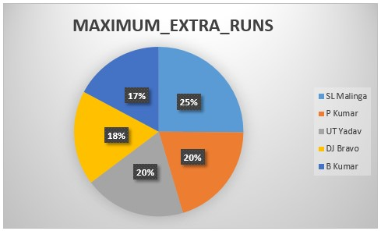
Additional Questions Q7. top 5 bowlers who conceded maximum extra runs
37

Slide 38
:: Additional Questions :: 08. Write a query to create a table named deliveries_v03 with all the columns of deliveries_v02 table and two additional column (named venue and match_date) of venue and date from table matche
38
create table deliveries_v03 as
(select a.*, b.venue, b.date as match_date
from deliveries_v02 as a
left join IPL_matches as b
on a.id = b.id);

Slide 39
:: Additional Questions :: 09. Write a query to fetch the total runs scored for each venue and order it in the descending order of total runs scored.
39
select venue, sum(total_runs) as total_runs
from deliveries_v03
group by venue
order by total_runs desc;

Slide 40
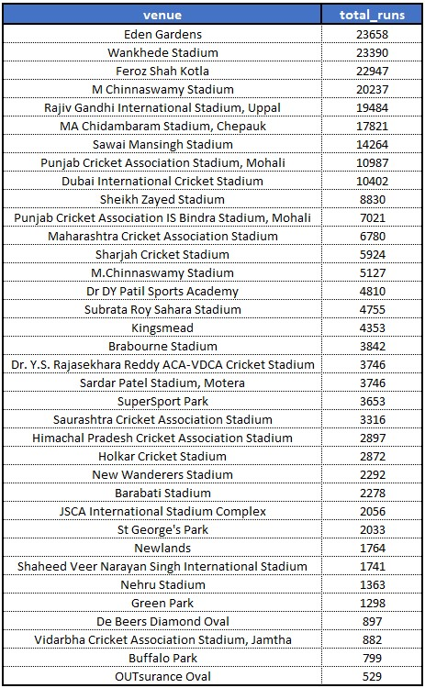
Additional Questions Q9. total runs scored for each venue
40

Slide 41
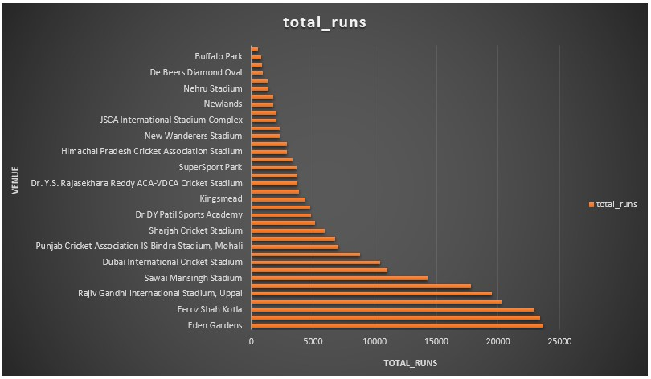
Additional Questions Q9. total runs scored for each venue
41

Slide 42
:: Additional Questions :: 10. Write a query to fetch the year-wise total runs scored at Eden Gardens and order it in the descending order of total runs scored.
42
select extract(year from match_date) as year,
sum(total_runs) as total_runs_scored
from deliveries_v03
where venue = 'Eden Gardens'
group by year
order by total_runs_scored desc;

Slide 43
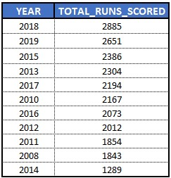
Additional Questions Q10. year-wise total runs scored at Eden Gardens
43

Slide 44
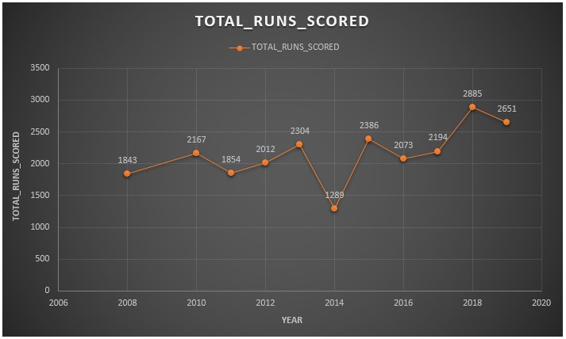
Additional Questions Q10. year-wise total runs scored at Eden Gardens
44

