Slide 1
Loan payoff plan (staged disbursal)
₹1.5Cr in Mar 2026, +₹1Cr in Mar 2028 | EMI cap ₹3,00,000/month | Prepay ₹5,00,000 every Oct | Rate 7.54% p.a.

Slide 2
Assumptions used
Interest rate: 7.54% p.a. (monthly reducing)
Disbursal: ₹1.5Cr at start, +₹1Cr at start of Year 3 (Mar 2028)
Payment: ₹3,00,000 every month from Mar 2026
Prepayment: ₹5,00,000 each October (applied after EMI)
No other extra payments assumed

Slide 3
Key result
Loan closes in month 92 (Oct 2033) ≈ 7.67 years
With the same caps and rate, closing within 7 years is not possible
Total principal: ₹25,000,000
Total paid (EMI + Oct prepay): ₹31,108,254
Total interest paid (approx.): ₹6,108,254

Slide 4
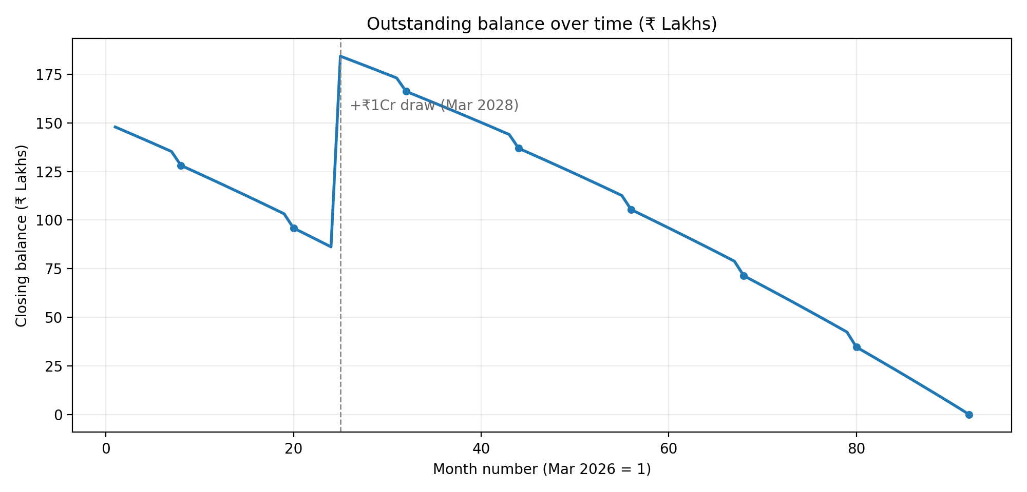
Outstanding balance trajectory

Slide 5
Milestones (Oct bonuses + disbursal + checkpoints)
Month | Disb | Interest | EMI | Oct prepay | Closing bal
Oct 2026 | ₹0 | ₹85,028 | ₹300,000 | ₹500,000 | ₹12,817,343
Feb 2027 | ₹0 | ₹76,373 | ₹300,000 | ₹0 | ₹11,931,177
Oct 2027 | ₹0 | ₹64,881 | ₹300,000 | ₹500,000 | ₹9,590,826
Feb 2028 | ₹0 | ₹55,715 | ₹300,000 | ₹0 | ₹8,622,799
Mar 2028 | ₹10,000,000 | ₹117,013 | ₹300,000 | ₹0 | ₹18,439,812
Oct 2028 | ₹0 | ₹108,812 | ₹300,000 | ₹500,000 | ₹16,626,304
Feb 2029 | ₹0 | ₹100,760 | ₹300,000 | ₹0 | ₹15,836,776
Oct 2029 | ₹0 | ₹90,521 | ₹300,000 | ₹500,000 | ₹13,697,118
Feb 2030 | ₹0 | ₹82,005 | ₹300,000 | ₹0 | ₹12,833,273
Feb 2031 | ₹0 | ₹61,787 | ₹300,000 | ₹0 | ₹9,595,313
Oct 2031 | ₹0 | ₹49,546 | ₹300,000 | ₹500,000 | ₹7,134,930
Feb 2032 | ₹0 | ₹39,991 | ₹300,000 | ₹0 | ₹6,104,595
Oct 2032 | ₹0 | ₹26,630 | ₹300,000 | ₹500,000 | ₹3,464,838
Feb 2033 | ₹0 | ₹16,493 | ₹300,000 | ₹0 | ₹2,341,387
Oct 2033 | ₹0 | ₹1,925 | ₹300,000 | ₹8,254 | ₹0

Slide 6
Year-wise summary (calendar year)
Year | Opening bal | Closing bal | Interest | EMI paid | Oct prepay | Disb
2026 | ₹15,000,000 | ₹12,377,036 | ₹877,036 | ₹3,000,000 | ₹500,000 | ₹15,000,000
2027 | ₹12,377,036 | ₹9,109,844 | ₹832,808 | ₹3,600,000 | ₹500,000 | ₹0
2028 | ₹9,109,844 | ₹16,234,012 | ₹1,224,168 | ₹3,600,000 | ₹500,000 | ₹10,000,000
2029 | ₹16,234,012 | ₹13,267,901 | ₹1,133,888 | ₹3,600,000 | ₹500,000 | ₹0
2030 | ₹13,267,901 | ₹10,070,251 | ₹902,350 | ₹3,600,000 | ₹500,000 | ₹0
2031 | ₹10,070,251 | ₹6,622,989 | ₹652,738 | ₹3,600,000 | ₹500,000 | ₹0
2032 | ₹6,622,989 | ₹2,906,631 | ₹383,642 | ₹3,600,000 | ₹500,000 | ₹0
2033 | ₹2,906,631 | ₹0 | ₹101,623 | ₹3,000,000 | ₹8,254 | ₹0

Slide 7
How to use this plan
Set standing instruction for ₹3,00,000/month from Mar 2026.
Each Oct, make ₹5,00,000 part-prepayment immediately.
When part-prepaying, request TENURE REDUCTION (not EMI reduction).
Expected closure: Oct 2033 (month 92).

