Slide 1
Loan payoff plan (updated bonuses)
Start: Mar 2026 | EMI ₹3,00,000/month starts Apr 2026 | Prepay: ₹1,00,000 every Feb + ₹5,00,000 every Oct | Disbursal: ₹1.5Cr now, +₹1Cr in Mar 2028 | Rate 7.54% p.a.

Slide 2
Assumptions used
Interest rate: 7.54% p.a. (monthly reducing)
Disbursal: ₹1.5Cr in Mar 2026, +₹1Cr in Mar 2028
EMI: ₹3,00,000/month starting Apr 2026
Prepayments: ₹1,00,000 each Feb + ₹5,00,000 each Oct (after EMI)

Slide 3
Key result
Projected closure: Sep 2033 (month 91) ≈ 7.58 years
Total principal: ₹25,000,000
Total paid (EMI + prepay): ₹31,106,737
Total interest paid (approx.): ₹6,106,737

Slide 4
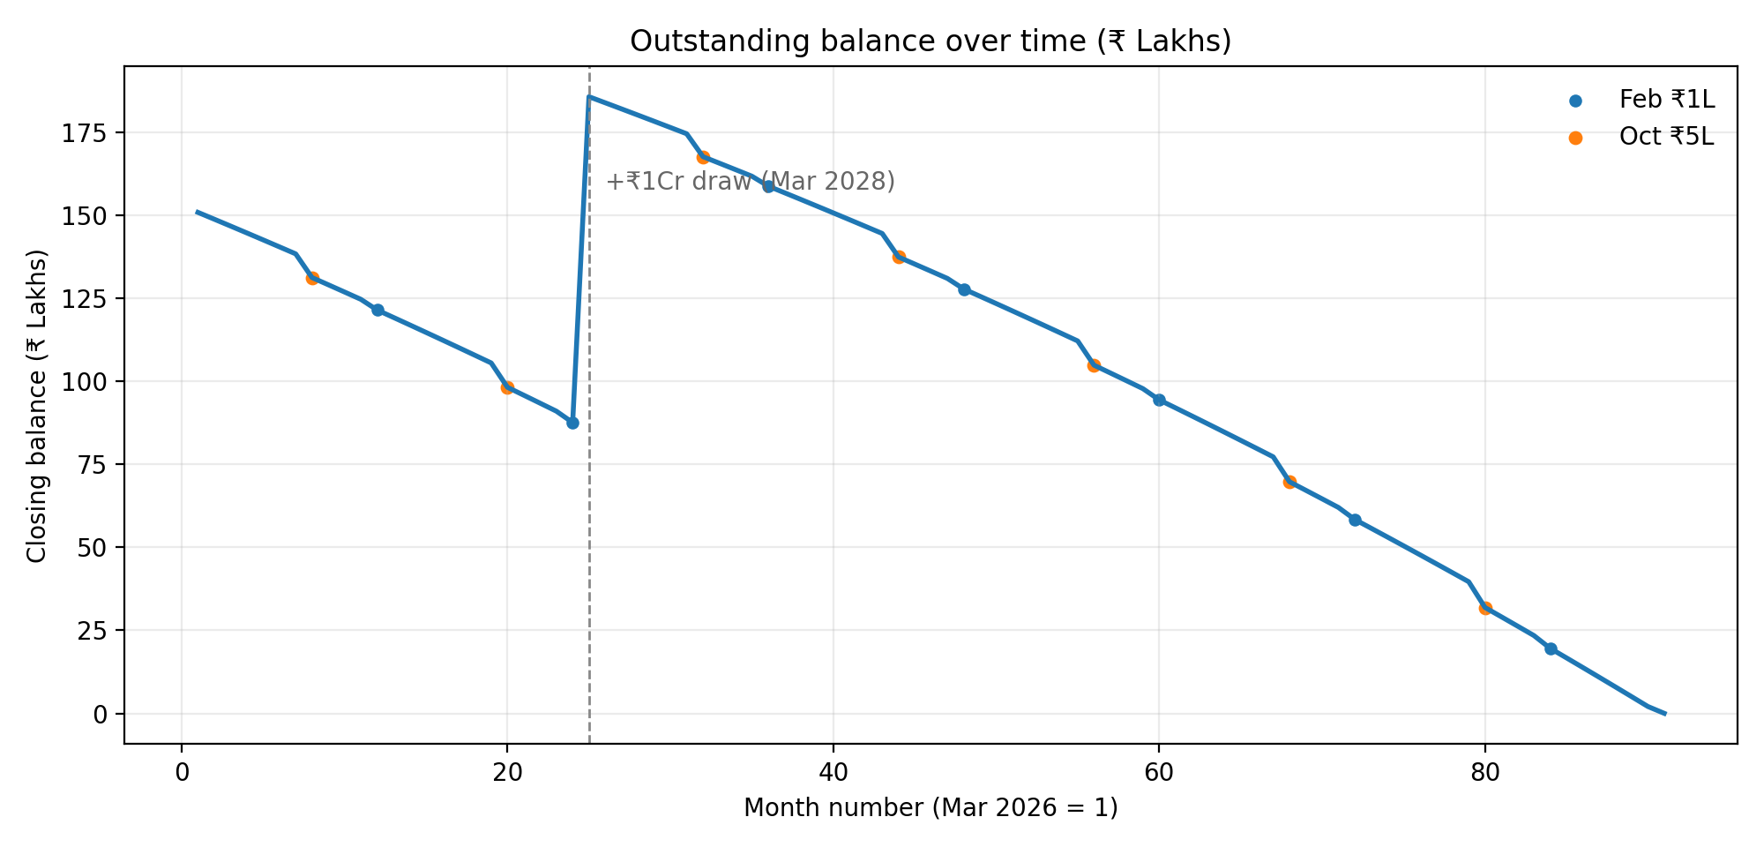
Outstanding balance trajectory

Slide 5
Milestones (Feb/Oct prepayments + disbursal)
Month | Disb | Interest | EMI | Prepay | Closing bal
Oct 2026 | ₹0 | ₹86,985 | ₹300,000 | ₹500,000 | ₹13,130,790
Feb 2027 | ₹0 | ₹78,380 | ₹300,000 | ₹100,000 | ₹12,152,576
Oct 2027 | ₹0 | ₹66,335 | ₹300,000 | ₹500,000 | ₹9,823,601
Feb 2028 | ₹0 | ₹57,205 | ₹300,000 | ₹100,000 | ₹8,761,481
Mar 2028 | ₹10,000,000 | ₹117,885 | ₹300,000 | ₹0 | ₹18,579,365
Oct 2028 | ₹0 | ₹109,722 | ₹300,000 | ₹500,000 | ₹16,772,112
Feb 2029 | ₹0 | ₹101,693 | ₹300,000 | ₹100,000 | ₹15,886,283
Oct 2029 | ₹0 | ₹90,846 | ₹300,000 | ₹500,000 | ₹13,749,169
Feb 2030 | ₹0 | ₹82,339 | ₹300,000 | ₹100,000 | ₹12,786,644
Oct 2030 | ₹0 | ₹70,497 | ₹300,000 | ₹500,000 | ₹10,490,252
Feb 2030 | ₹0 | ₹82,339 | ₹300,000 | ₹100,000 | ₹12,786,644
Oct 2030 | ₹0 | ₹70,497 | ₹300,000 | ₹500,000 | ₹10,490,252
Feb 2031 | ₹0 | ₹61,473 | ₹300,000 | ₹100,000 | ₹9,445,045
Oct 2031 | ₹0 | ₹48,560 | ₹300,000 | ₹500,000 | ₹6,976,940
Feb 2032 | ₹0 | ₹38,979 | ₹300,000 | ₹100,000 | ₹5,842,596
Oct 2032 | ₹0 | ₹24,910 | ₹300,000 | ₹500,000 | ₹3,189,376
Feb 2033 | ₹0 | ₹14,729 | ₹300,000 | ₹100,000 | ₹1,958,937

Slide 6
Year-wise summary (calendar year)
Year | Opening bal | Closing bal | Interest | EMI paid | Prepay | Disb
2026 | ₹15,000,000 | ₹12,694,433 | ₹894,433 | ₹2,700,000 | ₹500,000 | ₹15,000,000
2027 | ₹12,694,433 | ₹9,345,554 | ₹851,121 | ₹3,600,000 | ₹600,000 | ₹0
2028 | ₹9,345,554 | ₹16,381,658 | ₹1,236,104 | ₹3,600,000 | ₹600,000 | ₹10,000,000
2029 | ₹16,381,658 | ₹13,320,608 | ₹1,138,950 | ₹3,600,000 | ₹600,000 | ₹0
2030 | ₹13,320,608 | ₹10,020,609 | ₹900,001 | ₹3,600,000 | ₹600,000 | ₹0
2031 | ₹10,020,609 | ₹6,463,008 | ₹642,399 | ₹3,600,000 | ₹600,000 | ₹0
2032 | ₹6,463,008 | ₹2,627,697 | ₹364,689 | ₹3,600,000 | ₹600,000 | ₹0
2033 | ₹2,627,697 | ₹0 | ₹79,040 | ₹2,606,737 | ₹100,000 | ₹0

Slide 7
Action checklist
Standing instruction: ₹3,00,000 EMI from Apr 2026.
Every Feb: prepay ₹1,00,000 immediately.
Every Oct: prepay ₹5,00,000 immediately.
For every prepayment, request TENURE REDUCTION (not EMI reduction).
Expected closure: Sep 2033 (month 91).

