Slide 1

SMART INDIA HACKATHON 2026
Problem Statement Title: AI-Powered Email Threat Detection, Geolocation & Forensic Intelligence Platform
Problem Statement ID: SIH-2026-CYBER-001
Theme: Smart Communication / Cyber Security & Digital Forensics
PS Category: Software
Team Name: CyberTrace Innovations
Team Leader: Rakesh Singh Rawat (rakeshsinghrawat107@gmail.com)
Repository: https://github.com/rakeshsinghrawat107/MailTrace-AI
Problem Statement Title: AI-Powered Email Threat Detection, Geolocation & Forensic Intelligence Platform
Problem Statement ID: SIH-2026-CYBER-001
Theme: Smart Communication / Cyber Security & Digital Forensics
PS Category: Software
Team Name: CyberTrace Innovations
Team Leader: Rakesh Singh Rawat (rakeshsinghrawat107@gmail.com)
Repository: https://github.com/rakeshsinghrawat107/MailTrace-AI

Slide 2
MailTrace AI: Autonomous Email Threat Intelligence & Forensic Platform
CyberTrace Innovations
• The Missing Capability in Existing SEGs: Current email filters simply classify 'Phishing: YES/NO' without explaining why, tracking hop provenance, or preserving legal evidence for law enforcement.
• Proposed Forensic Intelligence Platform: MailTrace AI parses raw RFC-822/MIME emails, reconstructs the full hop-by-hop MTA relay path with IP geolocation and latency deltas, strips adversarial zero-width spaces, and normalizes Cyrillic/Greek homoglyphs.
• Novelty 1 — Multi-Pass Adversarial De-Obfuscation: Unmasks hidden Unicode evasions (ZWSP, Cyrillic lookalikes, punycode) and calculates Levenshtein distances against top protected enterprise and banking domains.
• Novelty 2 — Quishing (QR-Code Phishing) Extraction: Detects embedded QR codes in inline HTML and image attachments, extracting hidden credential theft payloads to circumvent textual filters.
• Novelty 3 — Section 63 BSA 2023 Digital Evidence Custody: Immediate SHA-256 byte-level ingestion hashing, append-only immutable custody logs, and court-admissible digital certificates under Indian evidence law.

Slide 3
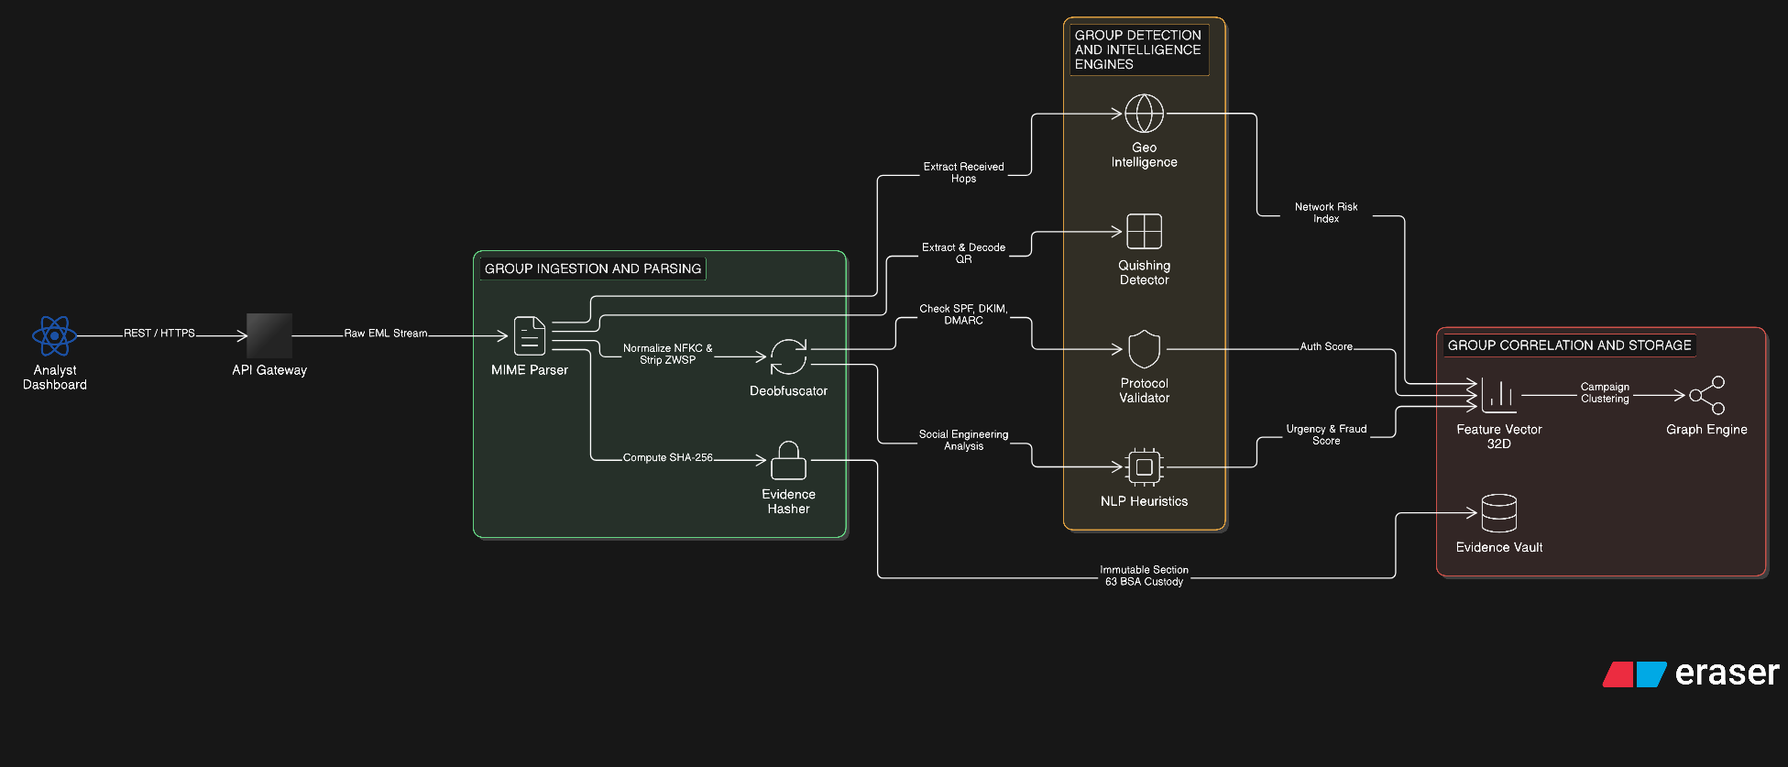
TECHNICAL APPROACH & SYSTEM ARCHITECTURE
CyberTrace Innovations
• Layered Architecture: Frontend (React + Vite + Tailwind + Leaflet.js) | Backend API (FastAPI + Python 3.14) | Evidence Vault (SHA-256 Custody Ledger).
• MIME Header & Hop Provenance: Parses RFC-5322 Received headers, resolves IP geolocation, ASN ownership, and identifies true originating MTA versus spoofed headers.
• Protocol Validation Engine: Validates SPF (RFC-7208), DKIM (RFC-6376), and DMARC (RFC-7489) alignment and policy compliance.
• 32-Dimensional Feature Vector: Computes explainable 32-dimensional vector feeding a normalized 0-100 MailTrace Fraud Score and structured IoC tables.
• Eraser Cloud Architecture: Hosted cloud architecture diagram generated via Eraser API (status 200).

Slide 4
FEASIBILITY, RISK ANALYSIS & MITIGATION
CyberTrace Innovations
• Technical Feasibility: High feasibility. Built upon standardized RFC-5322 email protocols, robust Python MIME parsers, and browser-standard Leaflet/OSM mapping without requiring costly proprietary APIs.
• Challenge 1 — Forged Headers: Attackers can inject fake 'Received:' headers. MITIGATION: Bottom-up hop provenance analysis verifies each MTA against upstream boundaries, tagging the first public IP as 'Probable Origin' rather than definitive user identity.
• Challenge 2 — Anonymizers (Tor / Commercial VPNs): Attackers route mail via Tor or bulletproof hosts. MITIGATION: Autonomous ASN intelligence tags bulletproof hosting subnets (AS53667, AS208294) to immediately flag anonymized infrastructure.
• Challenge 3 — Adversarial Zero-Width Evasion: Invisible characters defeat traditional regex/NLP. MITIGATION: Multi-pass NFKC pipeline strips all invisible codepoints and normalizes Cyrillic lookalikes before executing scoring heuristics.
• Operational Viability: Dockerized microservice deployable on-premise at enterprise SOCs, state cyber crime forensic labs, or cloud environments with low resource overhead.

Slide 5
IMPACT & STRATEGIC BENEFITS
CyberTrace Innovations
• Target Audience & Stakeholders: SOC Level 1/2/3 Analysts, Law Enforcement Cyber Crime Cells (State Police / CBI), CERT-In / NCIIPC, Banking & Financial Institutions, and Enterprise IT Security.
• Financial Loss Reduction: Rapid triage of BEC wire transfer requests and fake executive invoices before unauthorized payments are executed, directly protecting organizational capital.
• Investigation Time Accelerated (85% Faster): Automated hop sequence reconstruction and IoC extraction reduces manual header inspection from hours to seconds.
• Section 63 BSA 2023 Court Admissibility: Solves the primary bottleneck in digital prosecution by auto-generating formal certificates with cryptographic SHA-256 evidence digests and unbroken custody ledgers.
• Public & Sovereign Cyber Resilience: Strengthens national cybersecurity posture by providing law enforcement with explainable evidence bundles that stand up in Indian judicial courts.

Slide 6
RESEARCH, LEGAL FRAMEWORK & REFERENCES
CyberTrace Innovations
• Internet Engineering Standards (IETF RFCs): RFC 5322 (Internet Message Format), RFC 7208 (Sender Policy Framework), RFC 6376 (DKIM), RFC 7489 (DMARC).
• Indian Statutory Digital Evidence Framework: Section 63 of Bharatiya Sakshya Adhiniyam (BSA), 2023 (Admissibility of electronic records, certificates, and hash validation).
• Academic & Forensic Research: Adversarial Evasion in Phishing Detection: Unicode Homoglyphs & Zero-Width Obfuscation (IEEE Access / ACM Transactions on Cyber Security).
• Official Open-Source Repository (Verified & Public): https://github.com/rakeshsinghrawat107/MailTrace-AI (Full codebase, FastAPI backend, React dashboard, test suite & reports).
• Interactive Eraser Architecture Diagram: https://app.eraser.io/new?requestId=3d3CcXTU9ERwvDw0g4g2&state=TNltlLesfKL3mcDqgXFgs

