Slide 1
Mobile Menus
S No | Menu Name
 | Warehouse Manager
1 | Create Locations
2 | Create Totes/Trolley
3 | Create Bags/Pallets
 | First Mile
4 | Execute Pick from Vendor (CO)
5 | Execute Pick from Vendor (SO)
6 | Blind Pick from Vendor (SO)
7 | Add Drivers
 | Inbound
8 | Receive Customer Order
9 | Receive Stock Order
10 | Add Inbound Users
 | Quality Check
11 | Audit Customer Order
12 | Audit Stock Order
13 | Add QA Users
S No | Menu Name
 | Replenishment
14 | Assign Locations for Customer Orders
15 | Assign Locations for Stock Orders
16 | Add Replenishment users
 | Putaway
17 | Execute Putaway to Storage Location
18 | Execute Putaway to Order Location
19 | Execute Putaway to Shipping Location
20 | Add Putaway Users
 | Picking
21 | Execute Pick from Storage Task
22 | Add Picking Users
 | Packing
23 | Execute Packing Tasks
24 | Add Packing Users
 | Shipping
25 | Execute Shipping Tasks
 | Returns
26 | Receive Returns – Order
27 | Receive Returns – Items

Slide 2
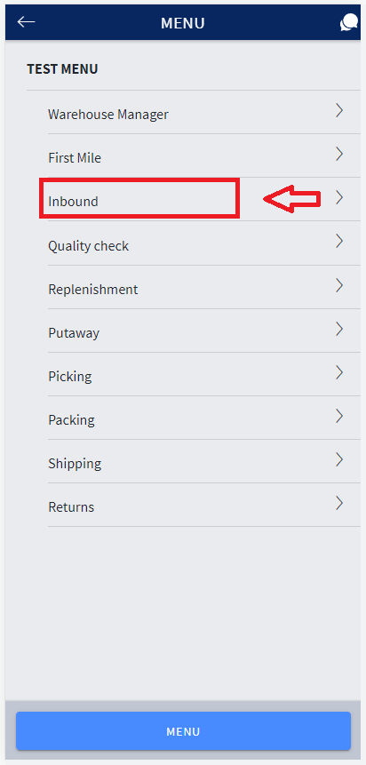
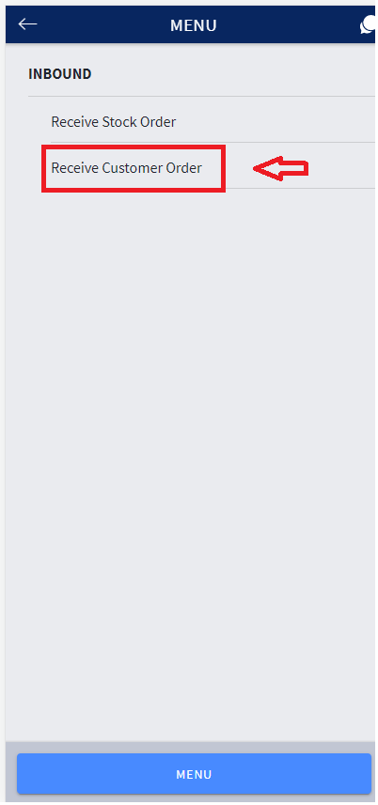
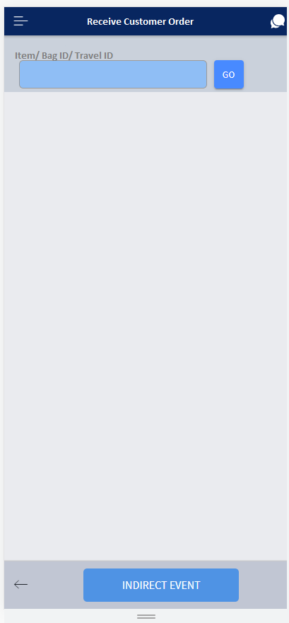
Receive Customer Order

Slide 3
Scan the Item/ Bag ID/ Travel ID
Bag ID
Item
Scan the Item
Scan the Item
Travel ID
Enter the Count
Enter the Count
Enter the No of Bags
Enter the No of Items

Slide 4
UI Menus
S No | Menu Name
1 | Users
2 | Department
3 | Warehouse
4 | Transactions
5 | Mobile Menu Maintenance
6 | Customer Orders
7 | Stock Orders
8 | Items
9 | Stock Locations
10 | Order Locations
11 | Inventory
12 | Containers
13 | Tasks
14 | Quality Check
15 | Shipment

Slide 5
Orders
Details
Allocate
Close
Cancel
De -Allocate
Edit
Order ID | Fulfilment Status | Detailed Status | Current Location in Facility | Priority | Ordered Date | Scheduled Delivery Date | Customer Name | To City | To State | To Country
1000000001 | Created |  | NA | HIGH | 2022/03/29 | 2022/04/01 | John | Dubai | NA | UAE
1000000002 | Vendor Pickup Started | Vendor Pickup – Scheduled | NA | MID | 2022/03/29 | 2022/04/01 | Adam | Dubai | NA | UAE
1000000003 | Vendor Pickup Started | Vendor Pickup - Being Picked | NA | LOW | 2022/03/29 | 2022/04/01 | Mike Dyson | Dubai | NA | UAE
1000000004 | Vendor Pickup Started | Vendor Pickup - Completed | NA | HIGH | 2022/03/29 | 2022/04/01 | Rick Mayes | Dubai | NA | UAE
1000000005 | Vendor Pickup Started | Vendor Pickup – Arrived | DOCK000001 | MID | 2022/03/29 | 2022/04/01 | Mohammed | Dubai | NA | UAE
1000000006 | Vendor Pickup Completed | Location Allocated | ISTAG00001 | LOW | 2022/03/29 | 2022/04/01 | Oleksander | Dubai | NA | UAE
1000000007 | In-Receiving | Putaway Complete | ORDER00001 | HIGH | 2022/03/29 | 2022/04/01 | Halamithi | Dubai | NA | UAE
1000000008 | In-Picking | Being Picked | ORDER00001 | MID | 2022/03/29 | 2022/04/01 | Luther Jr | Dubai | NA | UAE
1000000009 | Picking Complete | Picking Complete | PSTAG00001 | LOW | 2022/03/29 | 2022/04/01 | Manikandan | Dubai | NA | UAE
1000000010 | In-Packing | Being Packed | PSTAG00001 | HIGH | 2022/03/29 | 2022/04/01 | Gopinath | Dubai | NA | UAE
1000000011 | Packing Complete | Packing Complete | OSTAG00001 | MID | 2022/03/29 | 2022/04/01 | Jeneifer | Dubai | NA | UAE
1000000012 | Loaded | Loaded to the Trailer | TRL00000001 | LOW | 2022/03/29 | 2022/04/01 | Sandra | Dubai | NA | UAE
1000000013 | Shipped | Completed | NA | LOW | 2022/03/29 | 2022/04/01 | Wilson | Dubai | NA | UAE

Slide 6
Order – Details – General Tab
Order ID – 1000000002 | Fulfillment Status – In-Picking | Detailed Status - Being Picked
Order Date – 2021/03/29 | Scheduled Delivery Date – 2021/04/01 | Current location in Facility - ORDER00001
General
Pickup/Delivery
Fulfillment
Shipping
Misc
Order Lines
Order Type:
Payment Type:
Ordered timestamp:
Order received in WM:
External Order number:

Slide 7
Order – Details – Pickup/Delivery Tab
Order ID – 1000000002 | Fulfillment Status – In-Picking | Detailed Status - Being Picked
Order Date – 2021/03/29 | Scheduled Delivery Date – 2021/04/01 | Current location in Facility - ORDER00001
General
Pickup/Delivery
Fulfillment
Shipping
Misc
Order Lines
Estimated Delivery Date:
Actual Delivery Date:
Vendor number | Scheduled Pickup Date | Actual Pickup Date
VENDOR991
VENDOR992

Slide 8
Order – Details – Fulfilment
Order ID – 1000000002 | Fulfillment Status – In-Picking | Detailed Status - Being Picked
Order Date – 2021/03/29 | Scheduled Delivery Date – 2021/04/01 | Current location in Facility - ORDER00001
General
Pickup/Delivery
Fulfillment
Shipping
Misc
Order Lines
Customer Name:
Address Line 1:
Address Line 2:
City:
State:
Country:
Zip Code:

Slide 9
Order – Details – Shipping
Order ID – 1000000002 | Fulfillment Status – In-Picking | Detailed Status - Being Picked
Order Date – 2021/03/29 | Scheduled Delivery Date – 2021/04/01 | Current location in Facility - ORDER00001
General
Pickup/Delivery
Fulfillment
Shipping
Misc
Order Lines
Ship Via:
Service Level:
Shipping Cost:
Shipping Date:
Delivery Instruction from Customer:

Slide 10
Order – Details – Misc
Order ID – 1000000002 | Fulfillment Status – In-Picking | Detailed Status - Being Picked
Order Date – 2021/03/29 | Scheduled Delivery Date – 2021/04/01 | Current location in Facility - ORDER00001
General
Pickup/Delivery
Fulfillment
Shipping
Misc
Order Lines
Misc1:
Misc2:
Misc3:
Misc4:

Slide 11
Order – Details – Lines
Order ID – 1000000002 | Fulfillment Status – In-Picking | Detailed Status - Being Picked
Order Date – 2021/03/29 | Scheduled Delivery Date – 2021/04/01 | Current location in Facility - ORDER00001
General
Pickup/Delivery
Fulfillment
Shipping
Misc
Order Lines
Item number | Quantity | Status | Type of Fulfillment | Vendor Name | Scheduled Pickup Date | Actual Pickup Date
SKU00001 | 4 | Storage Picking – Task created | Pick from Storage | Nanyang | NA | NA
SKU00001 | 2 | Vendor Picking – Being Picked | Pick from Vendor | Telescope | 2021/03/30 | 2021/03/30

Slide 12
Order – Details – Line Detail
Order ID – 1000000002 | Status – Storage Picking – Task created | Quantity - 4
Line ID– 1 | SKU– SKU00001 | Type – Pick from storage
Quantity Allocated: Shipment#:
Storage Location Allocated: Load#:
To be Picked: Container#:
Picked:
To be Packed:
Packed:
Vendor Name:
Vendor Address:

