Slide 1
Spring Web MVC
By: Rakesh Srivastava Sr. Consultant Lead

Slide 2
Agenda
What is spring MVC
Features
Spring MVC Workflow
Important Components of Spring MVC
Demo – External configuration
Demo – Annotation
Convention over Configuration
World without Rules
Demo – Form Submission
Demo – Session Storage

Slide 3
Prerequisite
Spring Core
IOC & Dependency Injection

Slide 4
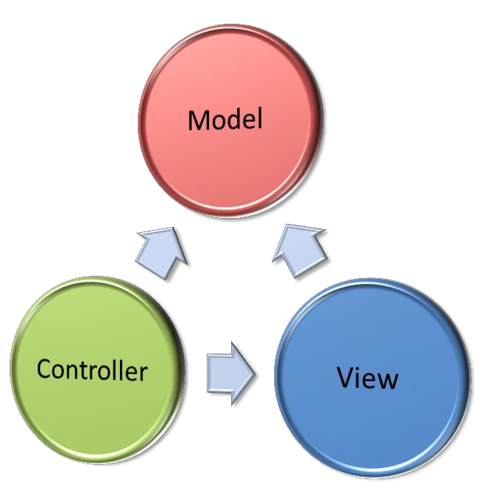



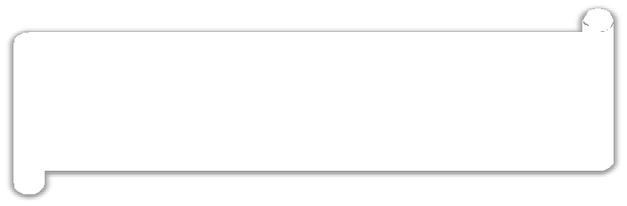




Exploring Spring MVC Framework
The core idea of the MVC pattern is to separate the business logic from UIs to allow them to change independently without affecting each other.
MVC design pattern is made up of the following components:
Represents the UI of the application.

Slide 5

Exploring Spring MVC Framework
Spring MVC Framework:
Is an MVC design pattern extension that allows you to represent the UI flow of a Web application into individual controllers and views.
Is a highly robust, flexible, and well-designed framework that is used for rapidly developing Web applications using the MVC design pattern.

Slide 6
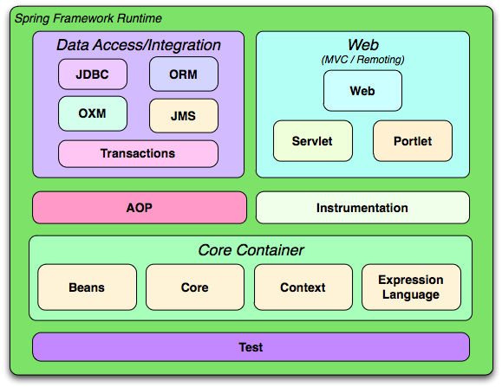

Slide 7
Spring MVC
The Spring Web MVC Framework is a robust, flexible, and well-designed framework for rapidly developing web applications using the MVC design pattern.

Slide 8
Features
Clear separation of roles. Each role — controller, validator, command object, form object, model object, handler mapping, view resolver and so on.
Powerful and straightforward configuration of both framework and application classes as JavaBeans
Adaptability and flexibility. Define any controller method signature you need for a given scenario

Slide 9
Features (cont.)
Use existing business objects as command or form objects instead of mirroring them to extend a particular framework base class
Flexible model transfer. Model transfer with a name/value Map supports easy integration with any view technology
A simple yet powerful JSP tag library
Easier testing
REST based URL support

Slide 10



Spring MVC

Slide 11

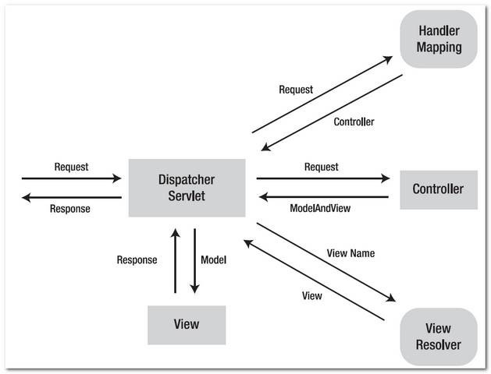
Spring Architecture

Slide 12
Exploring Spring
MVC Framework
●
The Spring Web MVC framework is built on generic Servlet known
as a DispatcherServlet class(Front Controller).
The DispatcherServlet class sends the request to the handlers with
configurable handler mappings, theme resolution, locale and view
resolution along with file uploading.
●

Slide 13
Exploring Spring's
Web MVC Framework
●
The handleRequest(request, response) method is given by the
default handler called Controller interface.
●
The application controller implementation classes
interface are as follows:
of the controller
–
–
–
AbstractController
AbstractCommandController
SimpleFormController.

Slide 14
Spring MVC
Features
●
Powerful configuration
Separation of roles.
of both framework
and
application
classes.
●
●
Flexibility in choosing subclasses.
Model transfer flexibility.
No need of duplication of code.
Specific validation and binding.
Specific local and theme resolution.
Facility of JSP form tag library.
●
●
●
●
●

Slide 15
Flow of Spring MVC

Slide 16
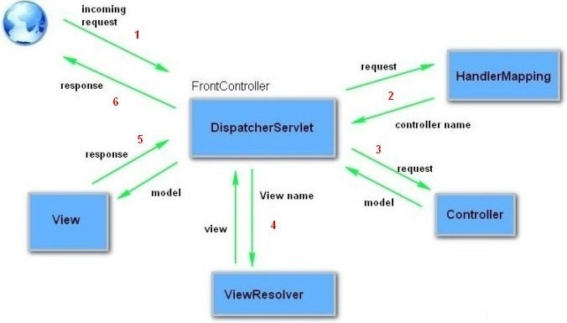
Flow of Spring MVC

Slide 17
DispatcherServlet

Slide 18
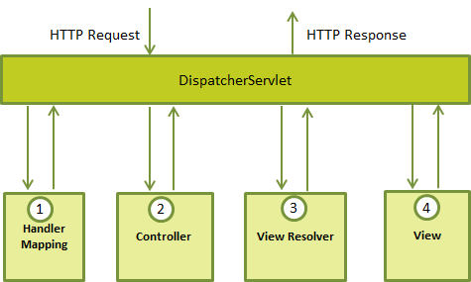
DispatcherServlet

Slide 19
DispatcherServlet
●
The DispatcherServlet class is important part of
spring Web MVC framework.
It is used for dispatching the request to application
controllers.
The DispatcherServlet class is configured in web.xml
file of a web application.
Map the request using Uniform Resource Locator
(URL) mapping in the same web.xml file to handle any request
●
●
●

Slide 20
HadlerMapping/Controller
/ViewResolver
●
Handler mapping : Manages the execution of controllers, provided
they match the specified criteria.
Controller : It handles the client's request.
View resolver : Resolves view names to view used by the
DispatcherServlet.
●
●

Slide 21
Important Components
DispatcherServlet
Controller
HandlerMapping/@RequestMapping
ModelAndView
Model & @ModelAttribute
ViewResolver

Slide 22
DispatcherServlet
The Dispatcher Servlet follows the Front Controller Design Pattern for handling Client Requests.
It means that whatever Url comes from the Client, this Servlet will intercept the Client Request before passing the Request Object to the Controller.

Slide 23
DispatcherServlet (cont.)
<web-app>
<servlet>
<servlet-name>dispatcher</servlet-name>
<servlet-class> org.springframework.web.servlet.DispatcherServlet
</servlet-class>
<load-on-startup>1</load-on-startup>
</servlet>
<servlet-mapping>
<servlet-name>dispatcher</servlet-name>
<url-pattern>*.html</url-pattern>
</servlet-mapping>
</web-app>

Slide 24
Controller
Controllers are components that are being called by the Dispatcher Servlet for doing any kind of Business Logic
Spring Distribution already comes with a variety of Controller Components each doing a specific purpose - spring 2.x
SimpleFormController
AbstractController
MultiActionController
Spring 5 Controller
@Controller Annotation

Slide 25
Controller (Cont.)
Old School of Spring MVC
public class MySimpleController extends AbstractController {
public ModelAndView handleRequestInternal (HttpServletRequest request,
HttpServletResponse response)
{
return new ModelAndView("myView");
}
}

Slide 26
Controller (Cont.)
Spring MVC 5.0
@Controller
public class DemoSpring3Controller {
@RequestMapping("/demoSpring5")
public ModelAndView helloWorld() {
String msg = "Hello Spring 5 World! Etilize -- GfK";
return new ModelAndView("demosp",
"message", msg);
}
}
<context:component-scan base-package="com.gfk.etilize.controller" />

Slide 27
HandlerMapping
A Handler Mapping provides an abstract way that tell how the Client's Url has to be mapped to the Handlers.
Four concrete variation of Handler Mapping are available
BeanNameUrl HandlerMapping
CommonsPathMap HandlerMapping
ControllerClassName HandlerMapping
SimpleUrl HandlerMapping

Slide 28
HandlerMapping (Cont.)
BeanNameUrl HandlerMapping
URL request
http://localhost:8080/spweb/showStudents
Bean Mapping
<beans>
<bean id="beanNameUrl" class="org.springframework.web.servlet.handler.BeanNameUrlHandlerMapping"/>
<bean name="/showStudents.jsp" class="com.gfk.etilize.ShowStudentsController">
</bean>
</beans>

Slide 29
HandlerMapping (Cont.)
SimpleUrlHandlerMapping
<bean id="urlMapping" class="org.springframework.web.servlet.handler.SimpleUrlHandlerMapping">
<property name="urlMap">
<map>
<entry key="/demoSpring.gfk">
<ref bean="demoSpringController"/>
</entry>
</map>
</property>
</bean>
<bean id="demoSpringController" class="com.gfk.etilize.controller.DemoSpringController" />

Slide 30
HandlerMapping (Cont.)
Spring 5.0 uses @RequestMapping for Mapping
@Controller
public class DemoSpring3Controller {
@RequestMapping("/demoSpring5")
public ModelAndView helloWorld() {
String msg = "Hello Spring 5 World";
return new ModelAndView("demosp", "message", msg);
}
}

Slide 31
ModelAndView
ModelandView is returned by the Controller object back to the Dispatcher Servlet.
This class is just a Container class for holding the Model and the View information.
This way of specifying a View is called a Logical View. It means that demosp either can point to something called demosp.jsp or demosp.pdf or demosp.xml
ModelAndView(viewName, “Key”, object);
return new ModelAndView("demosp", "message", msg);

Slide 32
Model & @ModelAttribute
Model object Automatically created on every request
@RequestMapping
public void showList(Model model){
model.addAttribute("studentList", studentService.getAllStudents());
}
Implicitly added to Model and can be accessed with key “student”
@RequestMapping
public Student showList(){
return studentService.getStudent();
}

Slide 33
Model & @ModelAttribute
@ModelAttribute – customized name
@RequestMapping
public @ModelAttribute(“stu”) Student showList(){
return studentService.getStudent();
}
@ModelAttribute – Form values
@RequestMapping("/new")
public ModelAndView getStudentForm(){
return new ModelAndView("studentForm","student",new Student());
}
<form:form action="add.gfk" method="POST" commandName=" student " >
Name:<form:input path="name" size="60" /><br>
<input type="submit" value="Register" /></td>
</form:form>
@RequestMapping
public void saveStudent(@ModelAttribute Student stu){
studentService.saveStudent(stu);
}

Slide 34
View Resolver
The mapping between the Logical name and the Physical View Location is taken care by the View Resolver object.
Spring comes with a set of Built-In Spring Resolvers.
We can write Custom View Resolvers by implementing the org.springframework.web.servlet.ViewResolver interface

Slide 35
View Resolver (Cont.)
BeanNameViewResolver
FreeMarkerViewResolver
InternalResourceViewResolver
JasperReportsViewResolver
ResourceBundleViewResolver
UrlBasedViewResolver
VelocityLayoutViewResolver
VelocityViewResolver
XmlViewResolver
XsltViewResolver

Slide 36
View Resolver (Cont.)
InternalResourceViewResolver
Controller returns - new ModelAndView("myView1")
<bean id="viewResolver“ class="org.springframework.web.servlet.view.InternalResourceViewResolver">
<property name="prefix">
<value>/WEB-INF/</value>
</property>
<property name="suffix">
<value>.jsp</value>
</property>
</bean>
the prefix + the logical View Name + the suffix
/WEB-INF/myView.jsp

Slide 37
View Resolver (Cont.)
BeanNameViewResolver
One of the dis-advantage of using InternalResourceViewResolver is that the name of the View file (jsp or pdf) must be present in the Web Application Context.
Dynamically generated View files may not be possible.
In such a case, we may use the BeanName ViewResolver which will dynamically generate View in Pdf or Excel Formats.

Slide 38
View Resolver (Cont.)
Controller returns - new ModelAndView(“excel")
<bean id="beanNameResolver" class="org.springframework.web.servlet.view.BeanNameViewResolver"/>
<bean id = “excel" class = "MyExcelGenerator"/>

Slide 39
Demo – External configuration

Slide 40

Creating Spring MVC
Application

Slide 41
Creating Spring MVC
Application
●
Create the request page (optional)
Create the controller class
Provide the entry of controller in the
Define the bean in the XML file
Display the message in the JSP page
●
●
web.xml file
●
●
●
Load the spring core and MVC jar files
Start server and deploy the project
●

Slide 42

Controller Class
@Controller
public class HelloWorldController
{
@RequestMapping("/samplepage")
public ModelAndView helloSpring()
{
String message = "Welcome to Spring
MVC";
return new ModelAndView("samplepage", "message",
message);
}
}

Slide 43

Controller
Annotation
●
The @Controller annotation defines the class as a
Spring MVC controller.
The @RequestMapping annotation is used to map
URLs like '/hello' onto an entire class or a particular
handler method.
@RequestMapping(method = RequestMethod.GET)
is used to declare the printHello() method as the controller's default service method to handle HTTP GET request.
●
●

Slide 44

web.xml File
<servlet>
<servlet-name>spring</servlet-name>
<servlet-class>
org.springframework.web.servlet.DispatcherServlet
</servlet-class>
<load-on-startup>1</load-on-startup>
</servlet>
<servlet-mapping>
<servlet-name>spring</servlet-name>
<url-pattern>*.html</url-pattern>
</servlet-mapping>

Slide 45
spring-servlet.xml
<context:component-scan basepackage="com.sample"/>
<bean class="org.springframework.web.servlet.view.
InternalResourceViewResolver">
<property name="prefix" value="/WEB-INF/jsp/" />
<property name="suffix" value=".jsp" />
</bean>

Slide 46
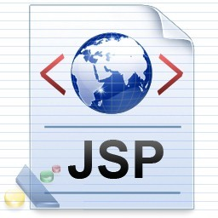
JSP Page
●
Message is: ${message}//sample.jsp
This is the simple JSP page, displaying the message returned by the
Controller.
It must be located inside the WEB-INF/jsp directory . Finally load the jar files and run.
●
●
●

Slide 47
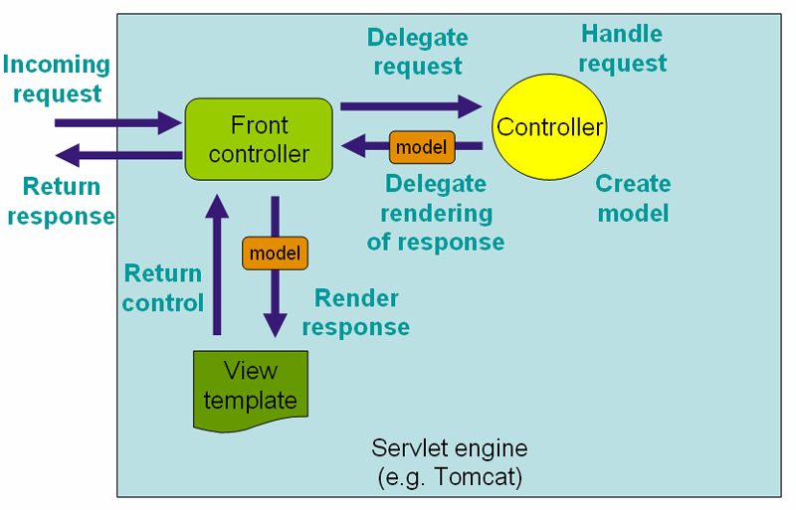
Spring MVC Workflow

Slide 48
Convention over Configuration
Write less code, get consistency
Conventions available for
Request mapping
View name selection
Model population

Slide 49
Convention over Configuration
Mapping By RequestMapping
@Controller
public class DemoSpring3Controller {
@RequestMapping("/demoSpring3")
public void helloWorld(){}
}

Slide 50
Convention over Configuration
@Controller
public class StudentController {
@RequestMapping
public void listAll(Model model){
model.addAttribute(new Student("Test",23));
}
}
GET /student/listAll
Mapping of class and
method name
Model key generated from object type
View with method name selected from request path

Slide 51
Convention over Configuration
Mapping By Convention
@Controller
public class StudentController {
URL → /student/showList , View → showList.jsp
@RequestMapping
public void showList(Model model){}
URL → /student/getStudent, View → getStudent.jsp
@RequestMapping
public Student getStudent(){
…
return stu;
}
}

Slide 52
World without Rules
Return Type?
Return Type Can be:
ModelAndViewObject
Model
Map
View
String
Void
Any Custom or built-in datatype
e.g. Student, Student[],ArrayList etc.

Slide 53
World without Rules (Cont.)
Parameter Type?
Parameter can be in any order:
ServletRequest/HttpServletRequest
ServletResponse/HttpServletResponse
HttpSession
InputStream/java.io.Reader
OutputStream/java.io.Writer
@RequestParam("product") int id or any type
@PathVariable String name or any type
@CookieValue("cookie_name") String or any type
@RequestHeader("content") String or any type
@ModelAttribute User us or any custom object
Errors
BindingResult
SessionStatus

Slide 54
Demo – Form Submission

Slide 55
@RequestParam
Type Conversion
@RequestMapping("/login")
public void login(@RequestParam String userName, @RequestParam int age){
}
Optional Request parameter -- must use object for optional
@RequestMapping("/login")
public void login(@RequestParam(required=false) String userName){
}

Slide 56
Demo – @RequestParam

Slide 57
@SessionAttribute
@Controller
@SessionAttributes("user")
public class LoginController {
@RequestMapping("/login")
public User login(@RequestParam int id){
return loginService.login(id);
}
}
User Object will be stored in session with key “user”

Slide 58

Thank
You

