Slide 1


Slide 2

Rakesh K.Srivastaw - rakesh.srivastaw@stackroute.in
IT Trainer Since 1996
Conducting Java Training Since 2001
About 60+ Corporate Clients

Slide 3
MICRO SERVICES – SPRING BOOT

Slide 4
Course Outline
Introduction to Microservices
Spring Cloud Eureka
Spring Cloud Ribbon
Spring Cloud Hystrix
Spring Cloud Feign
API Gateway and ZUUL
Spring Cloud Configuration

Slide 5
INTRODUCTION TO MICROSERVICES
Module – 1 - 1

Slide 6
Micro Services
Problems with Monolithic Application
What is Microservices
Advantages and disadvantages
When not to use Microservice
Use case for MicroServices

Slide 7
Monolith Application
A monolithic application is a single-tiered software application
  Has user interface and data access code combined into a single program from a single platform.
Its characteristics
  Doesn’t have Module but Modularized using object-based approach to be distributed across multiple computers
  Deployed together as a single deployment unit- EAR or WAR.
  Long Release Cycles
  Large Teams

Slide 8
Challenges to Monolith
  Large codebases become mess over the time
  Multiple teams working on single codebase become tedious
  Adapting to Device Explosion
  Scaling up certain parts of the application
  Technology updates/rewrites become complex and expensive tasks

Slide 9
Micro Services
An engineering approach focused on decomposing applications with well-defined interfaces
  Deployed independently as services and operated by small teams who own the entire lifecycle of the service.
  Each service handles a specific business domain (logging, auth, orders, customers)
  Each Service provides the implementation for user interface, business logic, and connection to database.
  Each Service can be scaled up Individually

Slide 10
Micro Service
  class UserApp() {
  User getUser() {
  // 1. auth user
  // 2. get user data
  // 3. log user actions
  }
  }
  class UserApp() {
  void authUser(User user) { ... }
  User getUserData() { ... }
  void logUserActions() { ... }
  }

Slide 11
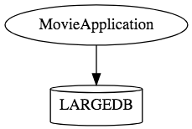
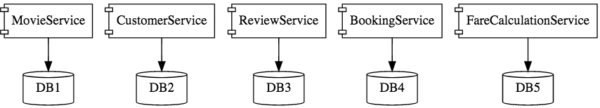
Micro Services

Slide 12
Characteristics of Micro Service
Single-function
  Each and every service has a specific function, or responsibility.
  A service can do many tasks, but all of them are relevant to a single function.
Well-defined interfaces
  Services must provide an interface that defines to communicate with it.
  Defines a list of methods, and their inputs and outputs.

Slide 13
Characteristics of Micro Service
Independent
  Services doesn’t know about each other implementation.
  They can get tested, deployed, and maintained independently.
  Services may be implemented using different language stacks, and communicate with different databases.
    They can work together to complete a required operation.

Slide 14
Characteristics of Micro Service
Small Teams
  Split the work up and team across the services.
  Each team focuses on a specific service, they don’t need to know about internal workings of other teams.
  Teams can work efficiently, communicate easily,
  Each service can be deployed rapidly as soon as it’s ready.
Entire Lifecycle
  The team is responsible for the entire lifecycle of the service; from coding, testing, staging, deploying, debugging, maintaining.
  No separate team for coding, deployment. Etc

Slide 15
Characteristics of Micro Service
Minimizing Communication
  Only essential cross-team communication should be through the interface that each service provides.
  They all need to agree on the external interface, so that communication between services is clearly defined.
Cloud Enabled
  Dynamic Scaling

Slide 16
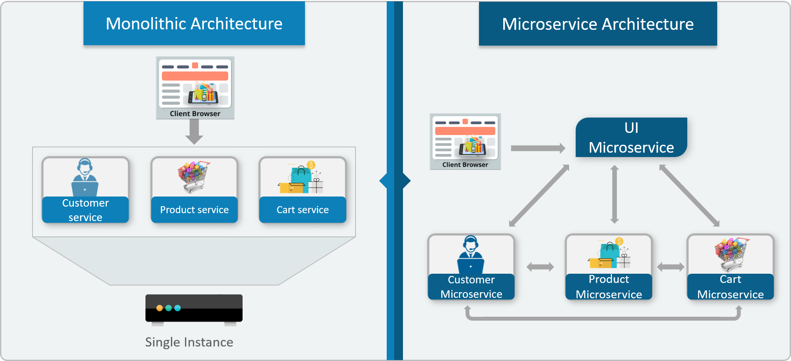

Monolithic vs Micro Service

Slide 17
When Not to use Micro Services
Complexity is a key factor
  "...don't even consider microservices unless you have a system that's too complex to manage as a monolith...“ –Martin Fowler
If complexity isn't problem, microservices aren't the solution.
Micro service architecture also brings with it significant overhead
  Design
  Interoperability of services
  Management
  Use of system resources.

Slide 18
Challenges with Micro service
Development has some inherent complexities
Quick Setup needed
  Should be able to create micro services quickly.
Automation
  Smaller component build ,deployment, monitoring etc should automated
Visibility :
  Should be able to monitor and identify problems automatically.
  Need great visibility around all the components.
Debugging
  Centralized Logging and Dashboards are essential to debug problems.

Slide 19
Challenges with Micro service
Configuration Management
  Need to maintain configurations for hundreds of components across environments.
  Should Have Configuration Management solution
Dynamic Scale Up and Scale Down
  Applications should be easily scaled up and down
Pack of Cards :
  If a Service at the bottom of the call chain fails, it can have knock on effects on all other services.
  Services should be fault tolerant by Design.
Consistency
  Should have some decentralized governance around the languages, platforms, technology and tools used for implementing/deploying/monitoring

Slide 20
Micro Services –Twelve Factor
The twelve-factor app is a methodology for building software-as-a-service
Codebase
    One codebase tracked in revision control, many deploys
Dependencies
    Explicitly declare and isolate dependencies
Config
    Store config in the environment
Backing services
    Treat backing services as attached resources
Build, release, run
    Strictly separate build and run stages
Processes
    Execute the app as one or more stateless processes

Slide 21
Micro Services –Twelve Factor
Port binding
    Export services via port binding
Concurrency
    Scale out via the process model
Disposability
    Maximize robustness with fast startup and graceful shutdown
Dev/prod parity
    Keep development, staging, and production as similar as possible
Logs
    Treat logs as event streams
Admin processes
    Run admin/management tasks as one-off processes

Slide 22
Solutions to Challenges
Spring Boot
  Enable building production ready applications quickly
  Provide non-functional features
  embedded servers (easy deployment with containers)
  metrics (monitoring)
  health checks (monitoring)
  externalized configuration

Slide 23
Solutions to Challenges
Spring Cloud
  Cloud solutions open sourced by Netflix
Dynamic Scale Up and Down.
  Using a combination of Naming Server (Eureka)
  Ribbon (Client Side Load Balancing)
  Feign (Easier REST Clients)
Visibility and Monitoring
  Zipkin Distributed Tracing
  Netflix API Gateway
Configuration Management
  Spring Cloud Config Server
Fault Tolerance
  Hystrix

Slide 24
NETFLIX OSS

Slide 25
Netflix OSS
Netflix built several cloud infrastructure libraries and systems
  Its backend and mid-tier applications are built using Java
  Has Patterns for service discovery, load balancing, fault-tolerance, etc
Developing Micro services using Spring often equate Spring Cloud with Netflix OSS
Spring framework has adapted Netflix’s with its very own software
  Community solutions have evolved beyond Netflix’s original needs.

Slide 26
Netflix OSS and Spring
Provides libaries and systems that are open sourced
  Ribbon for load balancing,
  Eureka for service discovery,
  Hystrix for fault tolerance.
Spring provides the following
  Data access through spring-data
  Complex security management through spring-security
  Integration with cloud providers spring-cloud-aws
  and many many more.

Slide 27
Service Register and Discovery
Applications may consist of many number of microservices.
  Each deployed in different servers and different ports.
Services may need to communicate with each other to execute some tasks
  Using ip address and port number has many limitations on invoking the services

Slide 28
Service Register and Discovery
Services should register themselves in the centralized location with an identifier and server details.
  This is known as “Service Registration“.
Each microservice should be able to look up the list of registered services in the centralized location and it is known as “Service Discovery”
Following are the implementations of Service Registration and Discovery Server
  Netflix Eureka
  Consul
  Zookeeper

Slide 29
SPRING CLOUD EUREKA

Slide 30
Netflix Eureka Server
An implementation for the “Service Registration and Discovery” pattern.
Keeps a track of registered micro sevices
  Hence knows as registry of micro services
Micro services should register with Eureka server by providing their details
  host name, ip address, port, and health indicators etc…
  Service will be registered with unique identifier known as serviceId.
  Other services can use this serviceId to access the particular service.

Slide 31
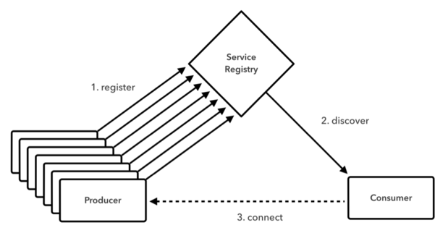
Service Registry

Slide 32
Service Registry
Eureka does not handle communication between the two servers, only the registration.
This means that a service uses Eureka only to find out the address of the other service.
After that the communication is done directly between the two services, without Eureka.
If Eureka is down, the client uses a cached copy of the remote service's address, which is good for resilience and temporary network failures.
If Eureka is down it doesn't mean that the remote service is also down or that it's physical address has changed.

Slide 33
Netflix Eureka Server
Represented by EurekaServerConfigBean
    It mplements com.netflix.eureka.EurekaServerConfig.
  Its properties are prefixed by eureka.server.
Server maintains a registry of up and running micro services.
Services registers itself with Eureka, and pings Eureka server to notify that it’s alive.

Slide 34
@EnableEurekaServer
Eureka instance
  Represented by EurekaInstanceConfigBean
    It indirectly implements com.netflix.appinfo.EurekaInstanceConfig.
  All properties are prefixed by eureka.instance.
@EnableEurekaServer
  Added to the main Spring Boot Application configuration class
  Used to Notify the Spring Container that this application is a registration service by Netflix technology
  It also activates Eureka Server related configurations

Slide 35
Enable Eureka Server
  @EnableEurekaServer
  @SpringBootApplication
  public class EurekaServerApplication {
  public static void main(String[] args) {
  SpringApplication.run(EurekaServerApplication.class, args);
  }
  }

Slide 36
Configuration Properties
  server.port=8761
  default port for eureka server
  spring.application.name=eureka-server
  Give a Unique name for a Eureka server

Slide 37
Configuration Properties
eureka.client.fetch-registry=false (default: true)
  Does not register itself in the service registry
  The client fetches the Eureka server registry at startup and caches it locally.
  From then on, it only fetches the delta
  The registry fetch is an asynchronous task scheduled every 30s
  Configurable with eureka.client.registryFetchIntervalSeconds

Slide 38
Configuration Properties
eureka.client.register-with-eureka=false (default: true)
  Should this server registers itself as a client;
  Eureka server is also acting as a client so that it can sync the registry.
  The value being false means it prevents itself from acting as a client.
  An instance registers with a Eureka server using a given URL

Slide 39
Configuration Properties
eureka.client.serviceUrl.defaultZone
  In standalone mode, used to switch off the client side behavior
    Does not keep trying and failing to reach its peers.
  To consult with other Eureka servers to sync the service registry.
  In a standalone mode points to the local server address.
  The port in which the server will be bound.

Slide 40
Configuration Properties
eureka.instance.leaseRenewalIntervalInSeconds.
  Client sends heartbeats every 30s
  If the server doesn’t receive a heartbeat, it waits for 90seconds
  After 90 seconds the instance is removed and there by disallowing traffic to that instance.
    Configued with the property
      eureka.instance.leaseExpirationDurationInSeconds

Slide 41
Server Config Properties
  server:
  port: 8761
  spring:
  application:
  name: eureka-server-registry
  eureka:
  client:
  fetch-registry: false
  register-with-eureka: false
  service-url:
  defaultZone: http://localhost:8761/eureka

Slide 42
Discovery From Eureka Server
Eureka client
  Represented by EurekaClientConfigBean
    Implements com.netflix.discovery.EurekaClientConfig.
  All properties are prefixed by eureka.client.
Micro services can register themselves as Discovery clients
  The Server will allow the discover clients to look up the other registered services and fetch their information.
  Discover client can fetch the information of the targeted service
  Services can communicate without IP addresses and port numbers manually.

Slide 43
Discovery Clients
Need to register the applications in the Eureka server as a Eureka Discoverable Client.
@EnableDiscoveryClient
  To be added in the main spring boot configuration class to make the service as a Discoverable client.
  Can work with any Discovery Client implementations like Eureka, Consul, Zookeeper
@EnableEurekaClient
  Works only with Eureka Discovery Client implementation.

Slide 44
Discovery Clients
  @RestController
  public class DonarService {
  @GetMapping("/donar")
  public String getDonar() {
  return "Ramesh - BPOS";
  }
  }

Slide 45
Discovery Client Service
  @SpringBootApplication
  @EnableEurekaClient
  public class BloodDonarServiceApplication {
  public static void main(String[] args) {
  SpringApplication.run(BloodDonarServiceApplication.class, args);
  }
  }

Slide 46
application.yml
  server:
  port: 2020
  spring:
  application:
  name: blood-donor-service
  eureka:
  client:
  fetch-registry: true
  register-with-eureka: true
  service-url:
  defaultZone: http://localhost:8761/eureka

Slide 47
@LoadBalanced
  Eliminates direct use of Ribbon
  Ribbon automatically integrates with RestTemplate
    Makes RestTemplate ribbon aware.
  Also helps to use "logical identifiers" for the URLs passed to restTemplate.
    logical identifiers are name of a service.
  @Bean
  @LoadBalanced
  public RestTemplate template() {
  return new RestTemplate();
  }

Slide 48
Rest Client - Application
  @SpringBootApplication
  @EnableEurekaClient
  public class DiscoverDonarServiceApplication {
  public static void main(String[] args) {
  SpringApplication.run(DiscoverDonarServiceApplication.class, args);
  }
  @Bean
  @LoadBalanced
  public RestTemplate template() {
  return new RestTemplate(); }
  }

Slide 49
Rest Client - Controller
  @RestController
  public class DonarServiceController {
  @Autowired
  RestTemplate template;
  @GetMapping(value = “/donarDetails")
  public String getDonars() {
  String response = template.getForObject("http://donar-details- service/donar/",String.class);
  return response;
  }
  }

Slide 50
Rest Client –yml File
  server:
  port: 3030
  spring:
  application:
  name: blood-donor-client
  eureka:
  client:
  fetch-registry: true
  register-with-eureka: true
  service-url:
  defaultZone: http://localhost:8761/eureka

Slide 51
Eureka Zones
  eureka:
  client:
  service-url:
  zone1: http://localhost:8761/eureka/
  fetch-registry: false
  register-with-eureka: false

Slide 52
Eureka Zones
  eureka:
  client:
  register-with-eureka: true
  fetch-registry: true
  service-url:
  zone1: http://localhost:8761/eureka

Slide 53
CLUSTERING EUREKA

Slide 54
Eureka High Availability
Eureka achieves high availability Using Server Cluster
  Eureka can be deployed as a cluster of servers.
    When one of these Eureka servers crash,
  clients can still connect to the remaining Eureka servers and discover other services
Peer Awareness
  Individual servers of the cluster are called peers.
  When the peers start up, they register with each other
  Helps in synchronizing registrations among themselves.

Slide 55
High Availability
  It is the ability of a system or system component to be continuously operational for a desirably long length of time
  A client is provided with a list of Eureka servers through configuration
    Either to DNS or /etc/hosts
  Client attempts to connect to server1; where server2 is sitting idle.
  In case server1 is unavailable, the client tries the next one from the list.
  When server1 comes back online, client goes back to using server1.
  server1 and server2 can be ran in peer-aware mode, and their registries replicated.

Slide 56
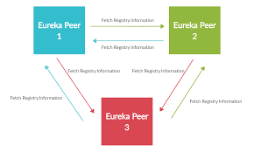
Peer Awareness

Slide 57
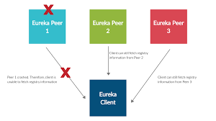
Peer Awareness

Slide 58
Service Registry
  @SpringBootApplication
  @EnableEurekaServer
  public class ServiceRegistryApplication {
  public static void main(String[] args) {
  SpringApplication.run(ServiceRegistryApplication.class, args);
  }
  }

Slide 59
Application.yml
  spring:
  profiles: default
  eureka:
  instance:
  hostname: default-eureka-server.com
  appname: eureka-cluster
  client:
  serviceUrl:
  defaultZone: http://localhost:8761/eureka/
  register-with-eureka: false
  fetch-registry: false
  server:
  port: 8761
  - - - : YAML supports multiple documents , New YAML document.

Slide 60
Application.yml
  spring:
  profiles: peer-1
  application:
  name: eureka-server-clustered
  eureka:
  instance:
  hostname: eureka-peer1
  appname: eureka-server-clustered
  client:
  serviceUrl:
  defaultZone: http://eureka-peer2:8770/eureka/
  server:
  port: 8765

Slide 61
Application.yml
  - - - ( Three Hypens)
  spring:
  profiles: peer-2
  application:
  name: eureka-server-clustered
  eureka:
  instance:
  hostname: eureka-peer2
  appname: eureka-server-clustered
  client:
  serviceUrl:
  defaultZone: http://eureka-peer1:8765/eureka/
  server:
  port: 8770

Slide 62
application.yml
eureka.instance.instanceId
  An instance is identified in Eureka by its Id
  Defaults to CLIENT IP:PORT
  If set ,it must be unique within the scope of the appName
eureka.instance.hostname:
  The hostname eureka advertises

Slide 63
application.yml
eureka.instance.appName
  Eureka instances find each other using appName
  Its defaulted to spring.application.name
    If Not defined declared as UNKNOWN
  Used when registering multiple Instances
  Applications with the same name are clustered together in Eureka server.

Slide 64
Client
  @SpringBootApplication
  @EnableDiscoveryClient
  public class ServiceRegistryClientApplication {
  public static void main(String[] args) {
  SpringApplication.run(ServiceRegistryClientApplication.class, args);
  }
  }

Slide 65
Client - Controller
  @RestController
  public class WelcomeController {
  @GetMapping(path = "/info")
  public String showMessage() {
  return "Hello from Client";
  }
  }

Slide 66
Client – application.yml
  spring:
  application:
  name: cluster-client
  server:
  port: 6060
  eureka:
  client:
  service-url:
  defaultZone: http://eureka-peer1:8765/eureka,http://eureka-peer2:8770/eureka
  instance:
  appname: cluster-client

Slide 67
Setting Cluster in Local Machine
Each of the server peers will run on separate hosts and ports.
Additional configurations are required to start this entire cluster in local machine
Need to edit the hosts file found in C:\Windows\System32\drivers\etc\hosts file
  Need to open with administrator privilege
  127.0.0.1 eureka-peer1
  127.0.0.1 eureka-peer2
java -jar -Dspring.profiles.active= eureka-peer1 eureka-server-1.0.0-
SNAPSHOT.jar

Slide 68
SPRING CLOUD CONFIG SERVER

Slide 69
Config Server
Cloud Applications requires a way to maintain and distribute the Configuration data to all services
Eureka is NOT meant for storing configurations.
  It is meant for service registry and discovery.
Spring Cloud Config Service acts as a centralized configuration mechanism.
Application Clients can connect to that server and manage configurations

Slide 70
Config First BootStrap
One Solution is to consolidate all configuration into a single Git repository
It can be used in two ways
  Config-first setup (default)
  Using a discovery-first setup

Slide 71
Config First Bootstrap
Default behavior for any application which has the Spring Cloud Config Client on the classpath.
Client Application that want to consume the Config Server need a bootstrap.yml
When a config client starts up it binds to the Config Server
  Uses the property spring.cloud.config.uri
  Initializes Spring Environment with remote property sources.

Slide 72
Types of Configuration
Global Configuration
  By Using application.yml or application.propeties
Application-Specific Configuration
  Serving only to a specific app.
  [APP-NAME].yml or [APP-NAME].properties
. Profile-Specific Configuration
  [APP-NAME]-[PROFILE-NAME].yml or [APP-NAME]-[PROFILE-NAME].properties

Slide 73
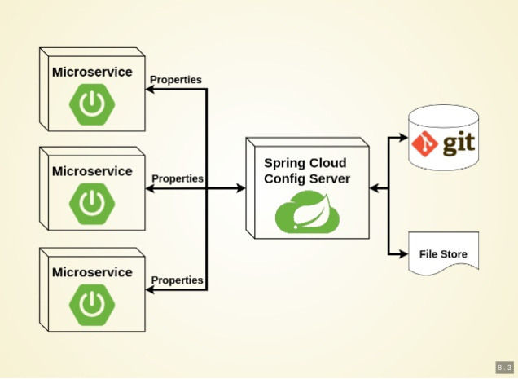
Working of Configuration Server

Slide 74
Git Repository
Can store the properties in git repository
Create or update a git repository.
Can Create and place the external property files
  Micro Service will be using external configuration of properties.
Can maintain same property name for different environment
It can be details of urls, credentials, database details etc.

Slide 75
Git Repository
application-dev.properties
  eureka.client.serviceUrl.defaultZone = http://localhost:8761/eureka/
  eureka.client.register-with-eureka=true
  eureka.client.fetch-registry=true
  spring.datasource.password=srivatsan
  spring.datasource.username=root
  spring.datasource.driver-class-name=com.mysql.cj.jdbc.Driver
  spring.datasource.url=jdbc:mysql://localhost:3306/test

Slide 76
Config Server
Spring Cloud Config Server provides an HTTP resource-based API for external configuration
@EnableConfigServer
  The server is embeddable in a Spring Boot application
  @SpringBootApplication
  @EnableConfigServer
  public class ConfigServer {
  public static void main(String[] args) { SpringApplication.run(ConfigServer.class, args);
  }
  }

Slide 77
Spring Cloud Configuration Server
application.properties
  Add the Reference to the Git URI and set the port
  spring.cloud.config.server.git.uri=
  https://github.com/vatsank/config-info.git
  server.port =2020
spring.config.server.git.uri
  To point to git repository location with properties files
Start the Application and test configuration by selecting following URL
http://localhost:2020/config-server/dev
http://localhost:2020/application-dev.properties

Slide 78
Spring Config Service - Client
Need to add Spring Cloud Config Client module
It will take care of starting the application by fetching the application properties from Config Server.
When a config client starts, it binds to the Config Server
  Using spring.cloud.config.uri bootstrap configuration

Slide 79
bootstrap.properties
This file will be loaded before application.properties
Provides the parent context for the main application
It binds to the Config Server
It has following two entries
spring.application.name
  On Startup Spring Cloud makes an HTTP(S) call to the Spring Cloud Config Server
  Uses the application name and retrieves back that application’s configuration.
  Should match with base filename in GIT Repository.
  It will also take profile and URI of the Config Server

Slide 80
Config server client
boortstrap.properties
  spring.profiles.active=dev
  spring.cloud.config.uri=http://localhost:2020
application.properties
  server.port=5050
  spring.application.name=config-client

Slide 81
Config server client
  boortstrap.yml
  spring:
  cloud:
  config:
  uri:
  - http://localhost:1212
  application.properties
  server:
  port: 2020
  spring:
  application:
  name: payment-service

Slide 82
@RefreshScope
By default, the configuration values are read on the client’s startup, and not again.
Can be forced on a bean to refresh its configuration
  To pull updated values from the Config Server
  Can trigger a refresh event.
  Annotated beans re-instantiated without restarting the DI container by POSTing refresh endpoint.

Slide 83
@RefreshScope
  @RestController
  @Slf4j
  @RefreshScope
  public class PaymentController {
  @Value("${user.name}")
  private String name;
  @Autowired
  private Payment payment;
  @GetMapping(path = "/payment")
  public Payment getPayment() {
  payment.setCustomerName(name);
  return payment;
  }
  }

Slide 84
@RefreshScope
payment-service.yml
  user: name: Nirmal kumar
Edit the file with a New value
Invoke Post Method with Blank Body of application/json
http://vatsan:2020/api/v1/actuator/refresh
Invoke the Service Again should get the changed value

Slide 85
Loading Properties From Multiple Files
  bootstrap.yml
  spring:
  application:
  name: order
  cloud:
  config: name: ${spring.application.name}, orderdb, ordermsg profile: dev
  First load the properties from order-dev.properties file.
  Then orderdb-dev.properties and then ordermsg-dev.properties.

Slide 86
Discovery First Bootstrapping
A config server address is fetched from a discovery server.
  all applications can retrieve their configuration by looking up the URL of the configuration service on Eureka:
  spring.cloud.config.discovery.enabled=true
  spring.cloud.config.uri=http://config-service
Application will look for a service named config-service on Eureka,
Client apps need a bootstrap.yml with the appropriate discovery configuration.

Slide 87
Config Server
  @SpringBootApplication
  @EnableDiscoveryClient
  public class ConfigServerDiscoveryFirstApplication {
  public static void main(String[] args) {
  SpringApplication.run(ConfigServerDiscoveryFirstApplication.class, args);
  }
  }

Slide 88
application.yml
  spring:
  application:
  name: client-discovery-first
  cloud:
  config:
  discovery:
  enabled: true
  server:
  git:
  uri: https://github.com/vatsank/spring-config-server.git
  server:
  port: 8764

Slide 89
application.yml
  spring:
  application:
  name: client-discovery-first
  cloud:
  config:
  fail-fast: true
  server:
  git:
  uri: https://github.com/vatsank/spring-config-server.git
  retry:
  max-attempts: 20
  max-interval: 15000
  initial-interval: 10000
  discovery:
  enabled: true
  service-id: config-server

Slide 90
Application.yml --- contd
  eureka:
  client:
  enabled: true
  register-with-eureka: true
  fetch-registry: true
  serviceUrl:
  defaultZone: http://localhost:8761/eureka

Slide 91
Client - bootstrap.yml
  server:
  port: 2020
  servlet:
  context-path: /api/v1
  spring:
  application:
  name: payment-service
  cloud:
  config:
  uri:
  - http://client-discovery-first

Slide 92
ADMINISTRATION SERVER

Slide 93
Spring Boot Administration- Server
Monitoring application by using Actuator Endpoint is slightly difficult.
  Every application has separate actuator endpoints,
  Need to thus making monitoring difficult.
Spring Boot Admin Server
  Used to manage and monitor Microservice application.
  Provides a UI to manage and monitor Actuator endpoints at one place.
Spring Boot Admin Client
  Need to add the Spring Boot Admin starter client dependency
  Applications should have a property to point out the Admin Server URI

Slide 94
@EnableAdminServer
@EnableAdminServer
  Added to the main Spring Boot application class file.
  Make the application as Admin Server to monitor all other microservices.
server:
port: 9494
spring:
application:
name: payment-service
boot:
admin:
client:
url:
- http://localhost:9494

Slide 95
SPRING CLOUD RIBBON
WITH EUREKA

Slide 96
Load Balancing
A distributed system may consists of many services running on different computers.
When the number of users is large, a service is created multiple replicas.
Each replica runs on a different computer.
A Load Balancer” helps to distribute incoming traffic equally among servers.

Slide 97
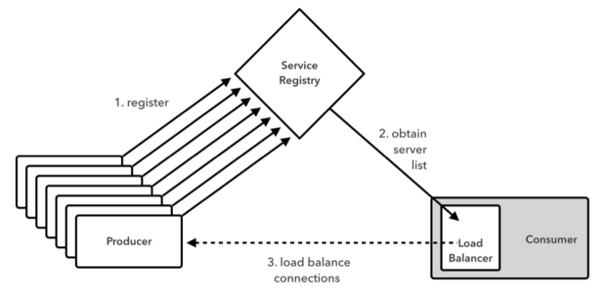
Working of Load Balancer

Slide 98
Load Balancing on Server Side
Load Balancers are components placed at the Server Side.
When the requests come from the Client, they will go to the load balancer, and the load balancer will designate a Server for the request.
It may use algorithm like random designation.
Most load balancers are hardware, integrated with software to control load balancing.
Need a separate server to host the load balancer instance which has the impact on cost and maintenance.

Slide 99
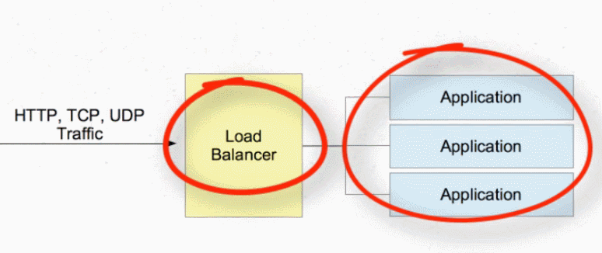
Load Balancer On Server Side

Slide 100
Client side load balancing
When the load balancer is located at Client side
  They reside in the application as inbuilt component and bundled along with the application
  No need to deploy them in separate servers.
  Will actively decide which server it will send requests to based on some criteria
Eureka server returns all the instances of the target microservice to the caller service.
Then it is the responsibility of the Client side load balancer to delegate to proper instance in balanced fashion.

Slide 101
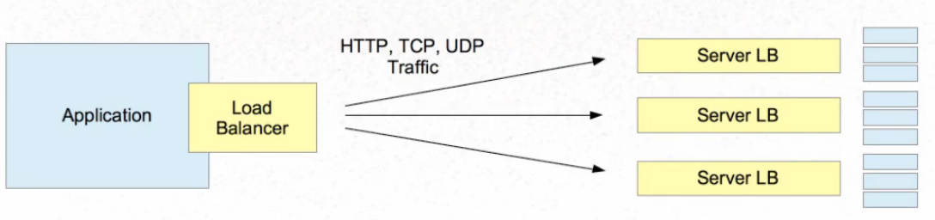
Load Balancer on Client Side

Slide 102
Netflix ribbon
Netflix ribbon is from Spring Cloud family
It is a library provides client side load balancing along with the service registry component.
Spring boot has ways of configuring ribbon client side load balancer with minimal effort.
It provides the following features
  Load balancing ,
  Fault tolerance
  Caching and batching

Slide 103
Service Configuration
spring.application.name=donor-service-provider
server.port=${random.int(4040,4050)}
  Unique Eureka instance identifier for this instance.
eureka.instance.instance-id=
  ${spring.application.name}:${spring.application.instance_id:${random.value}}
  Appends the current spring.application.instance_id to the spring.application.name
    separated by a colon (:).
  If the spring.application.instance_id doesn't exist
    Appends a random value

Slide 104
Rest Controller
  @RestController
  public class DonarService {
  @Value("${eureka.instance.instance-id}")
  private String instanceId;
  @Autowired
  Environment environment;
  @GetMapping("/donar")
  String serverPort = environment.getProperty("local.server.port");
  public String getDonar() {
  return "Ramesh - BPOS“+serverPort;
  }
  }

Slide 105
Application
  @SpringBootApplication
  @EnableEurekaClient
  public class BloodDonarServiceApplication {
  public static void main(String[] args) {
  SpringApplication.run(BloodDonarServiceApplication.class, args);
  }
  }

Slide 106
LoadBalancerClient
Interface that Represents the Client Side Load Balancer
It extends ServiceInstanceChooser Inteface
Autowired into the Controller Class
ServiceInstance choose(String serviceId)
  The Method in the super interface
  Chooses a ServiceInstance from the LoadBalancer for the specified service.
  serviceId => ID to look up the LoadBalancer.
  Returns a ServiceInstance that matches the serviceId.

Slide 107
Consumer Configuration
  @RestController
  public class ConsumeDonarRibbonClient {
  @Autowired
  RestTemplate template;
  @Autowired
  private LoadBalancerClient loadBalancer;
  }
  @Bean
  public RestTemplate template() {
  return new RestTemplate();
  }

Slide 108
Consumer Configuration
  @GetMapping("/ribbon")
  public String getEmployee() throws RestClientException, IOException {
  ServiceInstance serviceInstance= loadBalancer.choose("donar-details-service");
  System.out.println(serviceInstance.getUri());
  String baseUrl=serviceInstance.getUri().toString();
  baseUrl=baseUrl+"/donar/";
  String response = template.getForObject(baseUrl,String.class);
  return response;
  }

Slide 109
Consumer Configuration
  server.port=7070
  spring.application.name=ribbon-balanced-service
  logging.level.com.example.demo = DEBUG
  eureka.client.healthcheck.enabled=true
  eureka.client.serviceUrl.defaultZone = http://localhost:8761/eureka/

Slide 110
RIBBON CONFIGURATION

Slide 111
Customizing Ribbon settings
@RibbonClient(name = “myservice", configuration = SomeServiceConfig.class)
name
  Same name as the service being called
  will be used to prefix in the application.properties
  Will also be used as "logical identifier" in the URL passed to the to RestTemplate.
application.properties
  myservice.ribbon.eureka.enabled=false
  myservice.ribbon.listOfServers=http://localhost:5000,http://localhost:5001

Slide 112
Customizing Ribbon settings
configuration
  Mapped to a class with @Configuration class
  The class should have all customizations defined as @Beans.
  This class should not be in the path of @ComponentScan
  If so it will override the defaults for ALL Ribbon clients.

Slide 113
Configuring Ribbon Load Balancer
IClientConfig
  Defines the client configuration used by various APIs to initialize clients or load balancers
  It has a default implementation DefaultClientConfigImpl

Slide 114
Configurable load-balancing rules
WeightedResponseTimeRule
  Each server is given a weight according to its average response time.
  The longer the response time, the less weight it will get
  The rule randomly picks a server where the possibility is determined by server's weight.
BestAvailableRule
  Skips servers with "tripped" circuit breaker and picks the server with lowest concurrent requests.

Slide 115
Configurable load-balancing rules
  RoundRobinRule,
  A client request is forwarded to each server in turn. The algorithm instructs the load balancer to go back to the top of the list and repeats again.
AvailabilityFilteringRule
  Will skip servers that are deemed "circuit tripped" ,an instance is circuit tripped
  if the RestClient fails to make a connection to it for the last three times

Slide 116
Configuring Ribbon Load Balancer
Rule
  Logic component which specifies the load balancing rule we are using in our application
Ping
  A Component which specifies the mechanism we use to determine the server's availability in real-time
  PingUrl will ping every URL to determine the server's availability.
ServerList
  can be dynamic or static.
  Can be statically defined in the application configuration file directly

Slide 117
Customer Controller
  @RestController
  @Slf4j
  public class CustomerController {
  @Value("${server.port}")
  private String port;
  @GetMapping(path = "/message")
  public String getMessage() {
  log.info("Request Handled by =======: "+port);
  return "Hello from controller"+port;
  }
  }

Slide 118
Application.yml
  spring:
  profiles:
  - dev
  server:
  port: 4040
  ---
  spring:
  profiles:
  - prod
  server:
  port: 5050
  From Spring STS Run As maven buid use the following Goal
  spring-boot:run -Dspring-boot.run.profiles=dev

Slide 119
@RibbonClient
Used for configuring Ribbon clients
Not to Use
  While using Service Discovery
  While using default Ribbon settings,
Should Use
  Need to customize Ribbon settings for a particular Ribbon client
  When not using any service discovery

Slide 120
Ribbon Client Module
  Add Ribbon and Web as module Dependency
  @SpringBootApplication
  @RibbonClient(name = "customer-service",configuration = RibbonConfig.class)
  public class CustomerServiceRibbonClientApplication {
  public static void main(String[] args) {
  SpringApplication.run(CustomerServiceRibbonClientApplication.class, args);
  }
  @Bean
  @LoadBalanced
  public RestTemplate template() {
  return new RestTemplate();
  }
  }

Slide 121
Controller
  @RestController
  public class ClientController {
  @Autowired
  private RestTemplate template;
  @GetMapping(path = "/customer")
  public String fetchData() {
  // host name as given in the @RibbonClient(name="customer-service")
  return template.getForObject("http://customer-service/message", String.class);
  }
  }

Slide 122
Ribbon Custom Configurations
  public class RibbonConfig {
  @Autowired
  IClientConfig config;
  @Bean
  public IRule ribbonRule(IClientConfig config) {
  //return new BestAvailableRule();
  IRule rule = new RoundRobinRule();
  return rule;
  }
  }

Slide 123
Configuring Ribbon
ribbon. eureka.enabled= false
  Disable Eureka Use in Ribbon
  Explicitly disables the use of Eureka in Ribbon
ribbon: eager-load: enabled: true
clients: client1, client2, client3
  Each Ribbon named client has a corresponding child application Context that Spring Cloud maintains.
  This application context is lazily loaded on the first request to the named client.

Slide 124
Application.yml
  server:
  port: 8888
  customer-service:
  ribbon:
  eureka:
  enabled: false
  listOfServers: localhost:4040,localhost:5050
  ServerListRefreshInterval: 15000
  # customer-service as given in @RibbonClient(name)

Slide 125
@RibbonClients
@RibbonClients
  Used to provide a default configuration for all Ribbon Clients
  @RibbonClients(defaultConfiguration = DefaultRibbonConfig.class)
  public class RibbonClientDefaultConfiguration {
  }

Slide 126
HYSTRIX FAULT TOLERANCE

Slide 127
Hystrix
Another Netflix library.
  A latency and fault tolerance library
  To isolate points of access to remote systems, services
  Stops cascading failure
  Enable resilience in distributed systems where failure is inevitable."

Slide 128
Need for Hystrix
Applications may have heavy user traffic with a lot of dependencies.
  If a certain service is down or is too slow to respond
    it could slow down or throttle the entire application.
Hystrix creates a pool of threads for each dependency in the application.
  Even if a service is not behaving as expected
  The application system continues to function.
Isolates points of access between services
  Avoiding cascading failure across the different application layers.

Slide 129
Hystrix Fall Back
Hystrix also provides fallback options
Facilitates monitoring the system state and many other desirable features;
It monitors and Improves the application’s fault-tolerance and resiliency.
@EnableHystrixDashboard
  To give dashboard view of Hystrix stream.
  http://localhost:8080/hystrix
  http://localhost:8080/hystrix.stream
@EnableCircuitBreaker
  To enable Circuit breaker implementation.

Slide 130
@HystrixCommand
Spring Cloud automatically wraps Spring beans with that annotation in a proxy that is connected to the Hystrix circuit breaker.
The circuit breaker calculates when to open and close the circuit and what to do in case of a failure.
Can use the commandProperties attribute with a list of @HystrixProperty annotations.

Slide 131
Hystrix and fault-tolerance
  @RestController
  public class BookImageController {
  @GetMapping("/book/{id}")
  public BookImage fetchImage(@PathVariable("id") int id) throws InterruptedException {
  if(id<7) {
  return new BookImage(102, "images/spring.png", "Prof spring");
  } else {
  Thread.sleep(7000);
  return new BookImage(2000, "images/java.png", "head first java");
  }
  }
  }

Slide 132
Hystrix and fault-tolerance
  @RestController
  public class BookImageController {
  @Autowired
  private RestTemplate template;
  @GetMapping("/api/book/{id}")
  @HystrixCommand(fallbackMethod = "fetchImageFallBack",commandProperties = {
  @HystrixProperty(name = "execution.isolation.thread.timeoutInMilliseconds",value = "2000")
  })

Slide 133
Hystrix and fault-tolerance
  public String fetchImage(@PathVariable("id") int id) throws InterruptedException {
  String url = "http://localhost:3030/book/"+id;
  return template.getForObject(url,String.class );
  }
  public String fetchImageFallBack( int id) throws InterruptedException {
  String fallback ="{id:0,imageRef:images/logo.png,altText:default book}";
  return fallback;
  }
  }

Slide 134
REQUEST ROUTING WITH ZUUL

Slide 135
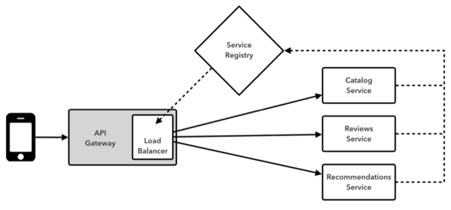
Working of Zuul API
Customer-service
Driver-service

Slide 136
Zuul
Micro Services require a unified interface to the consumers.
  Services are split into small composable apps
  It shouldn’t be visible to users
  Should have less development effort.
Zuul acts as a Gateway and handles requests to multiple backing services.
  It provides a unified “front door”
  Browser, Mobile Application or other user interface can consume services from multiple hosts
  Can mange the cross-origin resource sharing and authentication

Slide 137
Zuul
A proxy, gateway, an intermediate layer between the users and services.
  Eureka server solved the problem of giving names to services instead of hard coding their IP addresses.
Zuul Maps between a prefix path and a service or more than one service running on different ports
Can Use Eureka server to route the requested service.
Load balances instances
Can filter requests, add authentication, etc.

Slide 138
Zuul – Reverse Proxy
If any service/application need to access any of the microservices deployed It has to come through the Zuul proxy.
Zuul will hide the identities of the server applications behind the proxy and serve the client applications exposing its identity on behalf of backend servers and sever applications.
Therefore Zuul is identified as a Reverse Proxy.
Difference between Proxy (forward Proxy) and Reverse Proxy.
One is for protecting/hiding clients and other one is for protecting/hiding servers.

Slide 139
Filter in Zuul
Can filter requests through proxy service.
Zuul has four standard filter types:
pre
  filters are executed before the request is routed,
route
  filters can handle the actual routing of the request,
post
  filters are executed after the request has been routed, and
error filters
  execute if an error occurs in the course of handling the request.

Slide 140
Filter Class Methods
Filter classes implement four methods:
filterType()
  returns a String that stands for the type of the filter---in this case, pre, or it could be route for a routing filter.
filterOrder()
  gives the order in which this filter will be executed, relative to other filters.
shouldFilter()
  contains the logic that determines when to execute this filter (this particular filter will always be executed).
run()
  contains the functionality of the filter.

Slide 141
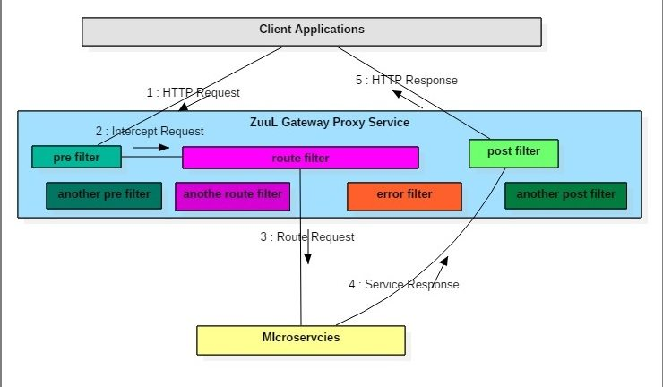
How Zuul Proxy Works

Slide 142
Zuul Proxy Server
  @EnableZuulProxy
  @SpringBootApplication
  public class ZuulGatewayProxyApplication {
  public static void main(String[] args) {
  SpringApplication.run(ZuulGatewayProxyApplication.class, args);
  }
  }

Slide 143
Connecting to Eureka
Eureka, is an an ideal component to integrate with Zuul proxy.
Need to deploy both a Eureka server and a Eureka client service
Once you have both components deployed
  Can connect them to Zuul, which can discover the Eureka client service from the Eureka server and proxy requests to it.

Slide 144
application.yml
  spring:
  application:
  name: api-gatway
  eureka:
  client:
  fetch-registry: true
  register-with-eureka: true
  service-url:
  defaultZone: http://localhost:8761/eureka
  server:
  port: 6060

Slide 145
Services Not Registered with Eureka
  zuul:
  routes:
  catlog-service :
  path: /catlog-service /**
  service-id: catlog-service
  ribbon:
  eureka:
  enabled: false
  catlog-service :
  ribbon:
  listOfServers: http://localhost:3030/, http://localhost:3033/

Slide 146
Services with Eureka and Ribbon
  zuul:
  host:
  socket-timeout-millis: 2000000
  ribbon:
  eager-load:
  enabled: true
  routes:
  catlog-service:
  path: /catlog-service/**
  url: http://localhost:3434/ => Host Name of Ribbon Cient
  http://localhost:6060/catalog-service/api/v1/catalogs

Slide 147
Zuul Filter
  public class MyPostFilter extends ZuulFilter {
  public boolean shouldFilter() {
  return true; }
  public Object run() throws ZuulException {
  System.out.println("INSIDE RESPONSE FILTER");
  return null;
  }
  public String filterType() {
  return "post";
  }
  public int filterOrder() {
  return 2;
  } }

Slide 148
Zuul Filter
  public class MyPreFilter extends ZuulFilter {
  public boolean shouldFilter() {
  return true; }
  public Object run() throws ZuulException {
  RequestContext ctx = RequestContext.getCurrentContext();
  HttpServletRequest request = ctx.getRequest();
  System.out.println("REQUEST METHOD: " + request.getMethod() + " Request URL : " + request.getRequestURL().toString());
  return null;
  }
  public String filterType() {
  return "pre"; }
  public int filterOrder() {
  return 1;
  } }

Slide 149
Deny Access to Certain Services
  @Override
  public Object run() {
  RequestContext ctx =RequestContext.getCurrentContext();
  Enumeration<String> list =ctx.getRequest().getHeaderNames();
  while(list.hasMoreElements()) {
  log.info(list.nextElement());
  }
  if(ctx.getRequest().getRequestURI().contains("tourist")) {
  ctx.setResponseStatusCode(400);
  ctx.setResponseBody("Zuul is preventing");
  ctx.setSendZuulResponse(false);
  }
    return null;
    }

Slide 150
Pre Filer
Can use the pre filter to authenticate the request, and if the request dose is not authorized
run () of pre filter.
  Add context.setSendZuulResponse(false);
  Other filters will still be called, but the request will not be redirected to the destination

Slide 151
Adding a CORS Filter
  @Bean
  public CorsFilter filter() {
  UrlBasedCorsConfigurationSource bean =new UrlBasedCorsConfigurationSource();
  CorsConfiguration config = new CorsConfiguration();
  config.setAllowCredentials(true);
  config.addAllowedOrigin("*");
  config.addAllowedHeader("*");
  config.addAllowedMethod("*");
  bean.registerCorsConfiguration("/**", config);
  return new CorsFilter(bean);
  }

Slide 152
FEIGN CLIENT

Slide 153
Rest Client Feign
Feign is a declarative web service client.
It makes writing web service clients easier.
Done by creating an interface and annotate it.
It support Spring MVC annotations by providing integrations for Spring Boot apps through autoconfiguration.
Spring Cloud integrates Ribbon and Eureka to provide a load balanced http client when using Feign.

Slide 154
Include Feign
Done By adding starter with artifact id
  spring-cloud-starter-openfeign.
  @SpringBootApplication
  @EnableDiscoveryClient
  @EnableFeignClients
  public class FeignclientApplication {
  public static void main(String[] args) {
  SpringApplication.run (FeignclientApplication.class, args);
  }
  }

Slide 155
@FeignClient
@FeignClient annotation is used to create a Ribbon load balancer
Feign works by processing annotations into a templatized request.
Arguments are applied to these templates in a straightforward fashion before output.
For application which are Eureka client
  Will resolve the service in the Eureka service registry.
  @FeignClient("SHOW-CUSTOMER-DETAILS")
  public interface MyClient {
  @RequestMapping(method = RequestMethod.GET, value = "/customer")
  List<LoanCustomer> findAll();
  }

Slide 156
Controller
  @RestController
  public class FeignController {
  @Autowired
  private MyClient loadBalancer;
  @GetMapping(value = "/client")
  public List<LoanCustomer> getCustomers() {
  return this.loadBalancer.findAll ();
  }
  }

Slide 157
Feign Hystrix Callback
  @EnableDiscoveryClient
  @EnableFeignClients
  @EnableCircuitBreaker
  feign.hystrix.enabled=true

Slide 158
Configuring Feign Client
  @FeignClient(name="SHOW-CUSTOMER-DETAILS“ fallback= HystrixClientFallback )
  public interface MyClient {
  @RequestMapping(method = RequestMethod.GET, value = "/customer")
  List<LoanCustomer> findAll();
  }

Slide 159
Feign Fallback Class
  @Component
  Class HystrixClientFallback implements MyClient{
  @Override
  public List<LoanCustomer> getCustomers () {
  return new ArrayList<>();
  }
  }

Slide 161
  @Bean
  public IClientConfig config() {
  return new DefaultClientConfigImpl();
  }
  @Bean
  public IRule ribbonRule(IClientConfig config) {
  //return new BestAvailableRule();
  IRule rule = new BestAvailableRule();
  return rule;
  }

Slide 162
  #server:
  # port: 7575
  #
  #spring:
  # application:
  # name: gateway-proxy-service
  #zuul:
  # host:
  # socket-timeout-millis: 2000000
  # ribbon:
  # eager-load:
  # enabled: true

Slide 163
  ###hystrix:
  ## command:
  ## default:
  ## execution:
  ## isolation:
  ## thread:
  ## timeoutInMilliseconds: 60000
  #

Slide 164
http://localhost:3232/actuator/filters
http://localhost:3232/actuator/routes

Slide 165
HttpServletRequest request = RequestContext.getCurrentContext().getRequest(); HttpServletResponse response = RequestContext.getCurrentContext().getResponse(); logger.info("REQUEST :: < " + request.getScheme() + " " + request.getLocalAddr() + ":" + request.getLocalPort()); logger.info("REQUEST :: < " + request.getMethod() + " " + request.getRequestURI() + " " + request.getProtocol()); logger.info("RESPONSE:: > HTTP:" + response.getStatus()); return null;

