Slide 1
Real Estate Buyer Segmentation
Internship project presentation
Machine Learning & Investment Profiling
End-to-end synthetic-data demonstration
Python | Scikit-learn | Streamlit

Slide 2
Business Problem
Buyer behavior varies by purpose, geography, financing and purchasing capacity.
Generic targeting can reduce marketing relevance.
Goal: discover buyer groups and translate patterns into testable business actions.

Slide 3
Project Objectives
Clean and understand buyer data.
Perform exploratory data analysis.
Build and evaluate clustering models.
Interpret segments and create an interactive dashboard.

Slide 4
Dataset Overview
1,512 raw rows including 12 intentional duplicates.
1,500 unique buyers after deduplication.
Original brief fields plus synthetic income, budget and units extensions.
All records are synthetic—not real company customers.

Slide 5
Data Preparation
Remove duplicate client IDs.
Impute categorical missing values using mode.
Impute satisfaction score using median.
Derive age from date of birth.
One-hot encode categorical variables and standardize numeric variables.

Slide 6
Modeling Approach
K-Means evaluated for k = 2 through 8.
Elbow method examines within-cluster inertia.
Silhouette score evaluates separation and cohesion.
Agglomerative hierarchical clustering provides a comparison.

Slide 7
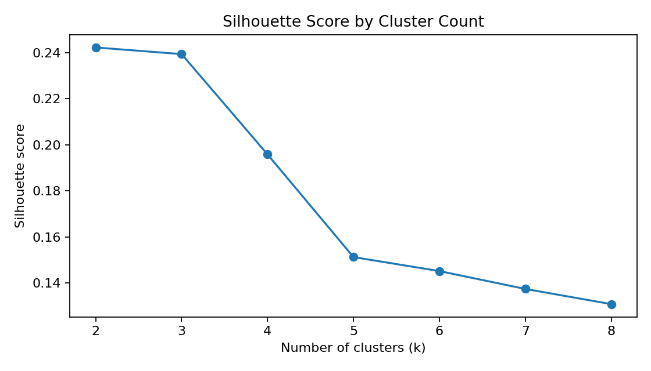
Model Evaluation
Selected K-Means cluster count: 2.
K-Means silhouette: 0.242.
Hierarchical sample silhouette: 0.248.
Separation is modest; do not overstate model quality.

Slide 8
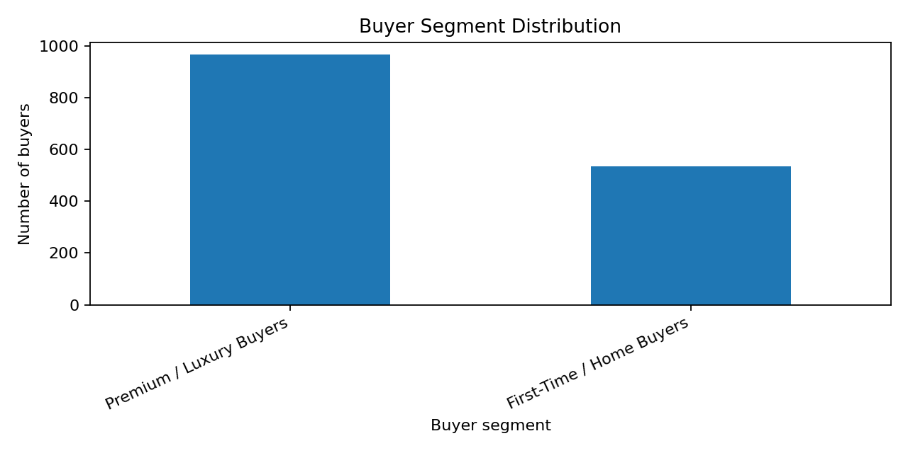
Buyer Segments
Higher-budget investment-oriented buyers: older profile, lower loan usage, more units of interest.
Younger personal-use buyers: lower budgets, higher loan usage, typically one unit.
Labels describe observed synthetic cluster profiles, not ground-truth identities.

Slide 9
Business Recommendations
Test premium portfolio and investment-focused outreach for investment-oriented buyers.
Test first-home education, affordability tools and financing guidance for personal-use buyers.
Measure qualified leads, conversion, campaign cost and satisfaction.

Slide 10
Streamlit Dashboard
Interactive filters: country, region, acquisition purpose and client type.
KPI cards, segment distribution and regional purpose analysis.
Financing mix, budget distribution, cluster profile and CSV export.

Slide 11
Limitations & Responsible Use
Synthetic data cannot represent actual market behavior.
Income and budget are generated extensions, not supplied source facts.
Validate on consented real data; assess privacy, fairness, cluster stability and drift.

Slide 12
Conclusion
A reproducible end-to-end segmentation prototype has been built.
Current generated sample yields two broad clusters with modest separation.
Validate with authentic data and business stakeholders before deployment.

