Slide 1

SONG RECOMMENDATION
GROUP 6
COLLABORATORS :
Sowmini Margonda Rakesh Varri Arshiya Taiba

Slide 2
CONTENTS
1.INTRODUCTION & OBJECTIVES
2.WEB SCRAPPING
3.DATA PREPROCESSING
4.EXPLORATORY DATA ANALYSIS (EDA)
5.MODEL BUILDING
6.DEPLOYMENT
7.CONCLUSION

Slide 3
INTRODUCTION
Spotify, one of the leading music streaming platforms globally, boasts a vast library of millions of songs, catering to a diverse user base with varied musical tastes. With such an expansive collection, helping users discover new music that resonates with their preferences is both a challenge and an opportunity. This project aims to tackle this challenge by developing a song recommendation system tailored for Spotify users.
The primary objective of this project is to create a data-driven recommendation system that enhances user experience by providing personalized song suggestions. By leveraging Spotify's rich dataset, which includes information about user listening habits, song attributes, and metadata, we will explore various recommendation techniques such as collaborative filtering, content-based filtering, and hybrid models.
The project will involve several key stages, including data collection from Spotify's API, data preprocessing, exploratory data analysis (EDA), model development, and evaluation. We will investigate how different algorithms can be employed to understand user preferences and predict songs that users are likely to enjoy.
By the end of this project, we aim to develop a robust recommendation system that not only personalizes the user experience on Spotify but also broadens users' musical horizons by introducing them to new and relevant tracks.

Slide 4
OBJECTIVES
User Personalization: Develop a recommendation system that provides personalized song recommendations based on individual user preferences, listening history, and interaction patterns.
Collaborative Filtering: Implement collaborative filtering techniques to identify patterns among users with similar music tastes, enabling recommendations of songs that similar users have liked.
Real-Time Recommendations: Ensure that the recommendation system can process and provide real-time suggestions based on users' most recent activities and preferences.
Diversity and Novelty: Design the system to introduce users to a diverse range of music, balancing familiar recommendations with novel suggestions to enhance user discovery.
Evaluation and Optimization: Continuously evaluate the performance of the recommendation model using metrics like precision, recall, and F1-score, and optimize the model for better user engagement and satisfaction.
Scalability: Ensure that the recommendation system is scalable and can handle large datasets, accommodating millions of users and songs without performance degradation.

Slide 5

Web Scrapping
To extract data for your song recommendation project, you’ll need to scrape relevant information from websites. Here are some techniques you can use:
1
Manual Web Scraping: This involves manually inspecting HTML code and extracting data. While it’s time-consuming, it can be useful for small-scale or one-time scraping projects.
2
Automated Web Scraping Tools: Consider using tools like Python’s Beautiful Soup or Scrapy. These streamline the process and handle larger-scale projects
3
HTTP Requests: Send HTTP Requests to the websites you want to scrape.
4
HTML Parsing: Use Libraries like Beautiful Soup to extract data from the HTML Code.
5
Data Storage : Save the extracted data in the structured format e.g. CSV, JSON, Database.

Slide 6

Data Preprocessing
Data Preprocessing:
Handle missing values in your dataset.
Convert data types (e.g., datetime format for Release Date).
Perform feature engineering

Slide 7
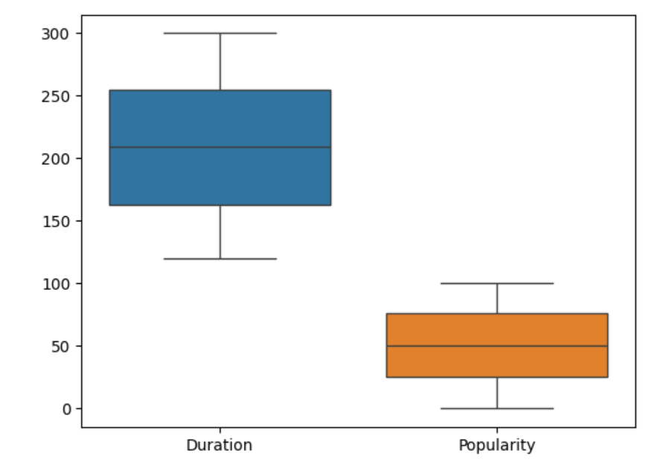
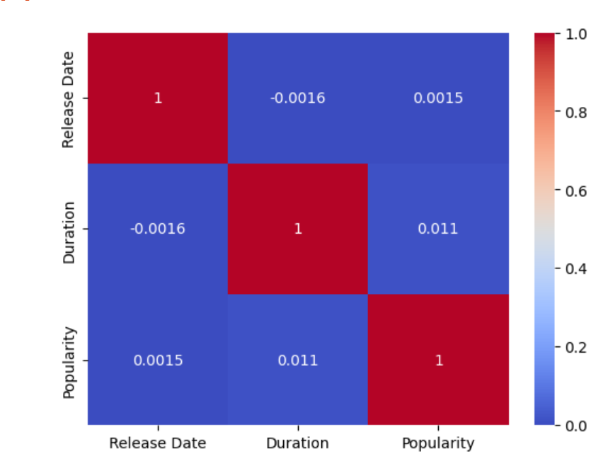
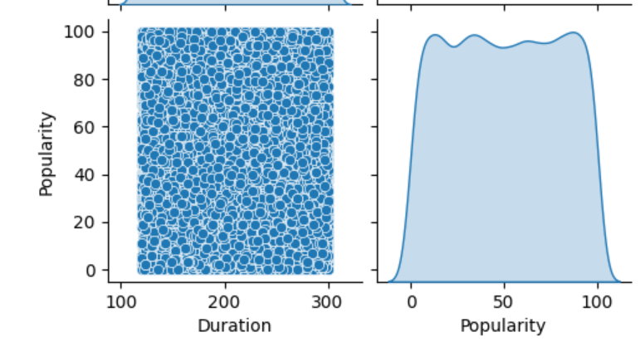
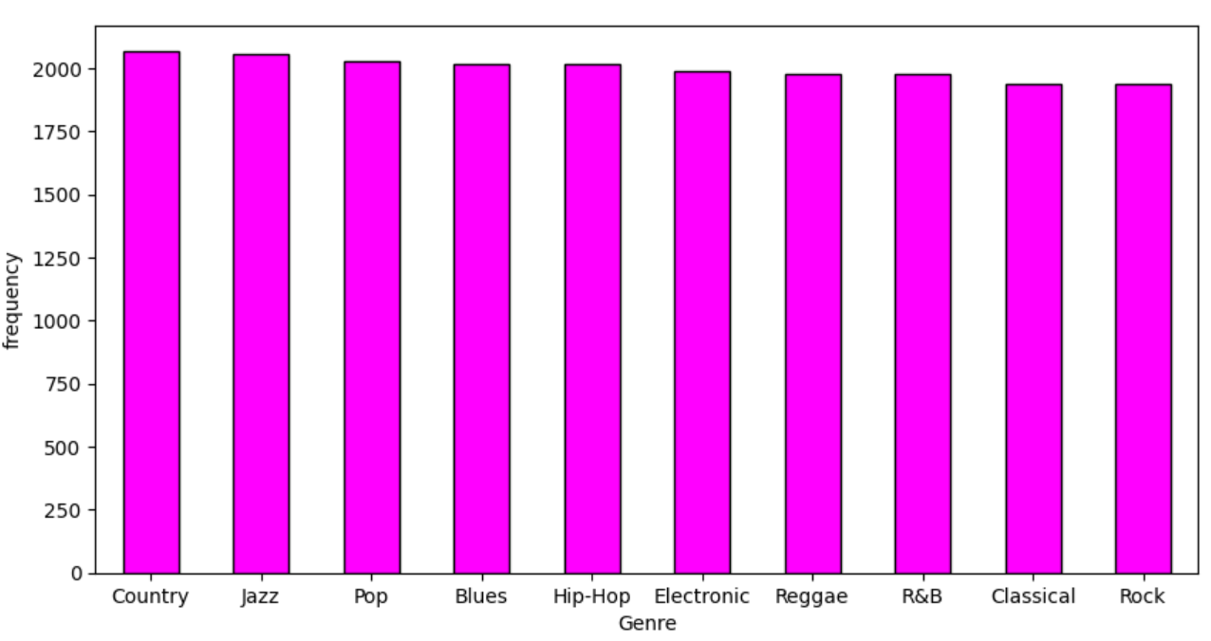
Exploratory Data Analysis (EDA)
Analyze song popularity across genres or artists.
Create visualizations (plots) to understand trends over time.

Slide 8
MODEL BUILDING
Content-Based Filtering: Use song features (e.g., Genre, Artist) to recommend similar songs. Calculate cosine similarity.
1
Hybrid Models: Combine content-based and collaborative filtering approaches.
2
NLP Concepts: Explore using natural language processing for recommendation systems.
3
Model Evaluation:
4
Evaluate your model using metrics like Precision@k, Recall@k, Mean Average Precision, and Mean Squared Error (for regression tasks).

Slide 9
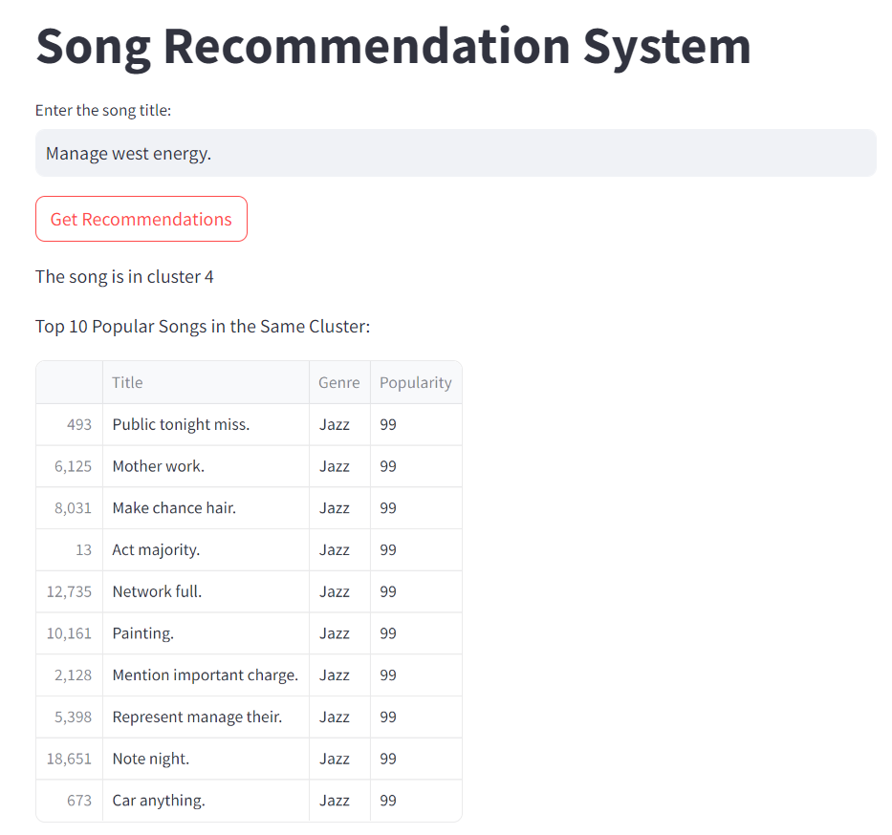

DEPLOYMENT
Integrate your recommendation model into a web or mobile application.
Set up a database to store user preferences and dynamically update recommendations based on user interactions.

Slide 10

Continuous Improvement
Feedback Loop: Implement a mechanism for users to provide feedback on the recommendations they receive. Use this feedback to fine-tune the model and improve future recommendations.
Regular Updates: Periodically retrain your recommendation model with fresh data. This ensures that your recommendations stay relevant as user preferences evolve.

Slide 11
CHALLENGES
1. Data Quality Issues
Challenge:
Inconsistent or incomplete metadata (e.g., missing genre tags, incorrect artist names).
Presence of duplicate songs.
Noise in user interaction data (e.g., bots generating fake play counts).
Solution:
Data Cleaning: Implement data preprocessing techniques to clean the dataset. This includes handling missing values, normalizing artist and song names, and removing duplicates.
Filtering: Apply filters to remove noise by identifying and eliminating anomalous patterns, such as unusually high play counts from specific users.
2. Data Sparsity
Challenge:
Sparse user-item interaction matrix due to the vast number of songs and relatively few user interactions per song.
Solution:
Dimensionality Reduction: Use techniques like Singular Value Decomposition (SVD) or Principal Component Analysis (PCA) to reduce the dimensionality of the interaction matrix.
Cold Start Problem: Implement hybrid models that combine collaborative filtering with content-based filtering to recommend songs to new users or recommend new songs.

Slide 12
3. Model Selection and Tuning
Challenge:
Deciding on the most suitable recommendation model (e.g., collaborative filtering, content-based, or hybrid) and tuning hyperparameters for optimal performance.
Solution:
Cross-Validation: Use cross-validation techniques to evaluate different models and their parameters.
Automated Hyperparameter Tuning: Implement automated tuning methods like grid search or Bayesian optimization to find the best model parameters.
4. Personalization vs. Diversity
Challenge:
Balancing between recommending songs that are highly personalized and ensuring diversity in recommendations to prevent the "filter bubble" effect.
Solution:
Diversity Metrics: Introduce diversity metrics in the evaluation process and penalize models that over-personalize.
Blending Models: Combine multiple recommendation strategies to ensure a balance between personalization and diversity (e.g., a weighted combination of collaborative filtering and content-based filtering).
5. Real-Time Recommendations
Challenge:
Generating recommendations in real-time as users interact with the platform, especially during peak usage.
Solution:
Real-Time Data Processing: Utilize streaming platforms like Apache Kafka to process data in real time.
Cache Results: Precompute and cache recommendations for users based on their historical data and update periodically.

Slide 13

CONCLUSION
Further Analysis: Deep dive into individual clusters to understand the nuances and preferences within each group.
Actionable Recommendations: Use the insights from the clusters to design targeted marketing campaigns or create curated playlists for specific audience segments.

Slide 14

THANK YOU ALL

