Slide 1
MasterThesis: StockTrendPrediction
Introduction / Motivation: Regime Shifts in Stock Price Movements

Slide 2
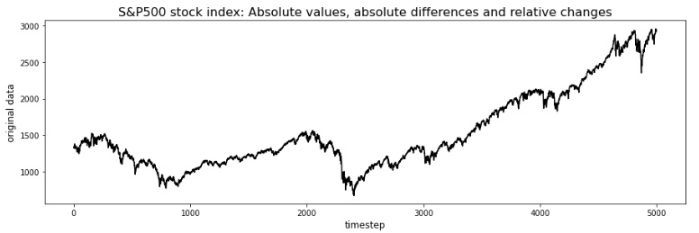
stationary vs. non-stationary
1st step: de-trend timeseries of absolute values
  Usually find some long-term exponential trend
  Plus series of „bear“ vs. „bull“ markets

Slide 3
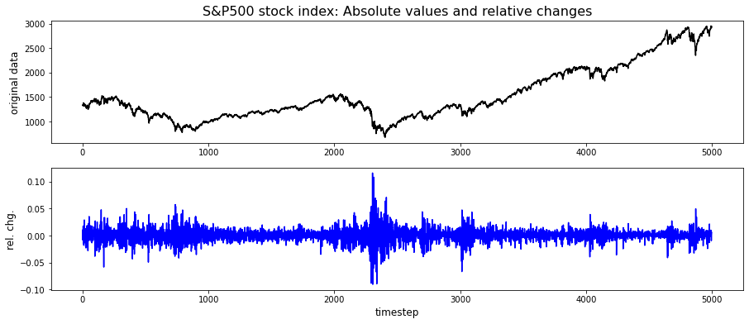
stationary vs. non-stationary
high-volatility regime

Slide 4
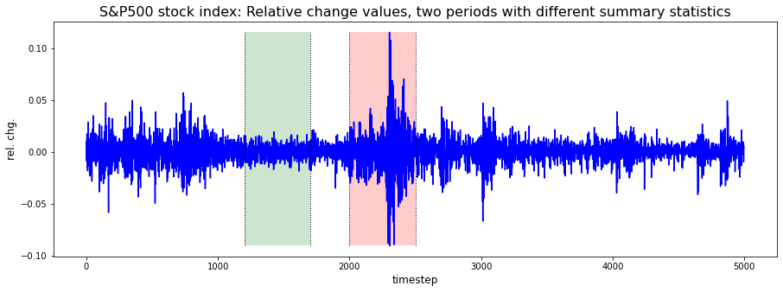
stationary vs. non-stationary
mean: 0.0 0.0
std dev: 0.006 0.022

