Slide 1


Slide 2
What we are going to look?
Version Control System
History of Git
Introduction of Git
Git vs others
Git Installation
Common Commands of Git
Working with Git
Branching and Merging
Working with remote

Slide 3
Version Control
Version control is the system that records the changes that occurs on file or any system over a time so that specific version or changes can be recovered or traced later in due course or development or debugging.
Generally there are two types of version control system:
Centralized VCS
Distributed VCS

Slide 4

What is Git?
In software development, git is a distributed version control and source code management (SCM) system with an emphasis on speed.
Initially designed and developed by Linus Torvalds for linux kernel development in 2005.
Everything is local
Git is fast
Git is small
Any workflow

Slide 5
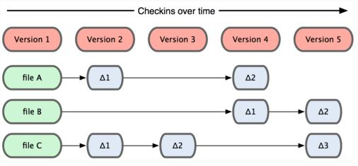
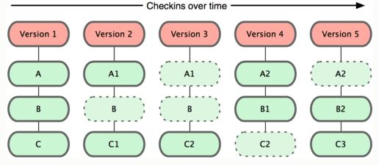
Data storage in Git:
Data storage in others
General data storage in git
Instead of saving or replacing entire file, only difference are saved and tracked.

Slide 6
Git vs x?
Git is distributed VCS
Almost everyting is local because everybody has their own repository.
Making branches and merging between branches is really easy.
Maintains integrity.

Slide 7
Git Installation?
Only windows installation process:
For this just download Git from http://msysgit.github.com/ and run the setup. After completing installation you will get both a command line version and the standard GUI.
After installation we have setup our identity which will be used through out our project when committing.
$ git config --global user.name <username>
$ git config --global user.email <email>

Slide 8
Command git command:
git init
git clone <ulr>
git status
git add <filename>
git commit –m ‘msg’
git push
git pull
git log
git fetch
git branch
git merge <branch>

Slide 9
Working with Git? Getting git repository?
Self initialization:
$ git init
Cloning remote repository into local directory:
$ git clone <url>
When we initialize a git repo .git directory is added into our local directory which contains all the informtion required for git repository.

Slide 10
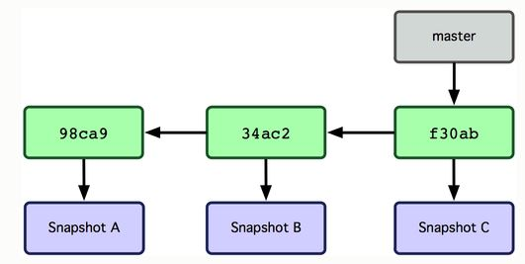
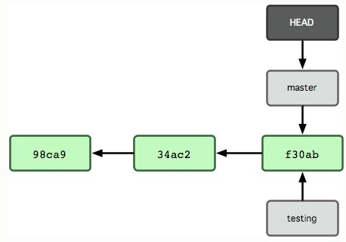
Branching in git?
Branching means that you diverge from the main line and continue to work without disturbing the main line.
The default branch name in a Git is master. When you commit for the first time you land on a master branch that points to the last commit you made as shown below:
What is HEAD?
When you make a new branch say testing

Slide 11
Syntax for branching?
$ git branch testing // creates branch with the name testing
$ git checkout testing // switch branch to testing
$ git checkout –b testing // creates branch testing and also switches to the same branch
$ git branch // list out all the branches
$ git branch –d testing // deletes branch testing but if the branch is still left to merge then git throws error msg
$ git branch –D testing // deletes branch regardless of merging

Slide 12
Merging in Git?
Merging is the process of including extended branch into the parent branch.
Generally in git we have three types of merging
Normal merge
Fast forward merge
Rebase merge

Slide 13
Fast Forward Merge?
Let us consider you have a branch testing other than master and you made some commit on testing and if there is no any commits made on master branch then you can merge each and every commits of second branch directly into your master without any conflict then this is called fast forward merge.
TESTING
HEAD
MASTER
MASTER
TESTING

Slide 14
Rebase Merge?
Let us consider a scenario that you have a branch named testing and you made some commit on that branch. Meanwhile there is also some commits on master branch then now if you want to merge setting into master then you cannot have fast forward merge i.e. you cannot have clean merge. So you conduct rebase so that all the commits that occur on master branch is first included on your testing branch and those commits that you have on testing branch comes only after commits of master branch. Now you can have fast forward merge.
MASTER
TESTING
HEAD
MASTER
TESTING

Slide 15
Command line for merging?
$ git merge <branch> // merge occures to the branch on which you are sitting generally done being on master
$ git rebase master // generally done being on branch

Slide 16
Working with remote?
Remote repositories are versions of your project that are hosted on the Internet or network somewhere. You can have several of them, each of which generally is either read-only or read/write for you.
dev1
dev2
Remote repo
dev4
dev3

Slide 17
Command for working with remote?
$ git remote // list all the remote server that you list
$ git remote add [alias] [url]
Eg, git remote add dev1 https://www.github.com/rakesmh/demo.git

Slide 18
References:
http://www.git-scm.com/

Slide 19
End of the slide
Thank you!

