Slide 1
Outline
Overview of web services
Create a web service with MS .Net
Requirements for project Phase II

Slide 2
What is a Web Service
A web service is a network accessible interface to application functionality, built using standard Internet technologies.
Clients of web services do NOT need to know how it is implemented.
Network
Web
Service
Application
client
Application
code

Slide 3
Web Service Technology Stack
shopping web service?
WSDL URIs
Web Service
Client
UDDI
Discovery
Description
Web Service
WSDL
WSDL
SOAP pkg request
Packaging
Proxy
SOAP pkg response
Transport
Network

Slide 4
Step1. Write Web Service Method
shopping web service?
WSDL URIs
Web Service
Client
UDDI
Discovery
Description
Web Service
WSDL
WSDL
SOAP pkg request
Packaging
Proxy
SOAP pkg response
Transport
Network

Slide 5
Step2. Describe Web Service using WSDL
shopping web service?
WSDL URIs
Web Service
Client
UDDI
Discovery
Description
Web Service
WSDL
WSDL
SOAP pkg request
Packaging
Proxy
SOAP pkg response
Transport
Network

Slide 6
Step3. Write Proxy to Access Web Service
shopping web service?
WSDL URIs
Web Service
Client
UDDI
Discovery
Description
Web Service
WSDL
WSDL
SOAP pkg request
Packaging
Proxy
SOAP pkg response
Transport
Network

Slide 7
Step4. Write Client to Invoke Proxy
shopping web service?
WSDL URIs
Web Service
Client
UDDI
Discovery
Description
Web Service
WSDL
WSDL
SOAP pkg request
Packaging
Proxy
SOAP pkg response
Transport
Network

Slide 8
Step1. Create a Web Service
Functionality is implemented in .asmx.vb or .asmx.cs files.
  <%@WebService Language=“C#” Class=“helloWorld” %>
Use System.Web.Services Namespace
  Using System.Web.Services
Inherit your own class from WebService Base Class
  public class helloWorld : System.Web.Services.WebService
Declare the WebMethod Attribute
  [WebMethod]
  public string HelloWorld(string name)
  {…}

Slide 9
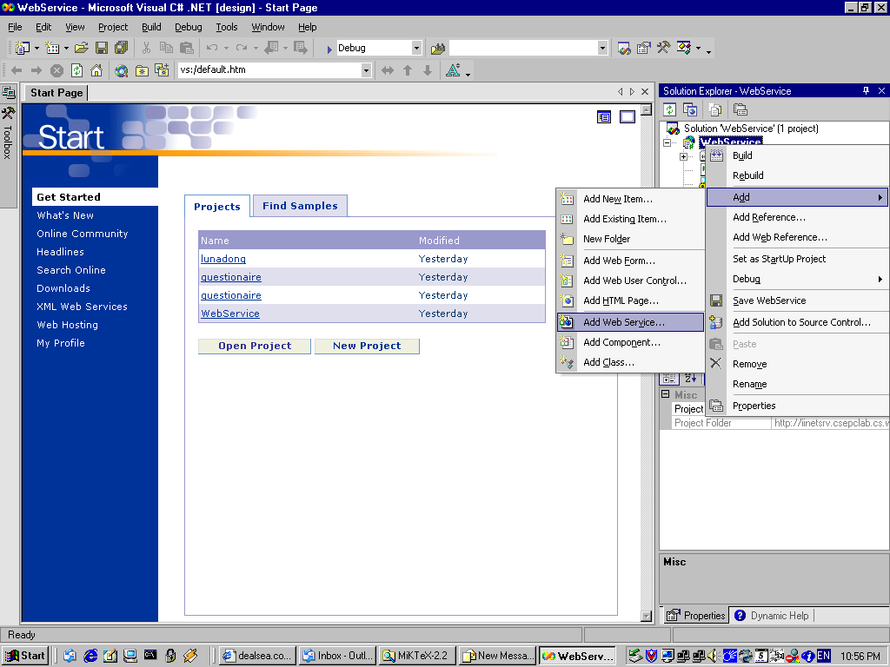
Creating a Web Service with .Net

Slide 10
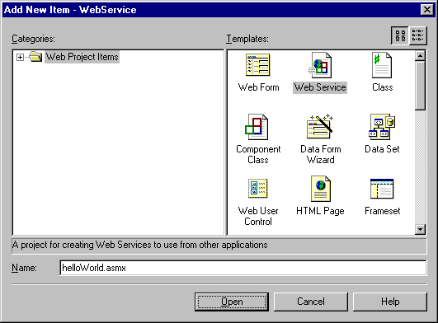
Creating a Web Service with .Net

Slide 11
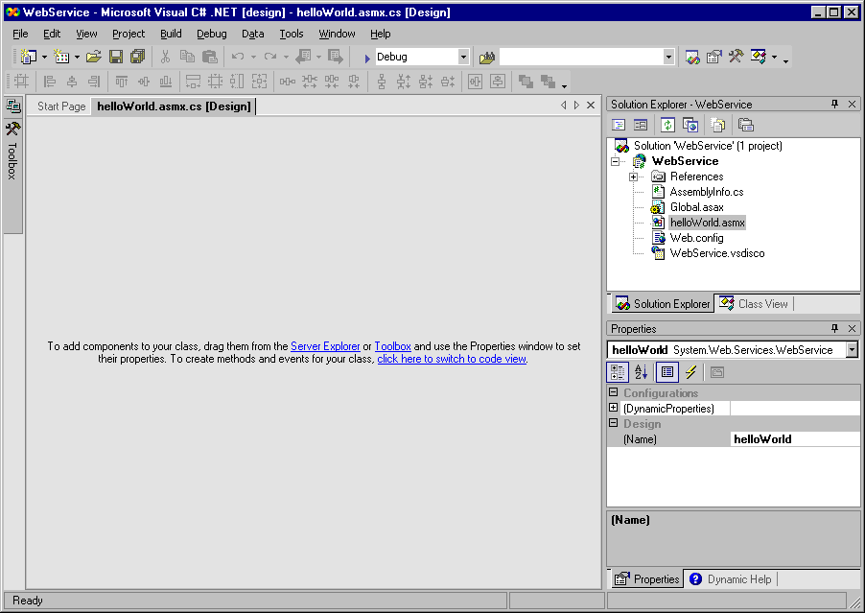
Creating a Web Service with .Net

Slide 12
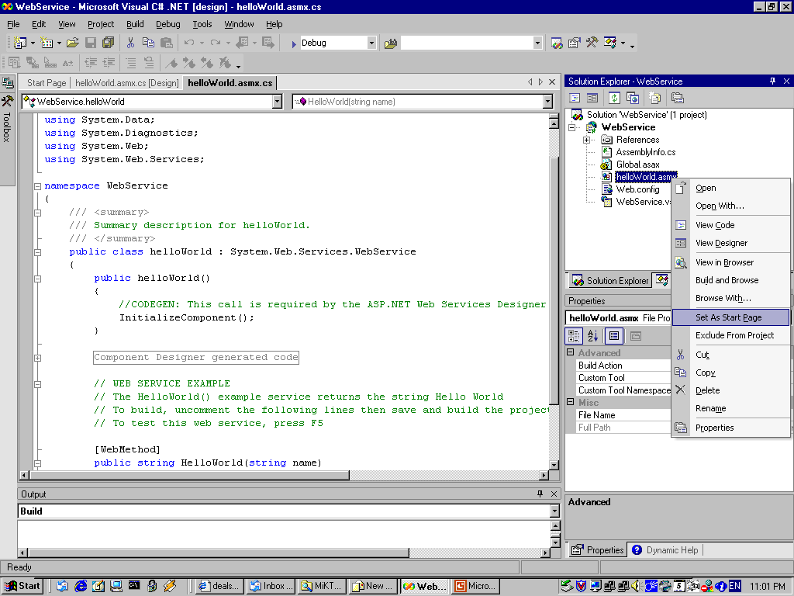
Creating a Web Service with .Net

Slide 13
Creating a Web Service with .Net
[WebMethod]
public string HelloWorld(string name)
{
return "Hello " + name;
}

Slide 14
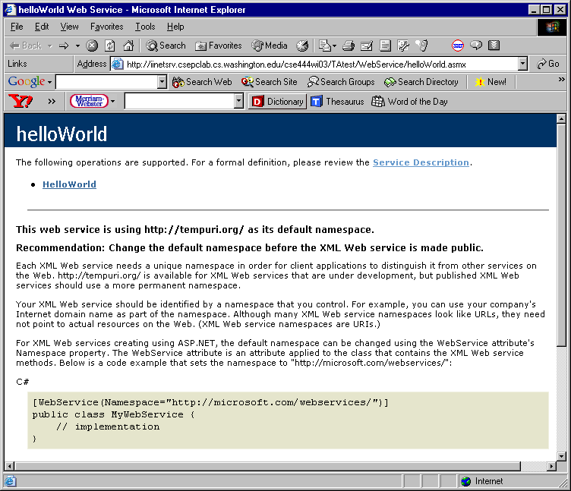
Compile and View Your Web Service

Slide 15
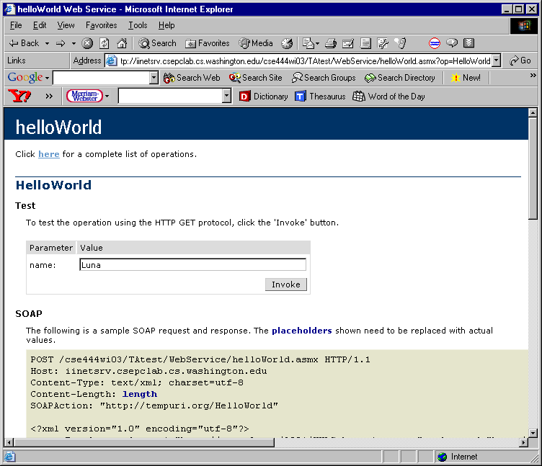
Compile and View Your Web Service

Slide 16
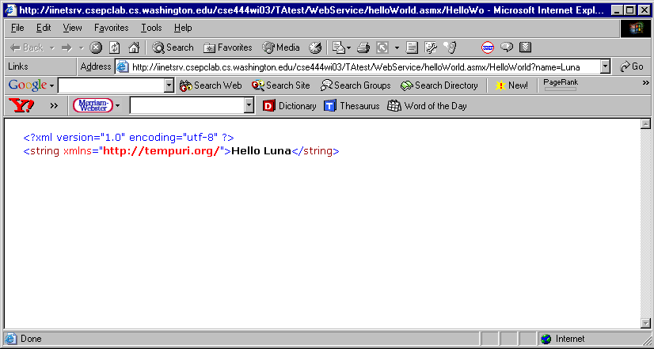
Compile and View Your Web Service

Slide 17
Step2. Describe Web Service using WSDL
WSDL (Web Services Description Language)
Describes 3 ways to access web service: GET, POST, SOAP
Element:
  <types>: XML schema for input/output
  <message>:
    HelloWorldSoapIn, …SoapOut, …HttpGetIn, …HttpGetOut, …HttpPostIn, …HttpPostOut
  <porttype>
    helloWorldSoap, …HttpGet, …HttpPost
  <binding>
    s0:helloWorldSoap, s0:…HttpGet, s0:…HttpPost
  <service name = “helloWorld”>
  <port name = “…Soap” binding = “s0:…Soap”>
  <soap:address location = “http://…”/>
  </port></service>

Slide 18
WSDL Generated by .NET

Slide 19
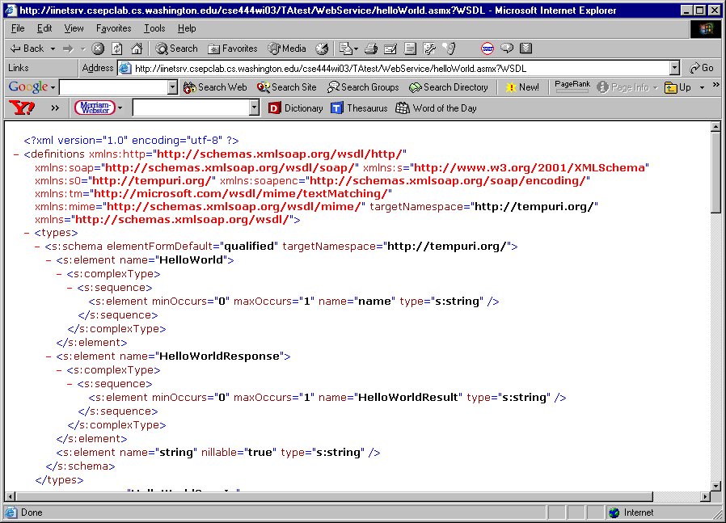
WSDL Generated by .NET

Slide 20
SOAP (Simple Object Access Protocol)
SOAP Messages
Using SOAP as RPC (Remote Procedure Call) Messages
SOAP client SOAP server
Request message
Response message

Slide 21
Step3. Write Proxy to Access Web Service
In software, a proxy is the code that does work on behalf of other code.
  For web service users, the proxy represents the web service the users wish to call
  For web service servers, the proxy makes request on the behalf of the user

Slide 22
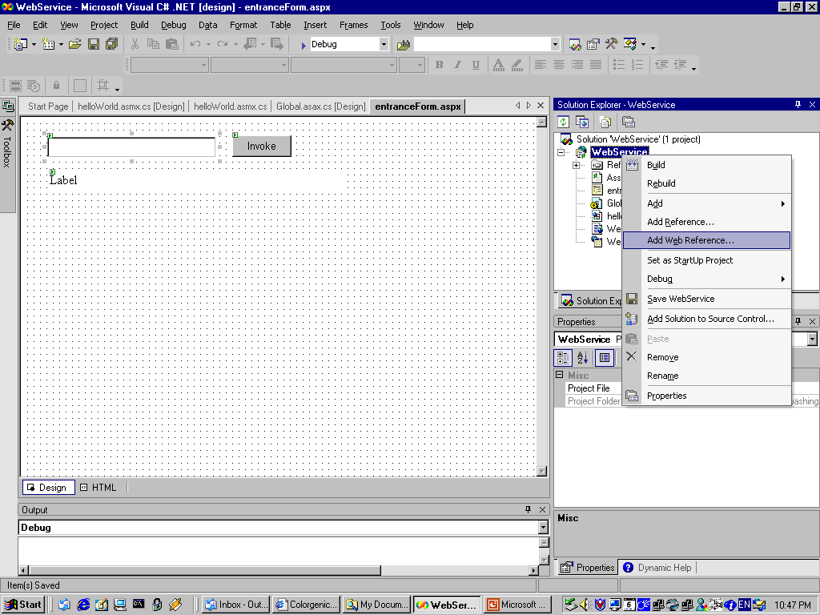
Create a Proxy (Web Reference) with .Net

Slide 23
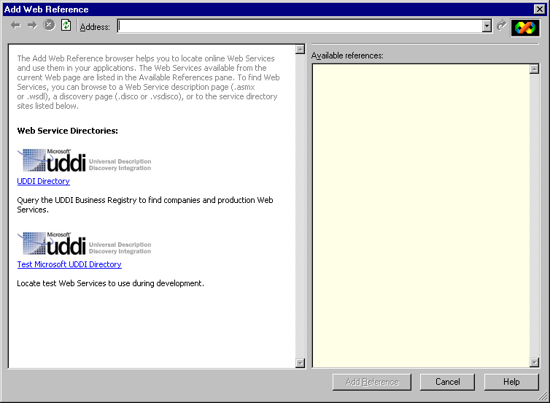
Create a Proxy (Web Reference) with .Net

Slide 24
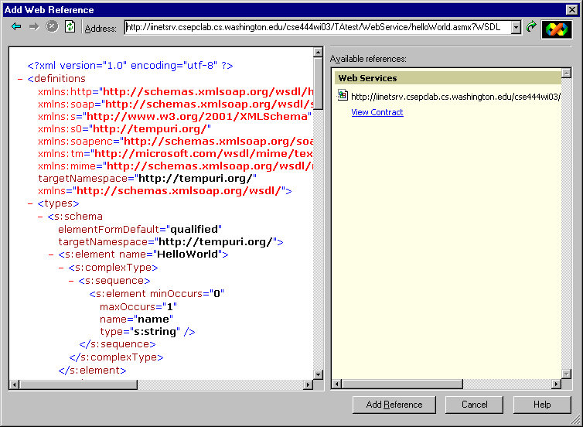
Create a Proxy (Web Reference) with .Net

Slide 25
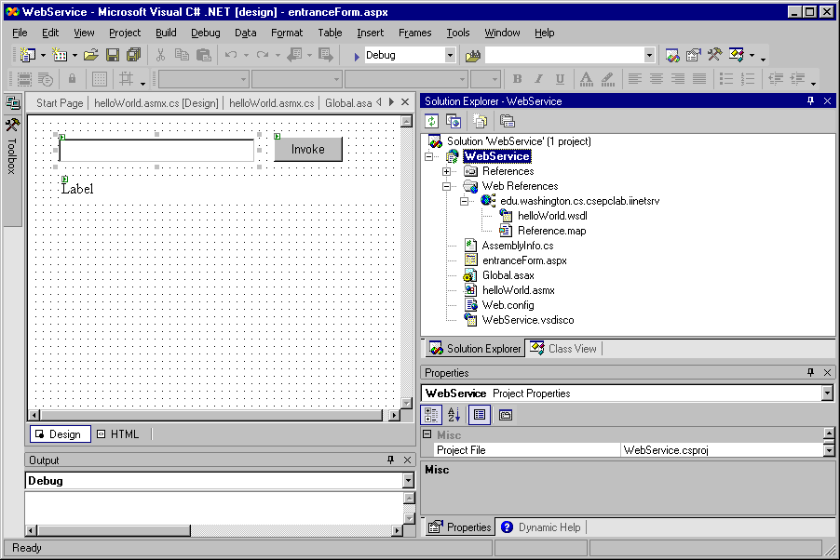
Create a Proxy (Web Reference) with .Net

Slide 26
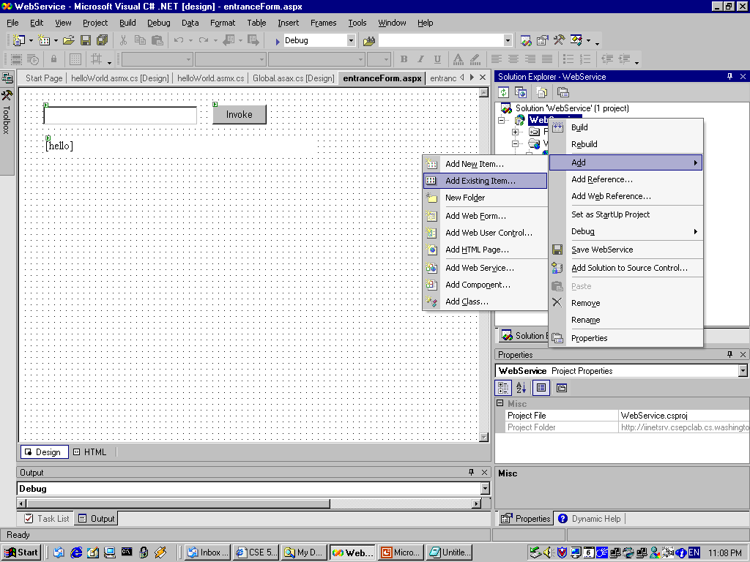
Read Code for Proxies

Slide 27
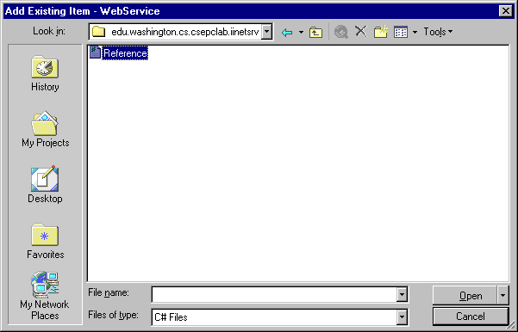
Read Code for Proxies

Slide 28
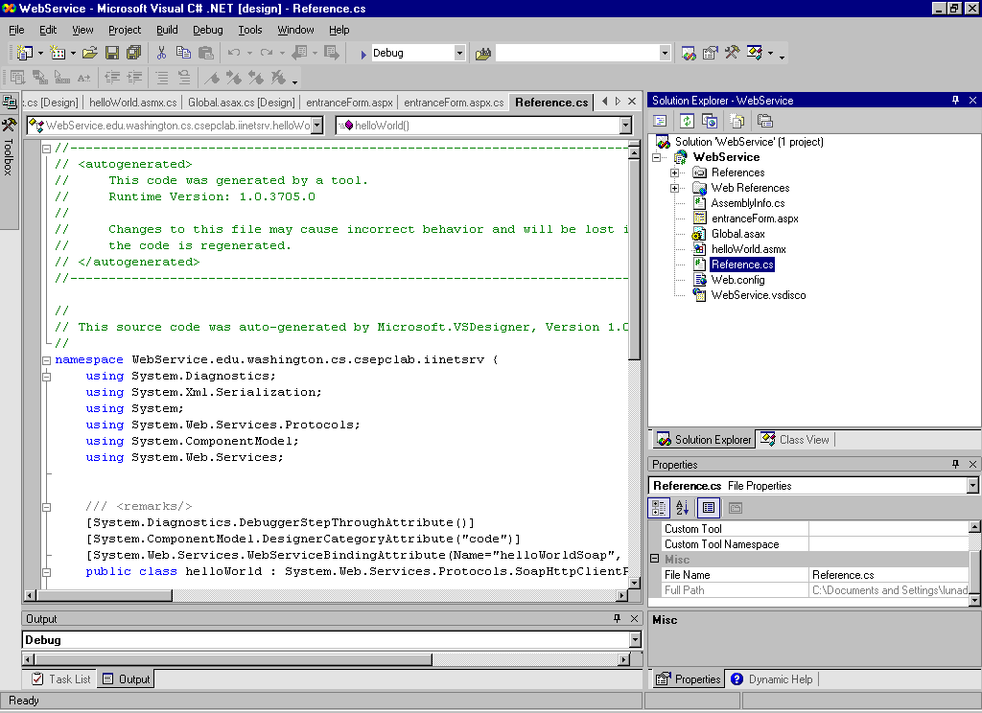
Read Code for Proxies

Slide 29
Read Code for Proxies
public class helloWorld : System.Web.Services. Protocols.SoapHttpClientProtocol
{
public helloWorld() {
this.Url = "http://iinetsrv.csepclab.cs.washington .edu/cse444wi03/TAtest/WebService/helloWorld. asmx";
}
…

Slide 30
Step4. Write a Client to Invoke Proxy

Slide 31
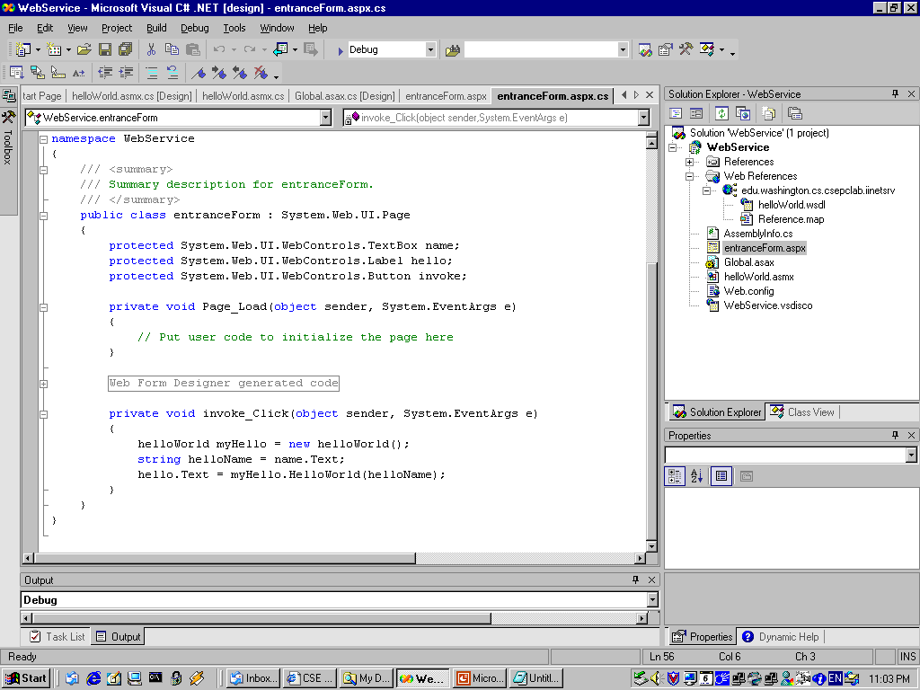
Step4. Write a Client to Invoke Proxy

Slide 32
Step4. Write a Client to Invoke Proxy
private void invoke_Click(object sender, System.EventArgs e)
{
helloWorld myHello = new helloWorld();
string helloName = name.Text;
hello.Text = myHello.HelloWorld(helloName);
}

Slide 33
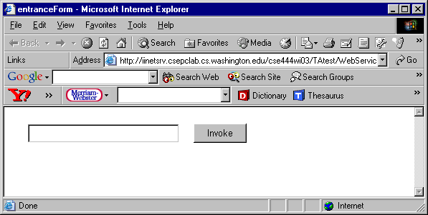
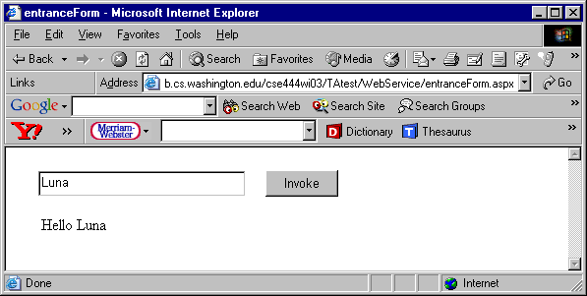
Step4. Write a Client to Invoke Proxy

Slide 34
Requirements for project Phase II
Write your web services
  Class name: [your_group_name]_webService. For example, RBM_webService
  4 Methods: details on project info webpage
Write a simple client for each web method
  Input: text boxes (with default value)
  Invoke button
  Output: label

Slide 35
Enjoy

