Slide 1
Customer Shopping Behavior Analysis
Uncovering insights from 3,900 purchases to drive strategic decisions

Slide 2
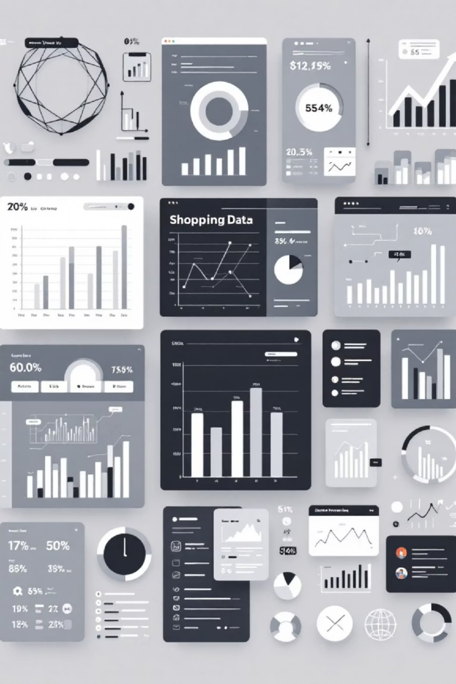
Dataset Overview
3,900
Total Purchases
Transactions analyzed across all categories
18
Data Columns
Comprehensive customer and purchase attributes
50
Locations
Geographic diversity in customer base
25
Products
Unique items across four categories

Slide 3
Data Preparation Journey
01
Data Loading & Exploration
Imported dataset using pandas, analyzed structure with df.info() and summary statistics
03
Feature Engineering
Created age_group bins and purchase_frequency_days columns for deeper analysis
02
Missing Data Handling
Imputed 37 missing Review Rating values using median rating per category
04
Database Integration
Connected to PostgreSQL and loaded cleaned data for SQL analysis

Slide 4
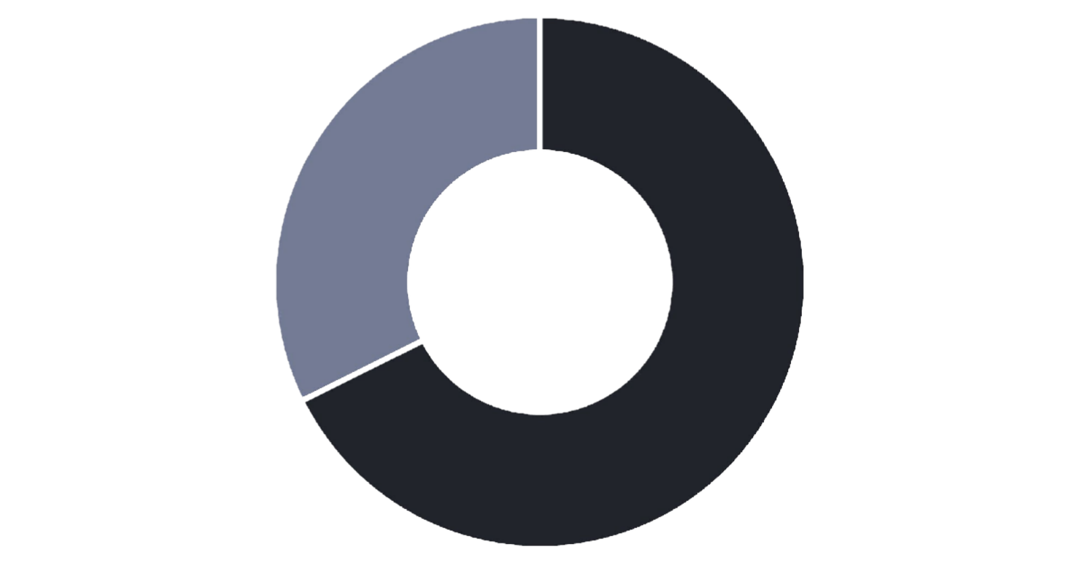


Revenue by Gender
Male customers drive 68% of total revenue
Male shoppers generated $157,890 compared to
$75,191 from female customers
Consider targeted campaigns to increase female customer engagement and spending
Male
Female

Slide 5
Top Products & Customer Ratings
1
2
3
Gloves
Average rating: 3.86
Sandals
Average rating: 3.84
Boots
Average rating: 3.82
4
5
Hat
Average rating: 3.80
Skirt
Average rating: 3.78

Slide 6

Shipping & Spending Patterns
Express Shipping
$60.48 average purchase
Premium shipping customers spend 3.5% more per transaction
Standard Shipping
$58.46 average purchase
Majority of customers prefer standard delivery option
Express shipping users represent high-value customer segment worth targeting

Slide 7


Subscription Status Analysis
Revenue Breakdown
Subscribers: $62,645 total revenue
Non-subscribers: $170,436 total revenue
Average spend nearly identical: $59.49 vs $59.87
27%
Massive opportunity: Converting non-subscribers could significantly boost recurring revenue
Subscribers
1,053 customers with subscriptions
73%
Non-Subscribers
2,847 customers without subscriptions

Slide 8



Customer Segmentation Insights
Loyal
3,116 customers
Returning
701 customers
New
83 customers
80% of customer base classified as loyal - strong retention foundation with opportunity to convert returning customers

Slide 9
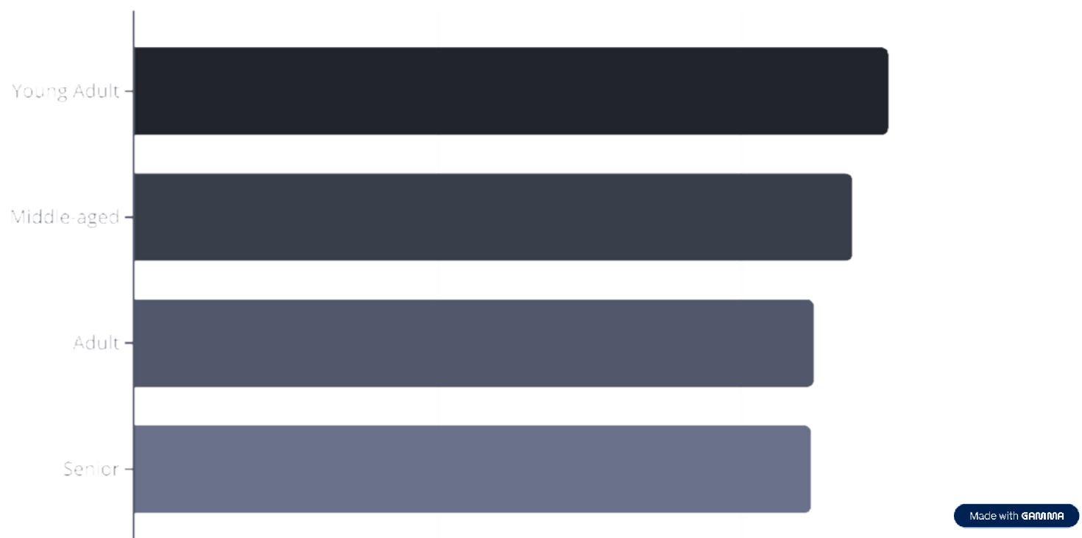
Revenue by Age Group

Slide 10





Strategic Recommendations
Boost Subscriptions
Promote exclusive benefits to convert 73% non-subscriber base
Loyalty Programs
Reward repeat buyers to move returning customers into loyal segment
Review Discount Policy
Balance sales boosts with margin control - 839 high spenders used discounts
Targeted Marketing
Focus on high-revenue age groups and express-shipping users
Product Positioning
Highlight top-rated items like Gloves and Sandals in campaigns

