Slide 1

Add function:
User Group
Explain:
- Students in class will be divided into few groups.
- Three people will be in a group.
- Members in a group can login in the their own group simultaneously, and edit the content at the same time.
Group 1
Group 2
Group 3
Group 4
Group 5

Slide 2
Add function:
Let student raise a question when they encounter a problem at home so that we can promptly give them the answer to the problem.
I have a question
Chatting room
Content analysis
If it can not work, it’ll be ok.
Quality research (group interview) will be carried out to prove students’ self regulation behavior.

Slide 3
Theme, purpose,
Add theme
Change order
The reason
Reason 1
Reason 2
*
Explain:
1. The reason why I choose this topic which can give my audience impressive settings, inspiration of education, and solutions of current educational difficulties.
2. Are there any reasons why I revise or adjust content in my storytelling?
Prompts
Short essay :
feedback from
my team members
feedback from peers
feedback from my instructor
else: ___________

Slide 4
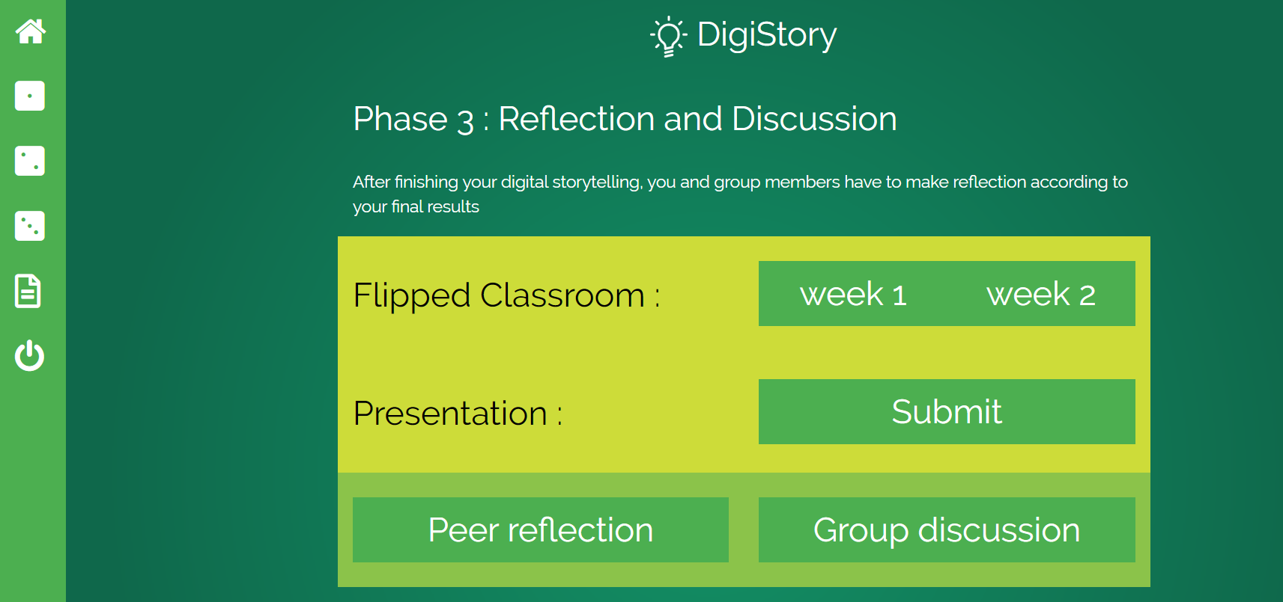

Slide 5
Phase 3 : Reflection and discussion
Phase 1
Feedback from my peers
Phase 2
Feedback from my peers
Phase 3
Feedback from my peers
Presentation
Submit
Upload your product
(file: ppt, URL )
2 Questions
Final personal and group reflection

Slide 6
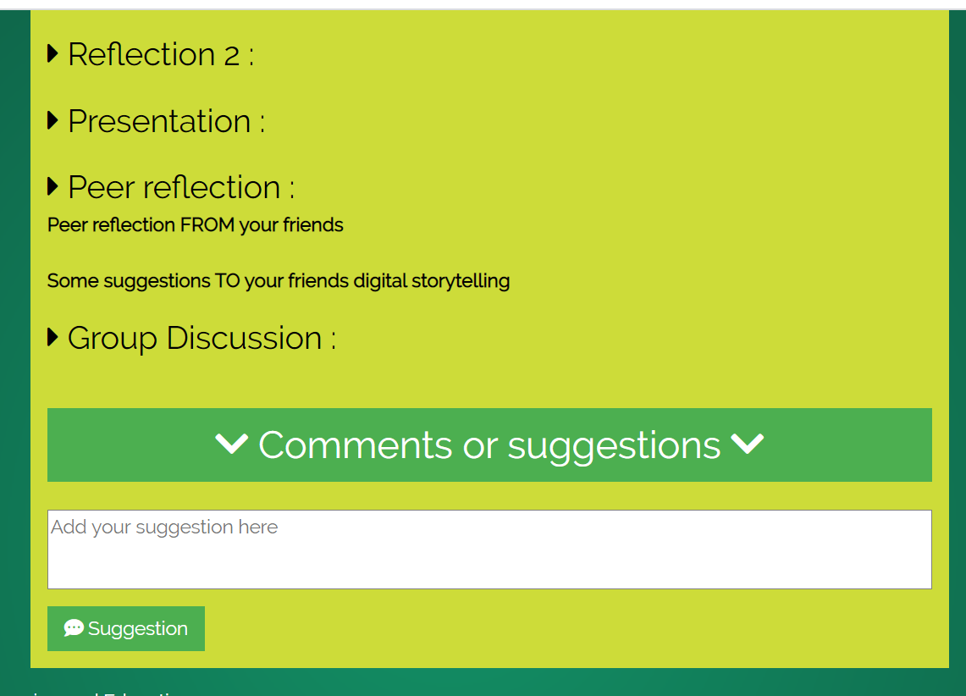
Reflections from my peers
1
2
3
First & Second → 2 questions
Third → 3 questions
It can be divided into 3 parts and questions will be showed below.
Question1 : ……..
Question2 : ……..
Question3 : ……..

