Slide 1



PLEDGE TO PROGRESS
Sustainability Hackathon
Sponsored By
Your Team Name : Mother_Nature_Earth
Your team bio :
Rakhee Vyas, IT professional,
Rishika Agrawal, BTECH IT student
Vishwaraj Khanderao, IT professional
Date :30/04/2023
// ‹#›
//01

Slide 2
Problem Statement?
When I was a teen the weather was complete different, the climatic conditions have had been changing a lot since then had a zeal to do something for nature i had submitted a global warming project in my college days. To protect the mother nature earth is collective responsibility.we see a lot of destructive impacts of this global warming and nature changes lots of species are on the verge of extinction. All around the world there are so many natural disasters occuring. Every year Amazon forest catches fire due to the heat produced by the environmental changes. Lots of living creatures are getting impacted due to this, it's not only the air pollution but all other forms of pollution causing this as of now to start with air pollution since this will have drastic change in global warming process if we achieve to control it. All of this is due to the change in environment.
// ‹#›
//01

Slide 3
User Segment & Pain Points
Government sector or private big brands can start it on a small scale as a prototype, every year government build roads by investing in it this solution would result in reducing the financial cost and also during the cement roads being build upon there is a lot of traffic congestion, am a IT professional and see this as part of daily life. Lots of species which we used to see during teenage don't exist now squirrels, birds, we are cutting down the trees and these species don't have shelters and many more such examples like water species due to water pollution and other animals including humans are all impacted due to this .natural disasters causing so much of damage every year even roads are damaged during natural disasters.
// ‹#›
//01

Slide 4
Pre-Requisite
Alternatives is solar vehicles which consume natural renewable resources instead of petrol, diesel, gases or even electricity because that as well generates while using water but that even would need tar/cement roads so we still will be investing in building roads every year. and competitors could be the vehicle manufacturing industries. I completely understand it would impact the industries and the people who are working in these industries and related jobs but then we need to have other job opportunities and the future is technology and most importantly we need to save our mother nature earth. If we save our nature we can live else living creatures including humans will be on the verge of extinction slowly.
// ‹#›
//01

Slide 5
Tools or resources
Metal escalators can be used to build these roads and these roads can be operated using technology where we have the age of identifying the natural disasters before they occur using data science and machine learning so in such cases these roads can be hidden just like when a ship goes below the bridge and bridge is opened the similar way these roads can be opened and closed to avoid the roads getting impacted and many accidents will not occur since the disasters would be known well in advance, it could start with a small prototype.
// ‹#›
//01

Slide 6
Any Supporting Functional Documents
https://m.engineeringnews.co.za/article/dutch-solar-road-proves-successful-moves-on-to-heavy-traffic-road-trial-2018-10-19/rep_id:4433
there has already been an example or solar roads in Dutch which is successful i had this idea since my college days.
// ‹#›
//01

Slide 7
Key Differentiators & Adoption Plan
This solution is majorly favourable to mother nature earth and society because if the nature is protected all living creatures are protected. The adoption process would be in prototypes for example a small area is covered first and then on a larger scale it can be built it should have a technical team to support and data science, machine learning team to foresee it and any natural disasters so that a proactive action is taken to open or close these roads. Since the future is technology there could be an addition to these roads similar to solar escalators so that the electricity is not wasted by recharging millions of vehicles just a solar escalators are charged and we are ready to go wherever we have to since the escalator will move instead of vehicles. The adoption process will also help in saving the space for parkings for so many vehicles all over the world and we could plant trees instead of those parking slots so that we move towards green revolution as we use solar energy water energy is also saved wherever possible instead of electric energy based roads.
// ‹#›
//01

Slide 8
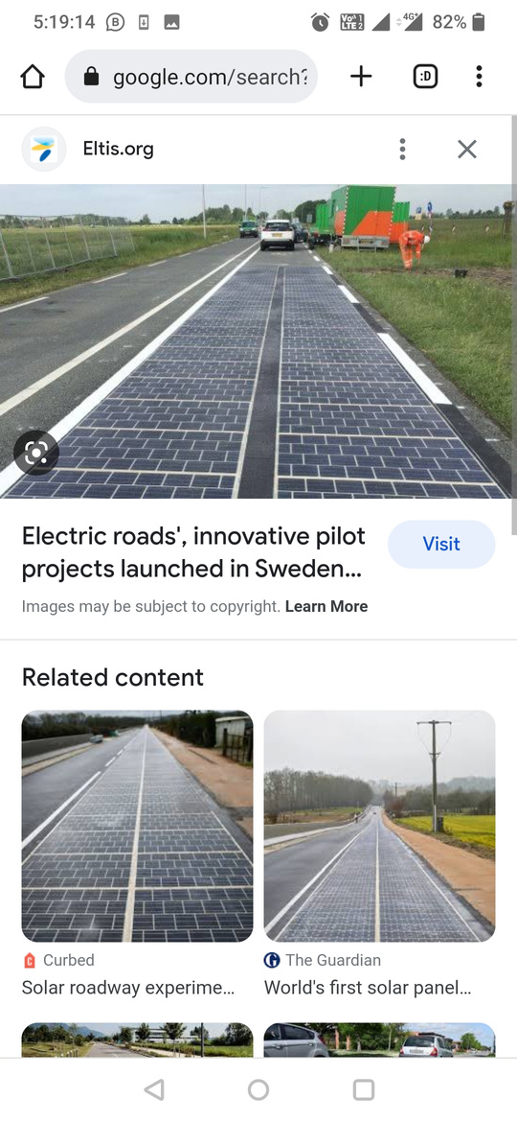
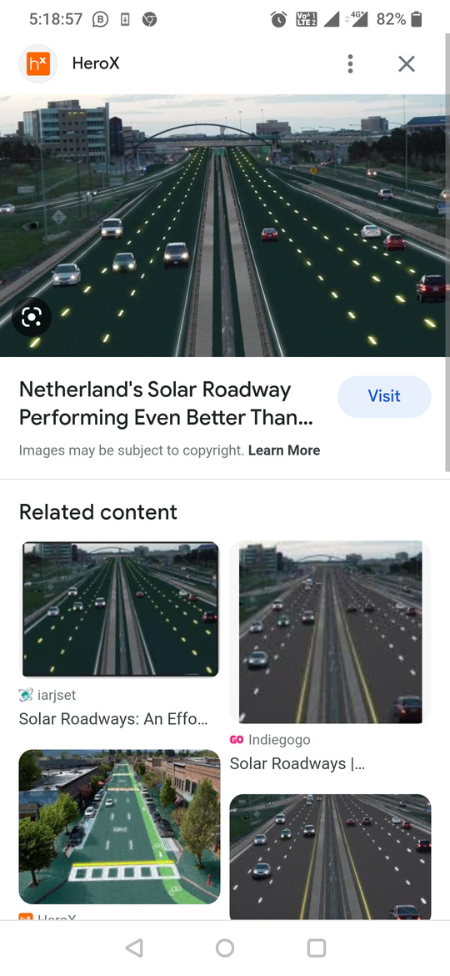
GitHub Repository Link & supporting diagrams, screenshots, if any
https://github.com/rakheeindia09/sustainability-hack/tree/main/idea
// ‹#›
//01

Slide 9


Thank You
Rakhee Vyas, Rishika Agrawal, Vishwaraj Khanderao

