Slide 1
The beginning is the most important part of the work
“
”

Slide 2
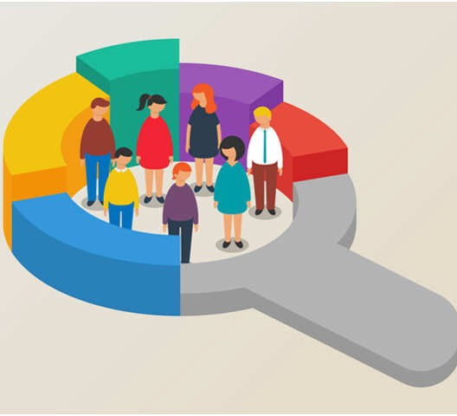
Mall Customer Segmentation
Submitted to:
Mr. Himanshu Pabbi
Assistant Professor

Slide 3

Introduction
Problem Statement
Objective
Overview of Dataset
Methodology
Data Collection and Preprocessing
7. Data Visualization
8. Model Building
9. Saving the Model
10. GUI of the Model
11. Future Scope
12. Conclusion

Slide 4
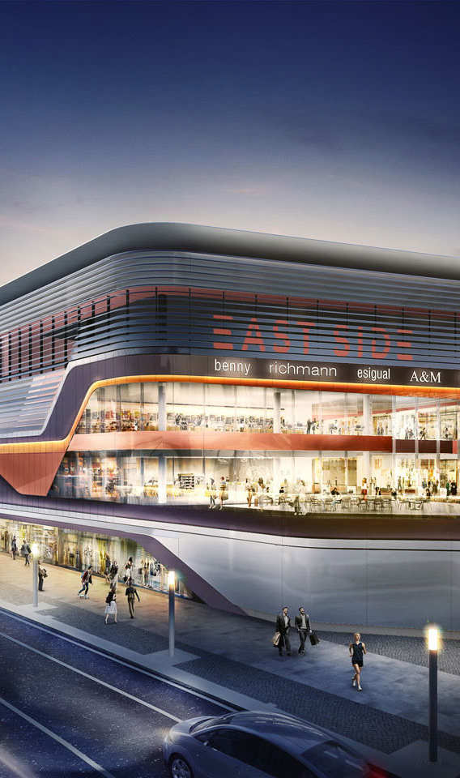
INTRODUCTION
Mall customer segmentation is a crucial strategy for businesses to understand and cater to the diverse needs and preferences of their customer base. By identifying distinct groups of customers with similar characteristics, businesses can tailor marketing strategies, enhance customer experience, and optimize product offerings. One powerful technique for customer segmentation is K-means clustering.

Slide 5

PROBLEM STATEMENT
In order to enhance the overall shopping experience and tailor marketing strategies, there is a need to segment mall customers based on their diverse preferences, behaviors, and demographics. By understanding distinct customer segments, the mall management can optimize store layouts, marketing campaigns, and promotional activities to cater to the specific needs and expectations of different customer groups. To identify such customers, this project analyses and forms clusters based on different criteria which will be discussed in the further sections.

Slide 6
Objective of the Project:
To identify distinct customer segments within the mall based on purchasing behavior, demographics and preferences.
To categorize customers with similar shopping patterns, allowing for the optimization of store layouts and resource allocation within the mall.
To create a personalized and engaging environment that maximizes customer satisfaction, loyalty, and the overall success of the mall.

Slide 7
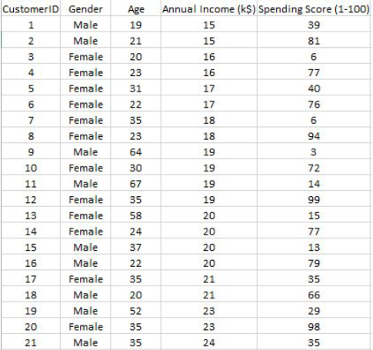
Overview of Dataset
The Dataset is collected from the Kaggle. This dataset contains 5 columns which are CustomerID, Gender, Age, Annual Income(k$) and Spending Score(1-100) where Gender is categorical value and rest all are numeric values.
The size of dataset is (200, 5) which is 200 rows and 5 columns.

Slide 8
Methodology
Creating an approach to solve the given problem statement
Exploring the dataset and obtaining useful insight from the same
Cleaning the dataset by handling nan values, remove duplicate records, etc.
Data Visualization used to obtain important information from the data
Data Preprocessing is performed to make the data ready to fit the model this includes feature scaling, splitting the dataset into features and labels, etc.
Model Building and Training
Model Deployment

Slide 9

Data Collection and Preprocessing
9

Slide 10



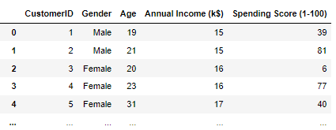
Importing the Libraries:
Loading the dataset:

Slide 11
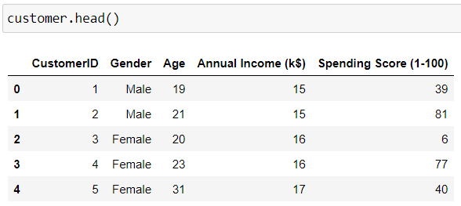

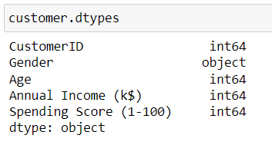
First five rows of the dataset:
Number of rows
&
columns in the dataset:
Checking the datatypes for the columns in the dataset:

Slide 12
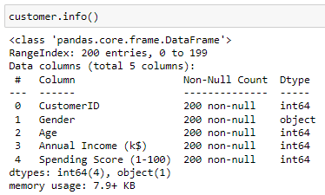
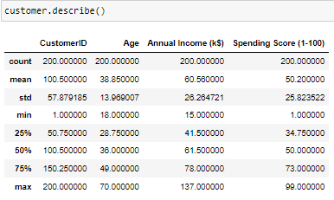
Information regarding the dataset:
Statistical Analysis of the dataset:

Slide 13
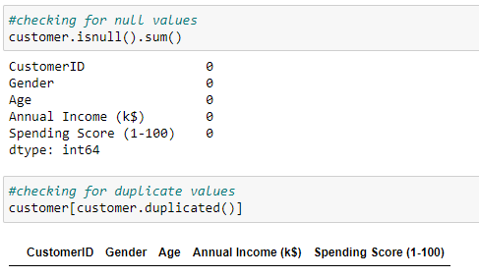
Checking for Null/Missing Values and Duplicate Values in our dataset:
The following output shows there is no null/missing values or duplicate values in our dataset.

Slide 14
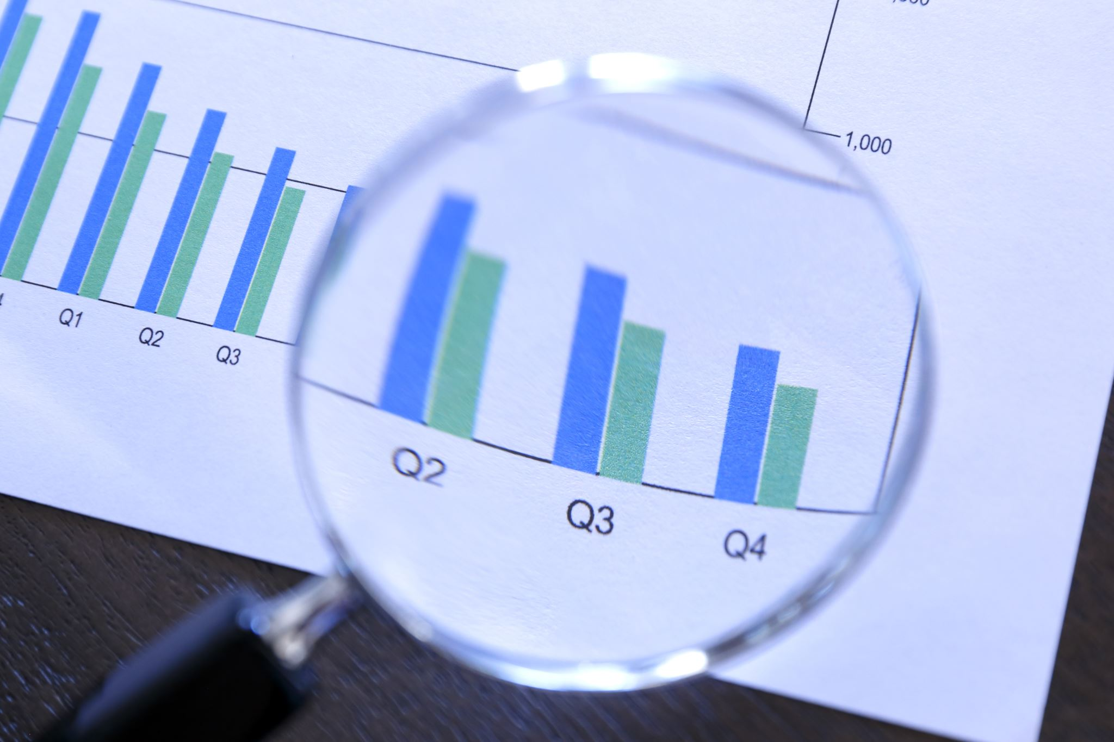
Data Visualization

Slide 15
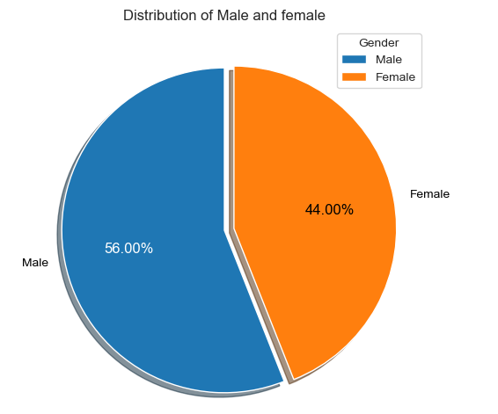
Distribution of Males and Females in the dataset
The distribution of Males and Females in the dataset are represented using Pie Chart.
This chart depicts that the percentage of Males are greater than the Females in the dataset.

Slide 16
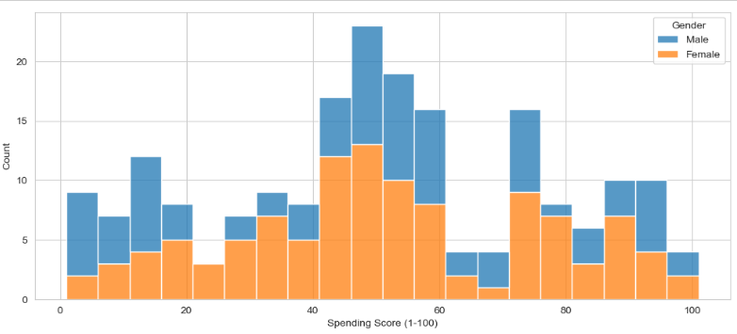
Comparision of Spending Score of Male and Female

Slide 17
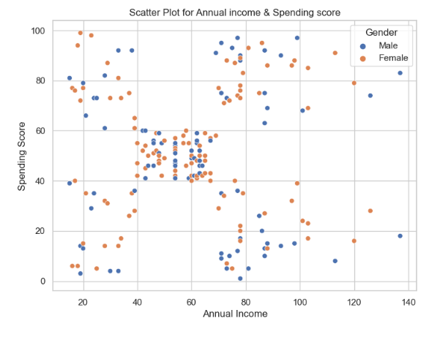
Distribution of Annual Income and Spending Score
Scatter Plot is used to show the representation of Annual Income and Spending Score on the basis of Gender.

Slide 18
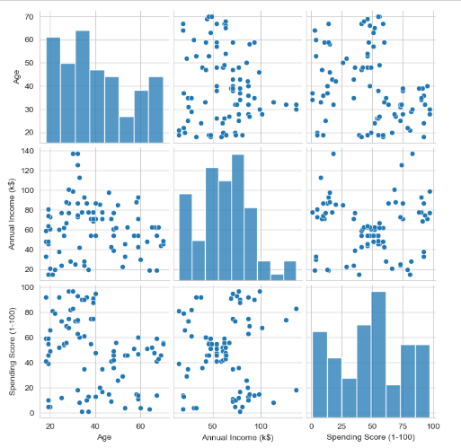
Distribution of Males in the Dataset
The Seaborn Pair plot allows us to plot pairwise relationships between variables within a dataset.
This pair plot represents the male data by summarizing all the values in the dataset.

Slide 19
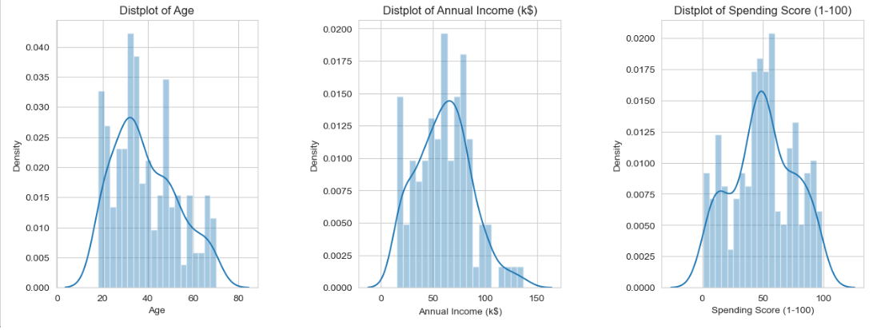
Plot distribution for each column in dataset

Slide 20


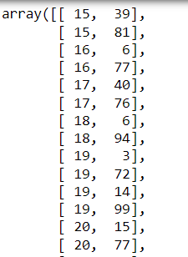
Model Building – K-Means Clustering Algorithm
Taking Annual Income and Spending Score as the important features of the dataset:

Slide 21
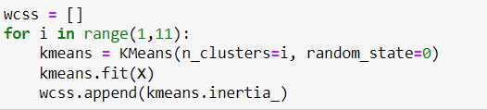
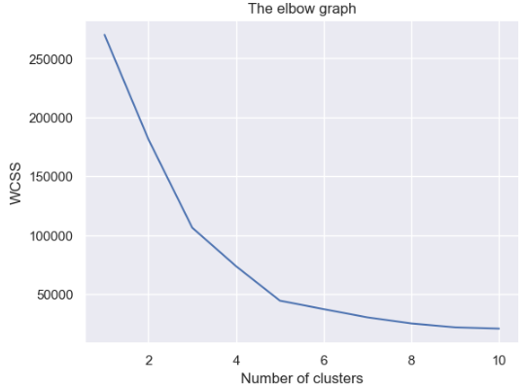
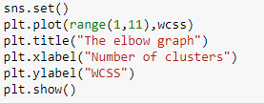
Finding the optimal number of clusters using Elbow Method:
Finding wcss value for different number of clusters:
Plotting the Elbow Graph:

Slide 22

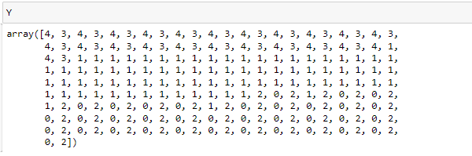

K-Means Clustering Model:
Clusters Formed
Prediction using K-means clustering algorithm:

Slide 23
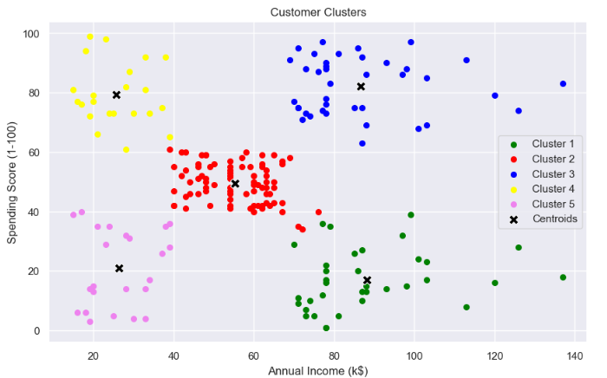
.
Visualizing the Clusters
This plot shows the clusters formed by different group of customers.
There are total of 5 clusters formed from the dataset.
All these clusters contains different types of customers varying from high spending to low spending score.
The centroid represents the center of the clusters

Slide 24
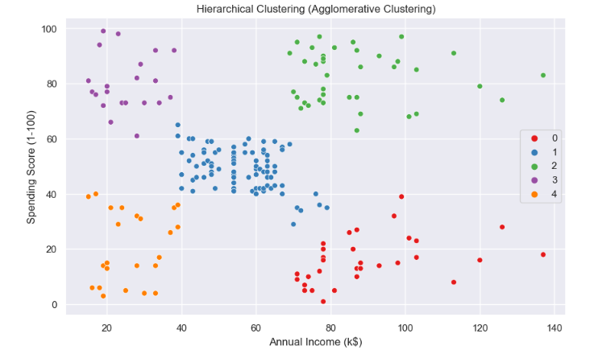
Hierarchical Clustering (Agglomerative Clustering)

Slide 25
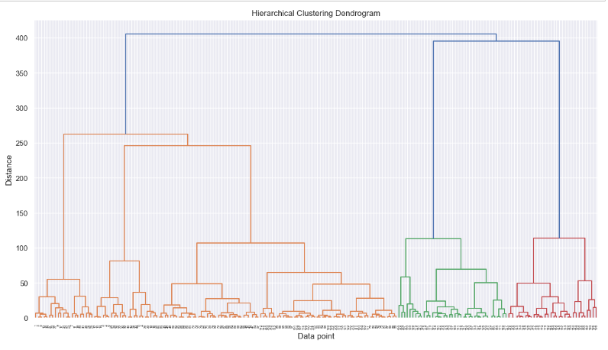
Hierarchical Clustering Dendogram:

Slide 26
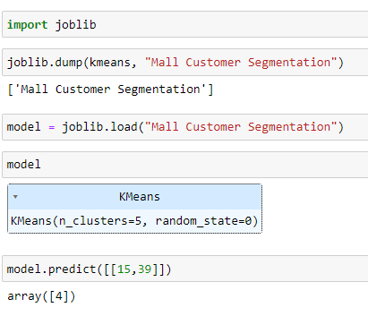
Saving the model with Joblib:

Slide 27
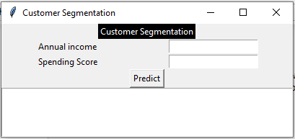
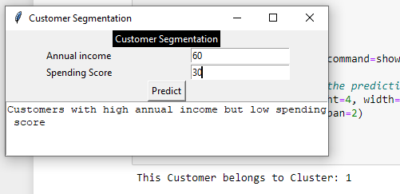
GUI of the Model:

Slide 28
Proposing Additions or Enhancements:
Customer Feedback Incorporation:
Future Scope: Implement a feedback loop where customer preferences and feedback are systematically integrated into the segmentation model, allowing for continuous improvement and adaptation.
Predictive Analytics:
Future Scope: Extend the project to include predictive analytics, forecasting future customer behavior based on historical data, and enabling proactive strategies for personalized customer engagement.
Real-time Segmentation Dashboard:
Future Scope: Develop a real-time segmentation dashboard that provides instant insights into changing customer patterns, empowering mall management with up-to-the-minute information for agile decision-making.
Personalized Marketing Campaigns:
Future Scope: Integrate the segmented customer data with marketing automation tools to enable the execution of highly targeted and personalized marketing campaigns tailored to each customer segment.

Slide 29
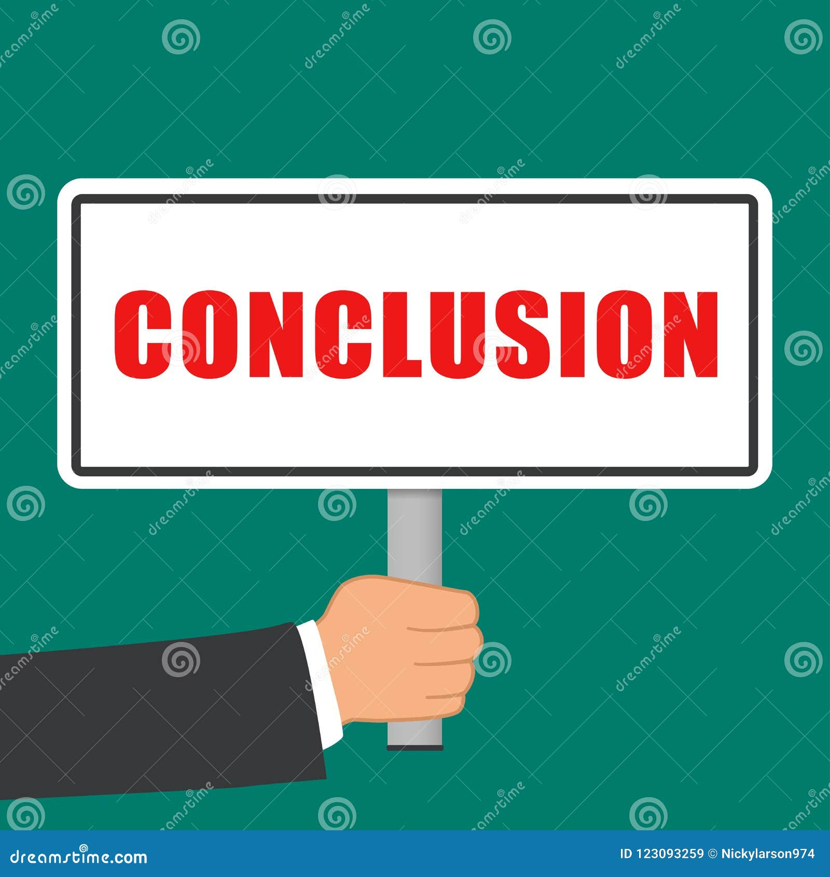
Closing remarks
In conclusion, the application of K-Means clustering has proven instrumental in unraveling distinct customer segments within the mall, enabling targeted strategies for personalized engagement. This project not only enhances marketing precision but also empowers mall management to optimize resources, ultimately fostering a more satisfying and tailored shopping experience for diverse customer groups.

Slide 30

Made By:
Vibhor Badola (03121102021)
Khushi Rakheja (03021102021)

