Slide 1
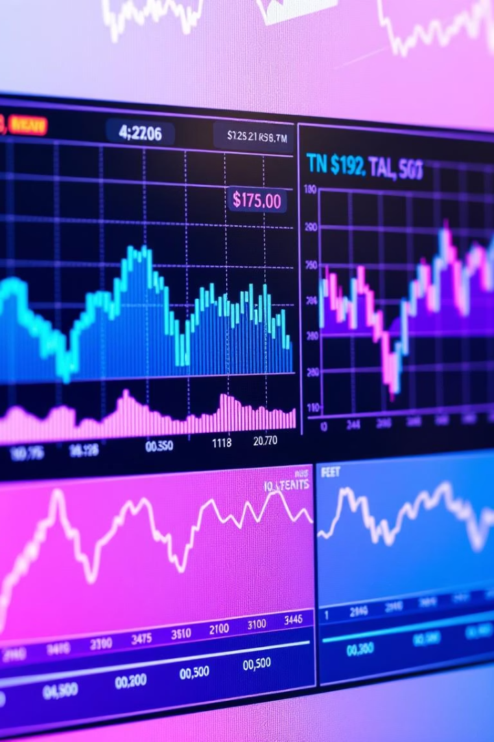

Stock Market Analysis of Top Tech Companies UNIFIED MENTOR PROJECT
Prepared by: Rakhi Chakrabarty
Email ID – rakhichakrabarty8@gmail.com
Date: April 2025
by Rakhi Chakrabarty

Slide 2
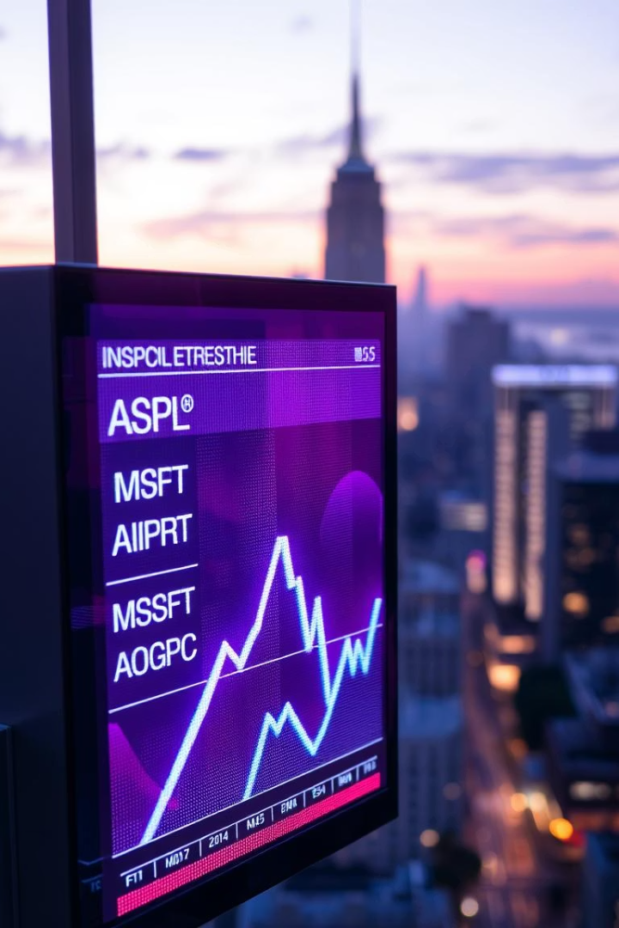
Project Overview
Objective
Analyze trends, volatility, volume and pricing patterns
Metrics Covered
Closing Price Trends
Trading Volume
7-Day Moving Averages
Daily Return % (Volatility)
Company Price Comparisons
Key KPIs

Slide 3
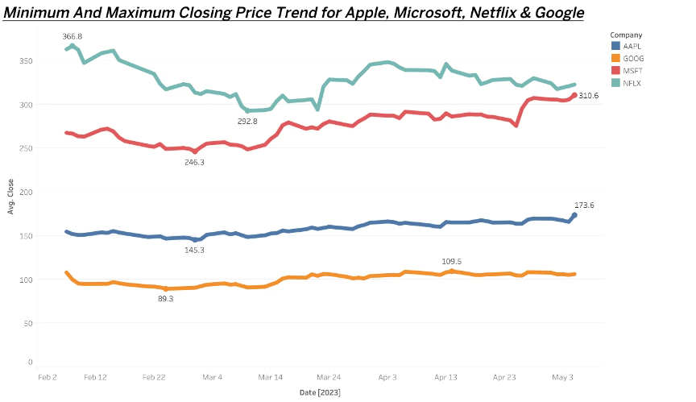
Stock Price Trend
MSFT & AAPL
NFLX
GOOG
Steady upward trend, long-term strength
High price fluctuations, volatile sentiment
Stable but lower pricing range

Slide 4
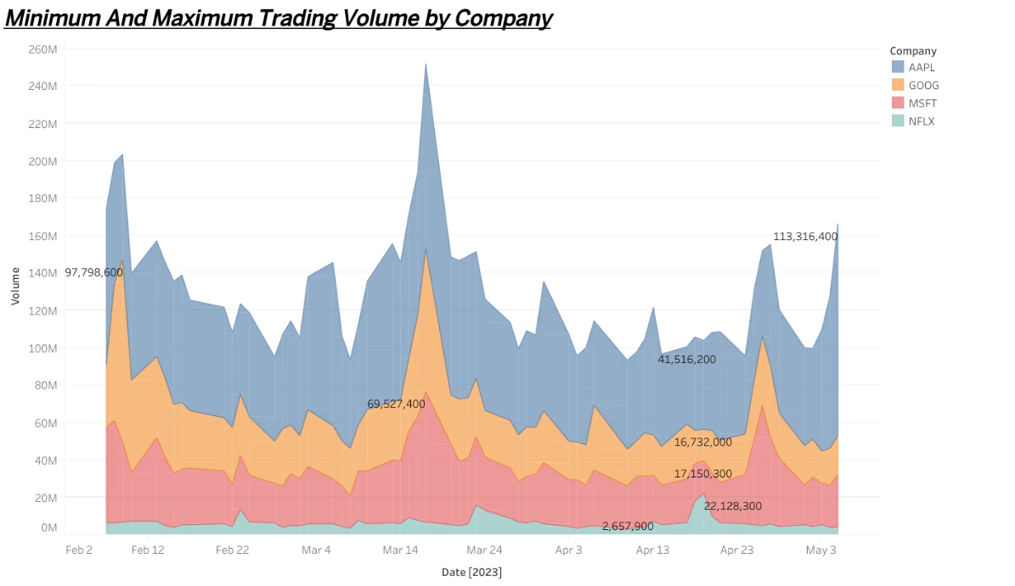
Trading Volume Comparison
AAPL Dominance
NFLX Volume
Business Insight
Highest and consistent trading volume
Lowest liquidity and investor interest
High volume enables easy trade entry/exit

Slide 5
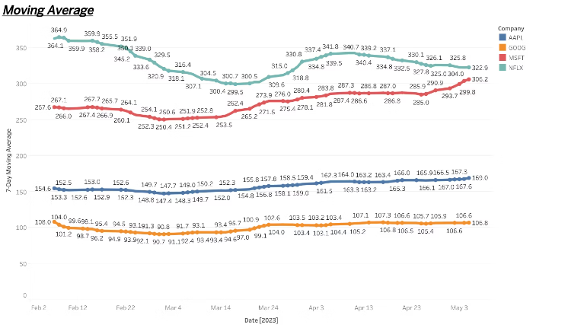



Moving Averages Analysis
NFLX Rebound
Strong surge mid-April
AAPL & MSFT
Smooth rising averages reflect confidence
GOOG Flat Line
Market neutrality, stagnation sign

Slide 6
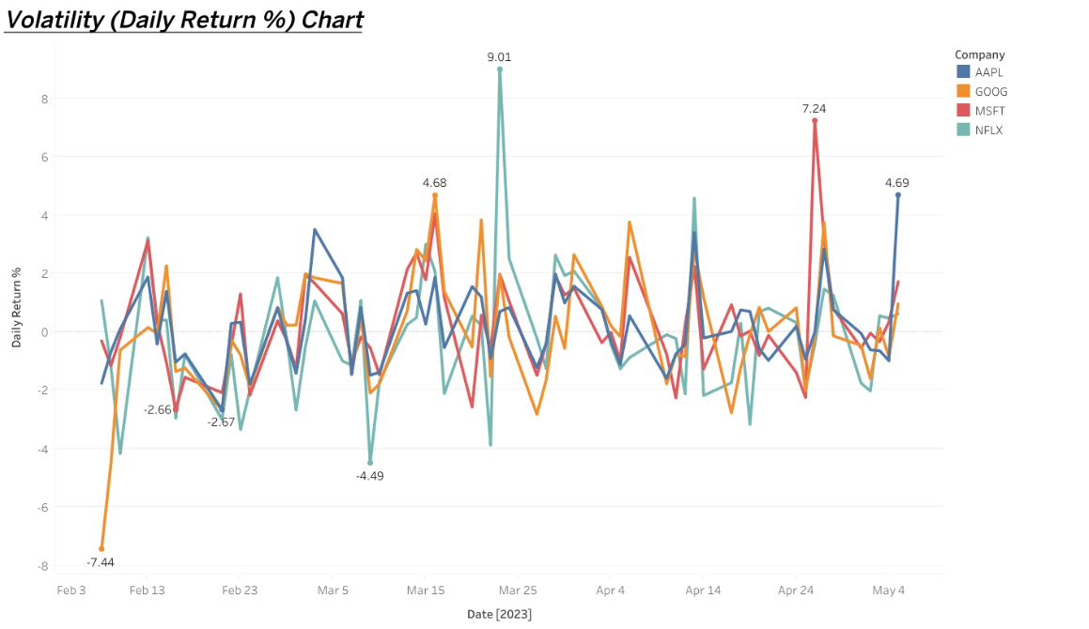
Volatility Overview (Daily Return %)
NFLX & GOOG
MSFT Stability
Investor Strategy
High volatility up to ±9%
Lower swings, safer investment
Volatile stocks for short-term traders

Slide 7
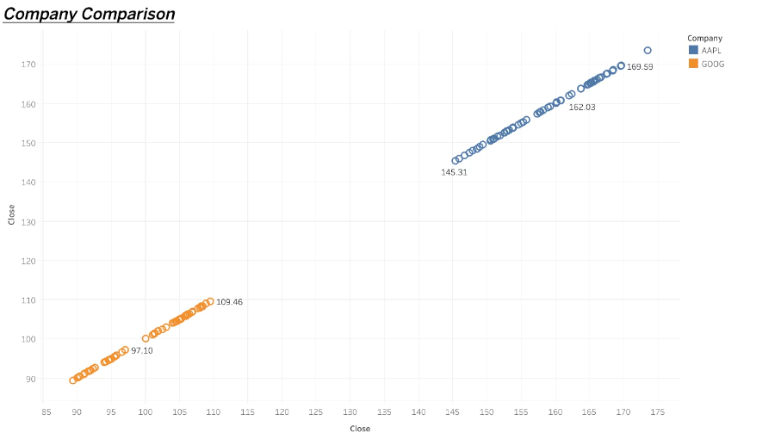
Company Price Comparison
AAPL Pricing
GOOG Trend
Use Case
Consistently trades much higher than GOOG
Similar direction, lower price range
Supports portfolio diversification decisions

Slide 8
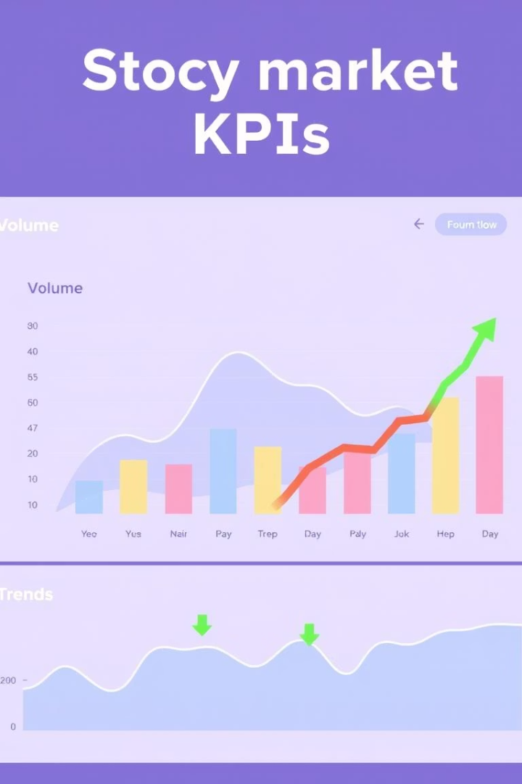
KPI Summary
7.95B
Total Volume
Billion shares traded
215.4
Avg Closing Price
Across all companies
54044
Highest Price
Peak trade value recorded
52749
Lowest Price
Minimum value observed

Slide 9

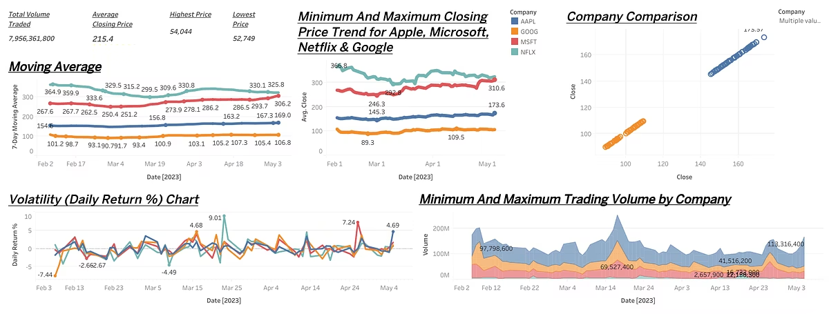
Final Dashboard Overview
Combines price trends, volume, volatility, and moving averages

Slide 10

Key Insights & Takeaways
1
Visual Dashboard
2
Investment Decisions
Enables simplifying comparison and spotting trends
Improved by combining multiple data points
3
Real-time Visibility
Supports timely entry and exit points

Slide 11
Business Observations
Key Observations:
•AAPL and MSFT are consistent, stable performers with high volume and low volatility.
•NFLX is aggressive and risky, showing both large growth potential and sharp dips.
•GOOG is relatively flat, stable but with low liquidity.

Slide 12
Recommendations
•Use AAPL and MSFT for long-term portfolios.
• Deploy NFLX for tactical, high-reward positions with tight risk control.
• Use volatility and volume insights for timing decisions.
•📉 Consider moving averages for trend validation before entering trades.

Slide 13
Conclusion
This Tableau-powered analysis provides a clear, interactive way to understand tech stock behavior. It enables smarter, faster investment decisions through visual trends, KPIs, and real-time comparison.

Slide 14
………Thank You…….

