Slide 1
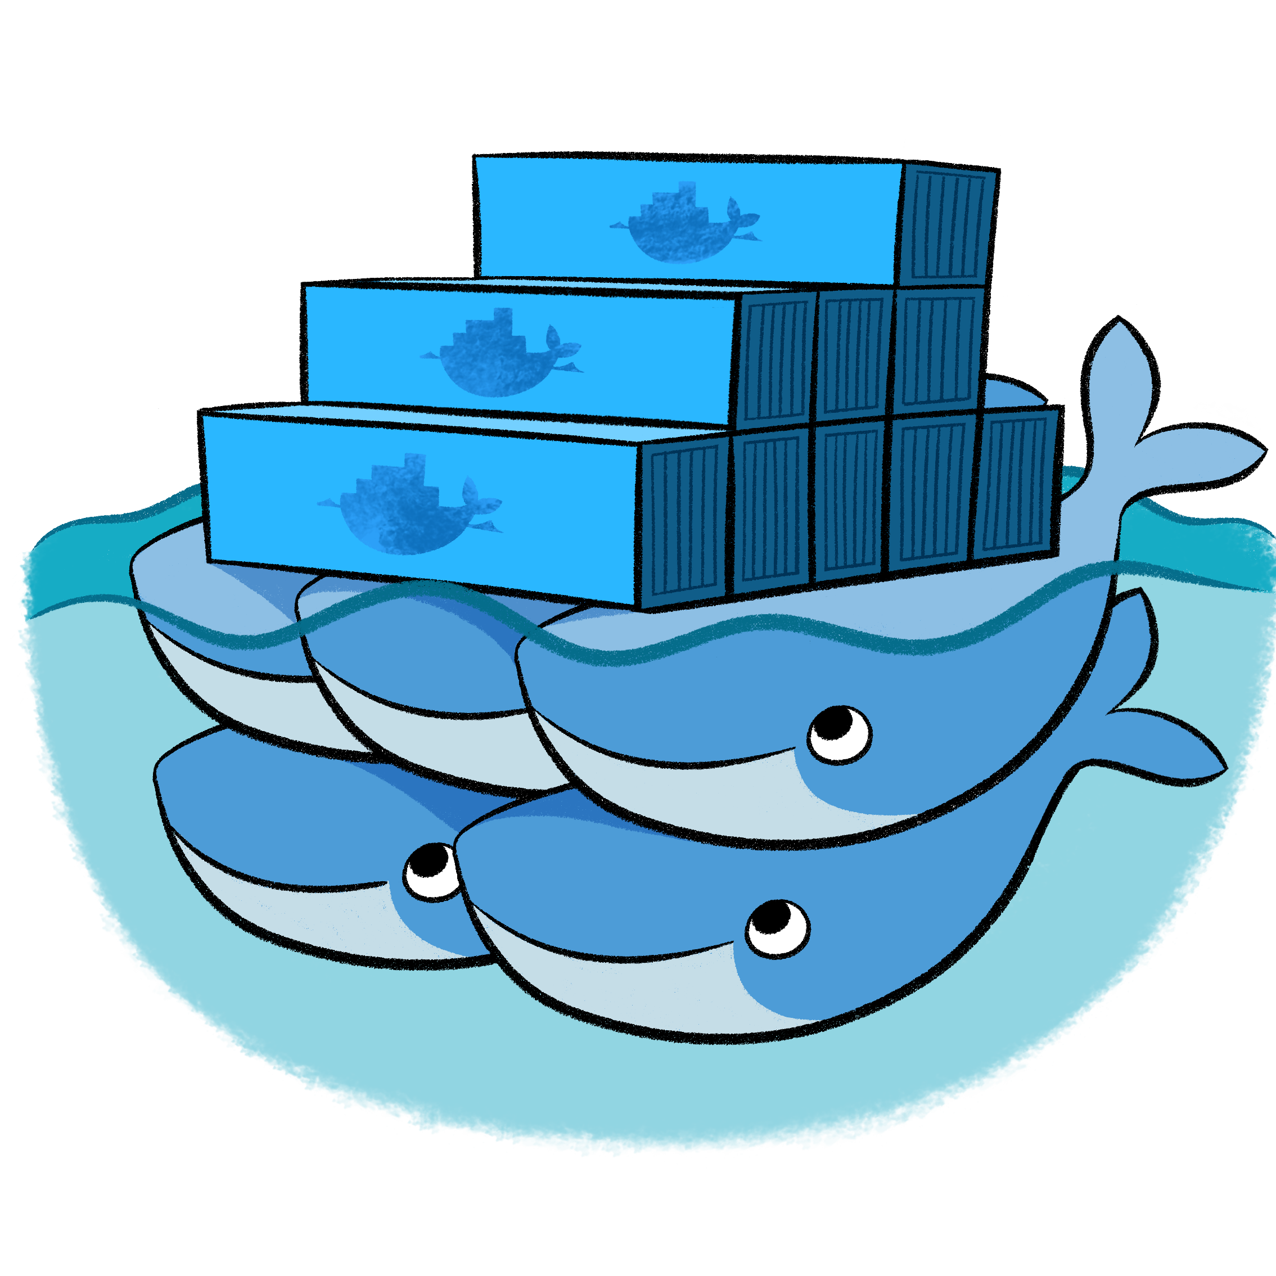
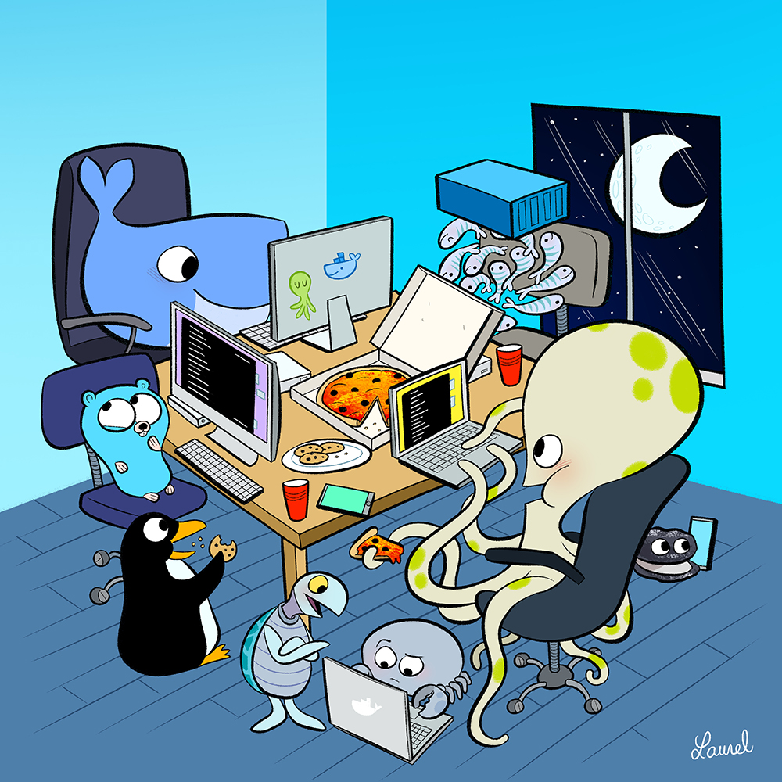

Introduction to Docker
Rakeshkumar Tammisetti
Notes:
1

Slide 2

Agenda
Why Docker
Docker Architecture
Docker Installation
How to run Docker?
Demo

Slide 3
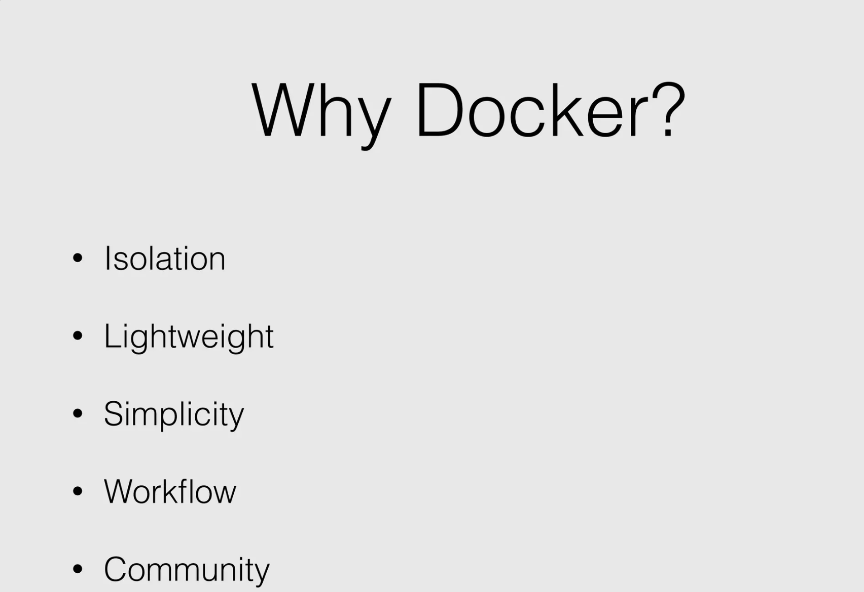

Slide 4
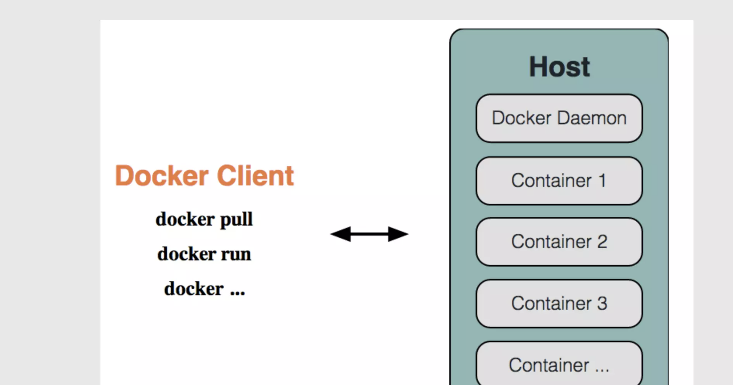

Slide 5
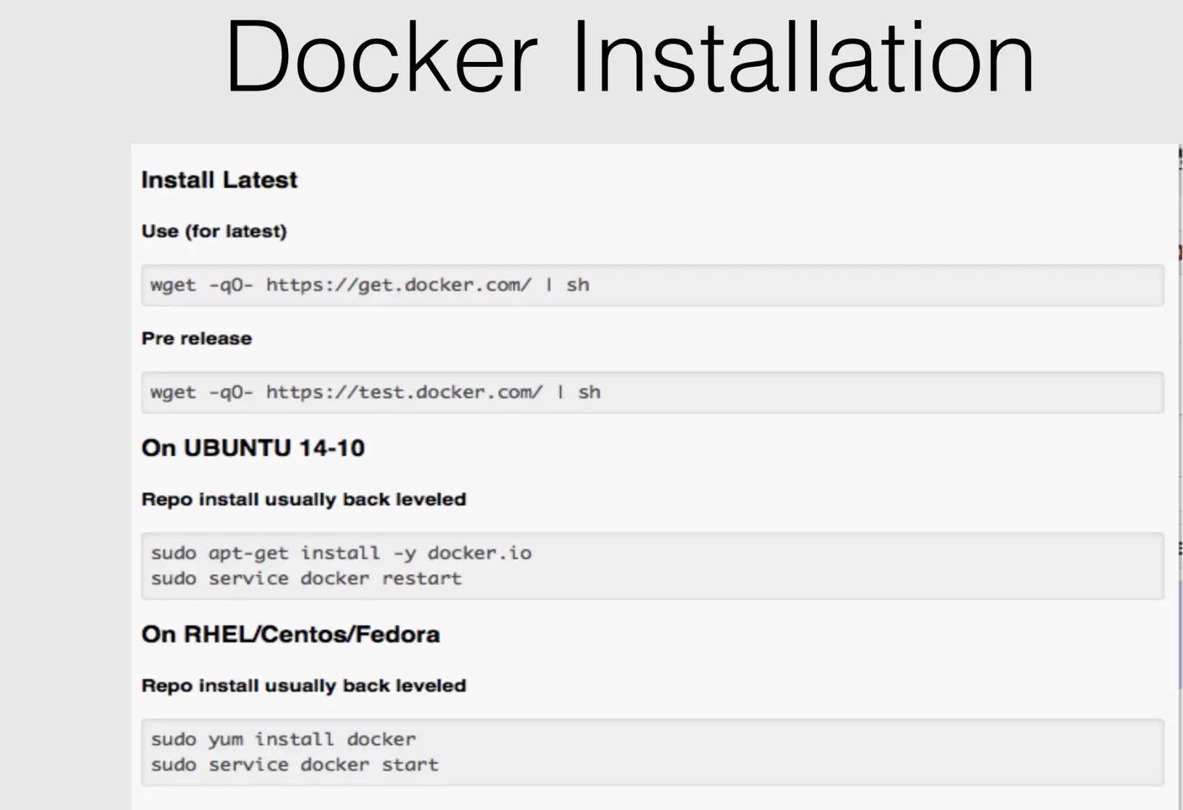

Slide 6
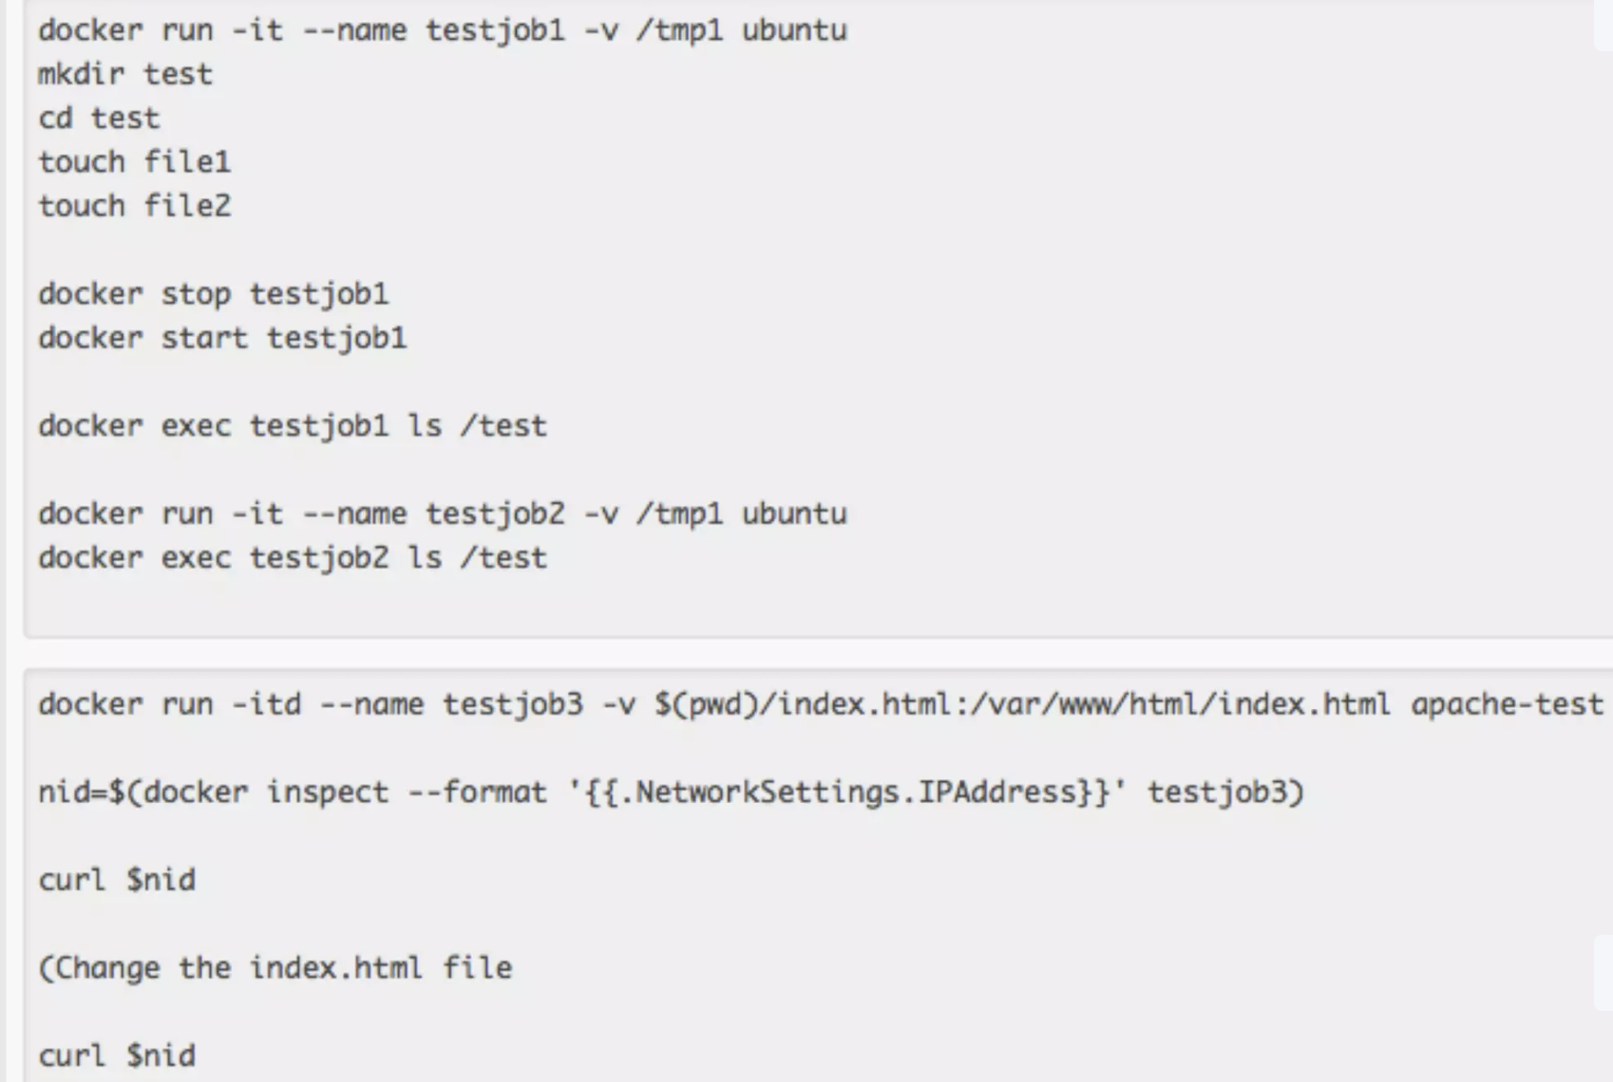
How to run Docker?

Slide 7
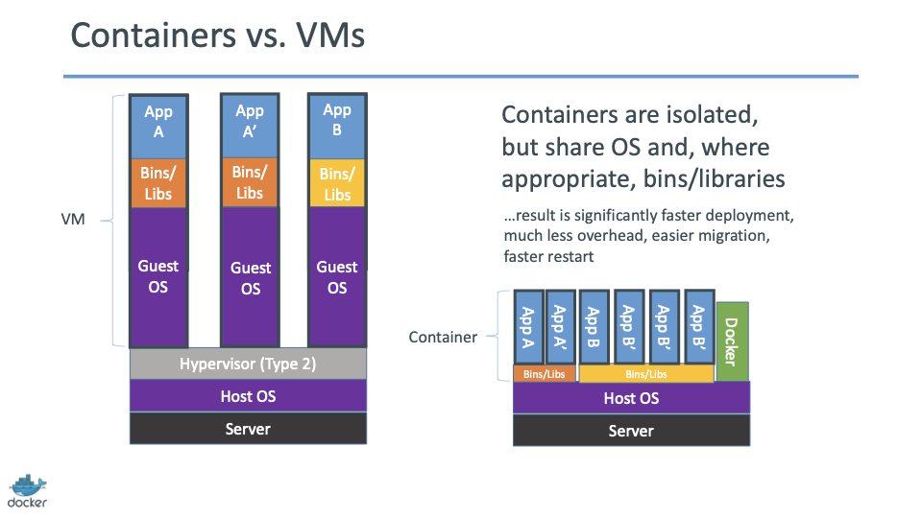

Slide 8
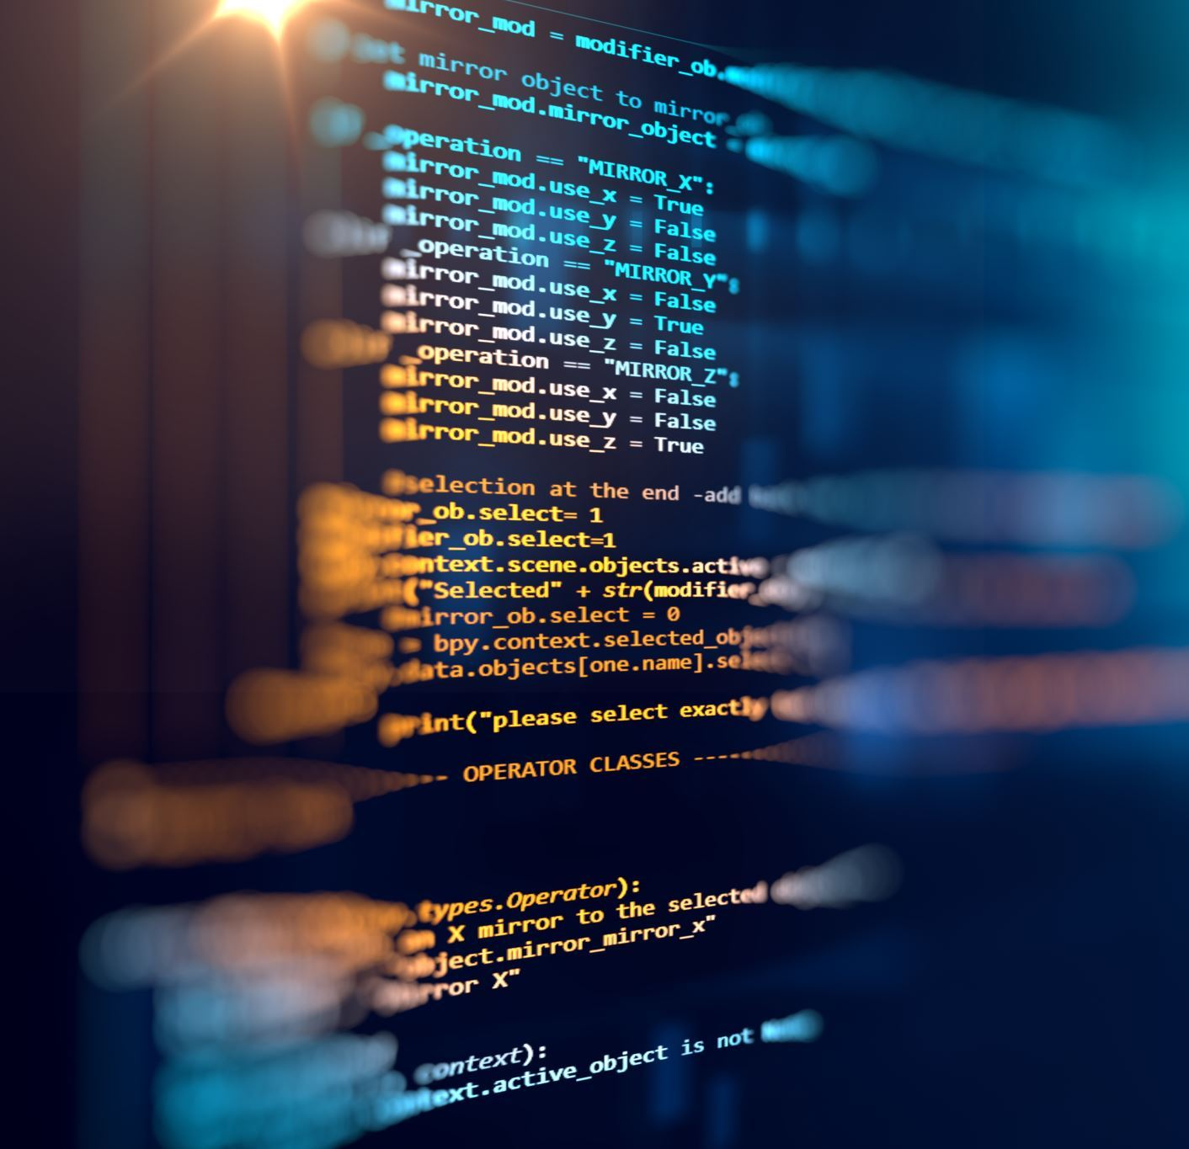
Demo

Slide 9

Q &A

Slide 10

Reference links
https://docs.docker.com/reference/cli/docker/
https://docs.docker.com/

