Slide 1



08-2 합성곱 신경망을 사용한 이미지 분류
박해선

Slide 2
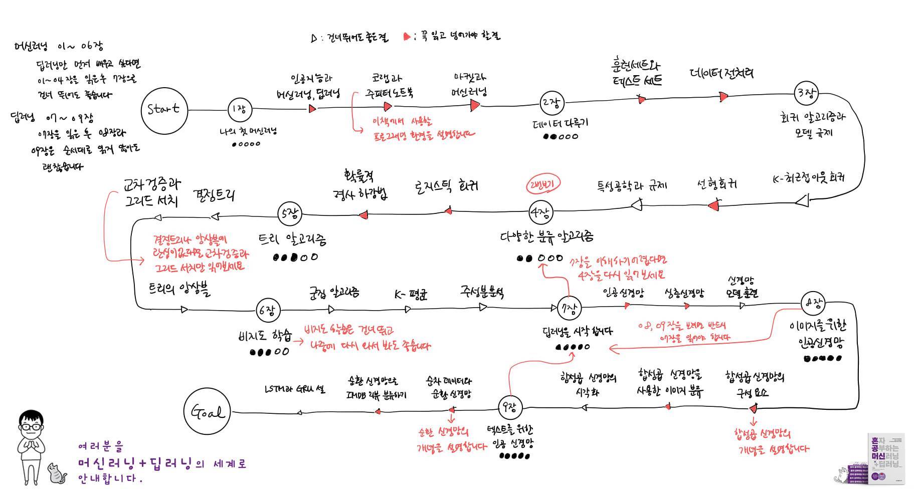

Slide 3
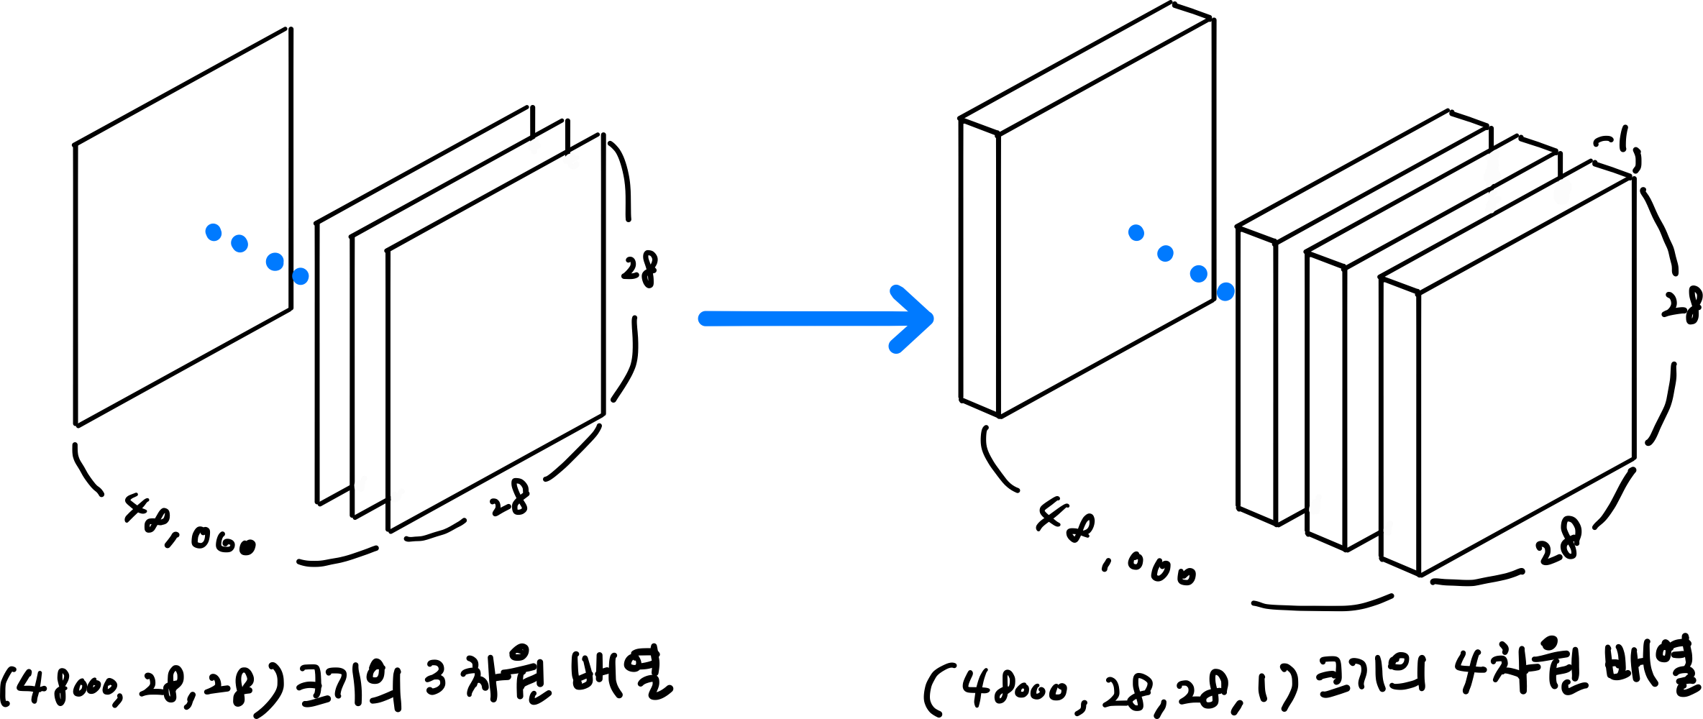
패션 MNIST 데이터
(train_input, train_target), (test_input, test_target) = keras.datasets.fashion_mnist.load_data()
train_scaled = train_input.reshape(-1, 28, 28, 1) / 255.0
train_scaled, val_scaled, train_target, val_target = train_test_split(
train_scaled, train_target, test_size=0.2, random_state=42)
P445

Slide 4
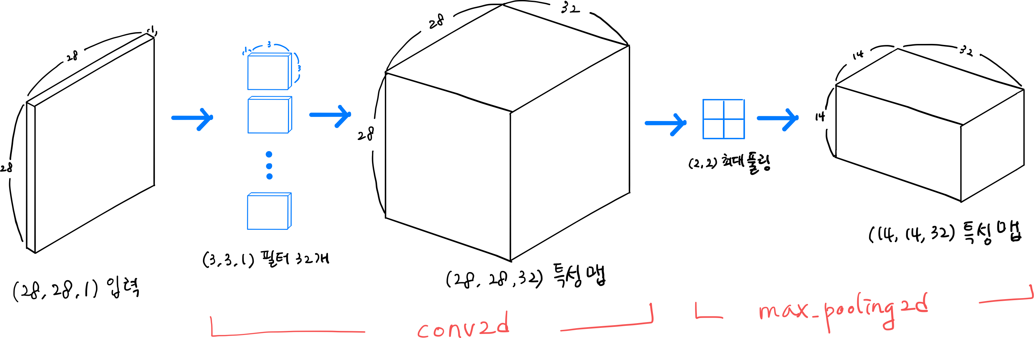
첫 번째 합성곱 층
model = keras.Sequential()
model.add(keras.layers.Conv2D(32, kernel_size=3, activation='relu’,
padding='same', input_shape=(28,28,1)))
model.add(keras.layers.MaxPooling2D(2))
P446

Slide 5
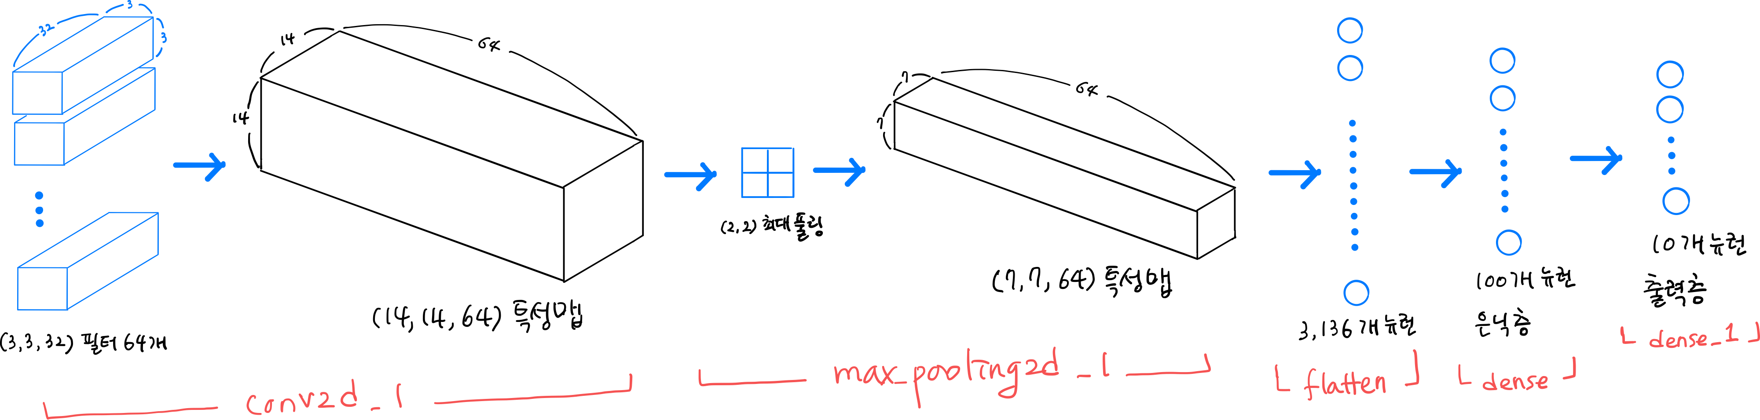
두 번째 합성곱 층+완전 연결 층
model.add(keras.layers.Conv2D(64, kernel_size=(3,3), activation='relu＇, padding='same’))
model.add(keras.layers.MaxPooling2D(2))
model.add(keras.layers.Flatten())
model.add(keras.layers.Dense(100, activation='relu’))
model.add(keras.layers.Dropout(0.4))
model.add(keras.layers.Dense(10, activation='softmax'))
P447

Slide 6
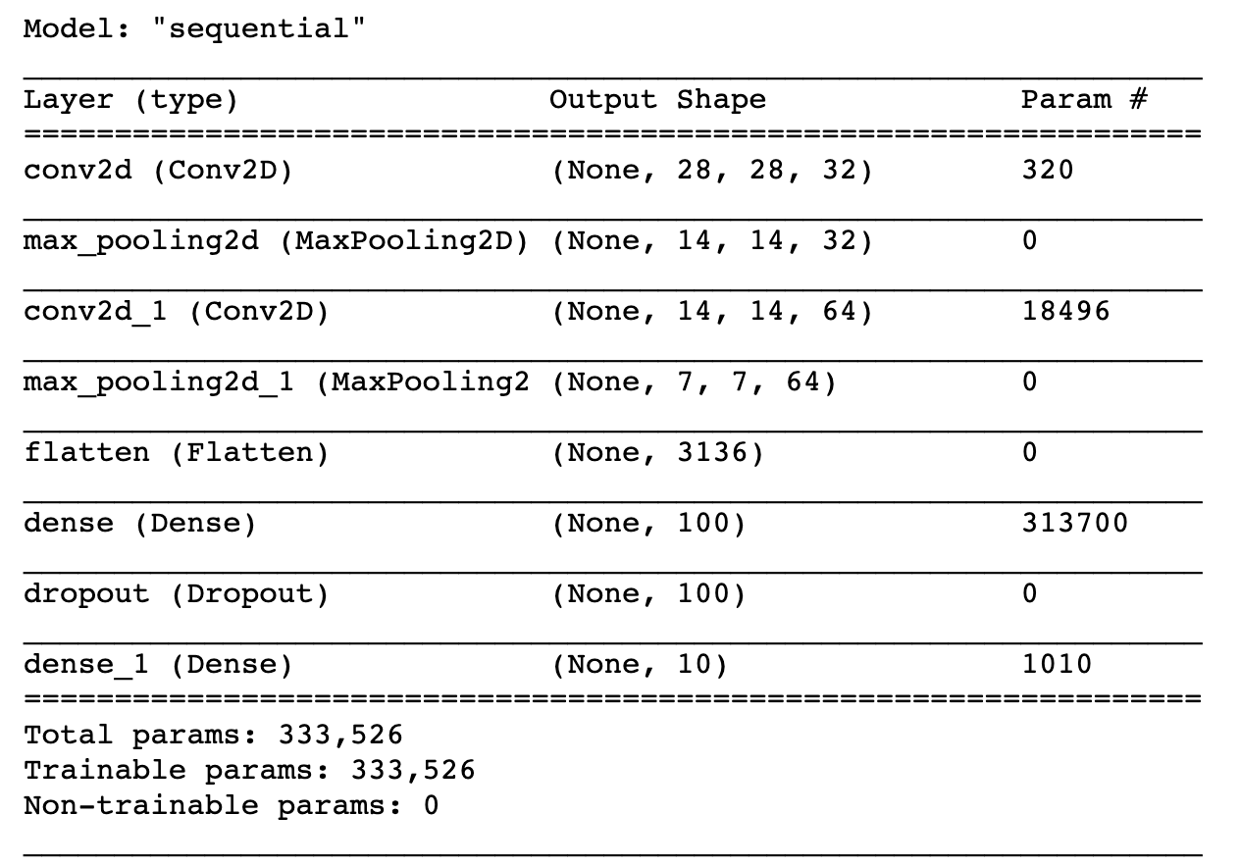
모델 요약
P448

Slide 7
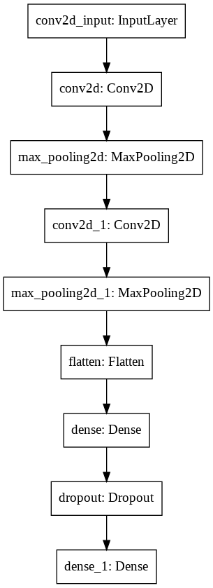
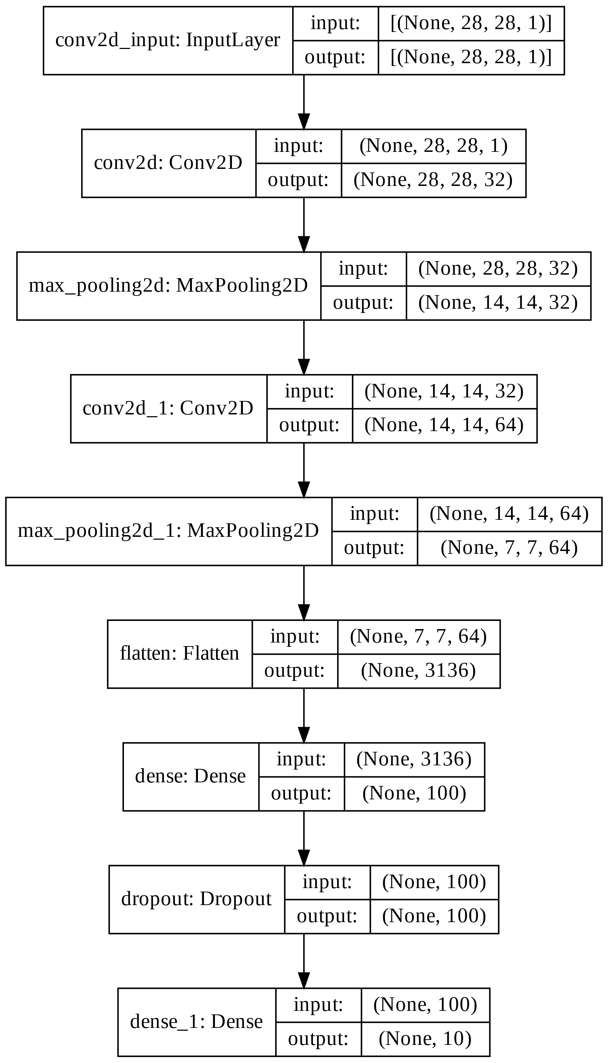
plot_model()
keras.utils.plot_model(model, show_shapes=True)
P449

Slide 8
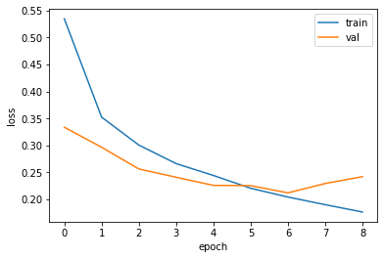
컴파일과 훈련
model.compile(optimizer='adam', loss='sparse_categorical_crossentropy’,
metrics='accuracy’)
checkpoint_cb = keras.callbacks.ModelCheckpoint('best-cnn-model.h5’)
early_stopping_cb = keras.callbacks.EarlyStopping(patience=2,
restore_best_weights=True)
history = model.fit(train_scaled, train_target, epochs=20,
validation_data=(val_scaled, val_target),
callbacks=[checkpoint_cb, early_stopping_cb])
P452

Slide 9
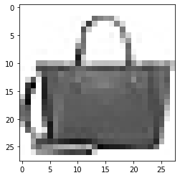
평가와 예측
model.evaluate(val_scaled, val_target)
375/375 [==============================] - 1s 2ms/step - loss: 0.2118 - accuracy: 0.9212
[0.2118101418018341, 0.9212499856948853]
plt.imshow(val_scaled[0].reshape(28, 28), cmap='gray_r’)
plt.show()
preds = model.predict(val_scaled[0:1])
print(preds)
[[1.4339859e-16 8.4426813e-24 2.2553201e-18 4.8564068e-16 3.6903781e-15
6.4212738e-20 3.1580050e-15 9.1121079e-19 1.0000000e+00 1.0684053e-20]]
P454-455

Slide 10
테스트 세트 점수
test_scaled = test_input.reshape(-1, 28, 28, 1) / 255.0
model.evaluate(test_scaled, test_target)
313/313 [==============================] - 1s 3ms/step - loss: 0.2360 - accuracy: 0.9163
[0.23596987128257751, 0.9162999987602234]
P457
Notes:
에포크 9(열번쨰 에포크)가 최소.

Slide 11
감사합니다

