Slide 1
Checkpoint 1
Web fundamentals

Slide 2

Contents of This prensentation
In this checkpoint , we will deal with 3 major subjects
How does th web work ?
What do we need to be a web developers ?
What is the role of a web developer ?

Slide 3
How does the web work ?
The world wide web is used by million of people every day for every thing from checking the weather ordering food and chatting with friends , sharing news or even starting revolutions. So what’s exactly the web ?
First of all the world wide web is not the internet even though the terms are often used interchangeably the internet is simply the way computers connect to each other in order to share information.
In our computers we use a piece of software called a web browser to request and view web pages. The most commun web browser are mozilla firefox, google chrome, internet explorer and apple safari.
you can use the web browsers to request a web page by typing a known adress into the address bar or searching for a page using a search engine like Google.
The communication enabled through internet has many uses such as emails ,file transfer and the most commun use of the internet is accessing the world wide web.

Slide 4
How does the web work ?
What’s a webserver? a Web server is a computer always connected to the internet specifically designed to store information and share it the people who own these web servers and rent space in them are called web hosts.
There’s another part to having a website without which we will be lost in the city ; This is website adress which consists of domain names just like with the real life adress .
The information stored in the websites is in web languages such as HTML and JavaScript when we find the website that we are looking for, our web browser is able to take all the code and turn it to words , pictures graphics so we don’t need to know any special computer languages because the web browser creates a graphic interface for us :
So to resume the world wide web is a big virtual city where we communicate with each other in web languages with browsers acting as our translators.
Each of our thoughts is linked to other thoughts, memories and emotions in a loose interconnected network like a web.
Tim berners lee the father of the wolrd wide web understood that we needed a way to organize information that mirrored this natural arrangement and the web accomplished this through hyperlikns by linking several pages within a websie or even redirecting you to other websites to expand o information or ideas immediately.

Slide 5
What do you need to be a web developer ?
First we need to know what’s the web developement ? Web development is the process of building websites and applications for the internet, or for a private network known as an intranet. Web development is not concerned with the design of a website; rather, it’s all about the coding and programming that powers the website’s functionality.
Therefore a web developer must have some qualifications in order to be leader in this field.
Qualifications:
Good programming skills
good knowledge of html , css and javascript ,jquery , sql etc
Qualities:
Good commnunication skills
Love of learning
Patience
Perfectionism
Consistency
Hard work

Slide 6
What does a web developer do ?
The role of the web developer is to build and maintain websites. Web developers can work in-house or freelance , and the specific tasks and responsibilities involved will vary depending on whether they’re working as a frontend, backend or full stack developer.
Full stack developers specialize in both the frontend and backend.
Web developers are responsible for building a product that meets both the client’s needs and those of the customer or end user. Web developers collaborate with stakeholders, clients and designers in order to understand the vision.

Slide 7
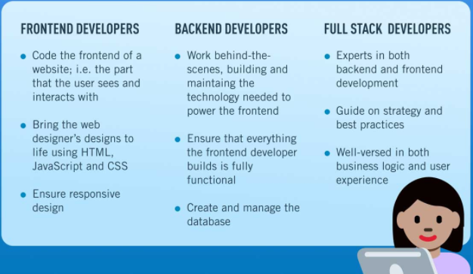
What does a web developer do ?

Slide 8
—Success code
“ while (! (succeed= try())); ”

