Slide 1


Slide 2
CHAPTER 3
ADJUSTING THE ACCOUNTS
Accounting Principles, Eighth Edition

Slide 3
Study Objectives
Explain the time period assumption.
Explain the accrual basis of accounting.
Explain the reasons for adjusting entries.
Identify the major types of adjusting entries.
Prepare adjusting entries for deferrals.
Prepare adjusting entries for accruals.
Describe the nature and purpose of an adjusted trial balance.
Notes:
1. On the topic, “Challenges Facing Financial Accounting,” what did the AICPA Special Committee on Financial Reporting suggest should be included in future financial statements?
Non-financial Measurements (customer satisfaction indexes, backlog information, and reject rates on goods purchases).
Forward-looking Information
Soft Assets (a company’s know-how, market dominance, marketing setup, well-trained employees, and brand image).
Timeliness (no real time financial information)

Slide 4

Adjusting the Accounts
Timing Issues
The Basics of Adjusting Entries
The Adjusted Trial Balance and Financial Statements
Time period assumption
Fiscal and calendar years
Accrual- vs. cash-basis accounting
Recognizing revenues and expenses
Types of adjusting entries
Adjusting entries for deferrals
Adjusting entries for accruals
Summary of journalizing and posting
Preparing the adjusted trial balance
Preparing financial statements
Notes:
Service Cost - Actuaries compute service cost as the present value of the new benefits earned by employees during the year. Future salary levels considered in calculation.
Interest on Liability - Interest accrues each year on the PBO just as it does on any discounted debt.
Actual Return on Plan Assets - Increase in pension funds from interest, dividends, and realized and unrealized changes in the fair market value of the plan assets.
Amortization of Unrecognized Prior Service Cost - The cost of providing retroactive benefits is allocated to pension expense in the future, specifically to the remaining service-years of the affected employees.
Gain or Loss - Volatility in pension expense can be caused by sudden and large changes in the market value of plan assets and by changes in the projected benefit obligation. Two items comprise the gain or loss:
difference between the actual return and the expected return on plan assets and,
amortization of the unrecognized net gain or loss from previous periods

Slide 5

Timing Issues
Accountants divide the economic life of a business into artificial time periods (Time Period Assumption).
. . . . .
Jan.
Feb.
Mar.
Apr.
Dec.
Generally a month, a quarter, or a year.
Fiscal year vs. calendar year
Also known as the “Periodicity Assumption”
LO 1 Explain the time period assumption.

Slide 6
Timing Issues
Review
The time period assumption states that:
a. revenue should be recognized in the accounting period in which it is earned.
b. expenses should be matched with revenues.
c. the economic life of a business can be divided into artificial time periods.
d. the fiscal year should correspond with the calendar year.
LO 1 Explain the time period assumption.

Slide 7
Timing Issues
Accrual- vs. Cash-Basis Accounting
Accrual-Basis Accounting
Transactions recorded in the periods in which the events occur
Revenues are recognized when earned, rather than when cash is received.
Expenses are recognized when incurred, rather than when paid.
LO 2 Explain the accrual basis of accounting.

Slide 8
Timing Issues
Accrual- vs. Cash-Basis Accounting
Cash-Basis Accounting
Revenues are recognized when cash is received.
Expenses are recognized when cash is paid.
Cash-basis accounting is not in accordance with generally accepted accounting principles (GAAP).
LO 2 Explain the accrual basis of accounting.

Slide 9
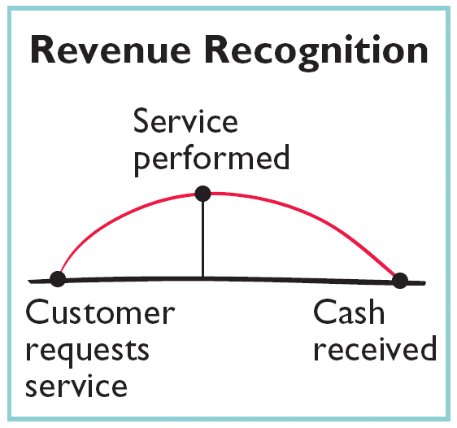
Timing Issues
Recognizing Revenues and Expenses
Revenue Recognition Principle
Companies recognize revenue in the accounting period in which it is earned.
In a service enterprise, revenue is considered to be earned at the time the service is performed.
LO 2 Explain the accrual basis of accounting.

Slide 10
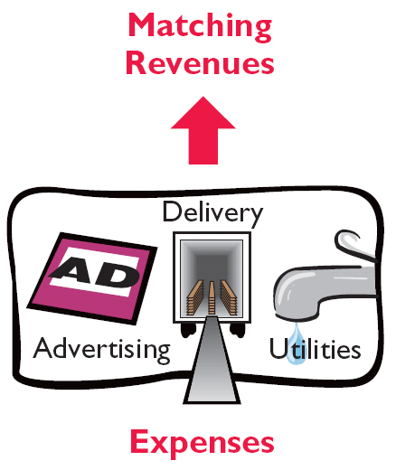
Timing Issues
Recognizing Revenues and Expenses
Matching Principle
Match expenses with revenues in the period when the company makes efforts to generate those revenues.
“Let the expenses follow the revenues.”
LO 2 Explain the accrual basis of accounting.

Slide 11
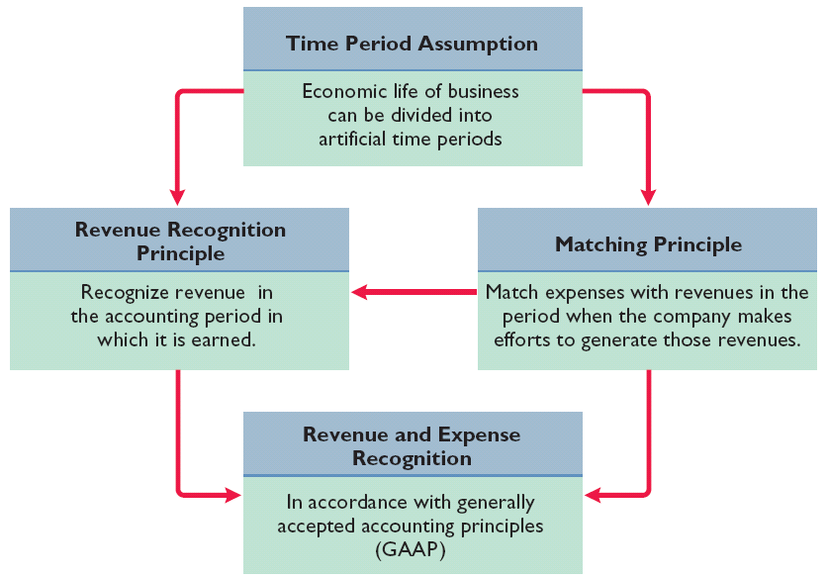
Timing Issues
GAAP relationships in revenue and expense recognition
Illustration 3-1
LO 2 Explain the accrual basis of accounting.

Slide 12
Timing Issues
Review
One of the following statements about the accrual basis of accounting is false. That statement is:
  Events that change a company’s financial statements are recorded in the periods in which the events occur.
  Revenue is recognized in the period in which it is earned.
  The accrual basis of accounting is in accord with generally accepted accounting principles.
  Revenue is recorded only when cash is received, and expenses are recorded only when cash is paid.
LO 2 Explain the accrual basis of accounting.

Slide 13
The Basics of Adjusting Entries
Adjusting entries make it possible to report correct amounts on the balance sheet and on the income statement.
A company must make adjusting entries every time it prepares financial statements.
LO 3 Explain the reasons for adjusting entries.

Slide 14
The Basics of Adjusting Entries
Revenues - recorded in the period in which they are earned.
Expenses - recognized in the period in which they are incurred.
Adjusting entries - needed to ensure that the revenue recognition and matching principles are followed.
LO 3 Explain the reasons for adjusting entries.

Slide 15
Timing Issues
Review
Adjusting entries are made to ensure that:
a. expenses are recognized in the period in which they are incurred.
b. revenues are recorded in the period in which they are earned.
c. balance sheet and income statement accounts have correct balances at the end of an accounting period.
d. all of the above.
LO 3 Explain the reasons for adjusting entries.

Slide 16
Types of Adjusting Entries
Deferrals
Accruals
1. Prepaid Expenses. Expenses paid in cash and recorded as assets before they are used or consumed.
3. Accrued Revenues. Revenues earned but not yet received in cash or recorded.
2. Unearned Revenues. Revenues received in cash and recorded as liabilities before they are earned.
4. Accrued Expenses. Expenses incurred but not yet paid in cash or recorded.
LO 4 Identify the major types of adjusting entries.

Slide 17
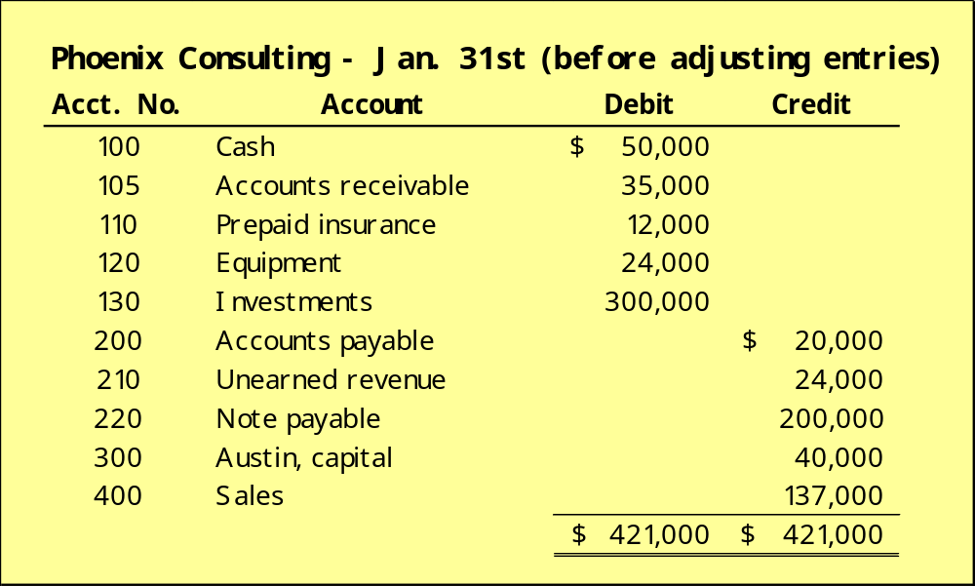
Trial Balance
Trial Balance – Each account is analyzed to determine whether it is complete and up-to-date.
LO 4 Identify the major types of adjusting entries.

Slide 18
Adjusting Entries for Deferrals
Deferrals are either:
Prepaid expenses
OR
Unearned revenues.
LO 5 Prepare adjusting entries for deferrals.

Slide 19
Adjusting Entries for “Prepaid Expenses”
Payment of cash, that is recorded as an asset because service or benefit will be received in the future.
Cash Payment
BEFORE
Expense Recorded
Prepayments often occur in regard to:
  insurance
  supplies
  advertising
  rent
  maintenance on equipment
  fixed assets (depreciation)
LO 5 Prepare adjusting entries for deferrals.

Slide 20
Adjusting Entries for “Prepaid Expenses”
Prepaid Expenses
Costs that expire either with the passage of time or through use.
Adjusting entries (1) to record the expenses that apply to the current accounting period, and (2) to show the unexpired costs in the asset accounts.
LO 5 Prepare adjusting entries for deferrals.

Slide 21
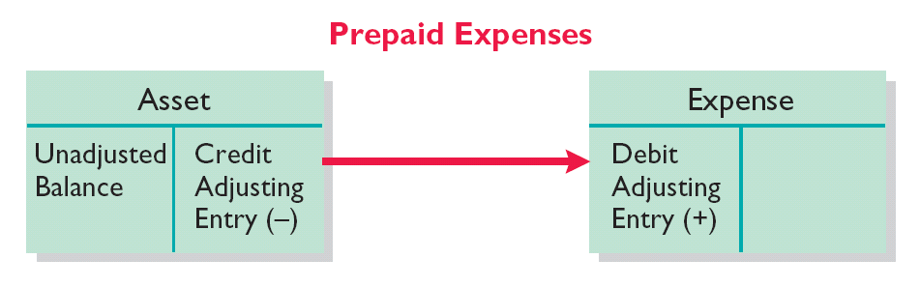
Adjusting Entries for “Prepaid Expenses”
Illustration 3-4
Adjusting entries for prepaid expenses
Increases (debits) an expense account and
Decreases (credits) an asset account.
LO 5 Prepare adjusting entries for deferrals.

Slide 22
Adjusting Entries for “Prepaid Expenses”
Example (Insurance): On Jan. 1st, Phoenix Consulting paid $12,000 for 12 months of insurance coverage. Show the journal entry to record the payment on Jan. 1st.
Jan. 1
Prepaid Insurance
12,000
Cash
12,000
Prepaid Insurance
Cash
Debit
Credit
Debit
Credit
12,000
12,000
LO 5 Prepare adjusting entries for deferrals.

Slide 23
Adjusting Entries for “Prepaid Expenses”
Example (Insurance): On Jan. 1st, Phoenix Consulting paid $12,000 for 12 months of insurance coverage. Show the adjusting journal entry required at Jan. 31st.
Jan. 31
Insurance Expense
1,000
Prepaid Insurance
1,000
Prepaid Insurance
Insurance Expense
Debit
Credit
Debit
Credit
12,000
1,000
1,000
11,000
LO 5 Prepare adjusting entries for deferrals.

Slide 24
Adjusting Entries for “Prepaid Expenses”
Depreciation
Buildings, equipment, and vehicles (long-lived assets) are recorded as assets, rather than an expense, in the year acquired.
Companies report a portion of the cost of a long-lived asset as an expense (depreciation) during each period of the asset’s useful life (Matching Principle).
LO 5 Prepare adjusting entries for deferrals.

Slide 25
Adjusting Entries for “Prepaid Expenses”
Example (Depreciation): On Jan. 1st, Phoenix Consulting paid $24,000 for equipment that has an estimated useful life of 20 years. Show the journal entry to record the purchase of the equipment on Jan. 1st.
Jan. 1
Equipment
24,000
Cash
24,000
Equipment
Cash
Debit
Credit
Debit
Credit
24,000
24,000
LO 5 Prepare adjusting entries for deferrals.

Slide 26
Adjusting Entries for “Prepaid Expenses”
Example (Depreciation): On Jan. 1st, Phoenix Consulting paid $24,000 for equipment that has an estimated useful life of 20 years. Show the adjusting journal entry required at Jan. 31st. ($24,000 / 20 yrs. / 12 months = $100)
Jan. 31
Depreciation Expense
100
Accumulated Depreciation
100
Depreciation Expense
Accumulated Depreciation
Debit
Credit
Debit
Credit
100
100
LO 5 Prepare adjusting entries for deferrals.

Slide 27
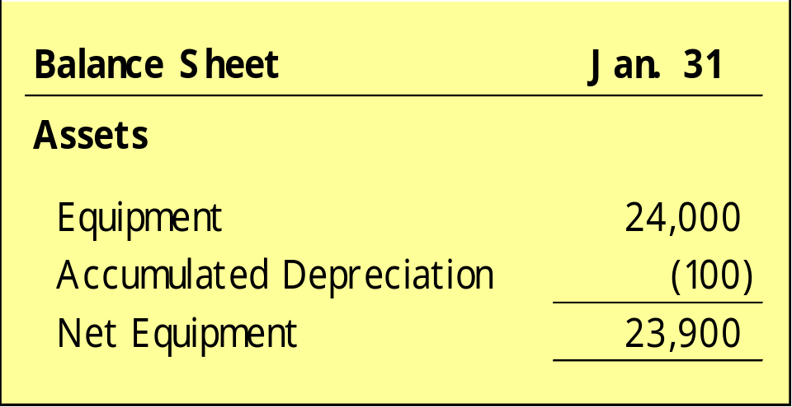
Adjusting Entries for “Prepaid Expenses”
Depreciation (Statement Presentation)
Accumulated Depreciation is a contra asset account.
Appears just after the account it offsets (Equipment) on the balance sheet.
LO 5 Prepare adjusting entries for deferrals.

Slide 28
Adjusting Entries for “Unearned Revenues”
Receipt of cash that is recorded as a liability because the revenue has not been earned.
Cash Receipt
BEFORE
Revenue Recorded
Unearned revenues often occur in regard to:
  rent
  airline tickets
  school tuition
  magazine subscriptions
  customer deposits
LO 5 Prepare adjusting entries for deferrals.

Slide 29
Adjusting Entries for “Unearned Revenues”
Unearned Revenues
Company makes an adjusting entry to record the revenue that has been earned and to show the liability that remains.
The adjusting entry for unearned revenues results in a decrease (a debit) to a liability account and an increase (a credit) to a revenue account.
LO 5 Prepare adjusting entries for deferrals.

Slide 30
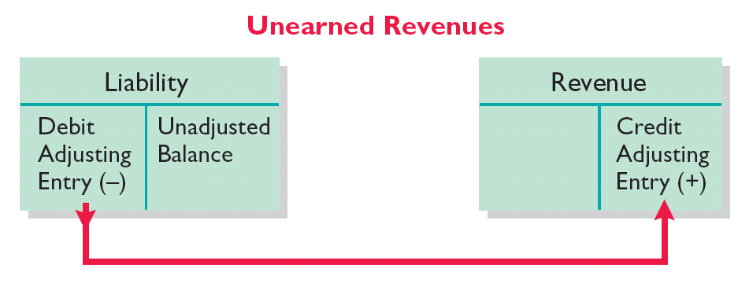
Adjusting Entries for “Unearned Revenues”
Illustration 3-10
Adjusting entries for unearned revenues
Decrease (a debit) to a liability account and
Increase (a credit) to a revenue account.
LO 5 Prepare adjusting entries for deferrals.

Slide 31
Adjusting Entries for “Unearned Revenues”
Example: On Jan. 1st, Phoenix Consulting received $24,000 from Arcadia High School for 3 months rent in advance. Show the journal entry to record the receipt on Jan. 1st.
Jan. 1
Cash
24,000
Unearned Rent Revenue
24,000
Cash
Unearned Rent Revenue
Debit
Credit
Debit
Credit
24,000
24,000
LO 5 Prepare adjusting entries for deferrals.

Slide 32
Adjusting Entries for “Unearned Revenues”
Example: On Jan. 1st, Phoenix Consulting received $24,000 from Arcadia High School for 3 months rent in advance. Show the adjusting journal entry required on Jan. 31st.
Jan. 31
Unearned Rent Revenue
8,000
Rent Revenue
8,000
Rent Revenue
Unearned Rent Revenue
Debit
Credit
Debit
Credit
8,000
8,000
24,000
16,000
LO 5 Prepare adjusting entries for deferrals.

Slide 33
Adjusting Entries for Accruals
Made to record:
  Revenues earned and
  OR
  Expenses incurred
in the current accounting period that have not been recognized through daily entries.
LO 6 Prepare adjusting entries for accruals.

Slide 34
Adjusting Entries for “Accrued Revenues”
Revenues earned but not yet received in cash or recorded.
Adjusting entry results in:
Revenue Recorded
BEFORE
Cash Receipt
Accrued revenues often occur in regard to:
  rent
  interest
  services performed
LO 6 Prepare adjusting entries for accruals.

Slide 35
Adjusting Entries for “Accrued Revenues”
Accrued Revenues
An adjusting entry serves two purposes:
(1) It shows the receivable that exists, and
(2) It records the revenues earned.
LO 6 Prepare adjusting entries for accruals.

Slide 36
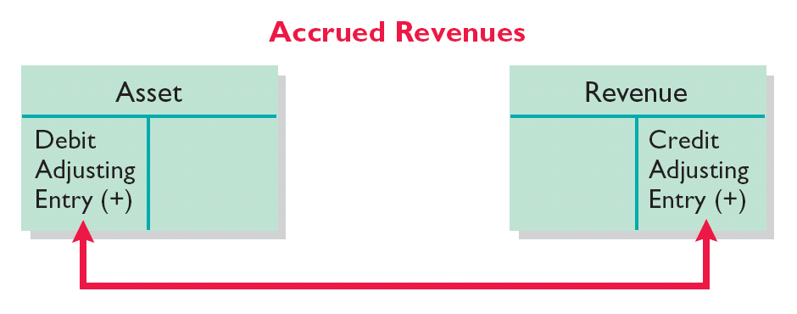
Adjusting Entries for “Accrued Revenues”
Illustration 3-13
Adjusting entries for accrued revenues
Increases (debits) an asset account and
Increases (credits) a revenue account.
LO 6 Prepare adjusting entries for accruals.

Slide 37
Adjusting Entries for “Accrued Revenues”
Example: On Jan. 1st, Phoenix Consulting invested $300,000 in securities that return 5% interest per year. Show the journal entry to record the investment on Jan. 1st.
Jan. 1
Investments
300,000
Cash
300,000
Investments
Cash
Debit
Credit
Debit
Credit
300,000
300,000
LO 6 Prepare adjusting entries for accruals.

Slide 38
Adjusting Entries for “Accrued Revenues”
Example: On Jan. 1st, Phoenix Consulting invested $300,000 in securities that return 5% interest per year. Show the adjusting journal entry required on Jan. 31st. ($300,000 x 5% / 12 months = $1,250)
Jan. 31
Interest Receivable
1,250
Interest Revenue
1,250
Interest Receivable
Interest Revenue
Debit
Credit
Debit
Credit
1,250
1,250
LO 6 Prepare adjusting entries for accruals.

Slide 39
Adjusting Entries for “Accrued Expenses”
Expenses incurred but not yet paid in cash or recorded.
Adjusting entry results in:
Expense Recorded
BEFORE
Cash Payment
Accrued expenses often occur in regard to:
  rent
  interest
  taxes
  salaries
LO 6 Prepare adjusting entries for accruals.

Slide 40
Adjusting Entries for “Accrued Expenses”
Accrued Expenses
An adjusting entry serves two purposes:
(1) It records the obligations, and
(2) It recognizes the expenses.
LO 6 Prepare adjusting entries for accruals.

Slide 41
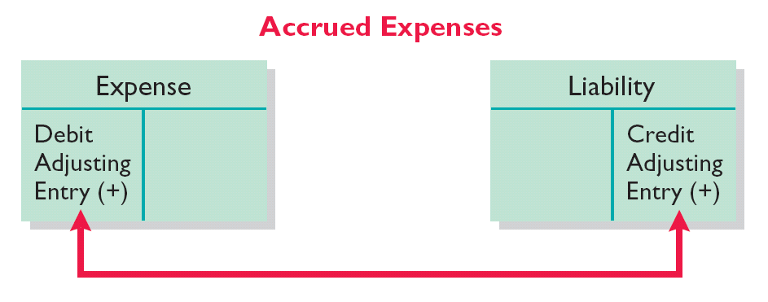
Adjusting Entries for “Accrued Expenses”
Illustration 3-16
Adjusting entries for accrued expenses
Increases (debits) an expense account and
Increases (credits) a liability account.
LO 6 Prepare adjusting entries for accruals.

Slide 42
Adjusting Entries for “Accrued Expenses”
Example: On Jan. 2nd, Phoenix Consulting borrowed $200,000 at a rate of 9% per year. Interest is due on first of each month. Show the journal entry to record the borrowing on Jan. 2nd.
Jan. 2
Cash
200,000
Notes Payable
200,000
Cash
Notes Payable
Debit
Credit
Debit
Credit
200,000
200,000
LO 6 Prepare adjusting entries for accruals.

Slide 43
Adjusting Entries for “Accrued Expenses”
Example: On Jan. 2nd, Phoenix Consulting borrowed $200,000 at a rate of 9% per year. Interest is due on first of each month. Show the adjusting journal entry required on Jan. 31st. ($200,000 x 9% / 12 months = $1,500)
Jan. 31
Interest Expense
1,500
Interest Payable
1,500
Interest Expense
Interest Payable
Debit
Credit
Debit
Credit
1,500
1,500
LO 6 Prepare adjusting entries for accruals.

Slide 44
Adjusting Entries for “Accrued Expenses”
Accrued Expenses
An adjusting entry serves two purposes:
(1) It records the obligations, and
(2) it recognizes the expenses.
LO 6 Prepare adjusting entries for accruals.

Slide 45
A review of the ledger of Remington Company at December 31,2008, produces the following data pertaining to the preparation of annual adjusting entries.
Salaries payable $0. There are eight salaried employees. Salaries are paid every Friday for the current week. Five employees receive a salary of $800 each per week and three employees earn $600 each per week. December 31 is a Tuesday. Employees do not work weekends. All employees worked the last 2 days of December.
Unearned rent $324,000. The

Slide 46
The Adjusted Trial Balance
After all adjusting entries are journalized and posted the company prepares another trial balance from the ledger accounts (Adjusted Trial Balance).
Its purpose is to prove the equality of debit balances and credit balances in the ledger.
LO 7 Describe the nature and purpose of an adjusted trial balance.

Slide 47
Timing Issues
Review
Which of the following statements is incorrect concerning the adjusted trial balance?
  An adjusted trial balance proves the equality of the total debit balances and the total credit balances in the ledger after all adjustments are made.
  The adjusted trial balance provides the primary basis for the preparation of financial statements.
  The adjusted trial balance lists the account balances segregated by assets and liabilities.
  The adjusted trial balance is prepared after the adjusting entries have been journalized and posted.
LO 7 Describe the nature and purpose of an adjusted trial balance.

Slide 48
Preparing Financial Statements
Financial Statements are prepared directly from the Adjusted Trial Balance.
Balance Sheet
Income Statement
Owner’s Equity Statement
Statement of Cash Flows
LO 7 Describe the nature and purpose of an adjusted trial balance.

Slide 49
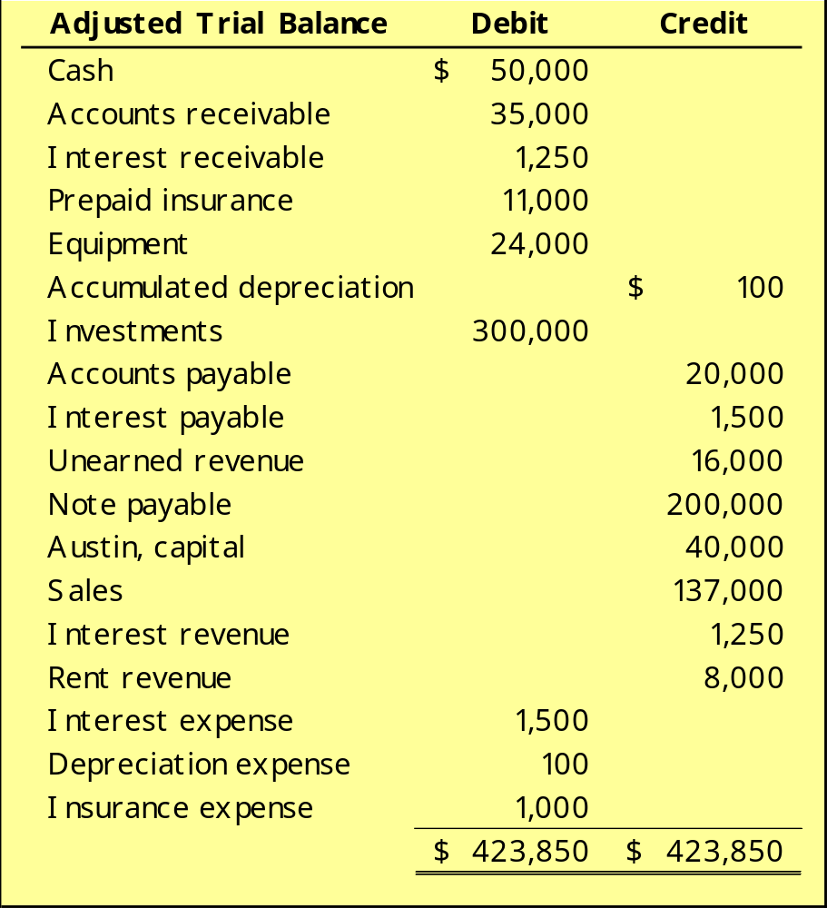
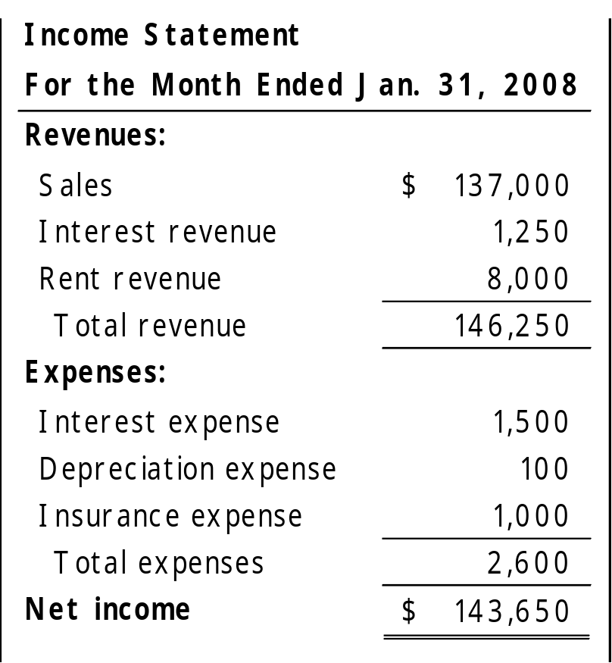
Preparing Financial Statements
Income Statement
LO 7 Describe the nature and purpose of an adjusted trial balance.

Slide 50
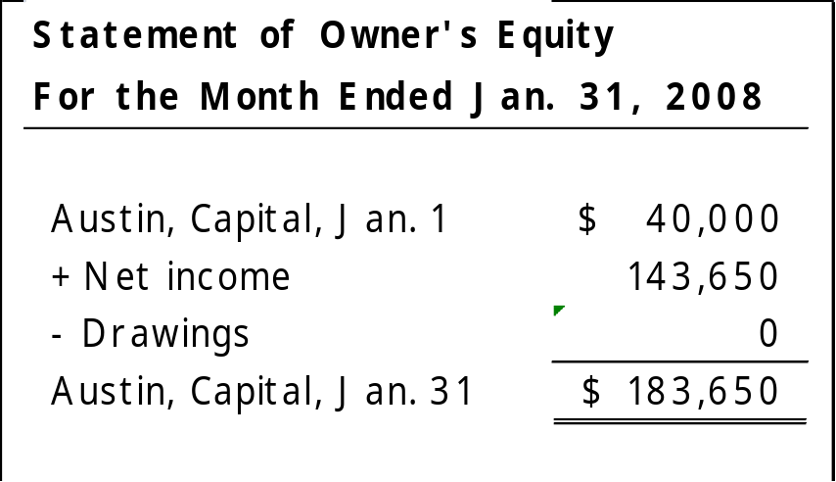
Preparing Financial Statements
Statement of Owner’s Equity
LO 7 Describe the nature and purpose of an adjusted trial balance.

Slide 51
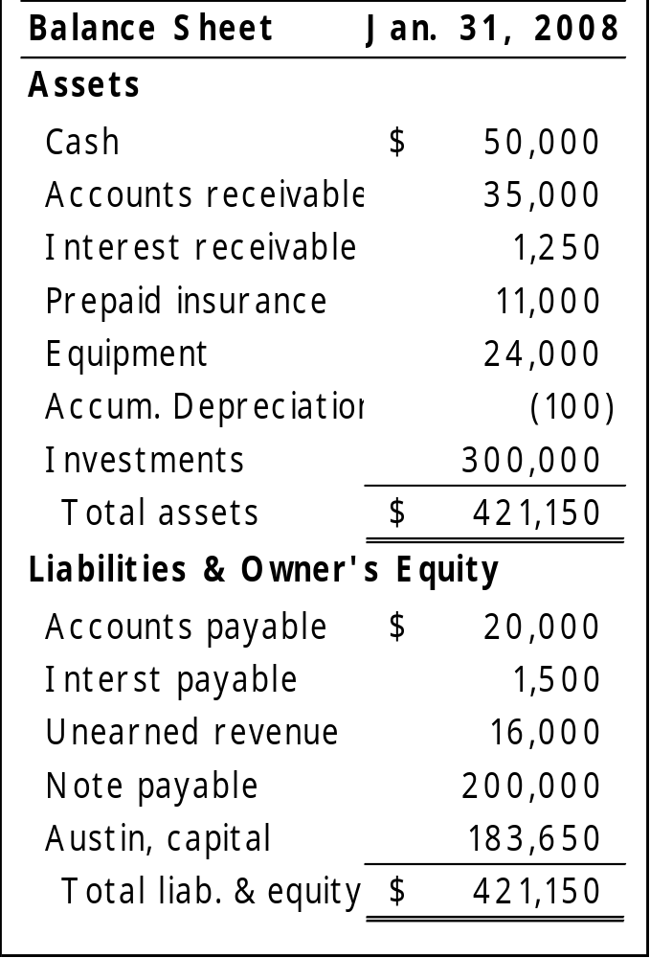
Preparing Financial Statements
LO 7 Describe the nature and purpose of an adjusted trial balance.

Slide 52
Alternative Treatment of Prepaid Expenses and Unearned Revenues
Some companies use an alternative treatment for prepaid expenses and unearned revenues.
When a company prepays an expense, it debits that amount to an expense account.
When a company receives payment for future services, it credits the amount to a revenue account.
LO 8 Prepare adjusting entries for the alternative treatment of deferrals.

Slide 53
Alternative Treatment for “Prepaid Expenses”
Example (Insurance): On Dec. 1st, Phoenix Consulting paid $12,000 for 12 months of insurance coverage. Show the journal entry to record the payment on Dec. 1st.
Dec. 1
Insurance Expense
12,000
Cash
12,000
Insurance Expense
Cash
Debit
Credit
Debit
Credit
12,000
12,000
LO 8 Prepare adjusting entries for the alternative treatment of deferrals.

Slide 54
Alternative Treatment for “Prepaid Expenses”
Example (Insurance): On Dec. 1st, Phoenix Consulting paid $12,000 for 12 months of insurance coverage. Show the adjusting journal entry required at Dec. 31st.
Dec. 31
Prepaid Insurance
11,000
Insurance Expense
11,000
Insurance Expense
Prepaid Insurance
Debit
Credit
Debit
Credit
12,000
11,000
11,000
1,000
LO 8 Prepare adjusting entries for the alternative treatment of deferrals.

Slide 55
Alternative Treatment for “Unearned Revenues”
Example: On Dec. 1st, Phoenix Consulting received $24,000 from Arcadia High School for 3 months rent in advance. Show the journal entry to record the receipt on Dec. 1st.
Dec. 1
Cash
24,000
Rent Revenue
24,000
Cash
Rent Revenue
Debit
Credit
Debit
Credit
24,000
24,000
LO 8 Prepare adjusting entries for the alternative treatment of deferrals.

Slide 56
Alternative Treatment for “Unearned Revenues”
Example: On Dec. 1st, Phoenix Consulting received $24,000 from Arcadia High School for 3 months rent in advance. Show the adjusting journal entry required on Dec. 31st.
Dec. 31
Rent Revenue
16,000
Unearned Rent Revenue
16,000
Unearned Rent Revenue
Rent Revenue
Debit
Credit
Debit
Credit
16,000
16,000
24,000
8,000
LO 8 Prepare adjusting entries for the alternative treatment of deferrals.

Slide 57
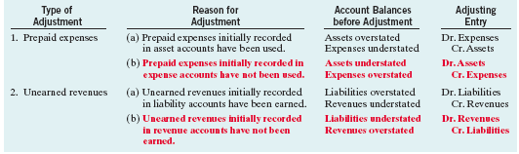
Summary of Basic Relationships for Deferrals
Illustration 3A-7
LO 8 Prepare adjusting entries for the alternative treatment of deferrals.

Slide 58
Copyright
“Copyright © 2008 John Wiley & Sons, Inc. All rights reserved. Reproduction or translation of this work beyond that permitted in Section 117 of the 1976 United States Copyright Act without the express written permission of the copyright owner is unlawful. Request for further information should be addressed to the Permissions Department, John Wiley & Sons, Inc. The purchaser may make back-up copies for his/her own use only and not for distribution or resale. The Publisher assumes no responsibility for errors, omissions, or damages, caused by the use of these programs or from the use of the information contained herein.”

