Slide 1


Slide 2
CHAPTER 4
COMPLETING THE
ACCOUNTING CYCLE
Accounting Principles, Eighth Edition

Slide 3
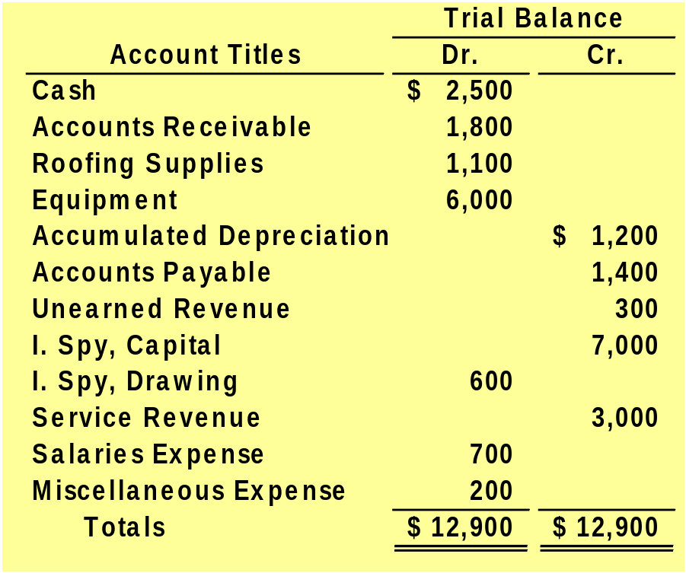
Example
The trial balance for Undercover Roofing for the month ended March 31, 2008, is as follows.
Other data:
1. Supplies on hand total $140.
2. Depreciation for March is $200.
3. Unearned revenue amounted to $130 on March 31.
4. Accrued salaries are $350.
LO 1 Prepare a worksheet.

Slide 4
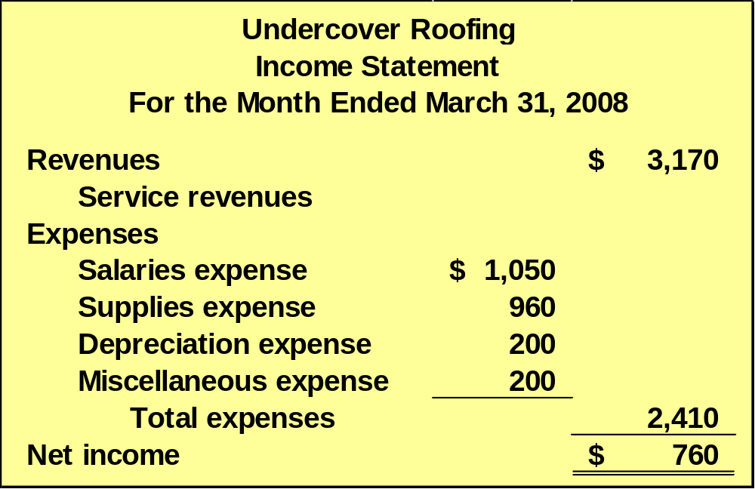
Preparing Financial Statements
b. Prepare an income statement for the month ended March 31, 2008.
LO 1 Prepare a worksheet.

Slide 5
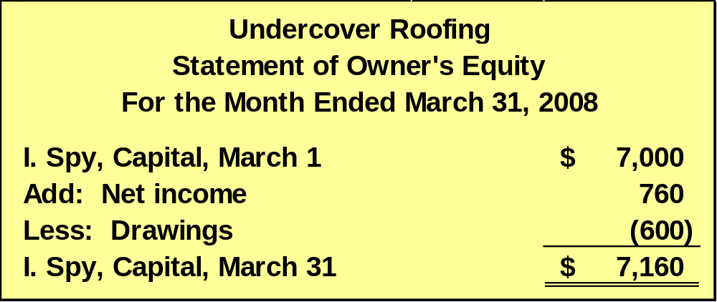
Preparing Financial Statements
b. Prepare an owner’s equity statement for the month ended March 31, 2008.
LO 1 Prepare a worksheet.

Slide 6
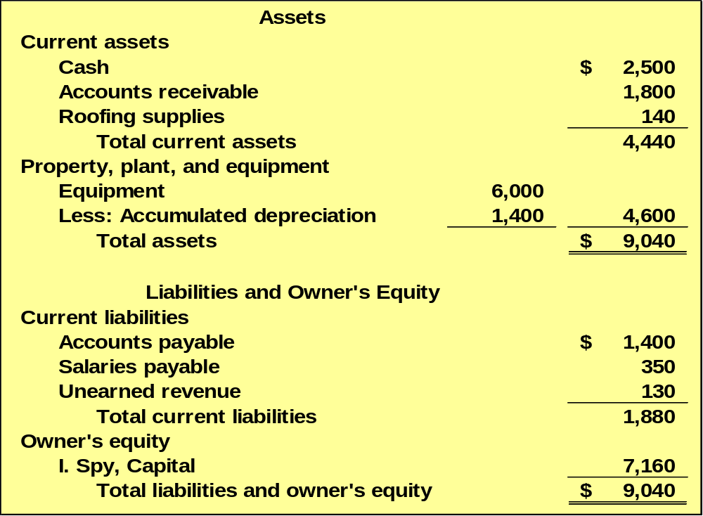
Preparing Financial Statements
b. Prepare a balance sheet as of March 31, 2008.
Undercover Roofing
Balance Sheet
March 31, 2008
LO 1 Prepare a worksheet.

