Slide 1
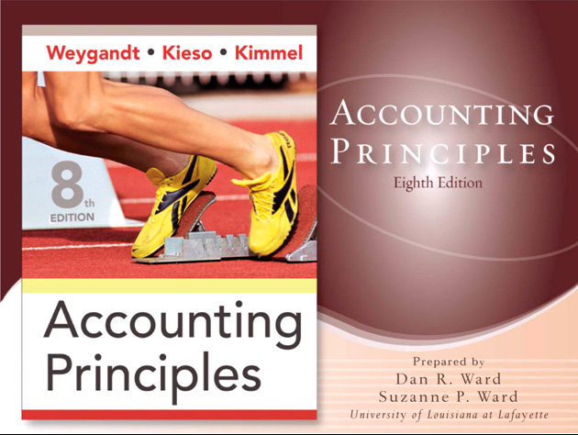

Slide 2
CHAPTER 19
MANAGERIAL ACCOUNTING
Accounting Principles, Eighth Edition

Slide 3
Managerial Accounting Basics
Definition of Managerial Accounting
A field of accounting that provides economic and financial information for managers and other internal users.
Also called Management Accounting

Slide 4
Managerial Accounting Basics
Distinguishing Features
Applies to all types of business -
Service, Merchandising, and Manufacturing
Applies to all forms of businesses –
Proprietorships, Partnerships, and Corporations
Applies to not-for-profit and profit oriented companies
LO 1 Explain the distinguishing features of managerial accounting.

Slide 5

Managerial Accounting Basics
Distinguishing Features: Continued
More responsible for strategic
cost management
Teams with people from production,
marketing, engineering, etc.
Aid in making critical decisions
LO 1 Explain the distinguishing features of managerial accounting.

Slide 6

Comparing Managerial and Financial Accounting
Similarities
Both deal with economic events of a business –
Thus, interests overlap
Both require that economic events be
quantified and communicated to
interested parties –
Determining unit cost is part of
managerial accounting,
Reporting cost of goods manufactured
is a part of financial accounting
LO 1 Explain the distinguishing features of managerial accounting.

Slide 7
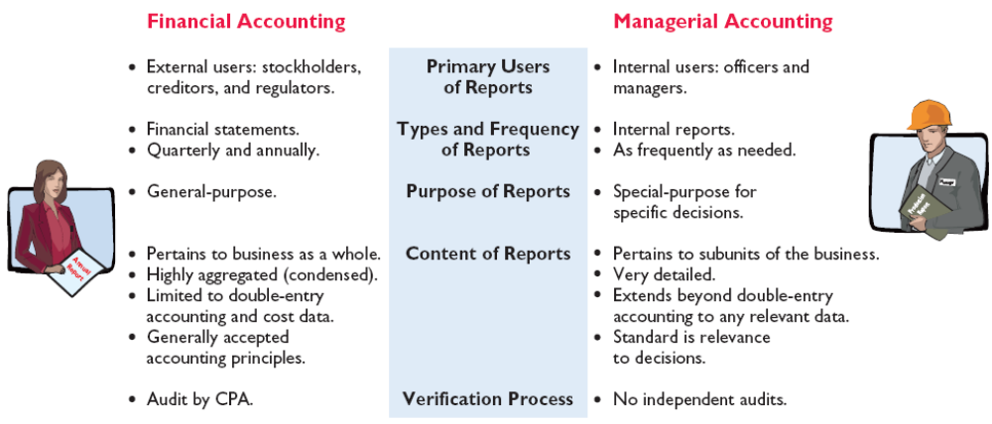
Comparing Managerial and Financial Accounting
Differences
LO 1 Explain the distinguishing features of managerial accounting.

Slide 8
Managerial Accounting Basics
Review Question
Managerial accounting:
a. Pertains to the entity as a whole and is highly aggregated.
b. Places emphasis on special-purpose information.
c. Is limited to cost data.
d. Is governed by generally accepted accounting principles.
LO 1 Explain the distinguishing features of managerial accounting.

Slide 9
Managerial Accounting Basics
Management Functions
Management’s activities and responsibilities can be classified into the following three broad functions:
  Planning
  Directing
  Controlling
LO 2 Identify the 3 broad functions of management.

Slide 10

Management Functions
Planning
Look ahead and establish objectives such as –
Maximize short-term profit
Commit to environmental protection
Key Objective: Add value to the business
Value measured by trading price of stock
and by potential selling price of the company
LO 2 Identify the 3 broad functions of management.

Slide 11

Management Functions
Directing
Coordinate diverse activities and human resources
Implement planned objectives
Provide incentives to motivate employees
Hire and train employees including
executives, managers, and supervisors
Produce smooth-running operation
LO 2 Identify the 3 broad functions of management.

Slide 12

Management Functions
Controlling
Keep activities on track
Determine whether goals are met
Decide changes needed to get back on track
May use an informal or formal system of evaluations
Good decision making is the outcome of good judgment in planning, directing, and controlling.
LO 2 Identify the 3 broad functions of management.

Slide 13
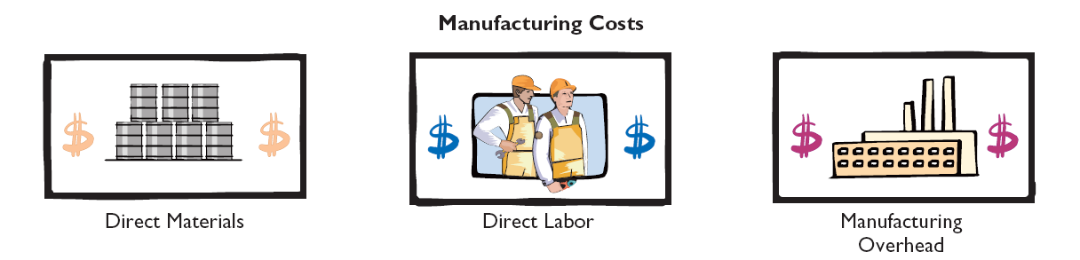

Managerial Cost Concepts
Manufacturing Costs
Manufacturing consists of activities to convert raw materials into finished goods.
In contrast, a merchandising firm sells goods in the form in which they were bought.
Categories of manufacturing costs include:
LO 3 – Define the three classes of manufacturing costs.

Slide 14
Manufacturing Costs
Materials
Raw Materials
Basic materials used in manufacturing
Direct Materials
Raw materials that can be physically and directly associated with the finished product
LO 3 Define the three classes of manufacturing costs.

Slide 15
Manufacturing Costs
Materials
Indirect Materials
Raw materials that cannot be easily associated with the finished product
Not physically part of the finished product or they are an insignificant part of finished product in terms of cost
Considered part of manufacturing overhead
LO 3 Define the three classes of manufacturing costs.

Slide 16
Manufacturing Costs
Labor
Direct Labor
Work of factory employees that can be physically and directly associated with converting raw materials into finished goods
Indirect Labor
Work of factory employees that has no physical association with the finished product or for which it is impractical to trace to the goods produced
LO 3 Define the three classes of manufacturing costs.

Slide 17
Manufacturing Costs
Manufacturing Overhead
Costs that are indirectly associated with manufacturing the product
Includes all manufacturing costs except direct materials and direct labor
LO 3 Define the three classes of manufacturing costs.

Slide 18
Manufacturing Costs
Review Question
Which of the following is not an element of manufacturing overhead?:
a. Sales manager’s salary.
b. Plant manager’s salary.
c. Factory repairman’s wages.
d. Product inspector’s salary.
LO 3 Define the three classes of manufacturing costs.

Slide 19
Product Versus Period Costs
Product Costs
Components: direct material cost, direct labor cost, and manufacturing overhead
A necessary and integral part of producing the product
Recorded as inventory when incurred
Not an expense until the finished goods inventory is sold then cost of goods sold
LO 4 Distinguish between product and period costs.

Slide 20
Product Versus Period Costs
Period Costs
Matched with revenue of a specific time period and charged to expense as incurred
Non-manufacturing costs
Deducted from revenues in period incurred to determine net income
Includes all selling and administrative expenses
LO 4 Distinguish between product and period costs.

Slide 21
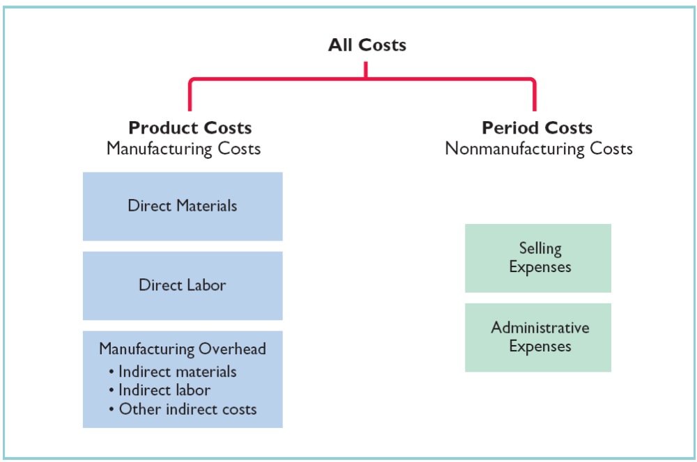
Product Versus Period Costs
LO 4 Distinguish between product costs and period costs.

Slide 22
Manufacturing Costs in Financial Statements
Income Statement
The income statement for a manufacturer is similar to that of a merchandiser except for the cost of goods sold section.
CGS
LO 5 Explain the difference between a merchandising and a manufacturing income statement.

Slide 23
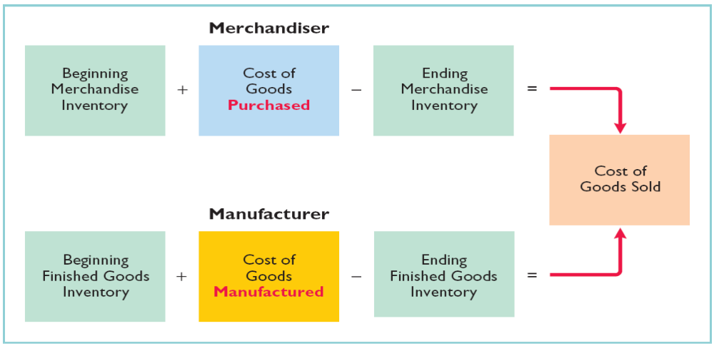
Manufacturing Costs in Financial Statements
Cost of Goods Sold Components
Merchandiser versus Manufacturer
LO 5 Explain the difference between a merchandising and a manufacturing income statement.

Slide 24
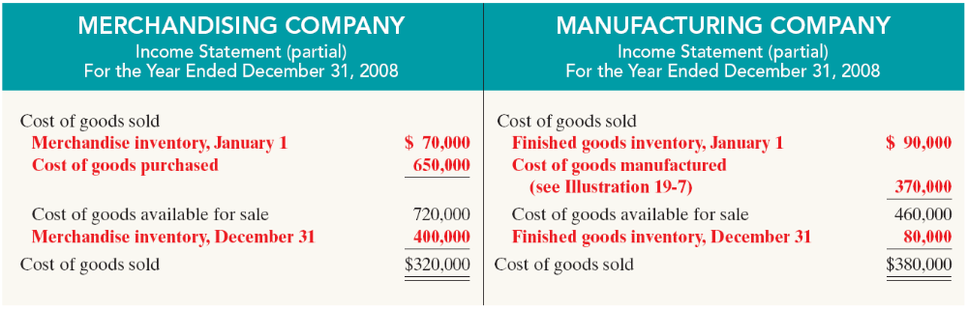
Manufacturing Costs in Financial Statements
Cost of Goods Sold Section of the Income Statement
LO 5 Explain the difference between a merchandising and a manufacturing income statement.

Slide 25
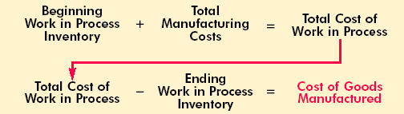
Manufacturing Costs in Financial Statements
Determining the Cost of Goods Manufactured
Work in Process – partially completed units of product
Total Manufacturing Costs – sum of direct material costs, direct labor costs, and manufacturing overhead; all incurred in the current period
LO 6 Indicate how cost of goods manufactured is determined.

Slide 26
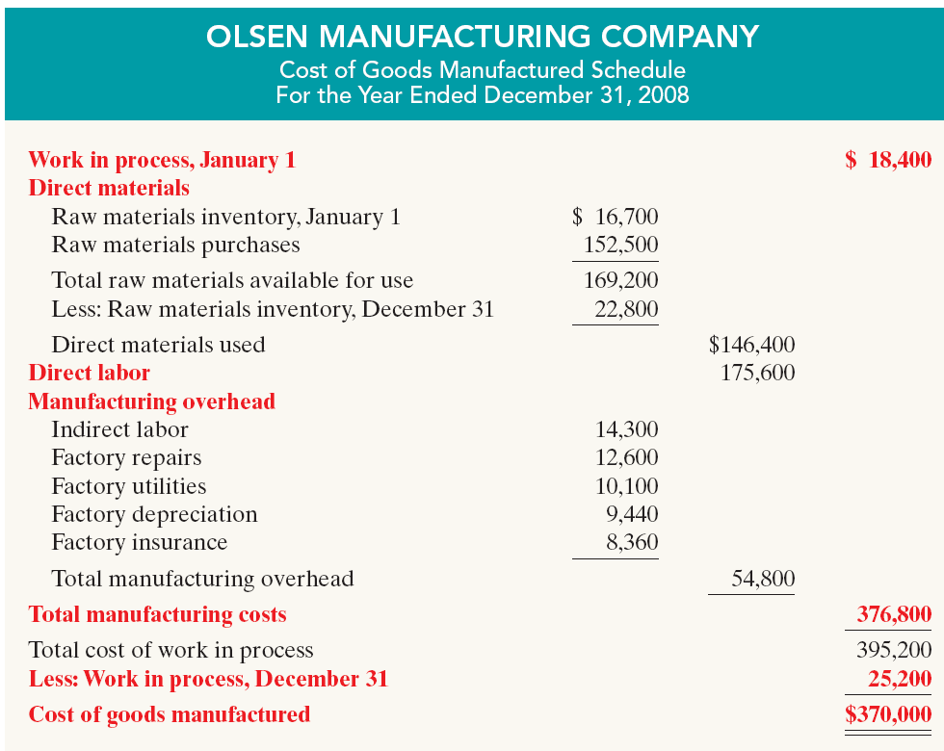
Manufacturing Costs in Financial Statements
LO 6 Indicate how cost of goods manufactured is determined.

Slide 27
Manufacturing Costs
Review Question
Direct Materials are a:
Product Manufacturing Period
Cost Overhead Cost
a. Yes Yes No
b. Yes No No
c. Yes Yes Yes
d. No No No

Slide 28
Managerial Accounting Today
Service Industry Trends
U.S. economy has shifted toward an emphasis on providing services rather than goods
Over 50% of U.S. workers are now employed by service companies
Trend is expected to continue in the future
Most of the techniques learned for manufacturing firms are applicable to service companies
LO 8 Identify trends in management accounting.

Slide 29
Chapter Review - Brief Exercise 19-5
Indicate whether each of the following costs of an automobile manufacturer would be classified as direct materials, direct labor, or manufacturing overhead.
______ a. Windshield
______ b. Engine
______ c. Wages of assembly line worker
______ d. Depreciation of factory machinery
______ e. Factory machinery lubricants
______ f. Tires
______ g. Steering wheel
______ h. Salary of painting supervisor
DM
DM
DL
MO
MO
DM
DM
MO

Slide 30
Chapter Review - Brief Exercise 19-6
Identify whether each of the following costs should be classified as product costs or period costs.
____________ a. Manufacturing overhead
____________ b. Selling expenses
____________ c. Administrative expenses
____________ d. Advertising expense
____________ e. Direct labor
____________ f. Direct material
Product
Period
Period
Period
Product
Product

