Slide 1
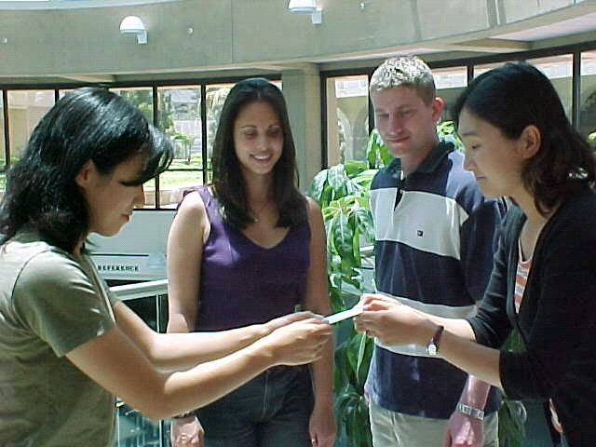
Communicating Across
Culturals
CHAPTER SIXTEEN

Slide 2
Overview
The Importance of Cross-cultural Communication in Business
Problems of Cultural Differences
Problems of Language
Some Solutions for Improved Communication

Slide 3
Why is communicating across cultures important to business?
Technological advances have made doing business more global.
Understanding those who buy and use a company’s products or services helps you design ones that fit your customers’ needs.
Successful communication improves productivity and creates a comfortable workplace.
Communicating with those from other cultures enriches your business and personal life.

Slide 4
Dimensions of Cultural Differences
Three major factor that affect culture
  Topography of the country
  Country’s history
  Role of religion in the culture

Slide 5
Problems of Cultural Differences
Body positions and movement
Views and practices concerning factors of human relationships
Effects on business communication techniques

Slide 6
Body Positions and Movement
Body Parts
Gestures
Eye Contact
Touching and Handshaking
Facial Expression

Slide 7
Some Gesture Differences
Gesture
Meaning 1
Meaning 2
Hand up, palm out, wrist stiff, back and forth motion
Good-bye
(America)
No
(Europe)
Raised hand with index finger extended, head high
Come here
(America)
Rude to point a finger
(Japan)
Raised hand, fingers in “V” position
Victory or peace
(with palm out)
(America)
Double, sexual, insulting
(with palm in)
(England)
Vertical horns
Hook’em Horns
(Texas)
Your spouse is unfaithful
(Italy)
Good luck
(Brazil and Venezuela)
Thumbs up
Fine, Good going, Everything is okay
(America)
Strong, sexual insulting
(Nigeria and Australia)

Slide 8
Attitudes Toward Factors of
Human Relationships
Time
Space
Odors
Frankness
Intimacy of Relationships
Values
Expression of Emotions

Slide 9
Effects on Business
Communication Techniques
Our communication techniques are not universally acceptable.
Our techniques do not work with all English-speaking people.
Problems can be overcome by learning about other cultures.

Slide 10
British English vs. American English
British
American
Spelling Differences
Labour
Labor
Generalise
Generalize
Mum
Mom
Meaning Differences
Lift
Elevator
Blokes
Guys
Phones
Called
Chips
Fries
Billion (12 zeros)
Billion (9 zeros)
Tights
Panty hose
Trousers
Pants
Bin
Trash

Slide 11
Problems of Language
Lack of language equivalency
Difficulties in using English
  Multiple meanings of words
  Two-word verbs
  Culturally derived words

Slide 12
Language Equivalency Examples
No such word
  The Japanese have several words to define fine shadings of dependence, obligations, and responsibility that are difficult to translate to English because our culture has not learned to experience them.
No need for the word
No equivalent grammatical form

Slide 13
Examples of Multiple Meanings
run
fast
ring

Slide 14
Substitutes for Two-word Verbs
Two-word Verb
Substitute
cut up
clown
keyed up
excited, nervous
live down
remove, overcome
put away
kill
shut out
prevent
tie down
hold
track down
search

Slide 15
Avoid Culturally Derived Words
Slang expressions
Shifted use (sports, computer, science)
Idioms and colloquialisms

Slide 16
Some American Idioms to Avoid
burn your bridges
cold turkey
doggie bag
fat chance
gravy train
have your cake and eat it too
in a nutshell
let the cat out of the bag
pot calling the kettle black
pull no punches
stick in the mud through thick and thin
tie the knot
tighten one’s belt
up a tree
walk on air
wheel and deal
worth one’s salt

Slide 17
Suggestions for Communicating Across Cultures Successfully
Do your research
Know yourself and your company
Be aware-and wary-of stereotypes
Adapt your English to your audience
Be open to change

Slide 18
Suggestions for Communicating Across Cultures Successfully
Talk or write as simply and clearly as possible
Word questions carefully
  Avoid double questions
  Avoid yes/no questions
  Avoid negative questions
Use continuous confirmation
  Use back translating when possible
  Use technology to assist with written and oral communication

Slide 19
“More than technical or infrastructure problems, cultural problems will be the biggest issue that merchants will face in the global marketplace.”
--Bruce Guptill, Analyst
The Gartner Group

