Slide 1

Getting to the Point in Good News and Neutral Messages
CHAPTER SEVEN

Slide 2
Overview
6-<number>
Preliminary assessment
A general direct plan
Applications of the general plan to
  Routine inquiries
  Inquiries about personnel
  Favorable responses
  Personnel evaluations
  Adjustment grants
  Order acknowledgments
  Claims

Slide 3
A General Guideline for
Organizing Messages
6-<number>
Short messages usually are written in the direct order.
Long messages may require indirect order.

Slide 4
Preliminary Assessment
6-<number>
Determine the reader’s probable reaction – positive, neutral, negative
  If positive or neutral, directness usually recommended
  If negative, indirectness usually recommended

Slide 5
The General Direct Plan
6-<number>
Start with the objective.
Include any necessary identification information.
Cover the remainder of the objective.
End with goodwill.

Slide 6
Preliminary Considerations in Writing Routine Inquiries (1 of 2)
6-<number>
You are asking for something your reader is likely to grant.
Thus, a direct approach is justified.

Slide 7
Directness for Routine Inquiries (2 of 2)
6-<number>
The message plan:
Opening
Begin directly with the objective.
  Either ask a specific question or
  make a general request for the information.
Include any necessary explanation--wherever it fits (as a separate part of the message or worked in with the questions).
If a number of questions are involved, give them structure.
  May number them.
  Make them stand out.
End with goodwill words--something appropriate that fits the one case.
Body
Closing

Slide 8
Routine Inquiry−Bad Example
6-<number>
Dear Mr. Crifasi:
As you will recall, you recently returned merchandise to us. We at Hobsons sincerely hope that this transaction was satisfactory. In fact, we are in the process of making changes which will insure that such transactions are favorably handled. Thus, we would like the answers for some questions about your experiences returning merchandise to us.
We’d like to know whether you were served promptly and courteously and whether the adjustment was satisfactory and in accordance with your wishes. Also, we’d like to know whether the salesperson offered assistance to you in selecting other merchandise.
You may just write your comments on this letter and return it in the enclosed addressed and stamped envelope. Thanking you in advance for your cooperation, I remain,
Sincerely,

Slide 9
Routine Inquiry--Good Example
6-<number>
Dear Mr. Crifasi:
Will you please help us to serve you better by answering the following questions.
When you returned merchandise at our store recently:
1. Were you served promptly and courteously?
2. Was the adjustment satisfactory and in accordance with your wishes?
3. Did the salesperson offer to assist you in selecting other merchandise?
Please write your answers--and any other comments you may wish to make about the service of this store and any other Hobson store--on this letter. Then return it in the enclosed stamped and addressed envelope.
We shall be most grateful for your help.
Sincerely,

Slide 10

[Jane Adami, 11:17 AM 11/17/2005 –0800, Confidential report on Ms. Cindy Commons, requested July 2]
Itemized statement for January
Date: Tue, 17 Nov 2005 09:11:15 –0800(PST)
From: Jadami1@aol.com
To: Sarah Brown <Sarah_Brown@trevorhardware.com>
Subject: Confidential report on Ms. Cindy Commons, requested July 2
Dear Ms. Brown:
Will you please send me an itemized statement covering my account for January.
According to my invoice file, the amount owed should be $2,374.27. Your statement shows $2,833.74 owed. Perhaps you did not record the $427.17 of merchandise returned on invoice no. 3211C late last week. But even this possible error does not explain all of the difference.
I shall appreciate your usual promptness in clearing up this matter.
Jane Adami, President
Two Sisters Antiques
Itemized …

Slide 11
Inquiries About People
6-<number>
They are a special form of routine inquiry.
They involve two differences:
  Need to respect human rights
  Need to structure around the one job

Slide 12
Thus the plan for this message becomes the following:
6-<number>
Opening
Begin directly--with a general question seeking information, or with a specific question.
Explain the situation.
Cover the questions systematically, including explanations, as needed.
End with specially adapted goodwill words.
Body
Closing

Slide 13
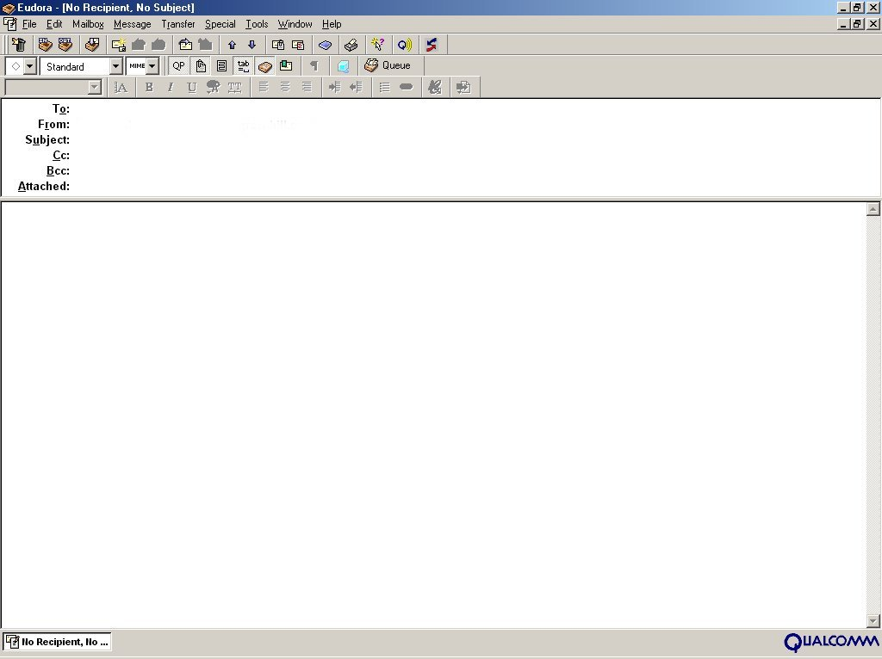
DougBateman@yahoo.com
JanetBaker@travelcenter.com
Recommendation for Alice Barron
Dear Mr. Bateman:
Will you please assist me in evaluating Ms. Alice Barron for work as a district sales manager with us. In her application Ms. Barron indicated that she worked for you as a salesperson from early 2001 to 2005. She has authorized this inquiry.
6-
The work for which we are considering Ms. Barron involves supervision a staff of four salespeople plus an office staff of two. While with you, did Ms. Barron show the leadership ability such an assignment requires?
As a manger, Ms. Barron would need to know administration. She would be responsible for running the business end of an office. Do you feel she has the necessary knowledge and ability?
Ms. Barron would also be responsible for managing the sales efforts in her district--activities like setting quotas, working out itineraries, evaluating performance, and coordinating and

Slide 14
DougBateman@yahoo.com
JanetBaker@travelcenter.com
Recommendation for Alice Barron
Ms. Barron would also be responsible for managing the sales efforts in her district--activities like setting quotas, working out itineraries, evaluating performance, and coordinating and stimulating sales efforts. Does she have the ability to do these things?
In addition to the managerial duties, Ms. Barron would spend some time selling Kopy Kat equipment. This is hard selling--and it requires an aggressive, personable, hardworking person. Does Ms. Barron meet this requirement?
Both Ms. Barron and I will appreciate your candid replies to these questions, plus any other information you feel we should have. Of course, I will hold your comments in strict confidence.
Janet Baker, Manager
Human Resources Department

Slide 15
Preliminary Considerations in Writing a Favorable Response
6-<number>
You are complying with the reader’s request.
The news is good.
Thus, directness is justified.

Slide 16
Directness for a
Favorable Response
6-<number>
The message plan:
Opening
Begin with the answer or state you are complying with the request.
Identify the message being answered--incidentally in the beginning or in a subject line.
Continue to give what is wanted in an orderly arrangement.
If negative information is involved, give it proper emphasis. Consider including extras.
End with friendly, adapted words.
Body
Closing

Slide 17
Indirect Approach and Grudging Tone Produce Negative Effect (1 of 2)
6-<number>
Dear Sir:
We are in receipt of your favor of April 12 in which you request that we furnish you a copy of our current Baton Rouge directory with certain notations and emendations. In reply I wish to assure you that we are very much interested in your proposed online directory of Louisiana manufacturers and believe it is a project which should be supported by Louisiana industry in every possible way.
In order to ascertain whether or not a particular manufacturer listed in our directory is a producer or is only the sales agent for goods manufactured outside the State, it will be obviously necessary for us to put a responsible and capable clerk on the

Slide 18
Indirect Approach and Grudging Tone Produce Negative Effect (2 of 2)
6-<number>
assignment to contact by telephone each manufacturer listed and to request information direct as to his classification and the nature of his operations. We are quite willing to do this, despite our own manpower shortage, in order to further your project, and in fact we have already selected the man and assigned his duties to him. He will start to work at an early date, and we will notify you in due course as to his progress.
Assuming you of our continued interest, and trusting that you will not hesitate to call on us in the future at any time we may be of service to you in any way, we are
Sincerely,

Slide 19
Jandrews@mclaughlinbody.com
Lisa.Miller@beeline.com
Manufacturers’ Directory Assistance
Mr. Andrews:
Yes, sir, we’ll gladly help with your manufacturers’ directory, just as you have asked in your April 12 message.
To get the names and classifications up to the “directory” exactness, Mr. Stanley McLaughlin, of our own directory staff, has already started a by-name check of each listed industry. He will label carefully the exact goods produced or processed; and he will mark the sales agents as such. You can expect his report by the 20th, I’m sure.
Your completed online directory will certainly help Louisiana industry get a measure of itself and will help to “sell” Louisiana as a ripe field for many types of new enterprises. It’s a fine job you are taking on. We’ll be glad to see the finished product.
Lisa Brown

Slide 20
Preliminary Considerations in Writing a Personnel Evaluation
6-<number>
You are giving the reader what he or she wants.
Thus, directness is justified.

Slide 21
Directness for a
Personnel Evaluation
6-<number>
The message plan:
Opening
Begin directly by
  saying that you are complying.
  answering a question.
Refer to the inquiry either incidentally or in a subject line.
Report fairly and accurately
  arranging the information systematically,
  giving each item the proper emphasis, and
  stressing fact rather than opinion.
End with adapted goodwill words.
Body
Closing

Slide 22
[Chris Woods, 09:11 AM 4/9/2005 –0800, Confidential report on Ms. Cindy Commons, requested July 2]
Confidential report on Ms. Cindy Commons, requested July 2
Date: Tue, 9 Apr 2005 09:11:15 –0600(PST)
From: Chris Woods<cwoods@centralgrocery.com>
To: jvillas@yahoo.com
Subject: Confidential report on Ms. Cindy Commons, requested July 2
Mr. Villas:
From December 2002 through February 2005, Ms. Commons worked for Central Grocery, Inc., under my direction. She left us for employment in her hometown. We would welcome her back. While she was with us, she served first as a stock clerk, later as a checkout cashier, and for the last year as my assistant. During this time she learned all aspects of the grocery business. In my judgment, she has the experience and knowledge needed for the job she seeks.
I feel, also, that Ms. Commons has the personal qualities the job requires. She is mature, stable, and personable. She has strong convictions and expresses them firmly--sometimes at the expense of harmony within the work group. But she is also sincere and open-minded. As far as I know, her morals are exemplary.
Confidential …

Slide 23
[Chris Woods, 09:11 AM 4/9/2005 –0800, Confidential report on Ms. Cindy Commons, requested July 2]
Confidential report on Ms. Cindy Commons, requested July 2
Answering your question about Ms. Commons’ leadership ability is somewhat difficult for her work with us was primarily in a subordinate position. But from what I have observed, I feel that she has good leadership potential. She appears to like people and to have a genuine concern for them. And she appears to have other characteristics of good leadership--a sense of fairness, good communication ability, loyalty, and dedication to work.
In summary, I feel that Ms. Commons is well qualified for the work she seeks. I would not hesitate to put her in a similar position in this company.
If I can help you further in your evaluation Ms. Commons, please write me again.
Christopher Woods, Manager
Human Resources
Central Grocery
Confidential …

Slide 24
Preliminary Considerations in Writing an Adjustment Grant (1 of 2)
6-<number>
The news is good.
Something bad has happened, and you are correcting it.
But even though the main message is good news, you have the need to regain lost confidence.

Slide 25
Directness for an
Adjustment Grant
6-<number>
The message plan:
Opening
Begin directly--with the good news.
Incidentally identify the message you are answering.
Avoid negatives that recall the situation being corrected.
Regain lost confidence through explanation or corrective action.
End with friendly positive words.
Body
Closing

Slide 26
[Albert T. Hamm, 07:12 PM 6/20/2005 –0800, Full credit for suit from Consort]
Full credit for suit from Consort
Mr. McShane:
Crediting your account for $321.40 is Consort’s way of assuring you that your satisfaction is very important to us.
Because we sincerely want to please, we thoroughly examined the suit you returned to us. Our investigation showed that the likely cause of the fading was accidental contact with some form of chemical. We couldn’t determine precisely what the chemical was or just how contact was made. But we suspect a liquid spill sometime after packaging, either in our warehouse or during shipment. Such unexpected happenings will occur in spite of our best precautions. Anyway, we were relieved to know that Consort’s reputation for quality fabrics and craftsmanship remains good.
We want you to know that we sincerely desire to serve you. And we look forward to serving you with high-quality Consort suits in the years ahead.
Albert T. Hamm, Manager
Consumer Relations
Full credit from…

Slide 27
Preliminary Considerations in Writing an Order Acknowledgment
6-<number>
You have received an order.
Now you must report the status of the order.
The situation is good news--routine in business.
Thus, directness is justified.

Slide 28
Directness for an Order Acknowledgment
6-<number>
The message plan:
Opening
Give the status of order.
Include some goodwill—acknowledging incidentally, reselling, sales talk, or such.
Include a “thank you.”
If there is a problem (vague order, back order)--
  Some businesses report frankly, assuming some problems are expected.
  Others prefer to use tactful approach to get needed information on vague orders, or report back orders.
Close with adapted, friendly words.
Body
Closing

Slide 29
[Krystal Benko, 03:17 PM 8/3/2005 –0800, Trevor Hardware Order Confirmation]
Trevor Hardware Order Confirmation
Mr. Cotton:
By the time you receive this letter, you should have received the assorted pipe you ordered July 15. As you requested we shipped it by Zephyr Freight, and we will bill you on the first.
As you may know, the J-4 Kotter Pipe Joint Clamps have been a very popular item recently. We have marked these clamps for rush shipment to you just as soon as our supplies are replenished. Our plant foreman tells me that his people are working overtime to catch up. He promises that we will have the clamps on the way to you no later than August 12.
Thank you for giving us another opportunity to serve you with quality Kotter products.
Krystal Benko
Office Manager
Trevor Hardware…

Slide 30
Justifying Directness in Claims
6-<number>
The reader wants to know.
Directness lends strength.

Slide 31
Preliminary Considerations in Writing a Claim Letter
6-<number>
A product or service has given you a problem.
  You are in the right.
  Probably the offending company will want to correct the matter.
  You want to make a strong claim.
These three facts of the case support directness.

Slide 32
Directness for a Claim Letter
6-<number>
The message plan:
Opening
Begin directly. Tell what is wrong.
Include all necessary facts in the text or in a subject line.
Explain the facts—enough to permit a decision.
Seek corrective action, either by
  stating what you want, or
  letting the reader decide what to do.
End positively—on a friendly but firm note.
Body
Closing

Slide 33

[Helen Toohey, 09:17 AM 9/17/2005 –0800, Wrong billing of shipment under Invoice X13771]
Wrong billing of shipment under Invoice X13771
Ms. Ott:
From your invoice of August 7, I see that you have sent my gifts C.O.D. I need your friendly help in restoring face.
Please refer to my original order of July 31 (copy attached) to see that the Madam Butterfly jewel box for Ms. Mary Ellen Bannister and the Piper smoking jacket for Mr. Collis Bannister were clearly specified for prepaid shipment. You were to include the bill for these items in the C.O.D. shipment of the Black Diamond desk sent to me.
Please correct this embarrassing error right away. I ask that you write each of the recipients of my gifts, refunding their money and explaining what happened. Then send copies of your letters and the total bill to me.
You have my grateful thanks for putting me back in the good graces of the Bannisters.
Helen Toohey
ORDER731.DOC

Slide 34
6-<number>
“You have to expect things of yourself before you can do them.”
--Michael Jordan

