Slide 1

Maintaining Goodwill in Bad-News Messages
CHAPTER EIGHT

Slide 2
Overview
7-<number>
Why Indirect Order for Bad News Messages
A General Indirect Order Plan
Adaptations of the General Plan to Specific Situations
  Refused requests
  Refused Adjustments
  Credit Refusals

Slide 3
Bad News Message Usually in Indirect Order
7-<number>
Why?
Bad news is received more positively when preceded by explanation.

Slide 4
But Exceptions Can Be Made
7-<number>
Examples:
When the message will be routinely accepted
When you know frankness is wanted
When goodwill not a concern (a rare case)

Slide 5
The General Indirect Plan
7-<number>
Begin with a strategic buffer
  Words that set up your strategy and
  Acknowledge any preceding messages
Develop the strategy
Present the bad news positively
End with goodwill, specifically adapted.

Slide 6
Brief Review of a Procedure for a Refused Request
7-<number>
Preliminary considerations:
The news is bad.
The reader wants something; you must refuse.
Your goals are:
  to say no, and
  to maintain goodwill.
The first goal is easy; the second requires tact.
You must present reasons that will convince.

Slide 7
Indirect Plan for Bad News
7-<number>
The message plan:
Opening
Begin with words that identify the subject, are neutral, and set up the message.
Present reasons using positive language and you-viewpoint.
Refuse clearly and positively, embedding where possible to de-emphasize the negative.
Include a counterproposal or compromise when appropriate.
End with an adapted goodwill comment.
Body
Closing

Slide 8
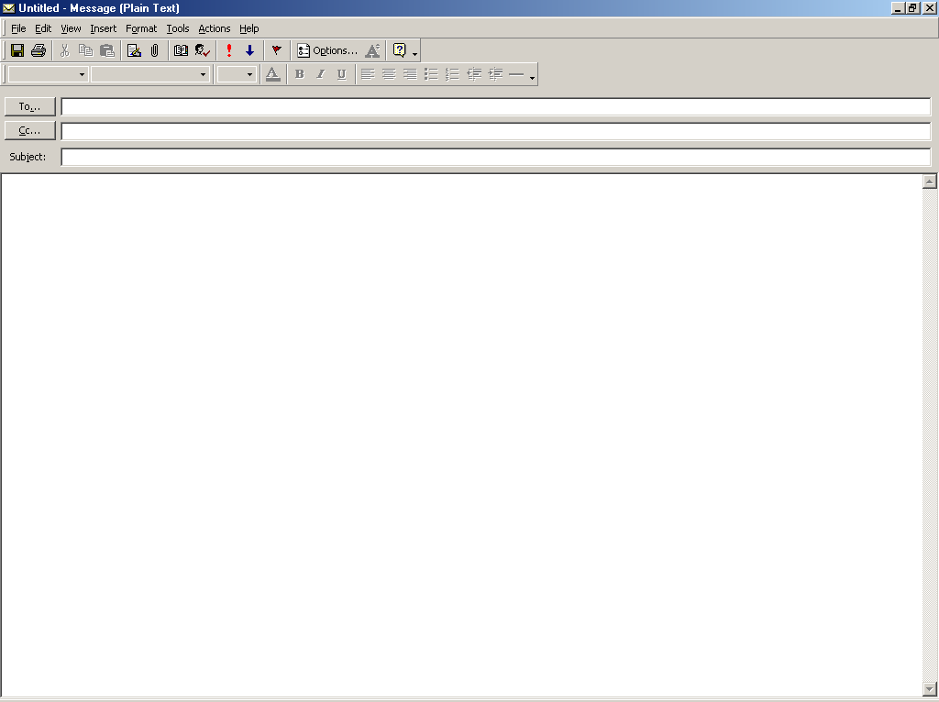
Larry_Bragg@callawaygolf.com
Request for alumni information
Mr. Bragg,
Your study of the progress of State University graduates is most commendable. We are pleased that you would ask our help in your efforts.
In reviewing the requirements of your project, we find that it would be necessary to search through the personnel files of each of our 10,000 employees. As our regular staff is already working at capacity, may we suggest that we make our files available to you or your representatives? We ask only that you protect the confidentially of the information in the files. We would be pleased to give you working space in the records center. And we would assure you of the cooperation and assistance of our records personnel.
As another alternative, may we suggest that you use a part-time student worker who is already acquainted with our files. From time to time, Ms. Mary Mahoney has worked in

Slide 9
Larry_Bragg@callawaygolf.com
Request for alumni information
center. And we would assure you of the cooperation and assistance of our records personnel.
As another alternative, may we suggest that you use a part-time student worker who is already acquainted with our file system. From time to time, Ms. Mary Mahoney has worked in our file center. We estimate that she could do your work in about five weeks, working her customary twenty hours a week. The cost would be about $900. If you prefer this arrangement, we would be pleased to contact her for you.
We expect that these suggestions will help you in completing your project. We look forward to reading the results in the Alumni Bulletin.
Terry

Slide 10
Preliminary Considerations in Writing Adjustment Refusals (1 of 2)
7-<number>
The decision has been made to refuse an unjustified claim.
The news is bad.
The goal is to present the bad news in a positive way.
Thus, you must think through the situation to develop a strategy to explain or justify the decision.

Slide 11
Brief Review of Procedure for Adjustment Refusals (2 of 2)
7-<number>
The message plan:
Opening
Begin with words that
  are off subject,
  are neutral, and
  set up the message.
Present the strategy that will explain or justify.
Make it factual and positive.
Lead systematically to the refusal.
Then refuse--clearly and positively.
End with off-subject, friendly words.
Body
Closing

Slide 12
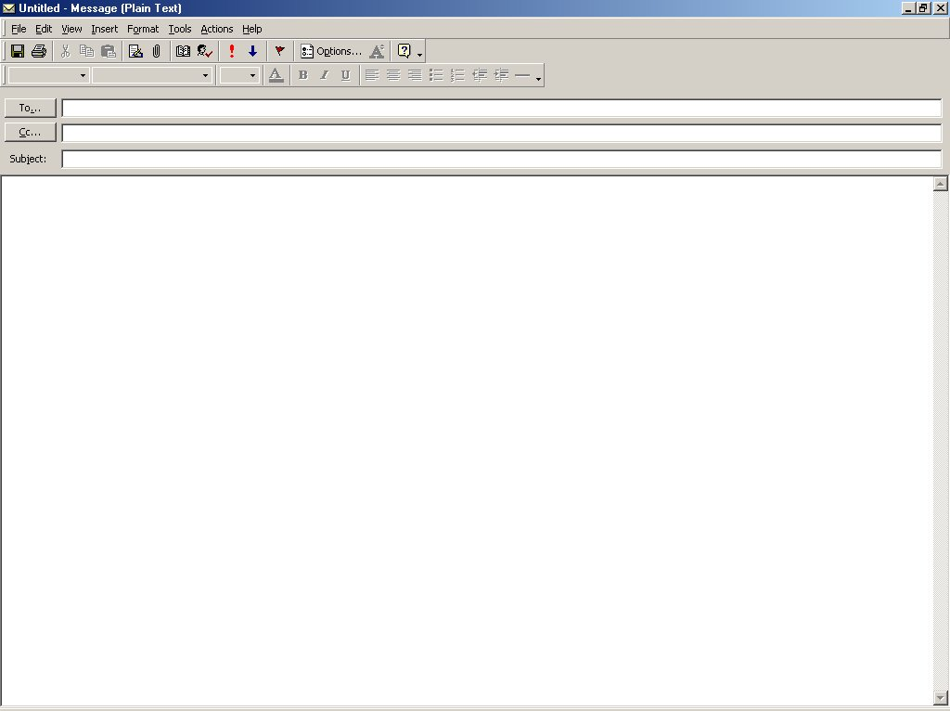
Jason Mertz
Payment on Invoice C2005
Mr. Mertz:
Thank you for your check for $945.07 on Invoice C 2005.
Although it is a small matter, I feel that you will want to look over this invoice. Probably you just looked at the wrong column, but you will see that you wrote the check for the amount less the discount. As you know, the discount is allowed only when payment is made within ten days of billing. As Invoice C2005 is now 45 days past this date, we are crediting your account with $945.07, leaving an unpaid balance of $29.23. I am confident you will understand.
Working with you and your excellent organization, Mr. Mertz, is always a pleasure. We look forward to serving you again real soon.
Ray Rojas

Slide 13
rjluce@uniquesupplies.com
Special paneling concern
Mr. Luce,
Certainly we understand your concern expressed in your May 11 letter about getting just the right material for your new office building. We share this concern with you. And we are determined to do our part about it.
To see whether we have done our part about your special paneling, we reviewed the facts of the case. We find that your architect specified a most unusual and distinctive finish. His specifications were in careful detail, and we followed them to the letter. Although the finished paneling is genuinely beautiful, it is unique and could not go into our regular stock. For this reason, we feel that any adjustment in this case must be between you and your architect. I am confident that you will see the justice in our decision.
We are grateful for the role we have played in constructing your distinctive building.

Slide 14
rjluce@uniquesupplies.com
Special paneling concern
be between you and your architect. I am confident that you will see the justice in our decision.
We are grateful for the role we have played in constructing your distinctive building. We stand ready to meet your future needs to the letter.
Dominic Terrado

Slide 15
Preliminary Considerations in Writing
Credit Refusals (1 of 2)
7-<number>
Refusals of credit are very negative, tending to reflect on one’s personal qualities.
They should be handled tactfully
  because it is the friendly way to do it, and
  because it is profitable.
Begin by developing an explanation.
  If finances are weak--can be fairly direct.
  If morals are weak--should be tactful.

Slide 16
Brief Review of Procedure for
Credit Refusals (2 of 2)
7-<number>
The message plan:
Opening
Begin with words that
  are neutral, and
  tie in with document being answered.
  set up the strategy (explanation).
Present the explanation and/or justification.
As a logical follow-up--refuse tactfully.
  If to a bad moral risk, may be by implication.
  If to one with weak finances,
    should refuse positively, and
    look hopefully to the future.
Close with goodwill words that fit the one case and are friendly and forward-looking.
Body
Closing

Slide 17
Tact in a Credit Refusal (1 of 3)
7-<number>
Opening
Dear Ms. Herrera:
Your March 29 order and accompanying request for credit were genuinely appreciated. We are especially grateful for your pleasant frankness in presenting your request for credit. The statements, trade references, and explanations were most helpful.
Click to view full letter at once.

Slide 18
Tact in a Credit Refusal (2 of 3)
7-<number>
Body
In checking over them, we find that you have an unusually heavy burden of invoices to pay within the next few months. As we see it, burdening you with more bills to pay at this time simply would not make good business sense. Thus, we can sell to you only for cash now. By buying for cash and taking advantage of the cash discount, you would be taking a sound step toward improving the financial health of your business. Just as soon as your situation is improved, we shall open your account.

Slide 19
Tact in a Credit Refusal (3 of 3)
7-<number>
Closing
We look forward to receiving your check for $730.69 ($745.60 less the $14.91 discount). When we get it, we’ll rush your merchandise to you.
Sincerely,
Susan Yassine
Susan Yassine

Slide 20
7-<number>
“ To speak kindly does not hurt the tongue.”
--Unknown

