Slide 1
Software Quality Assurance and Testing Lecture - 02
ABDUS SATTER
LECTURER
INSTITUTE OF INFORMATION TECHNOLOGY
UNIVERSITY OF DHAKA

Slide 2
SOFTWARE TESTING TERMINOLOGY & METHODOLOGY

Slide 3
Failure
When the software is tested, failure is the first term being used. It means the inability of a system or component to perform a required function according to its specification. In other words, when results or behavior of the system under test are different as compared to specified expectations, then failure exists.

Slide 4
Fault
Fault is a condition that in actual causes a system to produce failure. Fault is synonymous with the words defect or bug. Therefore, fault is the reason embedded in any phase of SDLC and results in failures.

Slide 5

Error
Whenever a development team member makes a mistake in any phase of SDLC, errors are produced. It might be a typographical error, a misleading of a specification, a misunderstanding of what a subroutine does, and so on. Error is a very general term used for human mistakes. Thus, an error causes a bug and the bug in turn causes failures

Slide 6
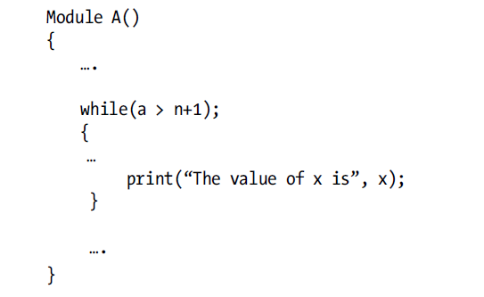
Error, Fault & Failure

Slide 7
Test Case
Test case is a well-documented procedure designed to test the functionality of a feature in the system. A test case has an identity and is associated with a program behavior. The primary purpose of designing a test case is to find errors in the system. For designing the test case, it needs to provide a set of inputs and its corresponding expected outputs.

Slide 8
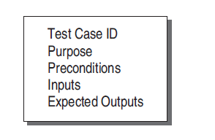
Test Case Template

Slide 9
Testware, Incident & Test Oracle
Testware: The documents created during testing activities are known as testware. Taking the analogy from software and hardware as a product, testware are the documents that a test engineer produces. It may include test plans, test specifications, test case design, test reports, etc. Testware documents should also be managed and updated like a software product.
Incident: When a failure occurs, it may or may not be readily apparent to the user. An incident is the symptom(s) associated with a failure that alerts the user about the occurrence of a failure.
Test oracle: An oracle is the means to judge the success or failure of a test, i.e. to judge the correctness of the system for some test. The simplest oracle is comparing actual results with expected results by hand. This can be very time consuming, so automated oracles are sought.

Slide 10
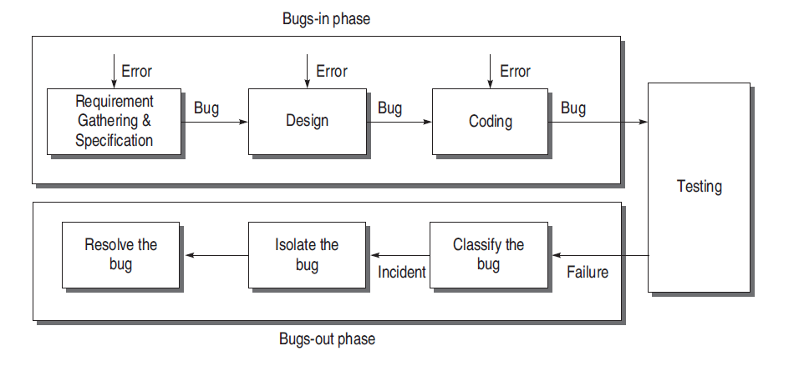
Life Cycle of A Bug

Slide 11
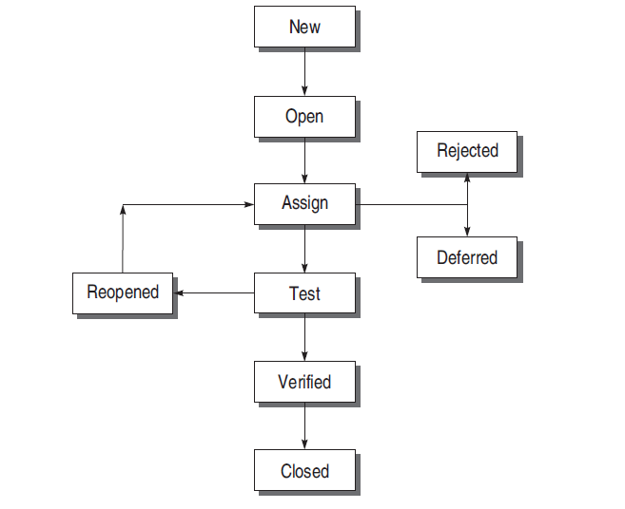
States of a Bug

Slide 12
Why Do Bugs Occur?
To Err is Human
Bugs in Earlier Stages go Undetected and Propagate

Slide 13
Bug Classification Based On Criticality
Critical Bug
Major Bug
Medium Bug
Minor Bug

Slide 14
Bug Classification Based On SDLC
Requirements and Specifications Bugs
Design Bugs
Control flow bugs
Logic bugs
Processing bugs
Data flow bugs
Error handling bugs
Race condition bugs
Boundary-related bugs
User interface bugs
Coding Bugs
Interface and Integration Bugs
System Bugs
Testing Bugs

Slide 15
Testing Principles
Effective testing, not exhaustive testing
Testing is not a single phase performed in SDLC
Destructive approach for constructive testing
Early testing is the best policy
Probability of existence of an error in a section of a program is proportional to the number of errors already found in that section
Testing strategy should start at the smallest module level and expand towards the whole program
Testing should also be performed by an independent team
Everything must be recorded in software testing
Invalid inputs and unexpected behavior have a high probability of finding an error
Testers must participate in specification and design reviews

Slide 16
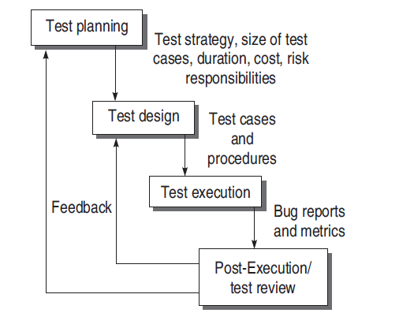
Software Testing Life Cycle (STLC)

Slide 17
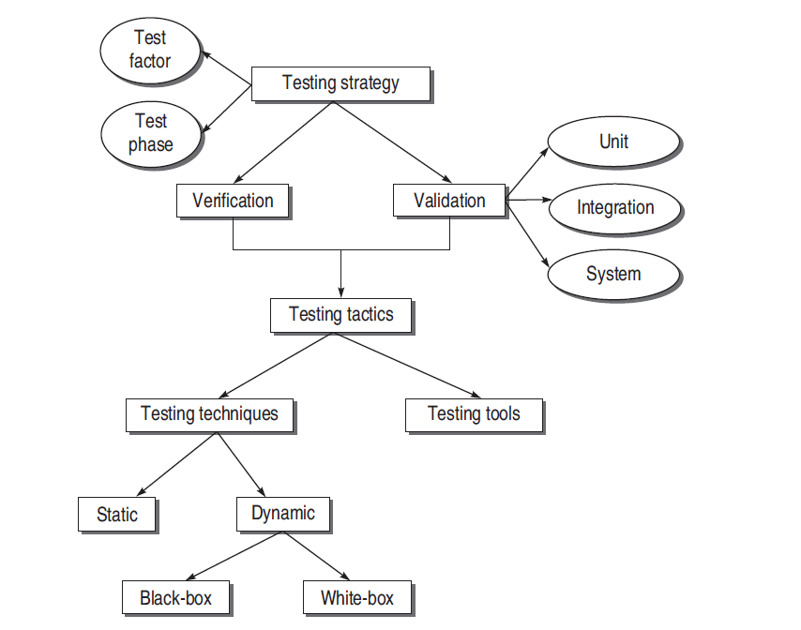
Testing Methodology
Verification is ‘Are we building the product right?’
Validation is ‘Are we building the right product?’

Slide 18
Thank You
END OF CHAPTER

