Slide 1
Program Comprehension
Moumita Asad
IIT, DU

Slide 2

Program Comprehension
the process of acquiring knowledge about a computer program
the precondition of performing any maintenance related activities
consumes more than half of the maintenance resources

Slide 3
Aims of Program Comprehension
The ultimate purpose of comprehending programs is to be able successfully to implement requested changes.
This entails acquiring information about following aspects of a system:
Problem domain
Execution effect
Cause-effect relation
Product-environment relation
Decision-support features

Slide 4
Problem Domain
To make change or simply to estimate the resource required for a maintenance task, knowledge of the problem domain in general and the sub-problems in particular is essential to direct maintenance personnel in the choice of suitable algorithms, methodologies and tools
Information can be obtained from various sources - the system documentation, end-users, or the program source code

Slide 5
Execution Effect
At a high level of abstraction, the maintenance personnel need to know what results the program will produce for a given input without necessarily knowing which program units contributed to the overall result or how the result was accomplished
At a low level of abstraction, they need to know the results that individual program units will produce on execution
Knowledge of data flow, control flow and algorithmic patterns can facilitate the accomplishment of these goals
During maintenance, this information can assist the maintenance personnel to determine whether an implemented change achieved the desired effect or not

Slide 6
Cause-Effect Relation
It allows the maintenance personnel to reason about how components of a software product interact during execution
It enables a programmer to predict the scope of a change and any knock-on effect that may arise from the change
The cause-effect relation can be used to trace the flow of information through the program. The point in the program where there is an unusual interruption of this flow may signal the source of a bug

Slide 7
Product-Environment Relation
A product is a software system. An environment is the totality of all conditions and influences which act from outside upon the product, e.g., business rules, government regulations, work patterns, software and hardware operating platforms
This knowledge can be used to predict how changes in these elements will affect the product in general and the underlying programs in particular

Slide 8
Decision-Support Features
Software product attributes such as complexity and maintainability are examples that can guide maintenance personnel in technical and management decision-making processes like decision making, budgeting and resource allocation
Measures of the complexity of the system can be used to determine which components of the system require more resource for testing
The maintainability of the system may be used as an indicator of its quality

Slide 9
Cognition Models for Program Comprehension
Letovsky model
Shneiderman and Mayer model
Brooks model
Soloway, Adelson, and Ehrlich model (top-down model)
Pennington model (bottom-up model)
Integrated metamodel

Slide 10
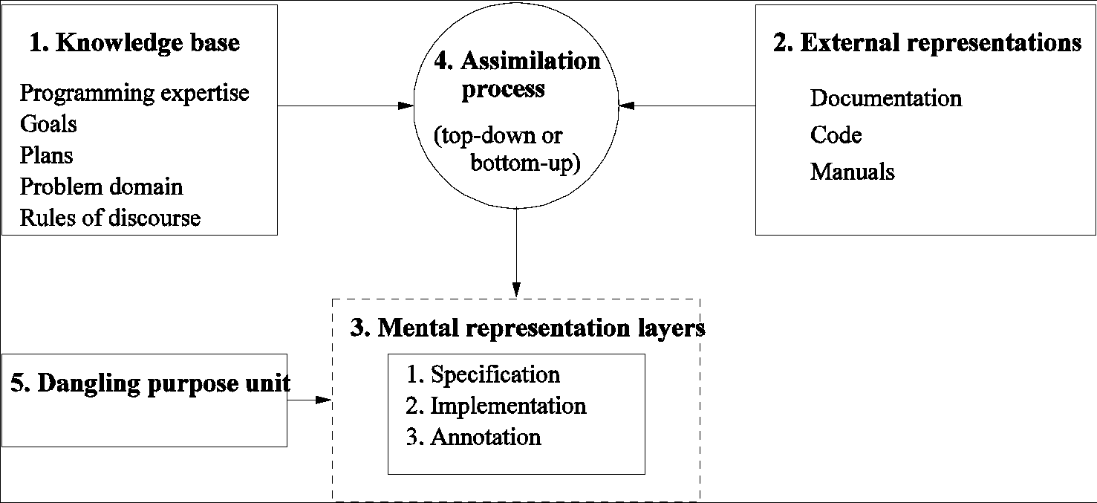
Letovsky Model

Slide 11
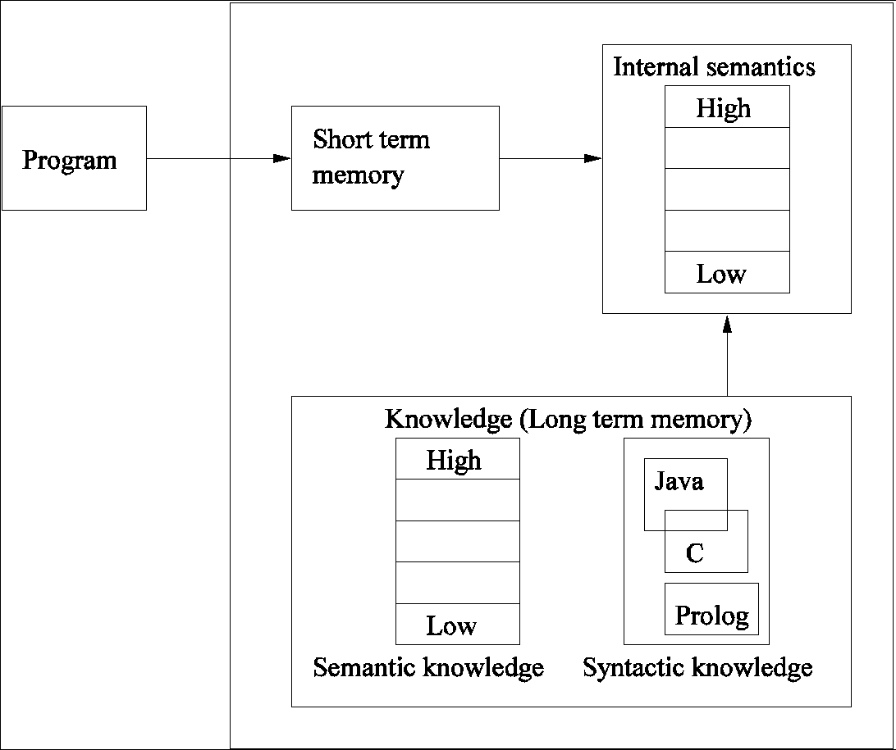
Shneiderman and Mayer Model

Slide 12
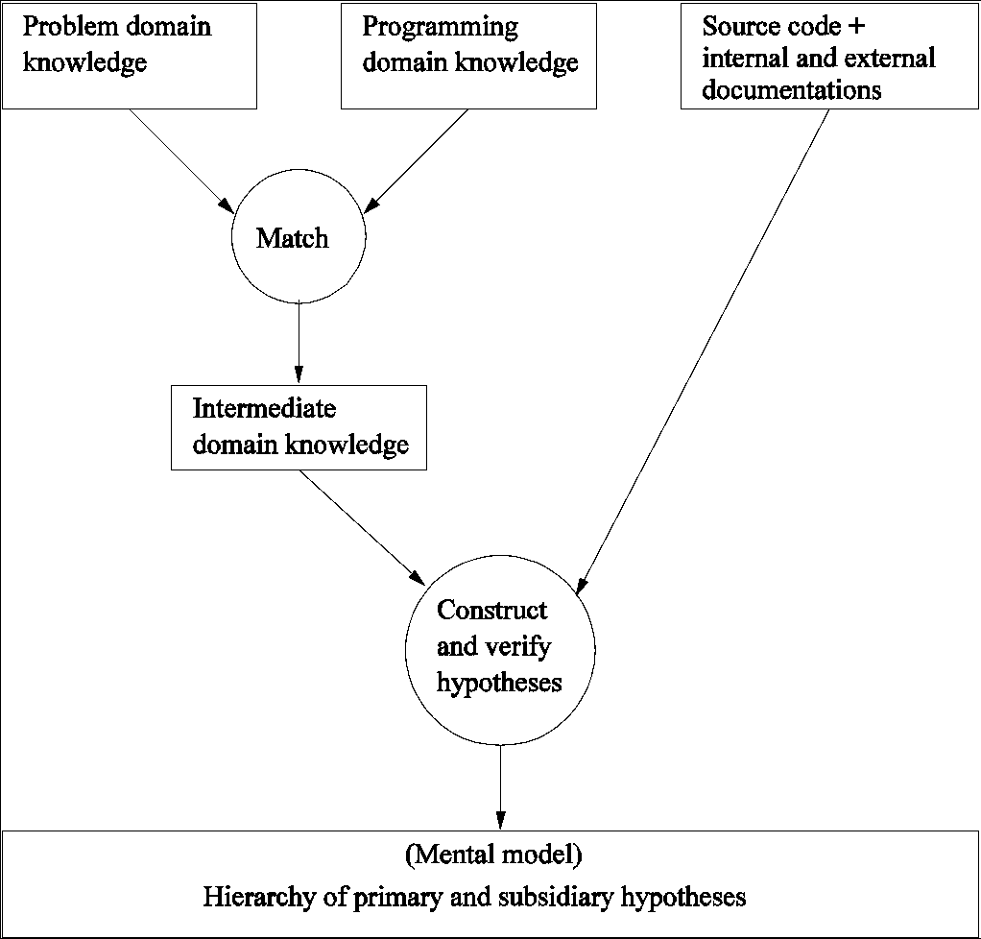
Brooks Model

Slide 13
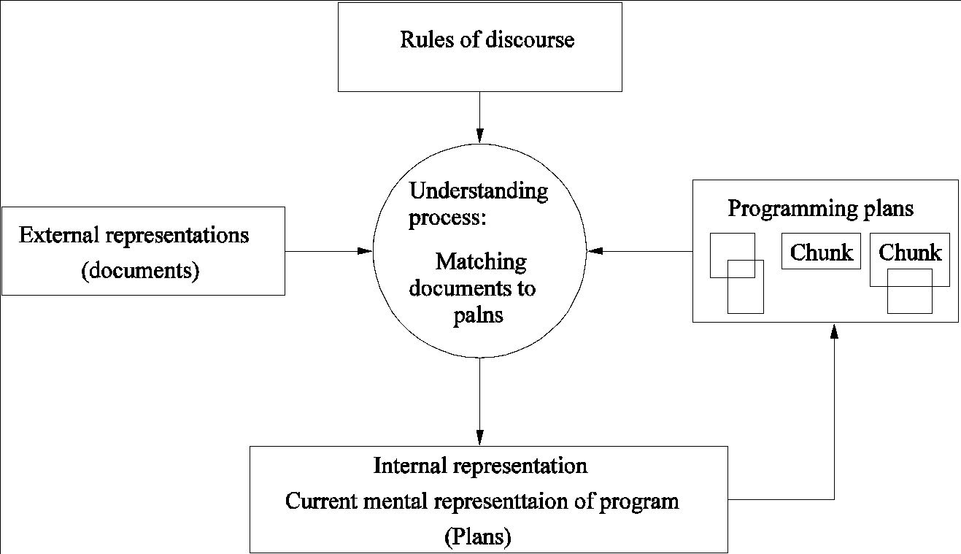
Soloway, Adelson, and Ehrlich Model

Slide 14
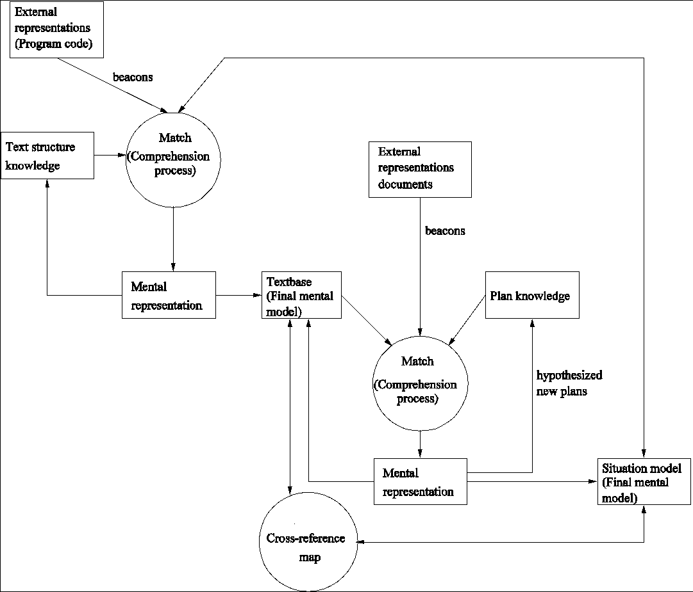
Pennington Model

Slide 15
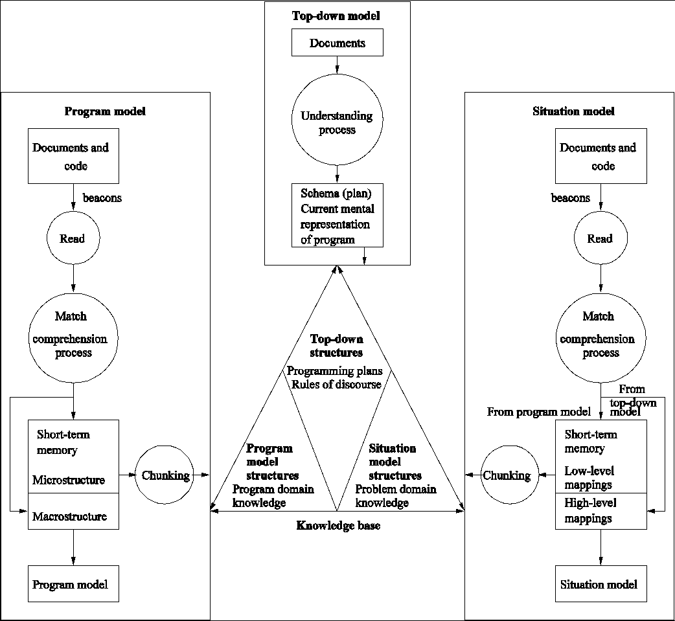
Integrated Metamodel

Slide 16
Factors that Affect Understanding
Expertise
Implementation Issues
Documentation
Organisation and Presentation of Programs

Slide 17
Expertise
Programmers become experts in a particular application domain or with a particular programming language by virtue of the repertoire of knowledge and skills they acquire from working in the domain or with the language
Expertise has a significant impact on comprehension
The more experienced a programmer is with an application domain or with a programming language, the easier and quicker it is to understand a program and indeed, the whole software system
Experts differ from novices in both their breadth and their organisation of knowledge: experts store information in larger chunks organised in terms of underlying abstractions. This organization apparently facilitates quick recognition of problem types and recall of associated solution strategies

Slide 18
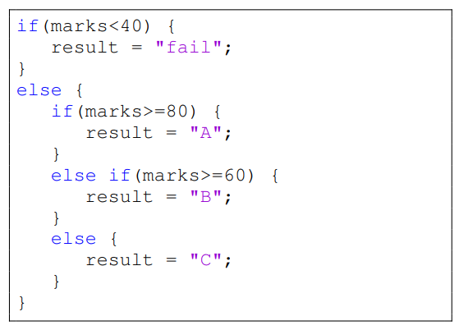
Implementation Issues
At the program level, the naming style, comments, level of nesting, clarity, readability, simplicity, decomposition mechanism, information hiding and coding standards can affect comprehension

Slide 19
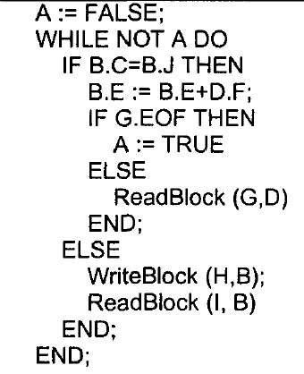
Implementation Issues: Naming Style
Meaningful identifier names can provide clues that assist programmers to invoke appropriate plans during understanding
Identifier names should be as informative, concise and unambiguous

Slide 20
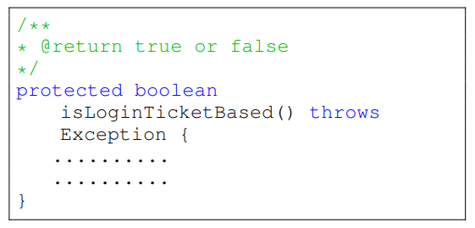
Implementation Issues: Comments
Program comments within and between modules and procedures usually convey information about the program, such as the functionality, design decisions, assumptions, declarations, algorithms, nature of input and output data, and reminder notes
Prologue comments precede a program or module and describe goals
In-line comments, within the program code, describe how these goals are achieved
N.B: The quality of the comment is important, not its presence or absence

Slide 21
Documentation
It is not always possible to contact the original authors of the system for information about it. This is partly due to the high turnover of staff within the software industry: they may move to other projects or departments, or to a different company altogether
Maintainers need to have access to the system documentation to enable them to understand the functionality, design, implementation and other issues that may be relevant for successful maintenance

Slide 22
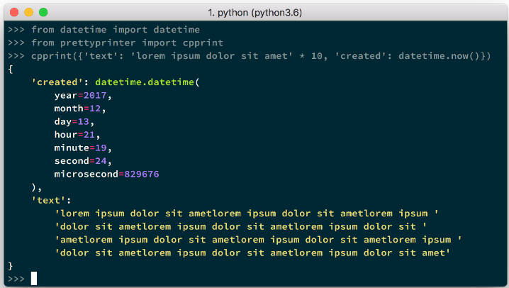
Organisation and Presentation of Programs
Well-structured programs take less time to understand
Indentation is used to emphasise the logical or syntactic relation between statements (or groups of statements) in a program, for example the use of indentation to group together statements belonging to a given control structure
Automatic program layout tools such as pretty-printers can be used automatically to enforce consistent program layout

