Slide 1
Software Project Management
Lecture # 3

Slide 2
Outline
Metrics for Process and Projects
  Introduction
  Software Metrics
    Process metrics
    Project metrics
    Direct and Indirect software measures
  Software Measurement
    Size-oriented Metrics
    Function-oriented Metrics
    Object-oriented Metrics
    Use-case-oriented Metrics
    Software Quality Metrics

Slide 3
Introduction
Software process and project metrics are quantitative measures that enable software engineers to gain insight into efficacy of the software process and projects that are conducted using the process as a framework.

Slide 4
Introduction (Contd.)
Basic quality & productivity data (called measures) are collected.
These data are then analyzed, compared against past averages (for similar projects) , and assessed to determine whether productivity & quality improvements have occurred.

Slide 5
Introduction (Contd.)
Metrics also indicate problem areas in processes and projects which can then be rectified.
Project metrics contribute to development of process metrics.

Slide 6
Introduction - Basic Terms
What is Measurement?
  It is the act of obtaining a measure.
  It is a mechanism of objective evaluation.
  It enables managers and practitioners to improve software process.
  It assists in planning, tracking and controlling a software project and assessing product quality.

Slide 7
Introduction - Basic Terms (Contd.)
What is a Measure?
  To ascertain or appraise by comparing to a standard [1]
  OR
  A standard or unit of measurement; the extent, dimensions, capacity, etc., of anything, especially as determined by a standard [2]
[1]IEEE Standard Glossary of Software Engineering Terminology, IEEE Std 729 1983.
[2]Engineering an Effective Measurement Program Course Notes, 1994.
Notes:
An example measure might be five centimeters. The centimeter is the standard, and five identifies how many multiples or fractions of the standard are being appraised
A measure is a value that is quantified against a standard at a point in time. For example, if we calculate a storeâ€™s sales for January 2008, the standard is the dollar, and the Total Sales for Jan 2008 is the measure. A single measure usually has little value without some context. (Ref: http://it.toolbox.com/blogs/dw-cents/measures-metrics-and-indicators-23543)

Slide 8
Introduction - Basic Terms (Contd.)
What is a Metric?
  A metric is quantitative measure of the degree to which a system, component or process possesses a given attribute (IEEE definition)
  A metric is the degree to which a particular subject possesses the quality that is being measured. It is based upon two or measures.
  (Ref: http://it.toolbox.com/blogs/dw-cents/measures-metrics-and-indicators-23543)
Notes:
The terms metric and measure have some overlap. We use measure for more concrete or objective attributes and metric for more abstract, higher-level, or somewhat subjective attributes

Slide 9
Introduction - Basic Terms (Contd.)
Difference between terms:
Measure
  It is a value which does not provide enough information to make meaningful decisions
Metric
  A comparison of two or more measures, e.g., temperature values over time, errors per KLOC
Indicator
  Compares a metric against a baseline or expected result and helps in making decisions
Reference:
  http://www.stsc.hill.af.mil/crosstalk/1995/03/Measure.asp

Slide 10
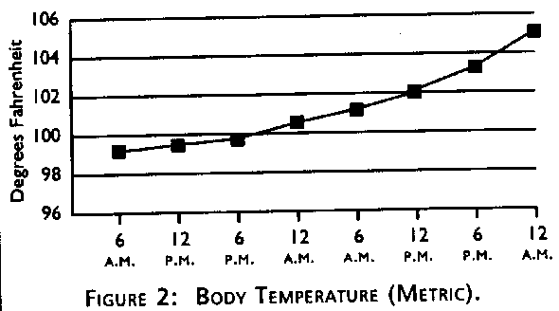
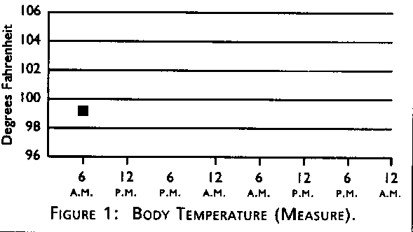
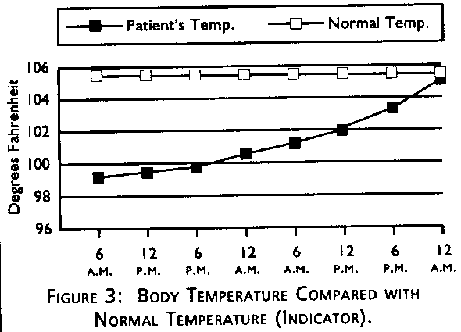
Reference: http://www.stsc.hill.af.mil/crosstalk/1995/03/Measure.asp

Slide 11
Process Metrics
& Software Process Improvement
To improve a process
  Measure specific attributes of process
  Develop meaningful metrics based on these attributes
  These metrics provide indicators that lead to strategy for improvement
Example
  Metrics can be derived from the following process outcomes/attributes
    Errors uncovered before software release,
    defects delivered to & reported by end-user,
    work products delivered,
    Human efforts expended,
    Calendar time expended,
    Schedule conformance and other measures.

Slide 12
Improving Software Quality & Organizational Performance
It is important to note that process is only one of the many controllable factors in improving software quality and organizational performance.
The figure (on next slide) shows other factors connected with the ‘process’ that have significant influence on the same:
  The skill and motivation of people
  The complexity of the product
  The technology

Slide 13
Improving Software Quality & Organizational Performance
Process connects 3 important factors that influence software quality and organizational performance
Product
Process
Customer
Characteristics
Business
conditions
People
Technology
Development environment

Slide 14
Project Metrics
Used by project managers and software team to adapt project workflow and technical activities.
Objective is
  To minimize the development schedule by making adjustments that can avoid delays and mitigate potential problems.
  To assess product quality on an ongoing basis and when necessary, modify technical approach to improve quality.
  Most first application of project metrics on software projects occurs during estimation (of time, effort).
  More project metrics are used as technical work of project commences.

Slide 15
Software Measurement
Software measurement can be categorized in two ways
  (1) direct measures of software process and product
  (2) indirect measures of software product
Direct Measures
  of software process are
    Cost and effort
  of software product are
    Line of Code (LOC)
    Execution Speed
    Defects over specified period of time

Slide 16
Software Measurement (Contd.)
Indirect Measures
  Of product are
    Functionality
    Quality
    Complexity
    Efficiency
    Reliability
    Maintainability
    .. Other Abilities

Slide 17
Size Oriented Metrics
These are derived by normalizing quality and/or productivity measures by considering the size of software that has been produced.
Assume that an organization maintains record of the following size-oriented measures for each project completed:
  Lines of code (LOC)
  Effort in person-months
  (see next slide)

Slide 18
Size Oriented Metrics (Contd.)
  Project cost (in dollars)
  Number of pages of documentation
  Number of errors
  Number of defects
  Number of people involved
To develop metrics that can be incorporated with other similar projects, we choose LOC as a normalization factor.

Slide 19
Size Oriented Metrics (Contd.)
Hence the following set of size-oriented metrics can be developed for each project:
  Errors per KLOC (thousand lines of code)
  Defects per KLOC
  $ per KLOC
  Pages of documentation per KLOC
Other metrics can be:
  Errors per person-month
  KLOC per person-month
  $ per page of documentation

Slide 20
Size Oriented Metrics - Pros and cons
Size-oriented metrics are widely used but not universally accepted as best way to measure a software process
Controversy lies in using LOC as a key measure
Proponents claim
  LOC is easy to count
  Many existing estimation models use LOC or KLOC as key input
  Large literature & data based on LOC exists

Slide 21
Size Oriented Metrics - Pros and cons
But opponents argue that
  LOC measures are programming language dependent
  When considering productivity, LOC criteria penalizes well designed short programs
  Can not accommodate non procedural languages
  Planner must estimate LOC long before analysis and design

Slide 22
Function-oriented Metrics
These use a measure of the functionality delivered by application as a normalization value.
Most widely used function-oriented metric is function point (FP)
FP’s computation is based on characteristics of software information domain and complexity.
Notes:
To normalize measures like productivity, quality and other attributes

Slide 23
Function-oriented Metrics: Function Point
Function points are a measure of the size of computer applications and the projects that build them.
The size is measured from a functional or user, point of view.
It is independent of the computer language, development methodology, technology or capability of the project team used to develop the application.
Reference URL: http://ourworld.compuserve.com/homepages/softcomp/fpfaq.htm

Slide 24
Function-oriented Metrics: Function Point (Contd.)
First proposed by Albrecht; can be used to measure functionality delivered by a system.
Using historical data, FP can be used to:
  Estimate cost and effort required to design, code and test the software,
  Predict no. of errors that will be encountered during testing,
  Forecast the no. of components and/or project source lines in the implemented system.

Slide 25
Computing function points (cont..) (Contd.)
Following empirical relationship is used to compute Function Point (FP)
FP= count total x [0.65+ 0.01 x Σ(F_{i})]
F_{i} (i=1 to 14 ) are VAF (Value adjustment factors) or simply ‘adjustment values’ based on answers to some questions (See list of 14 Qs on Page 473 from book 6th edition )
Answer to these questions are on a scale of 0 (not applicable) to 5 (absolutely essential)

Slide 26
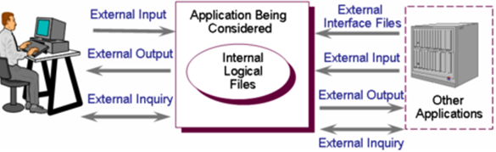
Function-oriented Metrics: Function Point (Contd.)
Count total is calculated using the following information domain values:
  External inputs (EIs)
  External outputs (EOs)
  External inquiries (EQs)
  Internal logic files (ILFs)
  External interface files (EIFs)

Slide 27
Function-oriented Metrics: Function Point (Contd.)
Each information domain value is multiplied by a weighting factor (simple, average or complex) and all values are added to get count total.
See example in book (Roger Pressman page 473)

Slide 28
Function-oriented Metrics: Function Point (Contd.)
Like LOC, FP is also controversial
  Proponents claim
    It is prog. Language independent, hence ideal for conventional and non-procedural languages
    Based on data that can be known early phases of projects
  Opponents claim
    Computation is based on subjective rather than objective data
    counts of information domain may be difficult to collect
    FP is just a number and has no physical meaning

Slide 29
Object-oriented Metrics
FP and LOC can be used to estimate OO software projects but these metrics do not address all aspects of such projects.
Hence OO metrics are used for object-oriented projects
Set of metrics for OO projects:
  Number of scenario scripts
    These are detailed sequence of steps about user and application interaction
    These are directly correlated to application size and no. of test cases

Slide 30
Object-oriented Metrics (Contd.)
  Number of key classes
    Key classes are independent components
    They Indicate amount of development effort and potential reuse
  Number of support classes
    Required to implement the system but not directly related to problem domain, e.g., UI classes, DB access, etc.
    These indicate amount of development effort and potential reuse

Slide 31
Object-oriented Metrics (Contd.)
  Average number of support classes per key class
    If these are known then estimation (based on total no. of classes) would be much simplified.
  Number of sub systems (aggregation of classes)
    If identified, it is easier to lay out the schedule in which work on subsystems is partitioned among project staff.

Slide 32
Use-case oriented Metrics
Use-cases describe user visible functions and features.
They are defined early in software process and can be used as normalization measure before significant activities are initiated.
They are independent of programming language
No. of use cases directly proportional to
  size of application in LOC &
  no. of test cases that will be designed
There is no standard size of a use case as they are created at different levels of abstraction
  For this reason, it is a suspect as a normalization measure

Slide 33
Web Engineering Project Metrics
Reading assignment, pages 559, 660, 661

Slide 34
Software Quality Metrics
Measuring quality through
  Correctness
    It is degree to which software performs its required function
    Common measure= defects per KLOC
    For quality assessment defects are counted typically for 1 year
  Maintainability
    It is the ease with which a program can be
      corrected if an error is found
      Adapted if environment changes or
      Enhanced if customer desires
    Measured indirectly, e.g., Mean-time-to change (MTTC)
    Maintainable programs -> lower MTTC
Notes:
Defect = any problem or lack of conformance to requirements reported by customer/user after delivery

Slide 35
Software Quality Metrics
  Integrity
    System’s ability to withstand (accidental & intentional) attacks
    Two more attributes that help determine integrity
      threat = probability of attack within a given time (that causes failure)
      security = probability that an attack will be repelled
    Integrity = Σ [1 – (threat * (1 – security))]
  Usability
    It quantifies ease of use and learning (time)

Slide 36
References
Today’s lecture taken from
  Roger Pressman’s “Software Engineering a practitioner’s approach”
    Chapter 22 - “Metrics for Process & Projects”
    Chapter 15 - For details of FP computation, 15.3.1, page 472
For more in-depth study of function points, see http://devdaily.com/fpa/fpa-borland/what-are-fps.shtml

