Slide 1
Software Project Management
Lecture # 8

Slide 2
What are we studying today?
Chapter 24 - Project Scheduling
  Project Scheduling
  Timeline charts
  Schedule tracking
  Earned Value Analysis

Slide 3
Scheduling
Two Project Scheduling methods that can be applied to software development:
  Program evaluation and review technique (PERT)
  Critical Path Method (CPM)
Both are driven by Info already developed:
  Estimates of effort
  A decomposition of product function
  The selection of appropriate process model and task set
  Decomposition of tasks

Slide 4
Timeline Charts
When creating software project schedule, the planner begins with a set of tasks (work breakdown structure)
If automated tools are used, the work breakdown is input as a task network
Effort, duration and start date are then input for each task
As a result of this input, a timeline chart or Gantt chart is generated

Slide 5
Tracking Schedule
Accomplished in a no. of ways
  Conducting periodic project status meetings in which each team member reports progress & problems
  Evaluating results of all reviews conducted throughout the s/w engg process
  Determining whether formal project milestones have been accomplished by scheduled date
  Comparing actual start date to planned date for each project task
  Meeting practitioners to get their assessment of progress to date and problems encountered
  Use earned value analysis to assess progress quantitatively

Slide 6
Earned Value Analysis
Earned Value Analysis (EVA) provides a quantitative indication of progress of a project.
Humphrey discusses earned value as:
  “The earned value system provides a common value scale for every [software project] task, regardless of the type of work being performed. The total hours to do the whole project are estimated and every task is given an earned value based on its estimated percentage of the total”

Slide 7
Earned Value Analysis (Contd.)
It compares the PLANNED work with the actually COMPLETED work, to determine if COST , SCHEDULE, and WORK ACCOMPLISHED are progressing as planned.
EVA is accomplished using Earned Value Management.

Slide 8
Earned Value Management (EVM)
EVM is a project management technique for measuring project progress.
If applied properly, it provides an early warning of performance and
  Improves definition of scope
  Communicates progress to stakeholders
  and keeps the project team focused on achieving progress.

Slide 9
Earned Value Management (EVM)
EVM implementation includes
  A project plan that identifies work to be accomplished or WBS,
  A valuation of planned work called Planned Value (PV) or Budgeted Cost of Work Scheduled (BCWS)
  Predefined “earning rules” (a.k.a. metrics) to quantify the accomplishment of work called Earned Value (EV) or Budgeted Cost of Work Performed (BCWP)
    BCWP value is sum of the BCWS values for all work tasks that have actually been completed by a point in time on the project schedule

Slide 10
Earned Value Management
‘Wilkens’ gives distinction between BCWS and BCWP as:
  BCWS represents the budget of activities that were planned to be completed
  and BCWP represents the budget of activities that were actually completed
EVM for large projects includes many more features such as indicators and forecast of cost performance and schedule performance.
Important progress indicators can be computed based on BCWS, BAC, BCWP values

Slide 11
Earned Value Management
SPI = BCWP/BCWS
  Schedule performance index indicates efficiency with which project is using scheduled resources. SPI value 1.0 indicates efficient execution of project schedule
SV = BCWP – BCWS
  Schedule variance is simply an absolute indication of variance from planned schedule
Percent scheduled for completion= BCWS/BAC
  Where BAC is Budget at completion computed as: BAC = ∑(BCWS_{k}) for all k tasks
Notes:
Percent scheduled for completion indicates percentage of work that should have been completed by time t

Slide 12
Earned Value Management
Percent complete= BCWP/BAC
  Provides indication of percent of completeness of the project at a given point in time t.
CPI = BCWP/ACWP
  Cost performance index value close to 1.0 indicates project is within its defined budget
  Actual Cost of Work Performed ACWP is sum of effort actually expended on work tasks that have been completed by a point in time on project schedule
CV = BCWP – ACWP
  Cost Variance is an absolute indication of cost savings against planed or shortfall at a particular stage of project

Slide 13
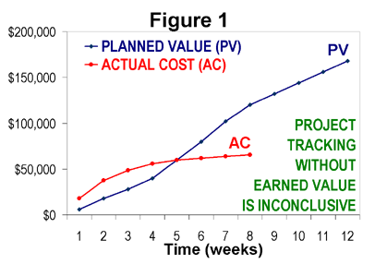
Project Tracking without EVM
Blue line= the cumulative budget for this project as a function of time. Red line = the cumulative actual cost of the project through week 8.

Slide 14
Project Tracking without EVM
To those unfamiliar with EVM, it might appear that this project was over budget through week 4 and then under budget from week 6 through week 8.
However, this chart does not indicate how much work has been accomplished during the project.
If the project was actually completed at week 8, then the project would actually be well under budget and well ahead of schedule.
If, on the other hand, the project is only 10% complete at week 8, the project is significantly over budget and behind schedule.
A method is needed to measure technical performance (progress) objectively and quantitatively, and that is what EVM accomplishes.

Slide 15

Project Tracking with EVM
Consider the same project, except this time the project plan includes pre-defined methods of quantifying the accomplishment of work.
At the end of each week, the project manager identifies every detailed element of work that has been completed, and sums the PV for each of these completed elements.
Earned value may be accumulated monthly, weekly, or as progress is made.

Slide 16
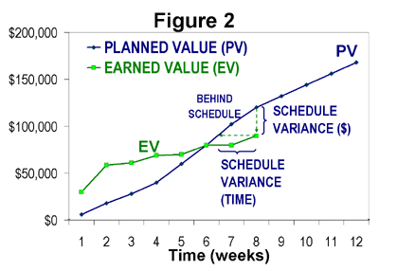
Project Tracking with EVM
Green line = EV curve, Blue line = PV curve

Slide 17
Project Tracking with EVM
The chart indicates that progress started more rapidly than planned, but slowed significantly and fell behind schedule at week 7 and 8.
This chart illustrates the schedule performance aspect of EVM.

Slide 18
References
Today’s lecture contents were taken from
  Chapter 24 – “Software Engineering, A Practitioner's Approach” by Roger Pressman
  Wikipedia

