Slide 1
C Programming Lecture 4 : Variables , Data Types
Lecture notes : courtesy of Ohio Supercomputing Center, science and technolgy support

Slide 2
First Program
#include <stdio.h>
int main()
{
/* My first program */
printf("Hello World! \n");
return 0;
}
Output :
Hello World!
C is case sensitive.
End of each statement must be marked with a semicolon (;).
Multiple statements can be on the same line.
White space (e.g. space, tab, enter, …) is ignored.

Slide 3
First Program
#include <stdio.h>
int main()
{
/* My first program */
printf("Hello World! \n");
return 0;
}
The C program starting point : main().
main() {} indicates where the program actually starts and ends.
In general, braces {} are used throughout C to enclose a block of statements to be treated as a unit.
COMMON ERROR: unbalanced number of open and close curly brackets!
Output :
Hello World!

Slide 4
First Program
#include <stdio.h>
int main()
{
/* My first program */
printf("Hello World! \n");
return 0;
}
#include <stdio.h>
Including a header file stdio.h
Allows the use of printf function
For each function built into the language, an associated header file must be included.
printf() is actually a function (procedure) in C that is used for printing variables and text
Output :
Hello World!

Slide 5
First Program
#include <stdio.h>
int main()
{
/* My first program */
printf("Hello World! \n");
return 0;
}
Comments
/* My first program */
Comments are inserted between “/*” and “*/”
Or, you can use “//”
Primarily they serve as internal documentation for program structure and function.
Output :
Hello World!

Slide 6
Why use comments?
Documentation of variables, functions and algorithms
Ex) for each function, explain input and output of the function, and what the function does.
Describes the program, author, date, modification changes, revisions,…

Slide 7
Header Files
Header files contain definitions of functions and variables
Preprocessor #include insert the codes of a header file into the source code.
Standard header files are provided with each compiler
To use any of the standard functions, the appropriate header file should be included.
Ex) to use printf() function , insert #include <stdio.h>
In UNIX, standard header files are generally located in the /usr/include subdirectory

Slide 8
Header Files
#include <string.h>
#include <math.h>
#include “mylib.h”
The use of brackets <> informs the compiler to search the compiler’s include directories for the specified file.
The use of the double quotes “” around the filename informs the compiler to start the search in the current directory for the specified file.

Slide 9
Second Program
#include <stdio.h>
#define TAXRATE 0.10
int main () {
float balance;
float tax=0.0; /* declaration + initialization */
char rate=‘A’;
int credit_no=1;
balance = 72.10;
tax = balance * TAXRATE;
printf("The tax on %.2f is %.2f\n",balance, tax);
printf(“CREDIT RATE : %d/%c\n”, credit_no, rate);
return 0;
}
Output :
The tax on 72.10 is 7.21
CREDIT RATE : 1/A

Slide 10
Names in C
Identifiers (variable name)
Must begin with a character or underscore(_)
May be followed by any combination of characters, underscores, or digits(0-9)
Case sensitive
Ex) summary, exit_flag, i, _id, jerry7
Keywords
Reserved identifiers that have predefined meaning to the C compiler. C only has 29 keywords.
Ex) if , else, char, int, while

Slide 11
Symbolic Constants
Names given to values that cannot be changed.
Use preprocessor directive #define
Symbols which occur in the C program are replaced by their value before actual compilation
#define N 3000
#define FALSE 0
#define PI 3.14159
#define FIGURE "triangle"

Slide 12
Declaring Variables
Variable
Named memory location where data value is stored
Each variable has a certain type (e.g. int, char, float, …)
Contents of a variable can change
Variables must be declared before use in a program
Declaration of variables should be done at the opening brace of a function in C. ( it is more flexible in C++ )
Basic declaration format
data_type var1, var2, …;
Examples)
int i,j,k;
float length, height;

Slide 13
Data Types
char : 1 byte, capable of holding one character (ascii code)
int : 4 byte (on 32bit computer) integer
float : single-precision floating point
double : double-precision floating point
type | size | min value | max value
char | 1byte | -2⁷ = -128 | 2⁷-1 = 127
short | 2byte | -2¹⁵ = -32,768 | 2¹⁵-1 = 32,767
int | 4byte | -2³¹ = -2,147,483,648 | 2³¹-1 = 2,147,483,647
long | 4byte | -2³¹ = -2,147,483,648 | 2³¹-1 = 2,147,483,647
Min/Max values are defined in <limit.h> header file

Slide 14
unsigned type
Use when representing only positive numbers
Data type | size | min | max
unsigned char | 1byte | 0 | 2⁸-1 = 255
unsigned short | 2 byte | 0 | 2¹⁶-1 = 65,535
unsigned int | 4byte | 0 | 2³²-1 = 4,294,967,295

Slide 15
Negative integer representation
signed
first bit represents the sign of a number
Rest of bits represent the value of a number
Negative integer number
Represented as 2’s complement
number | Bit representation
+5 | 00000101
1’s complement of 5 | 11111010
2’s complement of 5 | 11111011
-5 | 11111011

Slide 16
floating point
real number : significant number + position of decimal point
Decimal point(.) can be placed anywhere relative to the significant digits of the number
This position is indicated separately in the internal representation
Advantage of floating point representation
Support much wider range of values
Representing 314159265358979.3 vs 3.141592653589793
type | size | min | max
float | 4 byte | (7 significant numbers) -1.0E+38 | (7 significant numbers) 1.0E+38
double | 8 byte | (15 significant numbers) -1.0E+308 | (15 significant numbers) 1.0E+308

Slide 17
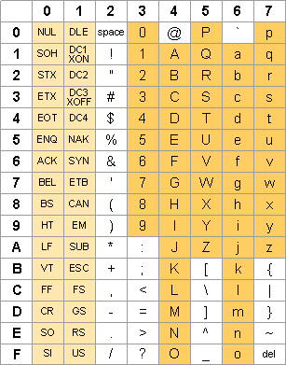
Ascii Code

Slide 18
Escape character
Starts with backslash(\)
Indicate special meaning and interpretation
Escape character | meaning
\b | backspace
\t | tab
\n | newline
\r | formfeed
\" | double quote
\' | single quote
\\ | back slash

Slide 19
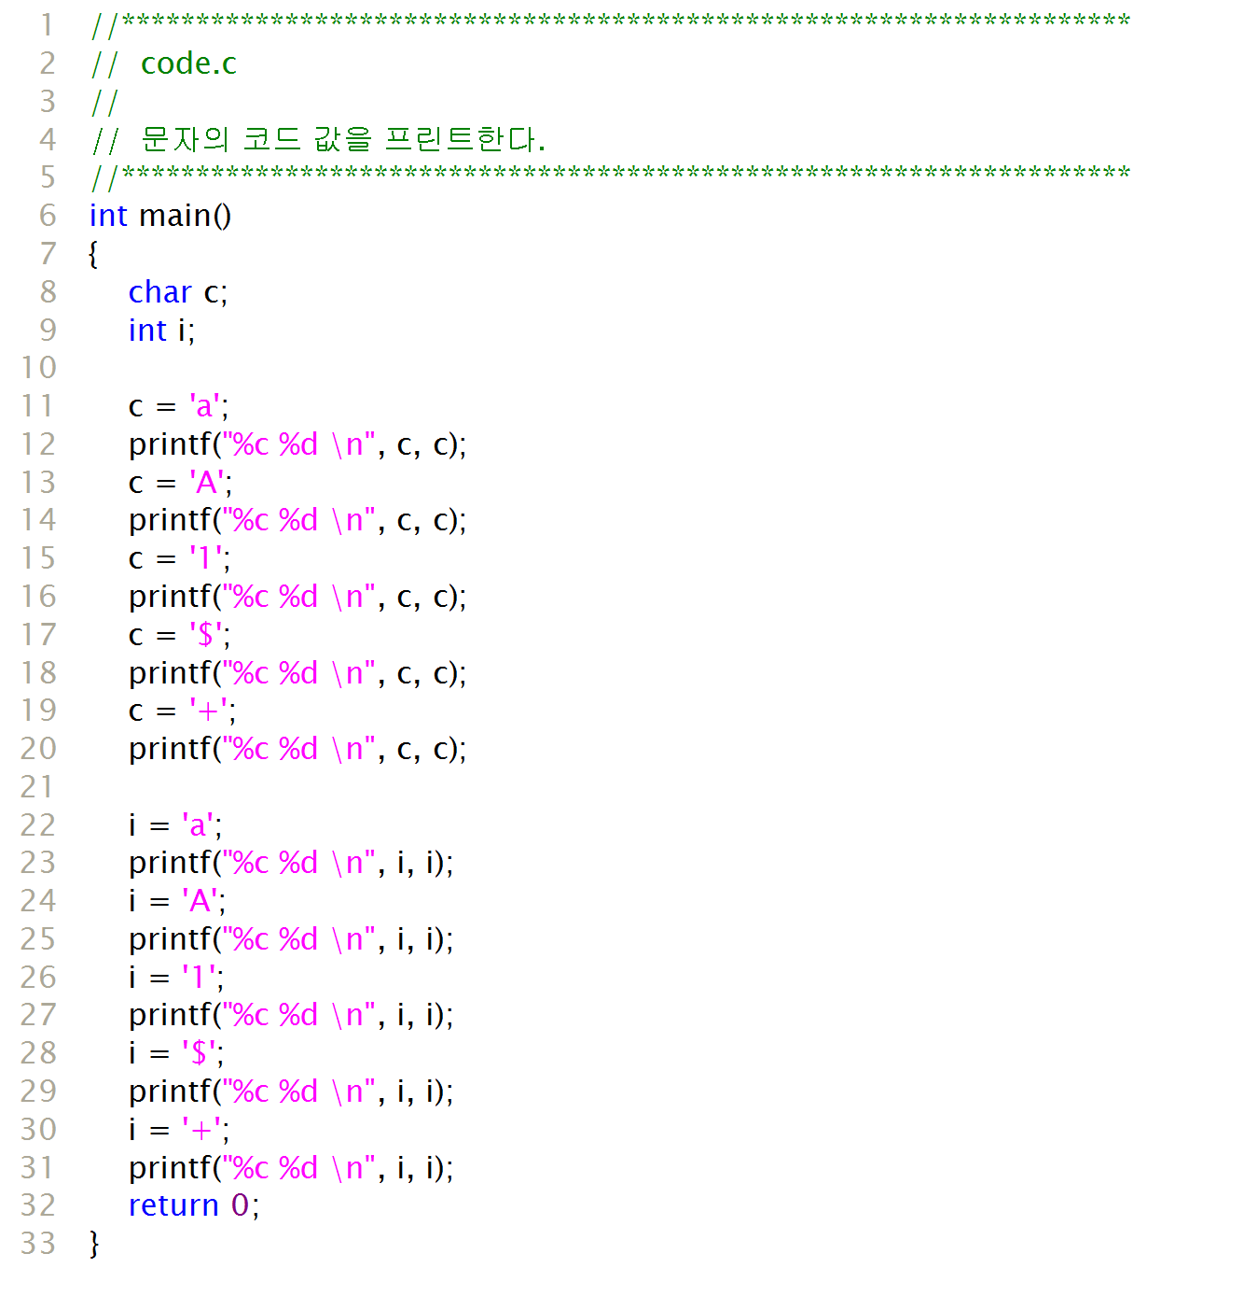
code.c
output:
a 97
A 65
1 49
$ 36
+ 43
a 97
A 65
1 49
$ 36
+ 43

Slide 20
getchar() , putchar()
int getchar()
Defined in <stdio.h>,
Get one character input from keyboard and return the ascii value
int putchar(int c)
Defined in <stdio.h>
prints one character provided as a parameter
#include <stdio.h>
int main()
{
int c;
printf(“keyboard input (one character?)”);
c=getchar();
printf(“character input : %c\n”,c);
printf(“ascii code : %d\n”, c);
return 0;
}
Output :
character input : A
ascii code : 65

Slide 21
korea.c
#include <stdio.h>
int main()
{
short no_univ = 276;
int population = 48295000;
long budget = 237000000000000L;
printf(“korea info\n”);
printf(“univ no : %d\n”, no_univ);
printf(“population : %d\n”, population);
printf(“budget : %d\n”, budget);
return 0;
}
Output :
korea info
univ no : 276
putpulation: 48295000
budget: -590360576

Slide 22
Overflow?
(integer type) overflow
occurs when storing a value that is bigger than what can be stored.
Ex) 2,147,483,647 (= 2³¹-1) + 1 = ?
01111111 11111111 11111111 11111111
+ 00000000 00000000 00000000 00000001
--------------------------------------------------
10000000 00000000 00000000 00000000
#include <stdio.h>
int main()
{
int a=2147483647;
printf("%d,%d\n",a,a+1);
return 0;
}

