Slide 1
Data Structure and Algorithm
Binary Search Trees
Data Structure and Algorithm

Slide 2
Binary Search Trees
Binary Search Trees (BSTs) are an important data structure for dynamic sets
Each element has:
  key: an identifying field inducing a total ordering
  left: pointer to a left child (may be NULL)
  right: pointer to a right child (may be NULL)
  p: pointer to a parent node (NULL for root)
Data Structure and Algorithm

Slide 3
Binary Search Trees…
BST property:
key[leftSubtree(x)] ≤ key[x] ≤ key[rightSubtree(x)]
Example:
F
B
H
A
D
K
Data Structure and Algorithm

Slide 4
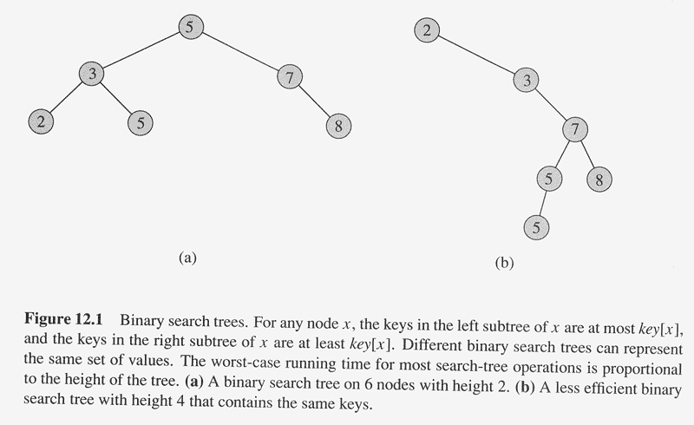
Binary Search Trees :Example
Data Structure and Algorithm

Slide 5
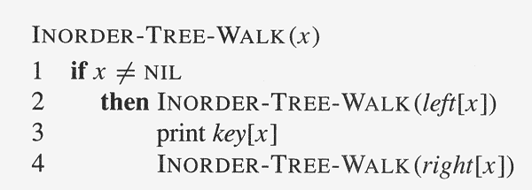
Inorder Tree Walk
What does the following code do?
A: prints elements in sorted (increasing) order
Data Structure and Algorithm

Slide 6
Inorder Tree Walk…
Example:
How long will a tree walk take?
Prove that inorder walk prints in monotonically increasing order
F
B
H
A
D
K
Data Structure and Algorithm

Slide 7
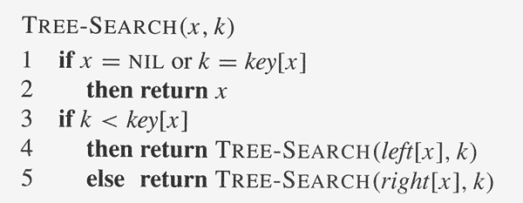
Operations on BSTs: Search
Given a key and a pointer to a node, returns an element with that key or NULL:
Data Structure and Algorithm

Slide 8
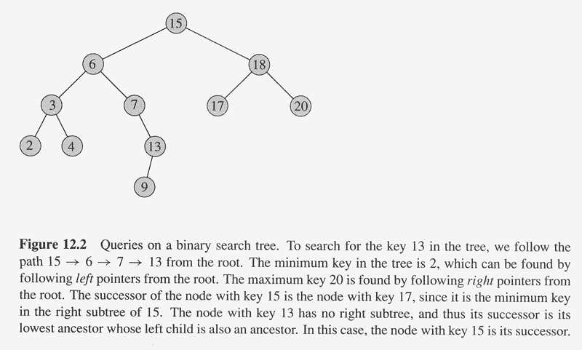
BST Search: Example
Data Structure and Algorithm

Slide 9
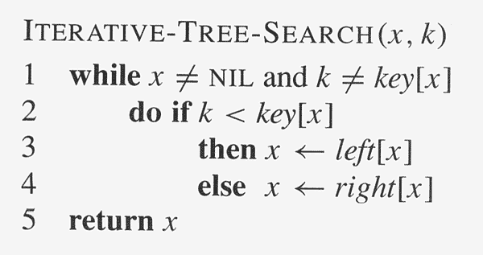
Operations on BSTs: Search…
Here’s another function that does the same:
Which of these two functions is more efficient?
Data Structure and Algorithm

Slide 10
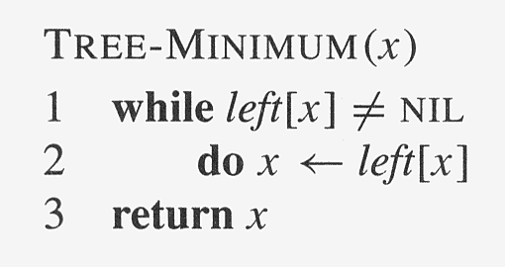
Operations on BSTs: Minimum
Data Structure and Algorithm

Slide 11
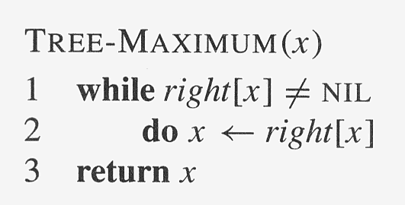
Operations on BSTs: Maximum
Data Structure and Algorithm

Slide 12
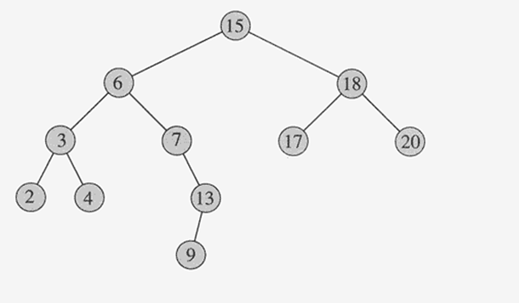
BST Operations: Successor
What is the successor of node 13? Node 15? Node 20?
What are the general rules for finding the successor of node x? (hint: two cases)
Data Structure and Algorithm

Slide 13
BST Operations: Successor…
Two cases:
  x has a right subtree: successor is minimum node in right subtree
  x has no right subtree: successor is first ancestor of x whose left child is also ancestor of x
    Intuition: As long as you move to the left up the tree, you’re visiting smaller nodes.
Data Structure and Algorithm

Slide 14
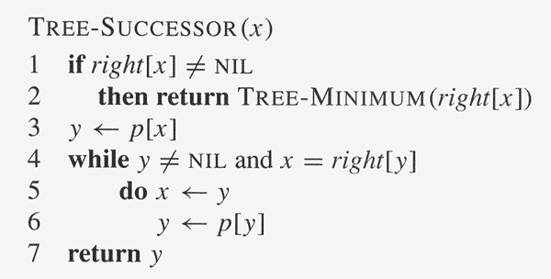
BST Operations: Successor…
Predecessor: similar algorithm
Data Structure and Algorithm

Slide 15
Operations of BSTs: Insert
Adds an element x to the tree so that the binary search tree property continues to hold
The basic algorithm
  Like the search procedure above
  Insert x in place of NULL
  Use a “trailing pointer” to keep track of where you came from (like inserting into singly linked list)
Data Structure and Algorithm

Slide 16
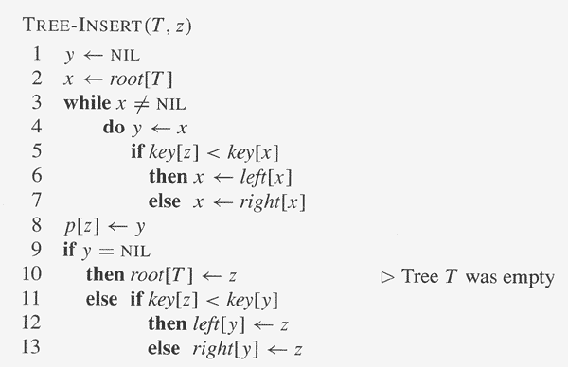
Operations of BSTs: Insert…
Data Structure and Algorithm

Slide 17
BST Insert: Example
Example: Insert C
F
B
H
A
D
K
C
Data Structure and Algorithm

Slide 18
BST Search/Insert: Running Time
What is the running time of TreeSearch() or TreeInsert()?
A: O(h), where h = height of tree
What is the height of a binary search tree?
A: worst case: h = O(n) when tree is just a linear string of left or right children
  We’ll keep all analysis in terms of h for now
  Later we’ll see how to maintain h = O(lg n)
Data Structure and Algorithm

Slide 19
Sorting With Binary Search Trees
Informal code for sorting array A of length n:
  BSTSort(A)
  for i=1 to n
  TreeInsert(A[i]);
  Inorder-Tree-Walk(root);
Argue that this is Ω(n lg n)
What will be the running time in the
  Worst case?
  Average case? (hint: remind you of anything?)
Data Structure and Algorithm

Slide 20
Sorting With BSTs…
Average case analysis
  It’s a form of quicksort!
for i=1 to n
TreeInsert(A[i]);
InorderTreeWalk(root);
3 1 8 2 6 7 5
3
1 2
8 6 7 5
1
8
2
6 7 5
2
6
5
7
5
7
Data Structure and Algorithm

Slide 21
Sorting with BSTs
Same partitions are done as with quicksort, but in a different order
  In previous example
    Everything was compared to 3 once
    Then those items < 3 were compared to 1 once
    Etc.
  Same comparisons as quicksort, different order!
    Example: consider inserting 5
Data Structure and Algorithm

Slide 22
Sorting with BSTs
Since run time is proportional to the number of comparisons, same time as quicksort: O(n lg n)
Which do you think is better, quicksort or BSTsort? Why?
Data Structure and Algorithm

Slide 23
Sorting with BSTs
Since run time is proportional to the number of comparisons, same time as quicksort: O(n lg n)
Which do you think is better, quicksort or BSTSort? Why?
A: quicksort
  Better constants
  Sorts in place
  Doesn’t need to build data structure
Data Structure and Algorithm

Slide 24
BST Operations: Delete
Deletion is a bit tricky
3 cases:
  x has no children:
    Remove x
  x has one child:
    Splice out x
  x has two children:
    Swap x with successor
    Perform case 1 or 2 to delete it
F
B
H
A
D
K
Example: delete K
or H or B
C
Data Structure and Algorithm

Slide 25
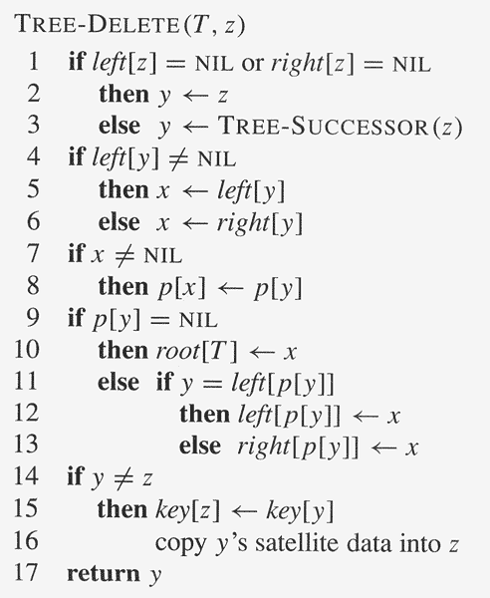
BST Operations: Delete…
Data Structure and Algorithm

Slide 26
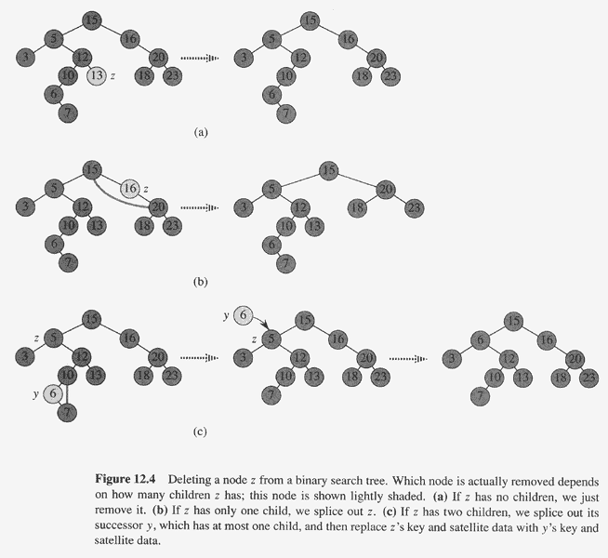
BST Delete: Example
Data Structure and Algorithm

Slide 27
BST Operations: Delete…
Why will case 2 always go to case 0 or case 1?
A: because when x has 2 children, its successor is the minimum in its right subtree
Could we swap x with predecessor instead of successor?
A: yes. Would it be a good idea?
A: might be good to alternate
Data Structure and Algorithm

Slide 28
More BST Operations
BSTs are good for more than sorting. For example, can implement a priority queue
What operations must a priority queue have?
  Insert
  Minimum
  Extract-Min
Data Structure and Algorithm

