Slide 1
strlen() implementation
/* strlen : return length of string s */
int strlen(char *s)
{
int n;
for (n = 0 ; s[n] != ‘\0’ ; n++) ;
return n;
}
/* strlen : return length of string s */
int strlen(char *s)
{
int n;
for (n = 0 ; *s != ‘\0’ ; s++) n++;
return n;
}

Slide 2
strcpy() implementation
/* strcpy : copy t to s */
void strcpy(char *s, char *t)
{
int i=0;
while ((s[i] = t[i]) != ‘\0’) i++;
}
/* strcpy : copy t to s */
void strcpy(char *s, char *t)
{
while ((*s = *t) != ‘\0’) {
s++;
t++;
}
}
/* strcpy : copy t to s */
void strcpy(char *s, char *t)
{
while (*s++ = *t++) ;
}

Slide 3
strcmp() implementation
/* strcmp : return <0 if s<t, 0 if s==t, >0 if s>t
int strcmp(char *s, char *t)
{
int i;
for (i = 0; s[i] == t[i]; i++)
if (s[i] == ‘\0’) return 0;
return s[i] – t[i];
}
int strcmp(char *s, char *t)
{
for ( ; *s == *t; s++, t++)
if (*s == ‘\0’) return 0;
return *s - *t;
}

Slide 4
#include <stdio.h>
#include <string.h>
#define MAX_LINE 81
int main()
{
char s[] = "Hello", t[6];
char *p = "world", *q;
printf(“string s = %s\n", s);
strcpy(t,s);
printf(“string t = %s\n", t);
printf(“string p = %s\n", p);
q = p;
printf(“string q = %s\n", q);
strcpy(s, "Good");
printf(“string s = %s\n", s);
printf(“string t = %s\n", t);
strcpy(p, "Bye");
printf(“string p = %s\n", p);
printf(“string q = %s\n", q);
return 0;
}

Slide 5
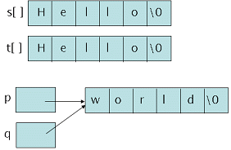
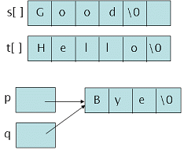

Slide 6
String
char *p =“Hello”;
char m[]=“world”;
p[0]
p[1]
p[2]
p[3]
p[4]
p[5]
p
H e l l o \0
m[0]
m[1]
m[2]
m[3]
m[4]
m[5]
m
w o r l d \0

Slide 7
String input
Example1)
char *name;
scanf("%s", name);
Example2)
char name[81];
scanf("%s", name);
Example3)
char *name;
name=(char*)malloc(sizeof(char)*81);
scanf("%s", name);
…
free(name); // deallocate when name is no longer useful

Slide 8
Multiple String
Using 2 dimensional array
char colors[3][10]= {"red", "blue", "white"};
or
char *colorp[3] = {"red", "blue", "white"};

Slide 9
Multiple String
colors[0]
colors[1]
colors[2]
r e d \0
b l u e \0
w h i t e \0
r e d \0
colorp[0]
colorp[1]
colorp[2]
b l u e \0
w h i t e \0

Slide 10
String Input/Output
char *gets(char *str);
Read one line string from keyboard
Put the input string into str
int puts(char *str);
Print string str into standard output

Slide 11
String Input/Output
int sprintf(char *str, char *format, ...);
Put the output into str instead of standard output
int sscanf(char *str, char *format, ...);
Get the input from str instead of standard input

Slide 12
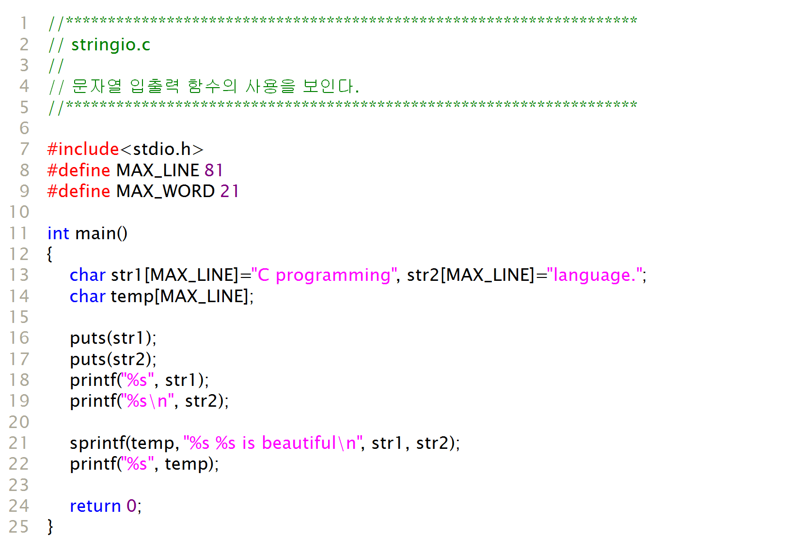
Output :
C programming
language
C programming language
C programming language is beautiful

Slide 13
Other String functions
strcpy, strcat, strcmp, strlen
int atoi(char *str); // ascii to integer
double atof(char *str); // ascii to double
char *strstr(char *str1, char *str2);
// search for str2 in str1

Slide 14
#include <stdio.h>
#include <stdlib.h>
#define MAX_LINE 81
int main()
{
float sum = 0;
int count = 0;
char num[MAX_LINE];
printf(“get price : \n");
while (gets(num) != NULL) {
count++;
sum = sum + atof(num);
}
printf(“ %d items , Sum : %6.2f \n", count, sum);
return 0;
}
Output :
get price :
15.5
31.40
180.05
29.99
^Z
4 items , Sum : 256.99

Slide 15
Main arguments
int main(int argc, char *argv[])
argc : number of arguments
argv
argv[0] : execution file name
argv[1] : first argument string
argv[2] : second argument string
…

Slide 16
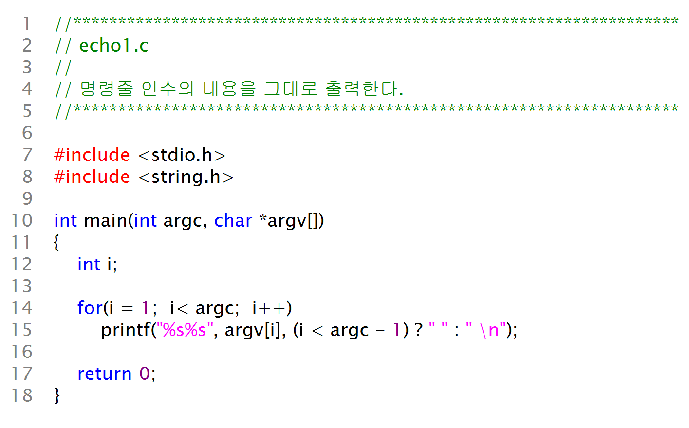
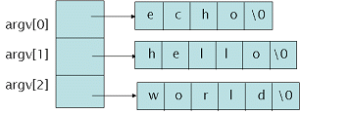
C\:> echo hello world
실행결과:
C:> echo hello world
hello world

