Slide 1
Lecture 9 : Array
Acknowledgment : Lecture notes from Ohio Supercomputing Center

Slide 2
Warming Up Problem
Problem : Get 5 integer numbers using scanf function, and print the numbers in reverse order.
Example
Input : 3 10 5 7 2
Output : 2 7 5 10 3

Slide 3
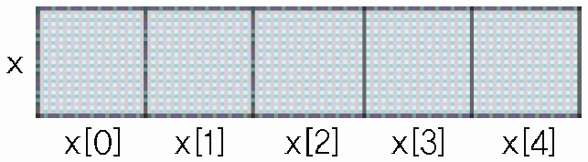
#include <stdio.h>
int main()
{
int x0, x1, x2, x3, x4;
printf("Get 5 integers : ");
scanf("%d", &x0);
scanf("%d", &x1);
scanf("%d", &x2);
scanf("%d", &x3);
scanf("%d", &x4);
printf("Reverse Order : ");
printf("%d ", x4);
printf("%d ", x3);
printf("%d ", x2);
printf("%d ", x1);
printf("%d ", x0);
printf("\n");
return 0;
}
#include <stdio.h>
int main()
{
int x[5], i;
printf("Get 5 integers : ");
for (i = 0; i < 5; ++i)
scanf("%d", &x[i]);
printf("Reverse order : ");
for (i = 4; i >= 0; --i)
printf("%d ", x[i]);
printf("\n");
return 0;
}
Using array
Memory structure

Slide 4
Array Variables?
Array variable holds a sequence of multiple values with same data type
int a[10];
There is an ordered method for extracting individual data items
a[3]=7;
Example
If we want to store scores for exam1 , exam2 , exam3 , ... , exam10
First try,
int exam1 = 90; int exam2 =85; … int exam100=93;
sum = exam1 + exam2 + … + exam100;
Using array
int exam[100] = {90 , 85, … , 93};
for (i=0;i<100;i++) sum+=exam[i];

Slide 5
Array Variables Example
In C, array index starts at zero.
int id[3]; /* declaration of array id,
which has space for three consecutive int variables */
id[0] = 101;
id[1] = 232;
id[2] = 231;
Each piece of data in an array is called an element. Thus, array id has three elements.

Slide 6
Array Declaration, Initialization
Array Declaration
type arrayName[arraySize];
float a[5]; // declare a float type array with size 5 and
int x, y, b[5];
Array Initialization
int a[5] = {1, 3, 5, 7, 9};
int a[] = {1, 3, 5, 7, 9};
a[2] = 11; // a -> {1, 3, 11, 7, 9}
a[5] = 20; // wrong!!!! Index can be between 0 and 4

Slide 7
example
#include <stdio.h>
int main()
{
int x[] = {1, 3, 5, 7, 9};
printf(" x = %8u\n", x);
printf(" sizeof(x) = %8d\n", sizeof x);
printf("sizeof(x[0]) = %8d\n", sizeof x[0]);
return 0;
}
output
x = 2280640
sizeof(x) = 20
sizeof(x[0]) = 4

Slide 8
Multi-Dimensional array
Multi-dimensional arrays have two or more index values which are used to specify a particular element in the array. For this 2D array element,
image[i][j]
the first index value i specifies a row index, while j specifies a column index. Declaring multi-dimensional arrays is similar to the 1D case:
int a[10]; /* declare 1D array */
float b[3][5]; /* declare 2D array */
double c[6][4][2]; /* declare 3D array */
Note that it is quite easy to allocate a large chunk of consecutive memory with multi-dimensional arrays. Array c contains 6x4x2=48 doubles.
Initialization
int age[2][3] = { {4,8,12} , {19,6,-1} };

Slide 9
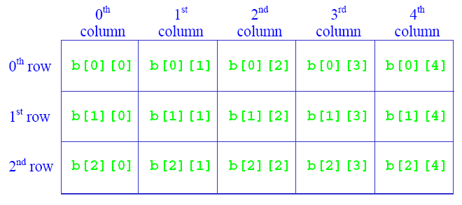
Multi-Dimensional array
Very commonly used for matrix
int b[3][5];
for (i=0;i<3;i++) {
for (j=0;j<5;j++) sum+=b[i][j];
}

Slide 10
Passing Array Argument
Pass address of an array into function
Example
int getSum (int score[] , int arraySize) // int getSum (int* score , int arraySize)
{
int i;
int sum=0;
for (i=0;i<arraySize;i++) sum+=score[i];
return sum;
}
int main()
{
int a[]={1,5,10};
int sum=0;
printf(“a[0]=%d, a[1]=%d, a[2]=%d , sum=%d\n”,a[0],a[1],a[2],sum);
sum = getSum(a,3);
printf(“a[0]=%d, a[1]=%d, a[2]=%d , sum=%d\n”,a[0],a[1],a[2],sum);
return 0;
}

Slide 11
Array Arguments
Because we pass address of array to function, array element value which is modified in a function will remain modified even after the function call is finished.
example
int getSum (int score[] , int arraySize)
{
int i;
int sum=0;
for (i=0;i<arraySize;i++) {
sum+=score[i];
score[i]=sum;
}
return sum;
}
int main()
{
int a[]={1,5,10};
int sum=0;
printf(“a[0]=%d, a[1]=%d, a[2]=%d , sum=%d\n”,a[0],a[1],a[2],sum);
sum = getSum(a,3);
printf(“a[0]=%d, a[1]=%d, a[2]=%d , sum=%d\n”,a[0],a[1],a[2],sum);
return 0;
}

Slide 12
Example : rcSum.c
#include <stdio.h>
#include <string.h> // strlen
#define N 3
void readNxN(int a[N][N]);
void sumNxN(const int a[N][N], int rSum[N], int cSum[N]);
void printNxN(const int a[N][N], const int rSum[N], const int cSum[N]);
int main()
{
int x[N][N];
int rSum[N] = {0}, cSum[N] = {0};
readNxN(x);
sumNxN(x, rSum, cSum);
printNxN(x, rSum, cSum);
return 0;
}

Slide 13
void readNxN(int a[N][N])
{
int i, j;
printf(“Input %d x %d integer matrix :\n", N, N);
for (i = 0; i < N; ++i)
for (j = 0; j < N; ++j)
scanf("%d", & a[i][j]);
}
void sumNxN(const int a[N][N], int rSum[N], int cSum[N])
{
int i, j;
for (i = 0; i < N; ++i) {
for (j = 0; j < N; ++j) {
rSum[i] += a[i][j];
cSum[j] += a[i][j];
}
}
}

Slide 14
void printNxN(const int a[N][N], const int rSum[N], const int cSum[N])
{
int i, j;
const char *lseg = "-------";
const int width = strlen(lseg) - 1;
for (i = 0; i < 3; ++i) {
for (j = 0; j < 3; ++j)
printf("%*d ", width, a[i][j]);
printf("| %*d\n", width, rSum[i]);
}
for (i = 0; i < 3; ++i)
printf("%s", lseg);
printf("+\n");
for (i = 0; i < 3; ++i)
printf("%*d ", width, cSum[i]);
printf("\n");
}

