Slide 1
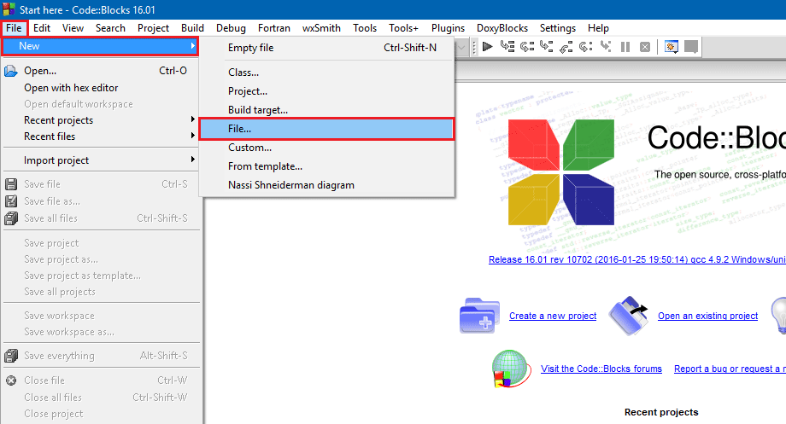
How to create C program in CodeBlocks IDE
Open CodeBlocks IDE and create a new file. Click on File → New → File.

Slide 2
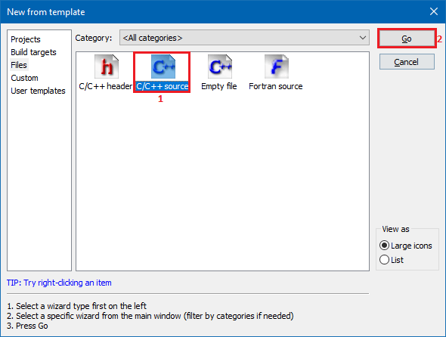
From the New form template window select C/C++ source and click Go button.

Slide 3
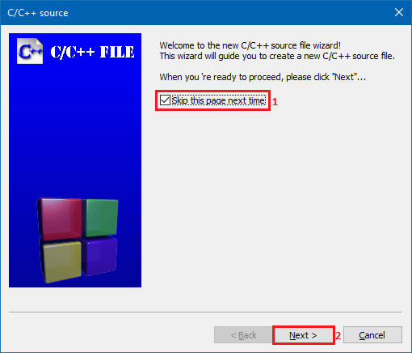
If you see a welcome message, click next to skip the welcome message. Make sure you have checked Skip this next time checkbox if you do not want to see this welcome message again.

Slide 4
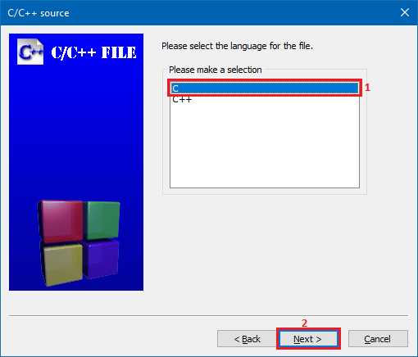
Next, select your language from C/C++ source window and click Next button.

Slide 5
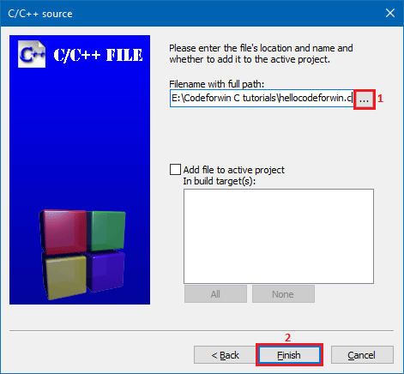
Give name to your file and specify the location.
It is always recommended to save all your C programs in a C workspace (directory). Creating a C workspace is onetime process. For now, create a new C workspace (folder) with name “Codeforwin C tutorials” anywhere in your computer.
Once you created a C workspace, click the ellipsis button present under File name with full path. Browse your C workspace, mention the file name click Finish.

Slide 6
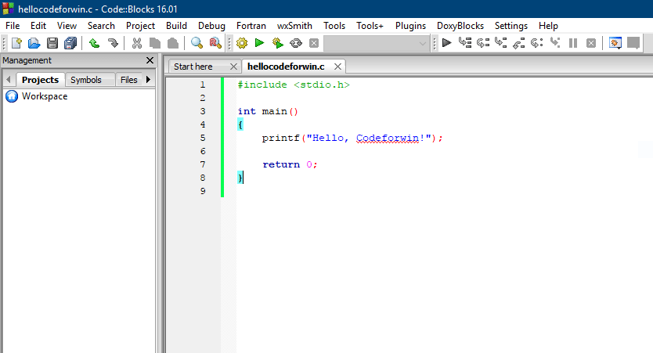
Write and save your first C program. Press Ctrl + S to save. For now you can simply copy paste the hello world C program.
#include <stdio.h>
int main()
{
printf("Hello, Codeforwin!");
return 0;
}

Slide 7
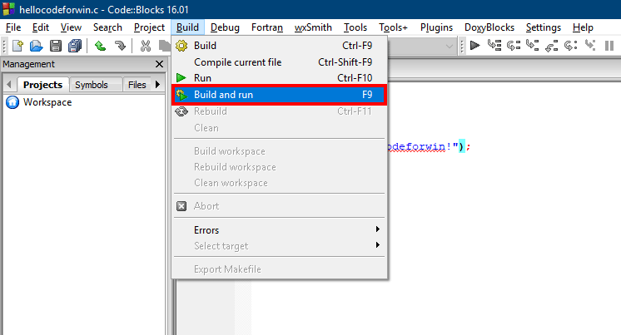
How to compile and run C program in CodeBlocks
Once you created your first C program it’s time to compile and run the program.
To compile and run a C program, click Build → Build and run to compile and build your C program, alternatively use the shortcut key F9. In case, your program contains any errors. Error messages are shown in the Build messages tab below the code editor.

