Slide 1
C Programming Lecture 6 : Operators
Lecture notes : courtesy of Ohio Supercomputing Center, and Prof. Woo and Prof. Chang

Slide 2
Expressions and Statements
Expression
Combination of constants, variables, operators, and function calls
Ex)
a+b
3.0*x – 9.66553
tan(angle)
Statement
An expression terminated with a semicolon
Ex)
sum = x + y + z;
printf(“Dragons!”);

Slide 3
Assignment Operator
The equal sign = is an assignment operator
Used to give a variable the value of an expression
Ex)
x=34.8;
sum=a+b;
slope=tan(rise/run);
midinit=‘J’;
j=j+3;
x=y=z=13.0;
Initialization
Ex)
int i=0;

Slide 4
Arithmetic operators
Binary operators
Addition : +
Subtraction : -
Multiplication : *
Division : /
Modulus : % // only works for integers values
Unary operators
+ , -
Integer division
1/2 = 0 (?) , 3/2 = 1 (?)

Slide 5
Arithmetic operators
In binary operators
If two operands are int type : the result is int type
If one or two operands are floating-point type : the result is floating-point type
2 + 3.14 ⇒ 2.0 + 3.14 = 5.14
12.0/5 ⇒ 12.0/5.0 = 2.4

Slide 6
increment/decrement
Increment operator ++
i=i+1;
i++; // postfix form
++i; // prefix form
decrement operator –
i=i-1;
i--; // postfix form
--I; // prefix form
Difference between i++ and ++i ?

Slide 7
prefix vs. postfix
Difference shows up when the operators are used as a part of a larger expression
++k : k is incremented before the expression is evaluated.
k++ : k is incremented after the expression is evaluated.
Ex) difference?
int a;
int i=0, j=0;
a= (++i) + (++j);
int b;
int i=0, j=0;
b= (i++) + (j++);

Slide 8
Shorthand Operators
General syntax
variable = variable op expression;
is equivalent to
variable op= expression;
Common forms
+=, -=, *=, /=, %=
Examples
j=j*(3+x); j *= 3+x;
a=a/(s-5); a /= s-5;

Slide 9
Precedence , Associativity of Operators
Operator Precedence
determines the order in which operations are performed
operators with higher precedence are employed first.
Operator Associativity
if two operators in an expression have the same precedence, associativity determines the direction in which the expression will be evaluated.
precedence | operators
1st | unary + , unary -
2nd | binary * / %
3rd | binary + -
* , / , % : L -> R
+ , - (bin): L -> R
= : R -> L
+ , - (unary) : R -> L

Slide 10
Precedence Examples
Evaluation Order
1 + 2 * 3 - 4
-> 1 + 6 - 4
-> 7 - 4
-> 3
use parenthesis to force a desired order of evaluation
Ex)
(1 + 2) * (3 – 4)

Slide 11
Associativity Examples
Left associativity
a / b * c → (a / b) * c
Right associativity
- + - a → - (+ (- a))

Slide 12
Bitwise Operators
shift/logic | Op. name | usage | type | output
shift op. | left shift | a<<n | integer | Shift bits of a to left by n bit Newly created bits will be 0
 | right shift | a>>n | integer | Shift bits of a to right by n bit Newly created bits will be 0
bit op. | bit AND | a & b | integer | AND of a’s and b’s each bit
 | bit OR | a | b | integer | OR of a’s and b’s each bit
 | bit XOR | a ^ b | integer | XOR of a’s and b’s each bit
 | 1’s complement | ~a | integer | 1’s complement of a

Slide 13
Truth/False Table
a | b | a & b | a | b | a ^ b
0 | 0 | 0 | 0 | 0
0 | 1 | 0 | 1 | 1
1 | 0 | 0 | 1 | 1
1 | 1 | 1 | 1 | 0
a | ~a
0 | 1
1 | 0

Slide 14
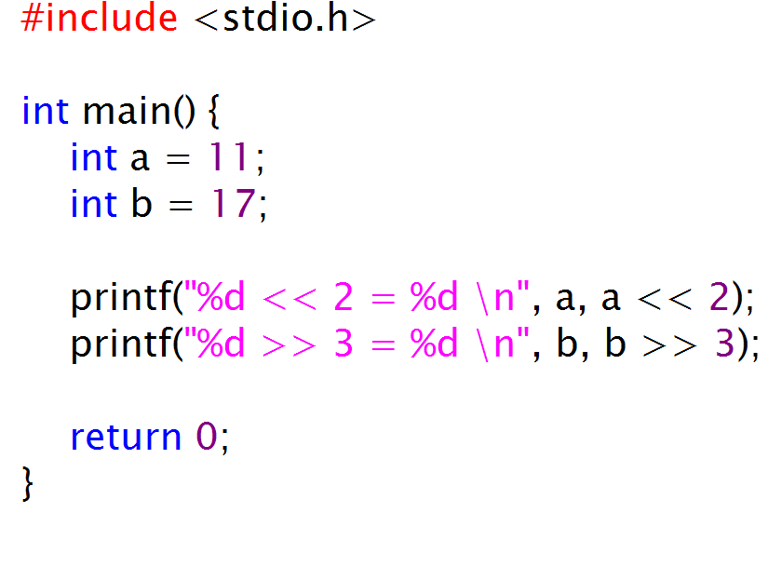
Bitwise Operators Examples
11 = 0000 0000 0000 1011
17 = 0000 0000 0001 0001
11 << 2
0000 0000 0000 1011 << 2 = 0000 0000 0010 1100 = 44
17 >> 3
0000 0000 0001 0001 >> 3 = 0000 0000 0000 0010 = 2
output:
11 << 2 = 44
17 >> 3 = 2

Slide 15
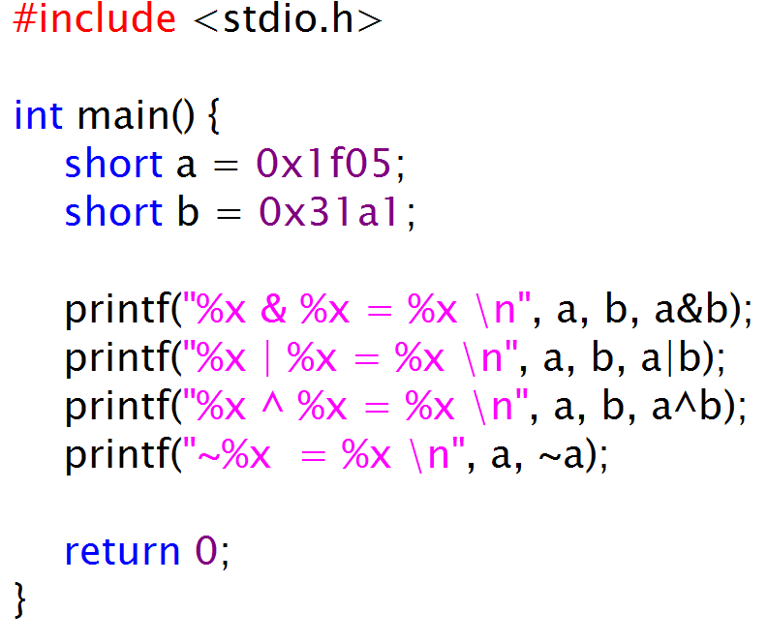
example
output:
1f05 & 31a1 = 1101
1f05 | 31a1 = 3fa5
1f05 ^ 31a1 = 2ea4
~1f05 = ffffe0fa

Slide 16
example
expression | value | result
a | 0x1f05 | 0001 1111 0000 0101
b | 0x31a1 | 0011 0001 1010 0001
~a | 0xe0fa | 1110 0000 1111 1010
a & b | 0x1101 | 0001 0001 0000 0001
a | b | 0x3fa5 | 0011 1111 1010 0101
a ^ b | 0x2ea4 | 0010 1110 1010 0100

Slide 17
Relational Operators
meaning | 연산자 | 자료형 | 결과값
Equal | a == b | integer or floating point | 1(=true) if a is equal to b otherwise 0(=false)
not equal | a != b | integer or floating point | 1(=true) if a is not equal to b otherwise 0(=false)
less than | a < b | integer or floating point | 1(=true) if a is less than b otherwise 0(=false)
less than or equal to | a <= b | integer or floating point | 1(=true) if a is less than or equal to b otherwise 0(=false)
greater than | a > b | integer or floating point | 1(=true) if a is greater than b otherwise 0(=false)
greater than or equal to | a >= b | integer or floating point | 1(=true) if a is greater than or equal to b otherwise 0(=false)

Slide 18
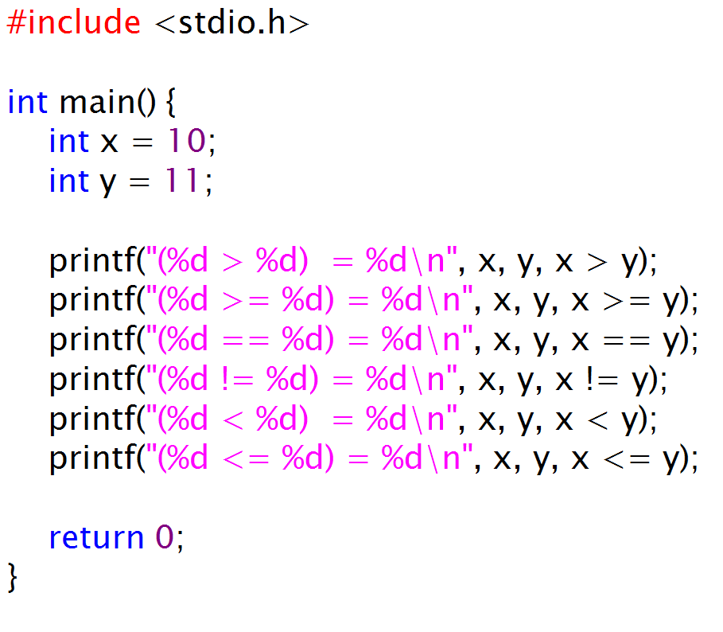
example
output:
(10 > 11) = 0
(10 >= 11) = 0
(10 == 11) = 0
(10 != 11) = 1
(10 < 11) = 1
(10 <= 11) = 1

Slide 19
Logical Operators
op name | expression | meaing
logical NOT | ! a | If a is false, then 1(=true), otherwise 0(=false)
logical AND | a && b | If both a and b are true, then 1(=true), otherwise 0(=false)
logical OR | a || b | If either a or b is true, then 1(=true), otherwise 0(=false)

Slide 20
example
#include <stdio.h>
int main()
{
int score;
printf("Score?");
scanf("%d",&score);
if (score >= 90 && score <=100)
printf("your grade is A.\n");
if (score >= 80 && score < 90)
printf("your grade is B.\n");
if (score >= 70 && score < 80)
printf("your grade is C.\n");
if (score >=60 && score < 70)
printf("your grade is D.\n");
if (score < 60)
printf("your grade is F.\n");
return 0;
}

Slide 21
Automatic Type Conversion
What happens when expression has mixture of different data types.
Ex)
double x=1.2;
float y=0.0;
int i=3;
int j=0;
j=x+i; /* (temporary copy of)i will be converted to double type
before ‘+’ operation.
the value of i in memory is unchanged */
y=x+i;
printf(“j=%d , y=%f\n”,j,y);

Slide 22
Automatic Type Conversion
“lower” types are promoted to “higher” types. The expression itself will have the type of its highest operand. The type hierarchy is as follows
long double
double
float
int
short , char
If either operand is long double, convert the other to long double
Otherwise, if either operand is double, convert the other to double
Otherwise, if either operand is float, convert the other to float
Otherwise, convert char and short to int

Slide 23
Automatic Type Conversion with assignment operator
Example
double x=5.5;
int y=3;
y=x; /* x will be converted to int type */
x=y; /* y will be converted to double type */

Slide 24
Type casting
Programmers can enforce type conversion to a variable
Ex1)
double x=3.5;
double y=2.7;
double below_point;
below_point = x*y - (int)(x*y) ;
Ex2)
double x=3.5;
printf(“integer number of x = %d\n”,(int)x);

