Slide 1
Lecture 2 :
Computer System and Programming

Slide 2
Computer?
a programmable machine that
Receives input
Stores and manipulates data
Provides output in a useful format

Slide 3
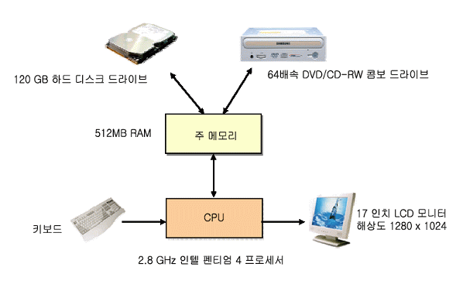
Computer System
Computer System
Hardware + Software
Computer Hardware
Hard Disk Drive (HDD)
DVD/CD
Main Memory
CPU
Monitor
Keyboard

Slide 4
Computer Hardware
CPU (Central Processing Unit)
Processing program instructions (one by one)
Basic program instructions : add/subtract/multiply/div, read/write, jump, test
Cache : duplicating original data stored in slow storage into faster storage
Main Memory (e.g. RAM)
Volatile : when power turned off, data in the memory will be erased
Storing progam and data
Fast, small, and expensive
Secondary Memory (e.g. HDD, CD/DVD, …)
Non volatile
Relatively slow, large, and cheap
I/O(Input/Output) Device
Help interaction between computer and human beings.
Keyboard, mouse, monitor, etc

Slide 5
Memory and Data
1278
1279
1280
1281
1282
1283
1284
1285
1286
1278
1279
1280
1281
1282
1283
1284
1285
1286
10011010
Each memory cell stores 1 byte data
10011010
Bigger data values are
Stored in consecutive memory cells

Slide 6
Program Execution
von Neumann architecture
Main Memory
Program
(Instruction + Data)
Program
loading
Instruction result
Instruction, data fetch
PC
CPU

Slide 7
Software
system software
Efficient management of computer system and resources
Operating System, compiler, debugger
application software
All kinds of software other than system software
Wordprocessor, spreadsheet(excel), graphics SW, artificial intelligence SW, Game SW, Statistics SW, medical SW

Slide 8
Software Layers
Application S/W
Powerpoint
System S/W
Wordprocessor
OS
Utilities
Debugger
Compiler
Web Browser
Database

Slide 9
Data Representation
Binary number
Computer uses binary number
1bit can represent 0 or 1
N bit number can represent up to 2^{N}
1 bit | 2 bit | 3 bit | 4 bit
0 1 | 00 01 10 11 | 000 001 010 011 100 101 110 111 | 0000 0001 0010 0011 0100 0101 0110 0111 1000 1001 1010 1011 1100 1101 1110 1111

Slide 10
Binary number, decimal number
Decimal number
Use 0 - 9
182 = 1 x 10² + 8 x 10¹ + 2 x 10⁰
= 1 x 100 + 8 x 10 + 2 x 1
Binary number
Use 0 and 1
1101₂ = 1 x 2³ + 1 x 2² + 0 x 2¹ + 1 x 2⁰
= 1 x 8 + 1 x 4 + 0 x 2 + 1 x 1
= 13

Slide 11
Programming Language
Language for programming computer processing
Machine readable language designed to express computations that can be performed by a computer
Specify behavior of machine, express algorithms
Human-Computer Communications
Machine language
Binary code
1001 0001 store value at address 0001 into accumulator
1100 0010 add value at address 0010 into accumulator
Assembly Language
Symbolization of machine language binary code
LOAD Y
ADD Z

Slide 12
Programming Language
High level language
Easy to use (read and write) , human friendly
Programmer does not need to know details of machine control.
More portable (machine independent)
X = Y + Z
example
FORTRAN, COBOL, BASIC, C, C++, Java

Slide 13
High Level Programming Language
FORTRAN(FORmula TRANslation)
Created in 1957 by John Backus (IBM)
General purpose PL especially suited For scientific computation
COBOL(COmmon Business Oriented Language)
Created in early 1960s
Primarily used for business, finance in companies and govenment
BASIC(Beginner's All-purpose Symbolic Instruction Code)
Easy to learn and use for beginners

Slide 14
High Level Programming Language
C
Made by Dennis Ritchie (AT&T Bell Lab)
made for developing UNIX OS (1970s)
High level language with low level language properties (pointers,…)
C++
Made by B. Stroustrup (AT&T Bell Lab)
OOPL(Object Oriented Programming Language) extending C
Java
Made by James Gosling (Sun Microsystems, 1990s)
Platform independent OOPL

Slide 15
Programming and Execution
Programming Tool
Editor, Compiler, Interpreter, Debugger, and etc
Integrated Development Environment (IDE)
Program Edit
Error
Compile
Error
Execution

Slide 16
Error
compile-time error
Error occurring during compilation
Grammar check
Cannot execute if there is compile error
logical error
Grammar is OK but logical error
run-time error
Abnormal termination owing to unexpected reasons during program execution
Ex) divided by zero, illegal memory access

Slide 17
Debugging
debugging
Bug : program error
Debugging : bug correction

Slide 18
Compiler / Interpreter
Compiler
Convert high level language to low level language
(occur at compile-time)
Interpreter
Compile and execute the program line by line
(occur at run-time)
Comparison?

