Slide 1
C Programming Lecture 5 : Basic standard I/O
Lecture notes : courtesy of Ohio Supercomputing Center, science and technolgy support

Slide 2
Standard Input/Output (I/O)
Preconnected input and output channels between a computer program and its environment(typically a text terminal).
Standard input :
text input from keyboard
Standard output
text output written to display
Standard error :
another text output written to display for error messaging

Slide 3
Standard I/O library
Library
A collection of subroutines (functions) used to develop software
Standard library
Library that is made available in every implementation of a programming language
Same interface(parameter type) , same functionality in different systems
Standard I/O library
Standard library for processing I/O

Slide 4
printf function
printf(control string,argument list);
Control string contains
Literal text to be displayed
format specifiers
Special characters
Arguments can be
Variable , function, expression, constant
# of argument list must match the # of format identifiers

Slide 5
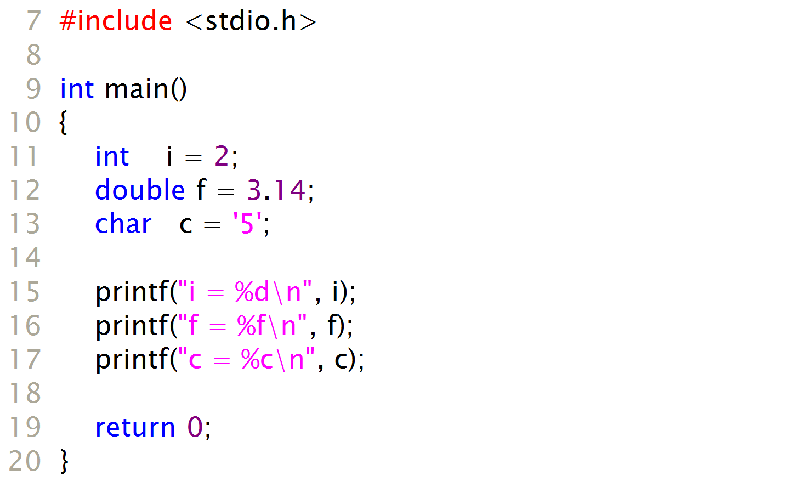
printf example
Output :
i = 2
f = 3.141593
c = 5

Slide 6
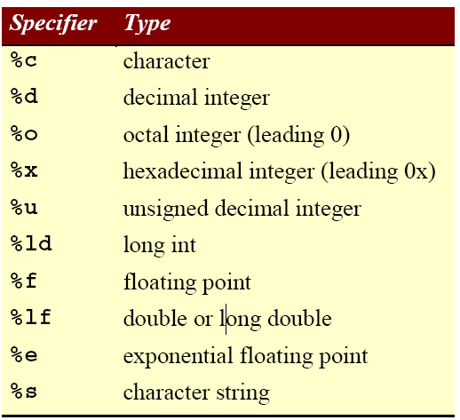
printf format specifiers

Slide 7
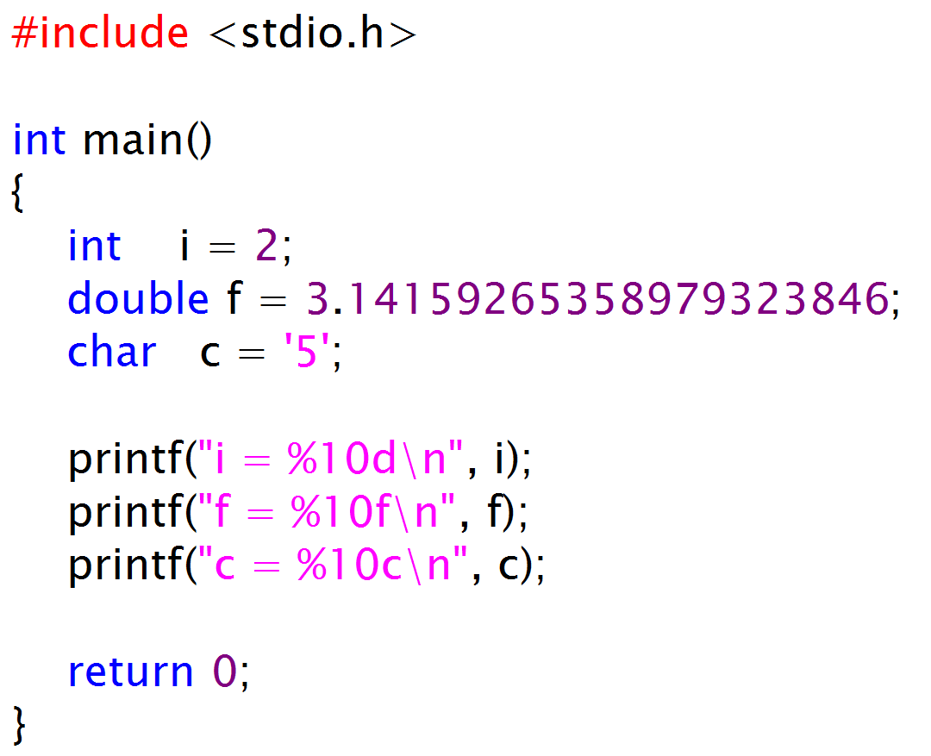
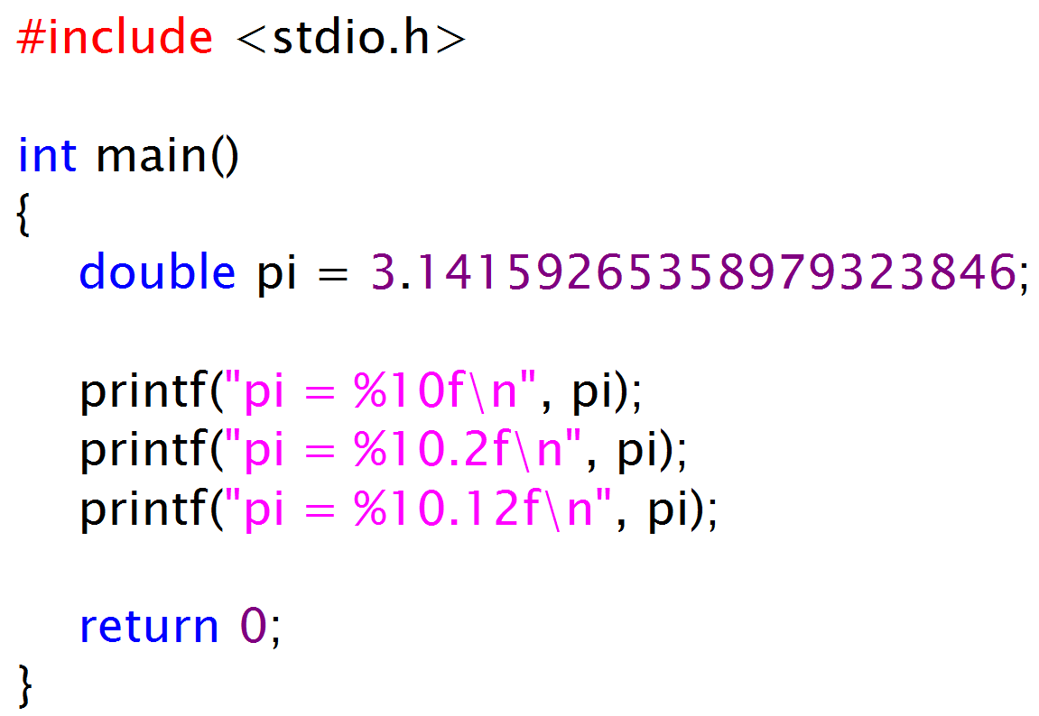
printf examples
output :
i = 2
f = 3.141593
c = 5
output:
pi = 3.141593
pi = 3.14
pi = 3.141592653590

Slide 8
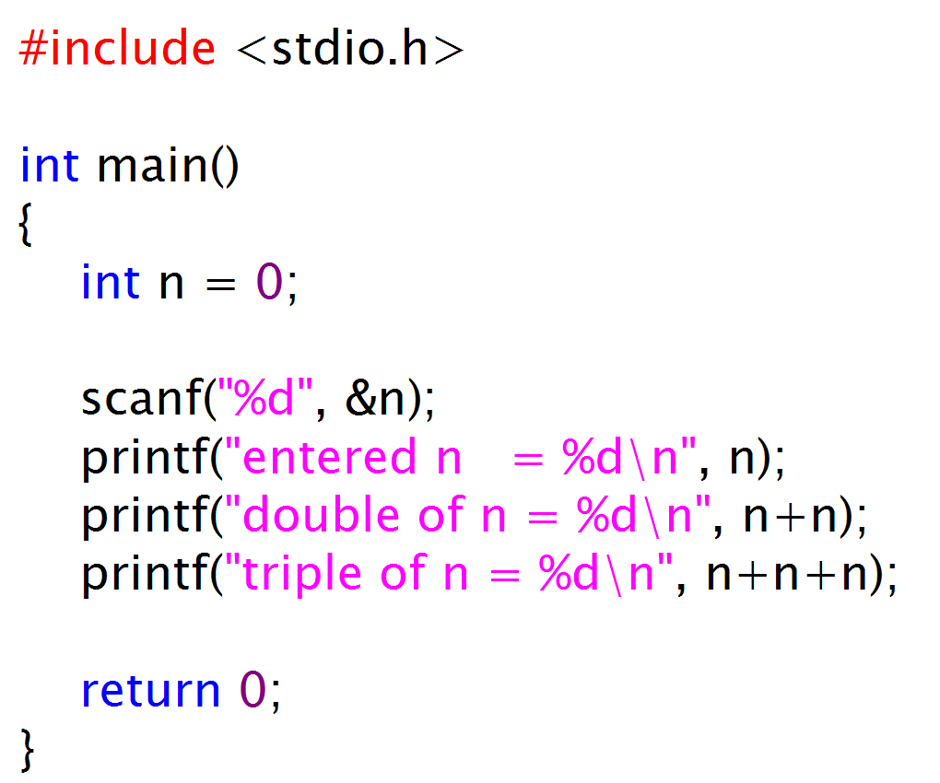
scanf function
Accept formatted text input
Output :
27 ←---- keyboard input
entered n = 27
double of n = 54
triple of n = 81

Slide 9
gets(), puts() functions
line based string I/O functions
Prototype
char* gets(char *BUF);
Read characters from standard input until a newline is found
int puts(const char *s);
Writes a string s to the standard output.
#include <stdio.h>
#define MAX_LINES 2
int main()
{
char line[MAX_LINES];
printf(“string input :”);
gets(line);
printf(“the input string is : ”);
puts(line);
return 0;
}

Slide 10
redirection
Input redirection
Gets standard input from a file “inputFile.txt”
program.exe < inputFile.txt
Output redirection
writes standard output to a file “outputFile.txt”
program.exe > outputFile.txt
Combination
Gets standard input from a file “inputFile.txt” and writes standard output to a file “outputFile.txt”
program.exe < inputFile.txt > outputFile.txt

Slide 11
Exercise
Write a program that converts meter-type height into [feet(integer),inch(float)]-type height. Your program should get one float typed height value as an input and prints integer typed feet value and the rest of the height is represented as inch type. (1m=3.2808ft=39.37inch)
Ex) 1.80meter -> 5feet 10.9inch
use automatic type conversion
1/2 = 0 (?) , 3/2 = 1 (?)
(ex)
int a;
float b;
b = 3.6/2.0;
a=b;
printf(“a=%d, b=%f\n”,a,b);

