Slide 1
Alexander-Sadiku
Fundamentals of Electric Circuits
Chapter 1
Basic Concepts
Copyright © The McGraw-Hill Companies, Inc. Permission required for reproduction or display.

Slide 2
Basic Concepts - Chapter 1
1.1 Systems of Units.
1.2 Electric Charge.
1.3 Current.
1.4 Voltage.
1.5 Power and Energy.
1.6 Circuit Elements.

Slide 3
1.1 System of Units (1)
Six basic units
Quantity | Basic unit | Symbol
Length | meter | m
Mass | kilogram | Kg
Time | second | s
Electric current | ampere | A
Thermodynamic temperature | kelvin | K
Luminous intensity | candela | cd

Slide 4
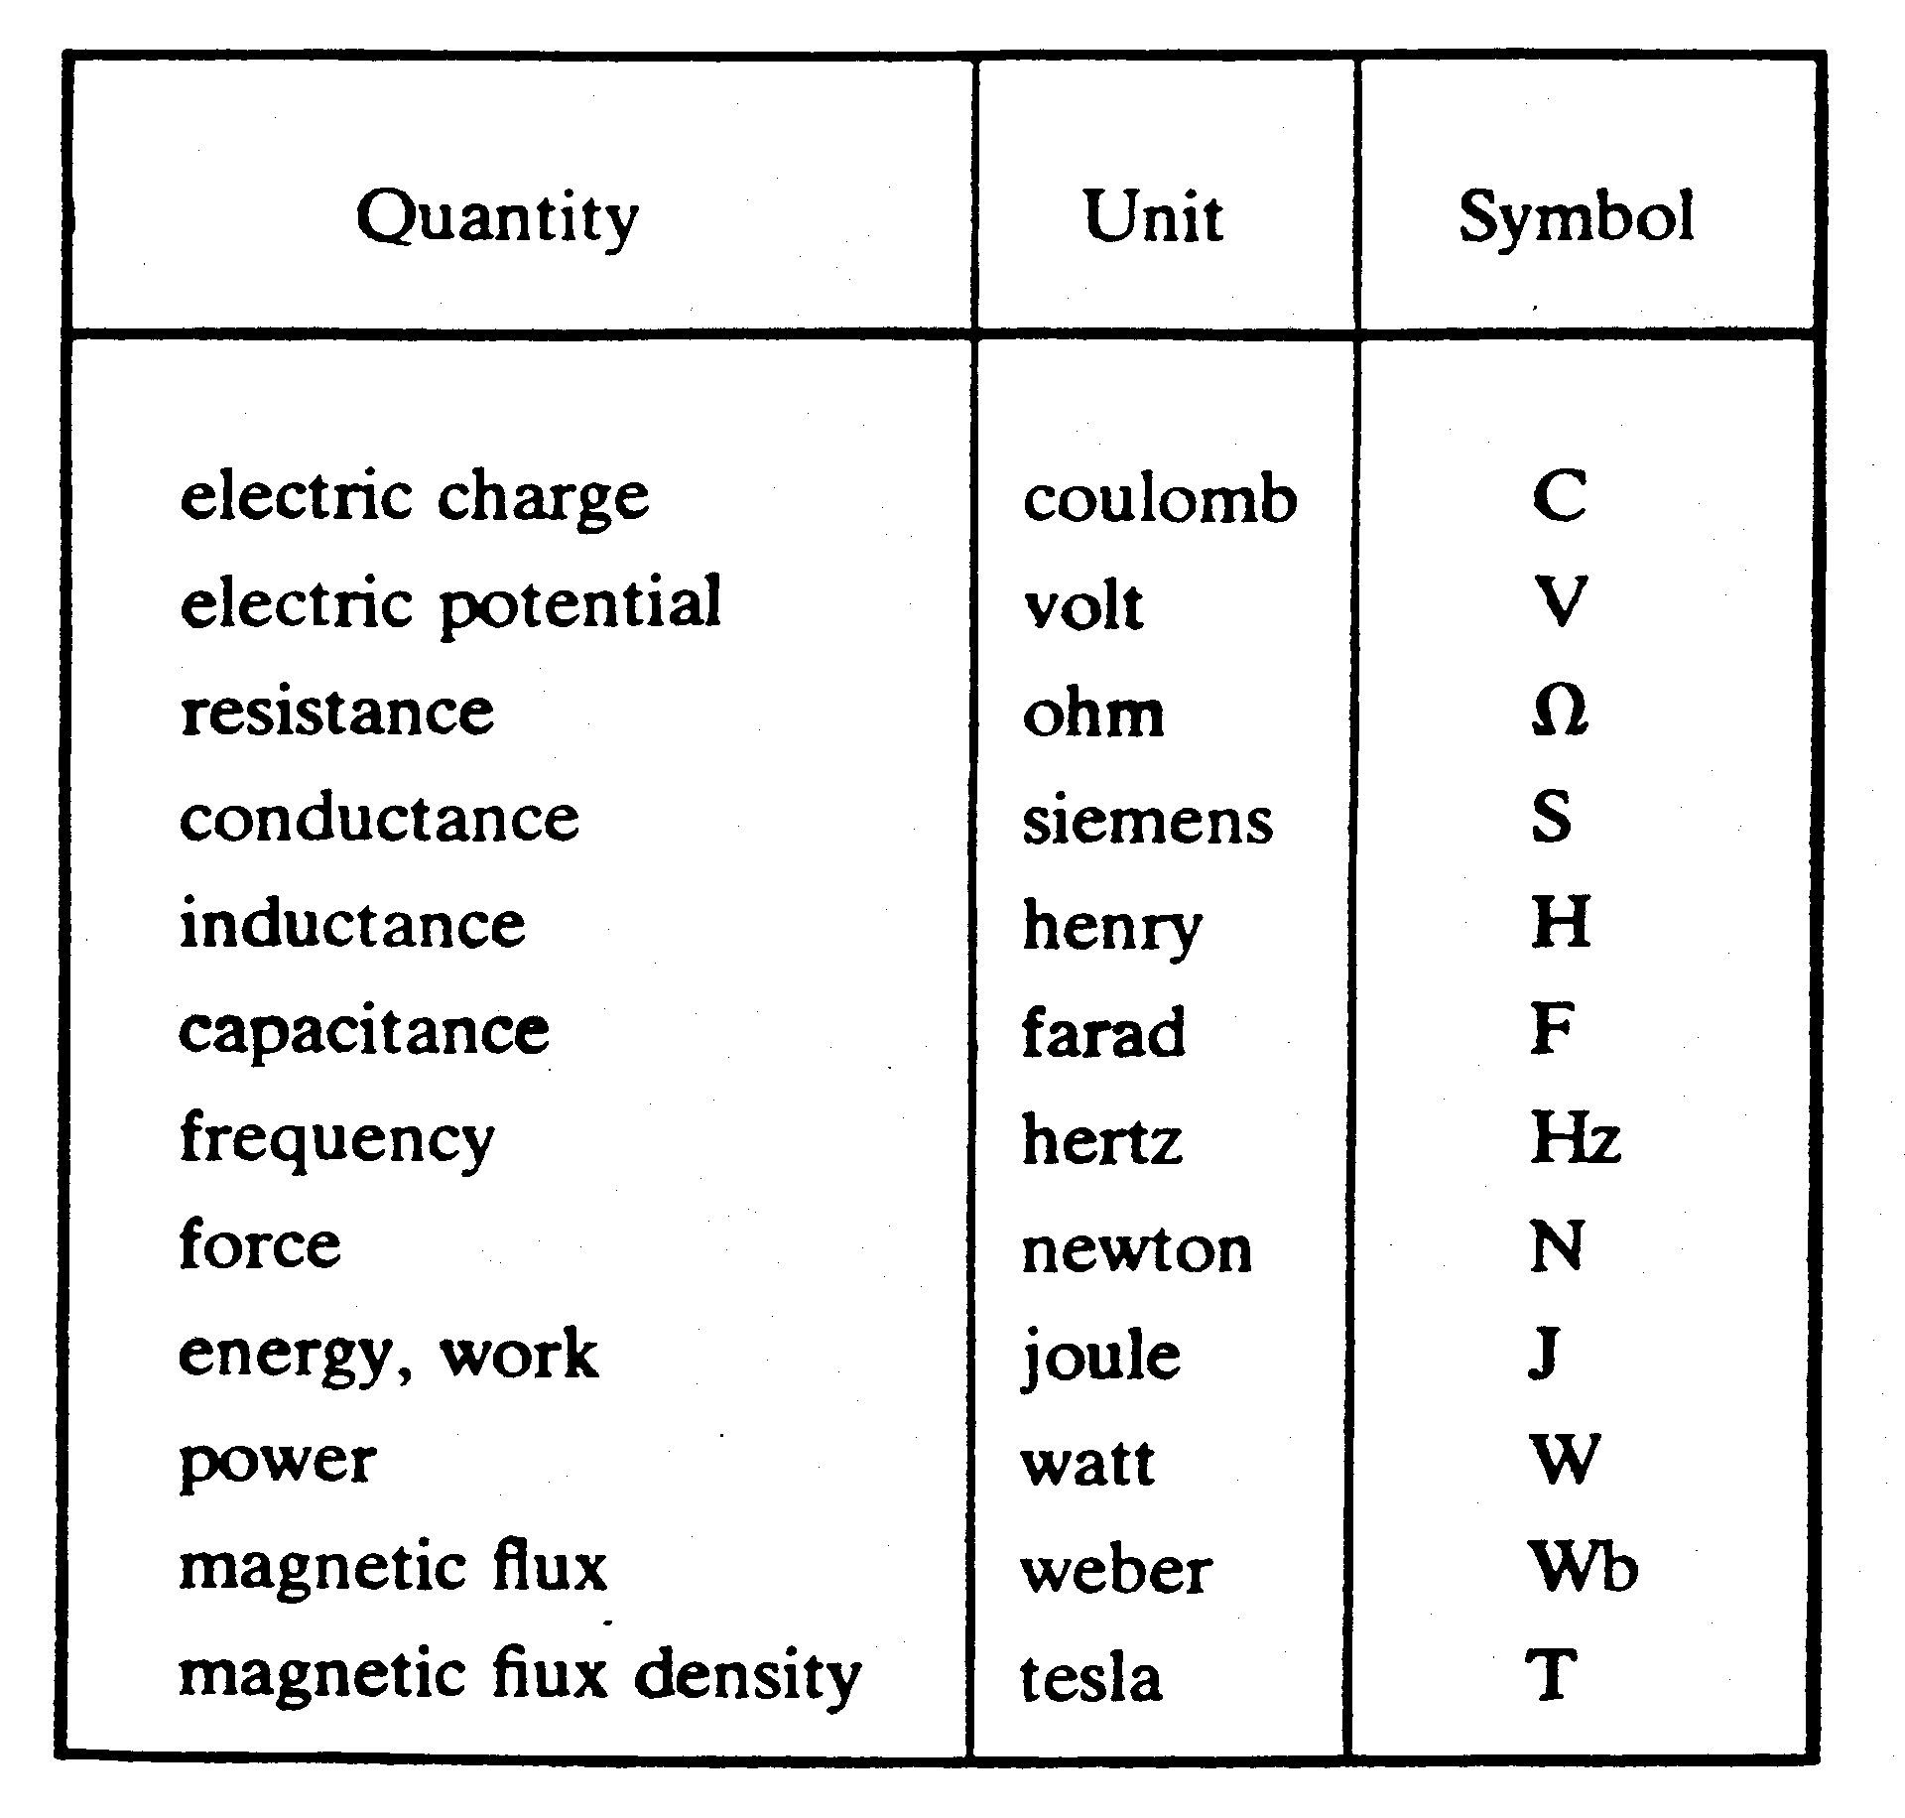
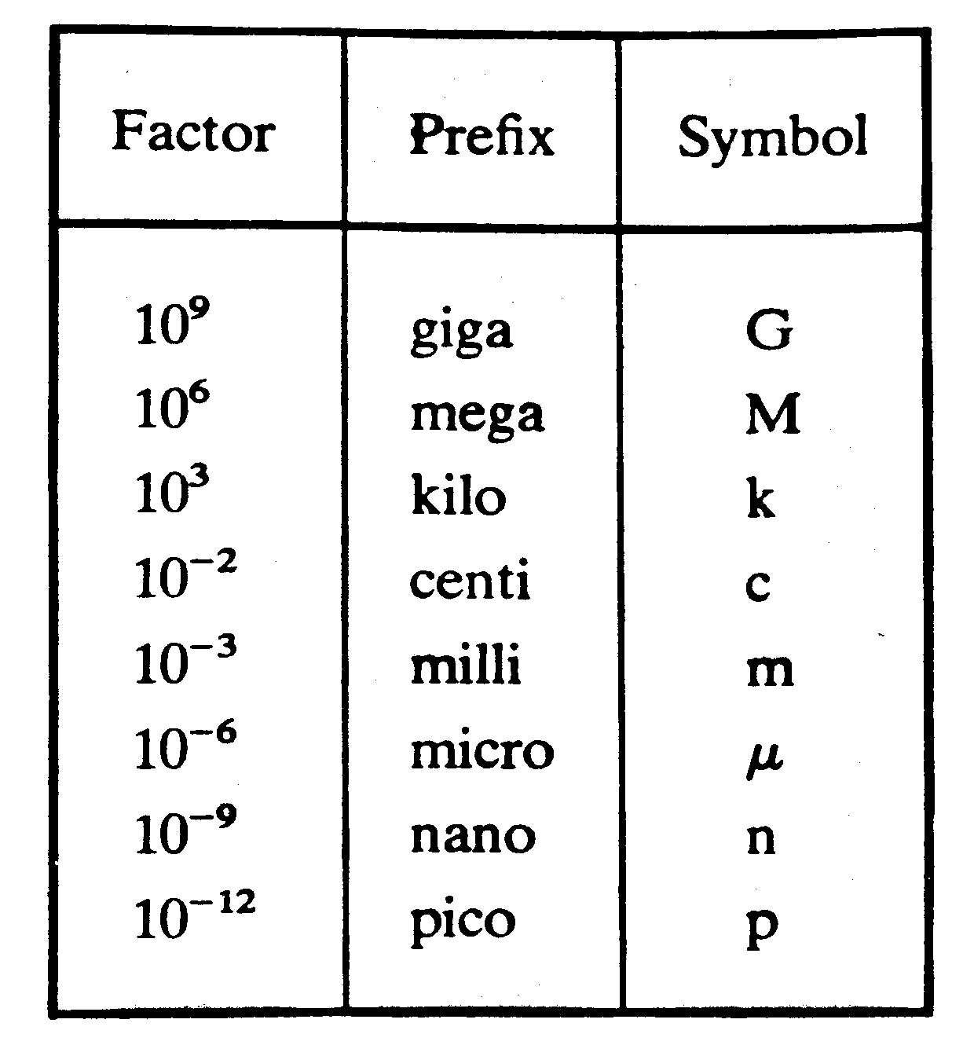
1.1 System of Units (2)
The derived units commonly used in electric circuit theory
Decimal multiples and submultiples of SI units

Slide 5
1.2 Electric Charges
Charge is an electrical property of the atomic particles of which matter consists, measured in coulombs (C).
The charge e on one electron is negative and equal in magnitude to 1.602 × 10⁻¹⁹ C which is called as electronic charge. The charges that occur in nature are integral multiples of the electronic charge.

Slide 6
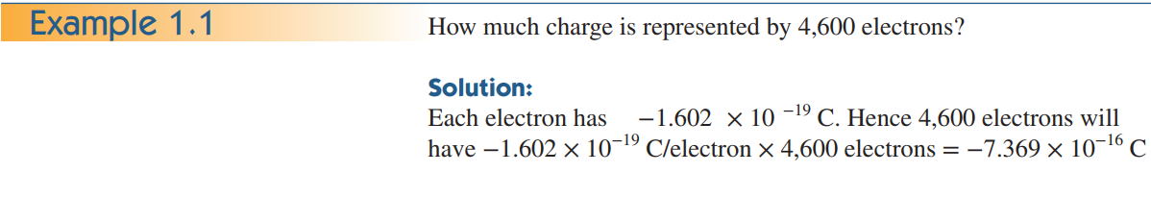
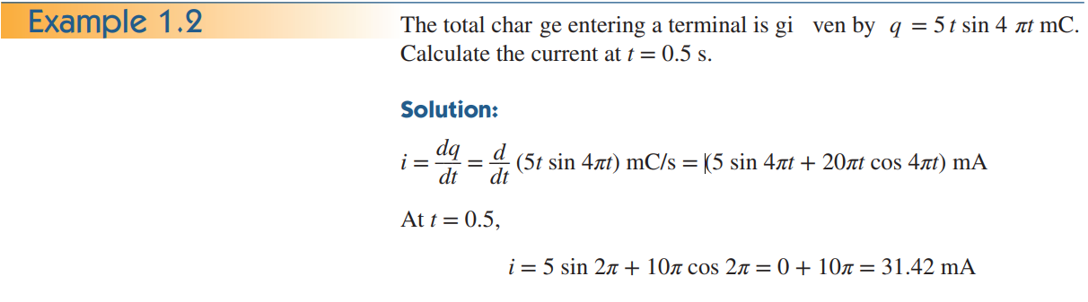

Slide 7
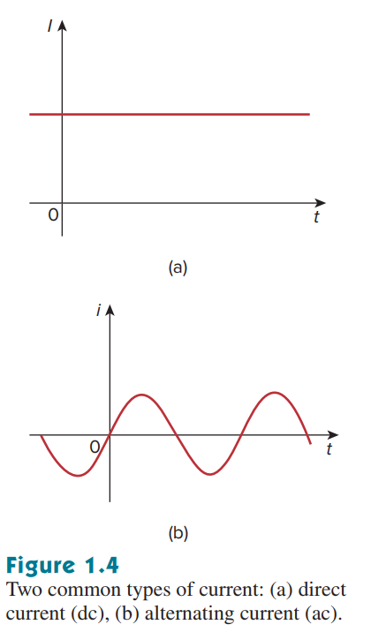
1.3 Current (1)
Electric current is the time rate of change of charge, measured in amperes (A)
Electric current i = dq/dt. The unit of ampere can be derived as 1 A = 1C/s.
A direct current (dc) is a current that remains constant with time.
An alternating current (ac) is a current that varies sinusoidally with time. (reverse direction)

Slide 8
A direct current (dc) ﬂows only in one direction and can be constant
or time varying.

Slide 9
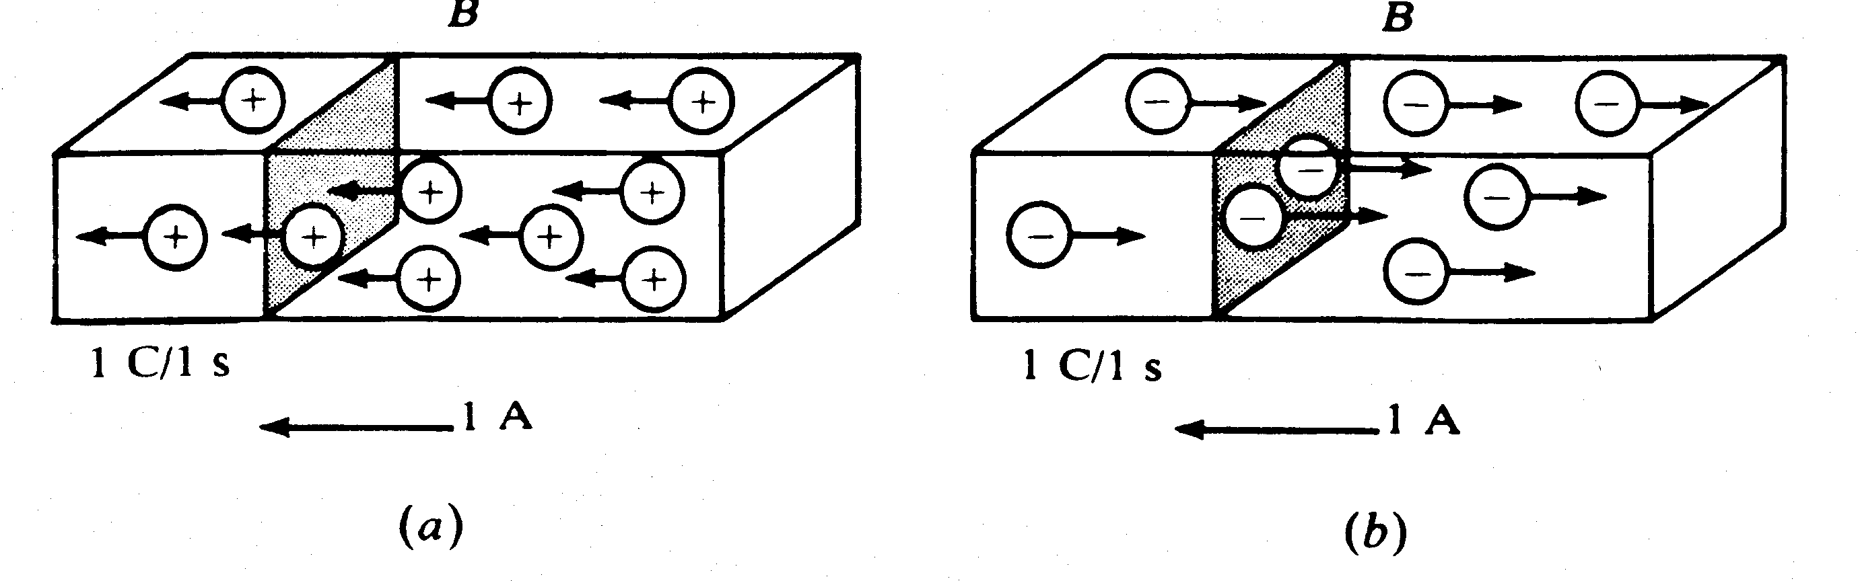
1.3 Current (2)
The direction of current flow
Positive ions
Negative ions

Slide 10
1.3 Current (3)
Example 1
A conductor has a constant current of 5 A.
How many electrons pass a fixed point on the conductor in one minute?

Slide 11
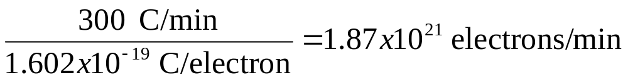
1.3 Current (4)
Solution
Total no. of charges pass in 1 min is given by
5 A = (5 C/s)(60 s/min) = 300 C/min
Total no. of electronics pass in 1 min is given

Slide 12
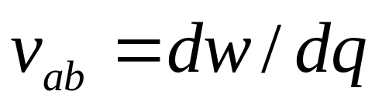
1.4 Voltage (1)
Voltage (or potential difference) is the energy required to move a unit charge through an element, measured in volts (V).
Mathematically, (volt)
  w is energy in joules (J) and q is charge in coulomb (C).
Electric voltage, v_{ab,} is always across the circuit element or between two points in a circuit.
  v_{ab} > 0 means the potential of a is higher than potential of b.
  v_{ab} < 0 means the potential of a is lower than potential of b.

Slide 13
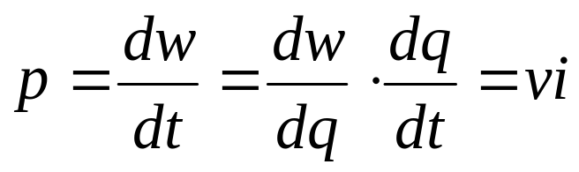
1.5 Power and Energy (1)
Power is the time rate of expending or absorbing energy, measured in watts (W).
Mathematical expression:
i
i
+
+
v
v
–
–
Passive sign convention
P = +vi p = –vi
absorbing power supplying power

Slide 14
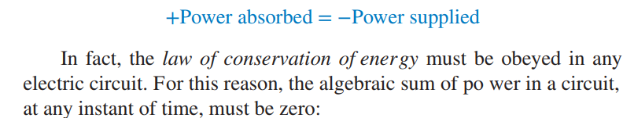
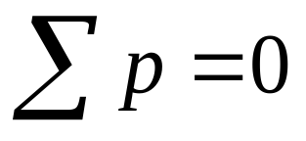
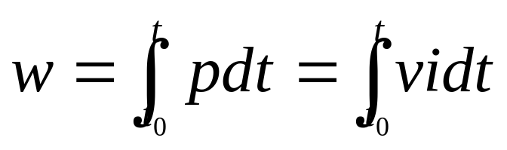
1.5 Power and Energy (2)
The law of conservation of energy
Energy is the capacity to do work, measured in joules (J).
Mathematical expression

Slide 15
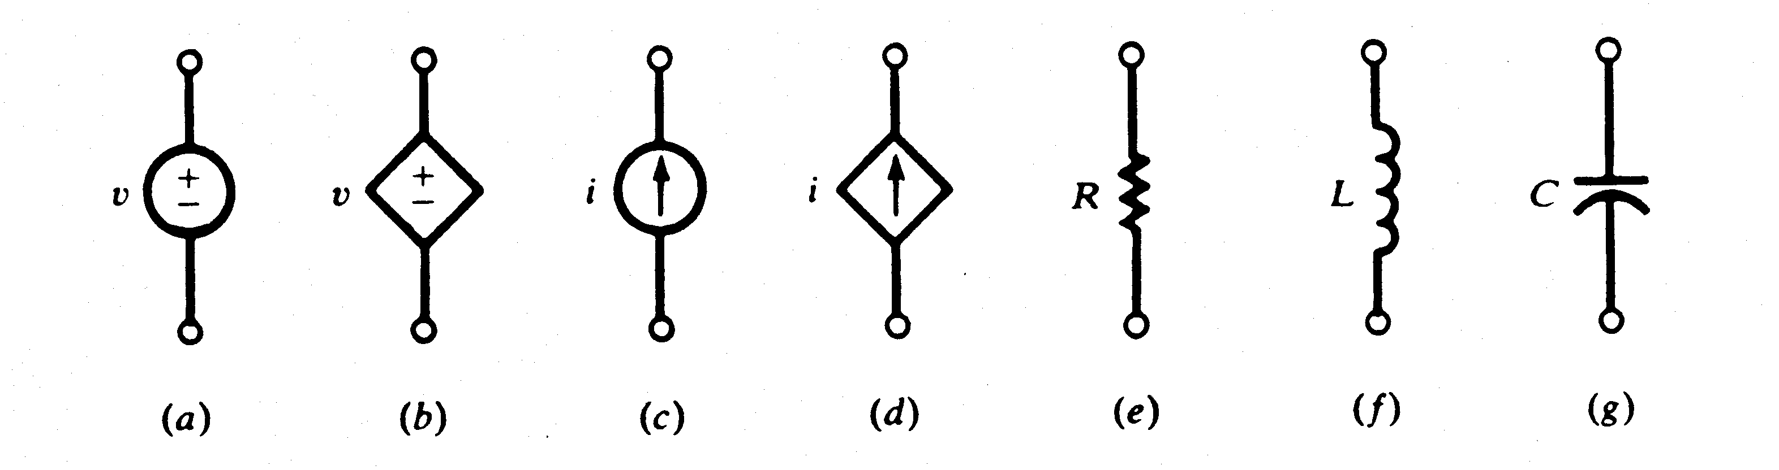
1.6 Circuit Elements (1)
Active Elements
Passive Elements
A dependent source is an active element in which the source quantity is controlled by another voltage or current. Dependent sources are usually designated by diamond-shaped symbols
They have four different types: VCVS, CCVS, VCCS, CCCS. Keep in minds the signs of dependent sources.
Independent
sources
Dependent
sources
An ideal independent source is an active element that provides a specified voltage or current that is completely independent of other circuit elements.

Slide 16
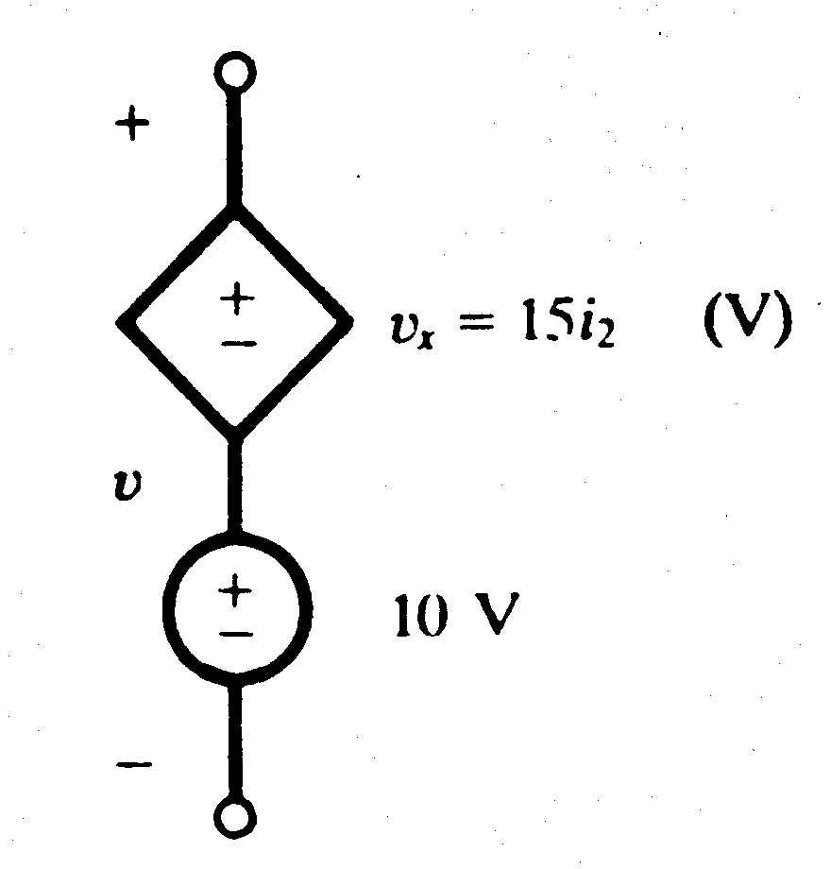
1.6 Circuit Elements (2)
Example 2
Obtain the voltage v in the branch shown in Figure 2.1.1P for i₂ = 1A.
Figure 2.1.1P

Slide 17
1.6 Circuit Elements (3)
Solution
Voltage v is the sum of the current-independent 10-V source and the current-dependent voltage source v_{x}.
Note that the factor 15 multiplying the control current carries the units Ω.
Therefore, v = 10 + v_{x} = 10 + 15(1) = 25 V

