Slide 1
Map-Stack

Slide 2
Feature of Map-Stack
Contains location names
Collect data from local database.
Makes an API call if internet is connected.
Shows location on clicking any name.

Slide 3
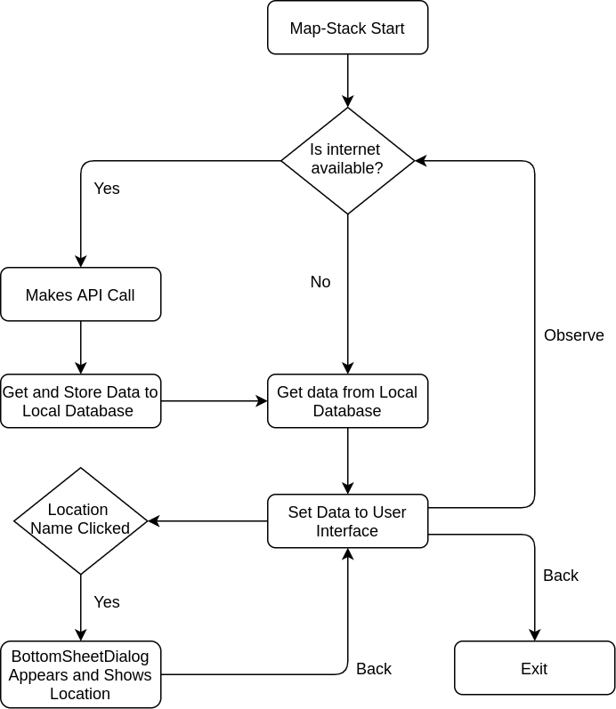
Flow Diagram

Slide 4
Architectural Pattern (MVVM)
Model
Model Classes
Repository
API Service
View
Activities
Adapter
Viewmodel

