Slide 1
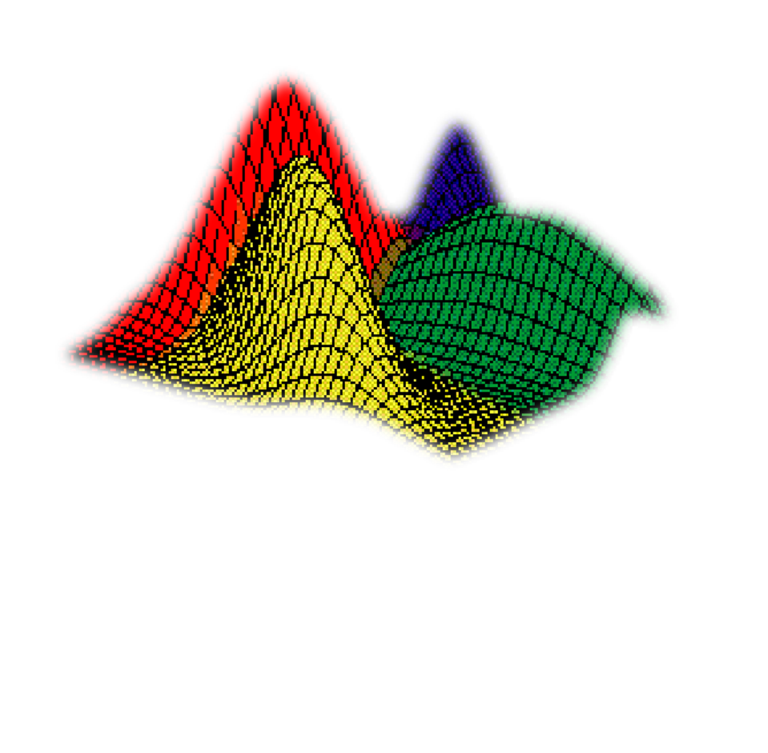
Bayesian Network
1

Slide 2
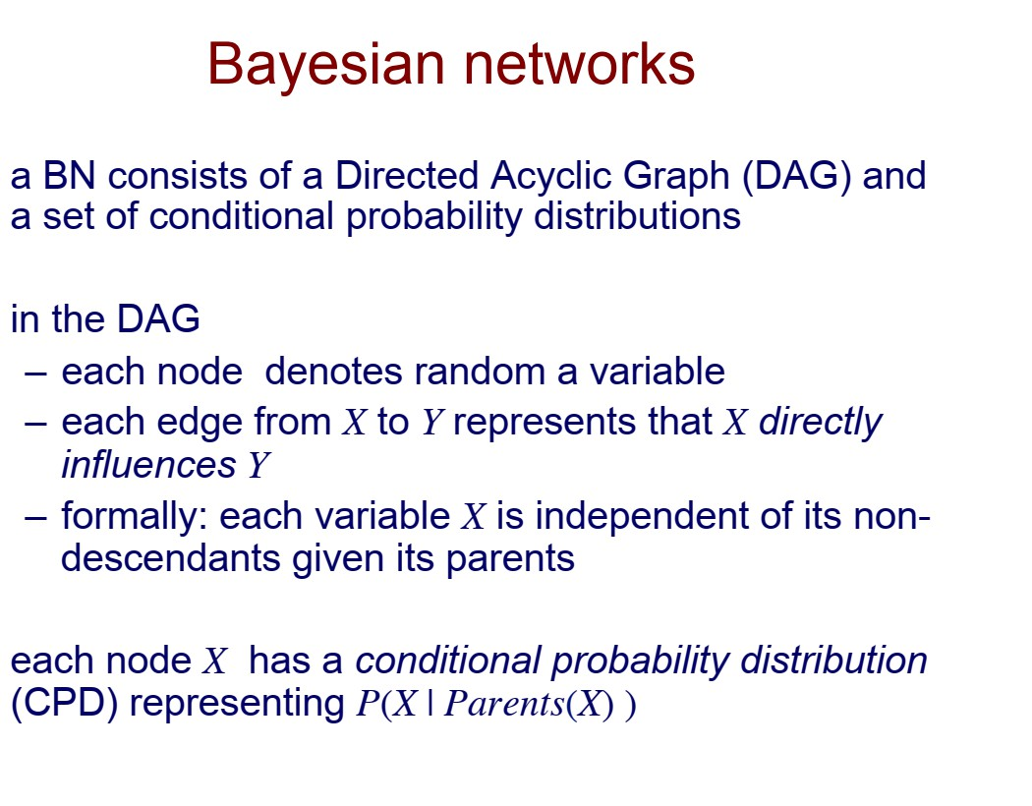
2
Notes:
parents জানা থাকলে একটা variable তার ancestor দের উপর নির্ভর করে না।

Slide 3
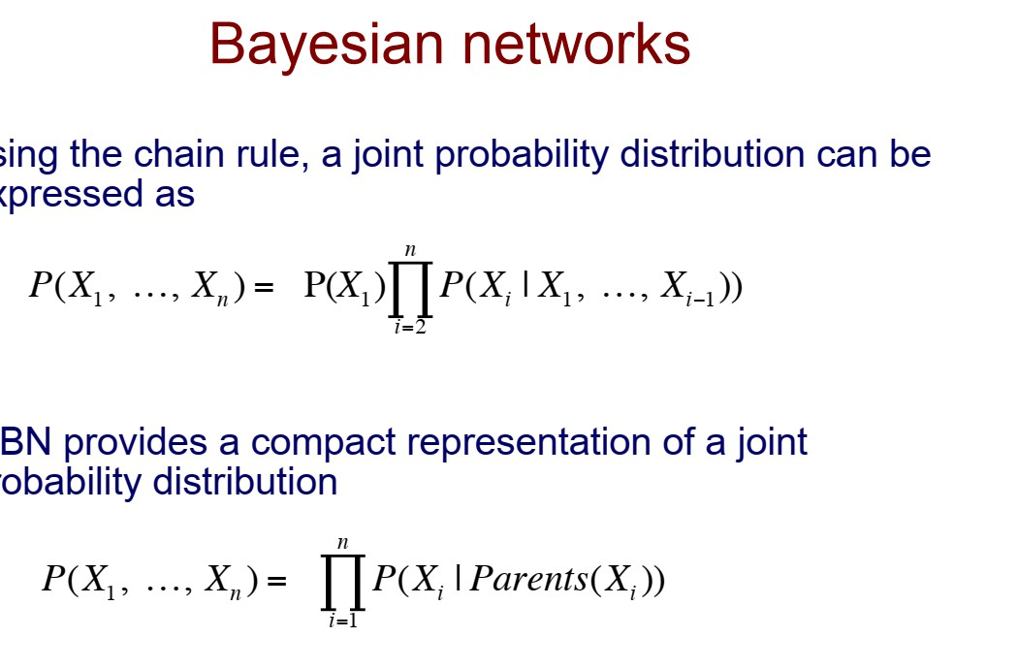
3

Slide 4
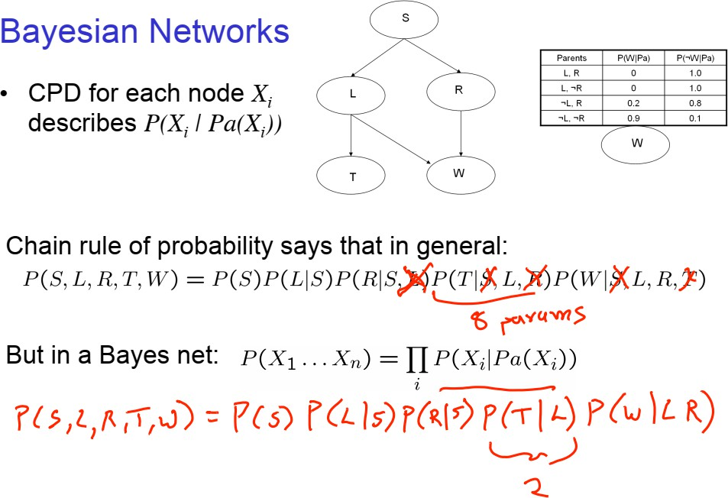
4

Slide 5
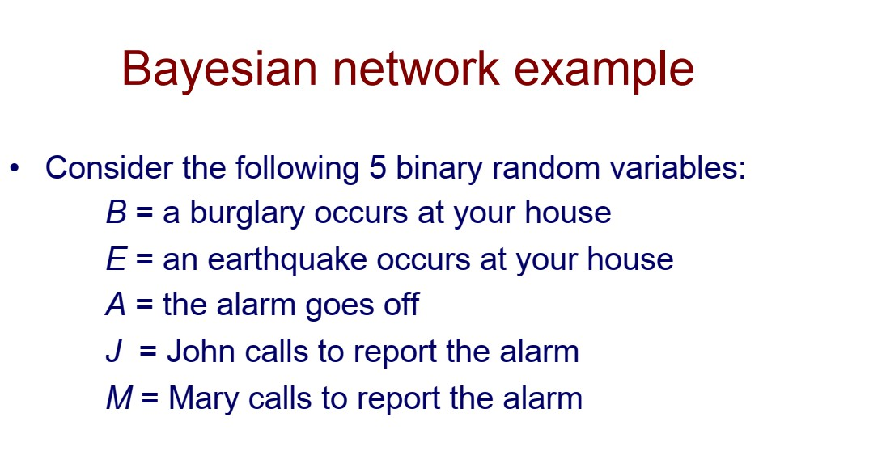
5

Slide 6
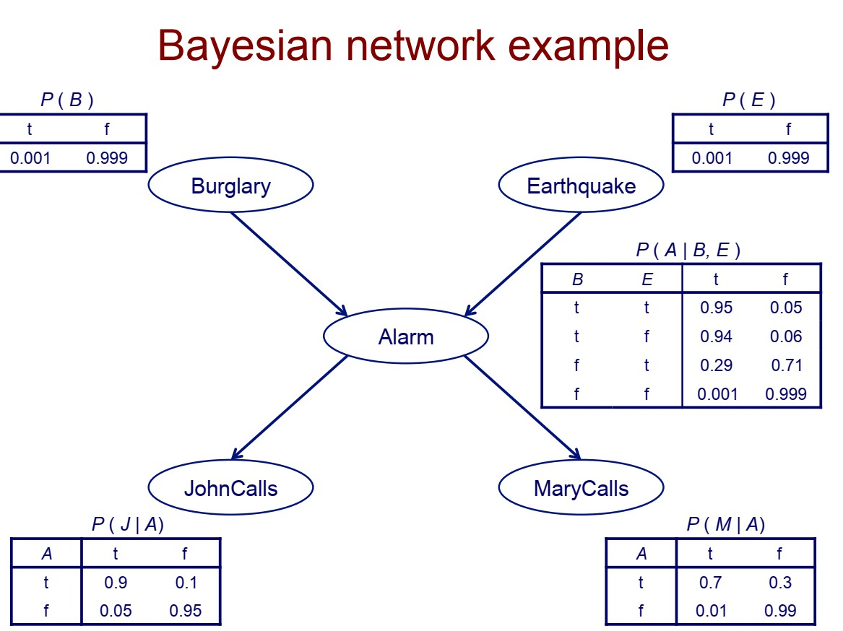
6

Slide 7
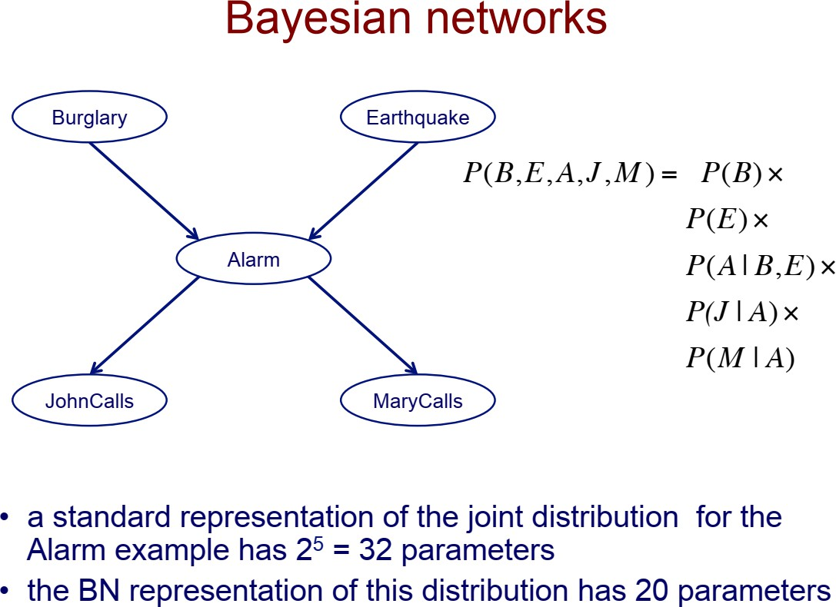
7

Slide 8
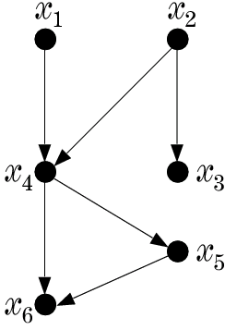
– A graphical way to portray conditional dependencies

Slide 9
A graphical way to portray conditional dependencies
  According to this figure we have that:
    x₆ is conditionally
dependent on x₄, x₅.
    x₅ on x₄
    x₄ on x₁, x₂
    x₃ on x₂
    x₁, x₂ are conditionally independent on other variables.

Slide 10

A graphical way to portray conditional dependencies
  According to this figure we have that:
    x₆ is conditionally
dependent on x₄, x₅.
    x₅ on x₄
    x₄ on x₁, x₂
    x₃ on x₂
    x₁, x₂ are conditionally independent on other variables.
For this case:
p(x₁, x₂ ,..., x₆ ) = p(x₆ | x₅ , x₄ ) ⋅ p(x₅ | x₄ ) ⋅ p(x₃ | x₂ ) ⋅ p(x₂ ) ⋅ p(x₁)

Slide 11
Bayesian Networks
  a directed acyclic graph (DAG)
  the nodes correspond to random variables
  arc represents parent-child (dependence) relationship

Slide 12
A Bayesian Network is specified by:
  The prior probabilities of its root nodes.
  The conditional probabilities of the non-root nodes, given their parents, for ALL possible combinations.

Slide 13
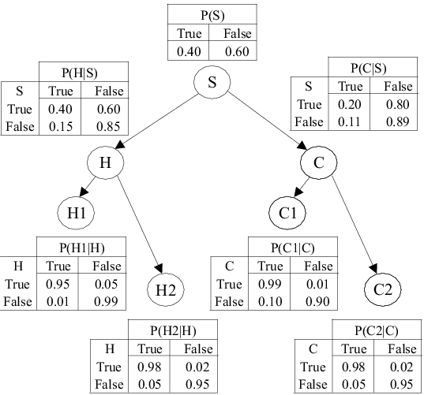
A Bayesian Network from a medical application
  BBN models conditional dependencies concerning smokers (S), tendencies to develop cancer (C) and heart disease (H), together with variables corresponding to heart (H1, H2) and cancer (C1, C2) medical tests.

Slide 14
any joint probability can be obtained by multiplying the prior (root nodes) and the conditional (non-root nodes) probabilities.
Training: given a topology, probabilities are estimated from training data.
Probability Inference: Given an pattern (evidence), the goal is to compute the conditional probabilities for some of the other variables (class)

Slide 15
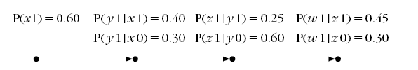
Example: Consider the Bayesian network of the figure:
x
y
z
w
Random variables: x, y, w, z
x0 means x = 0
x1 means x = 1

Slide 16
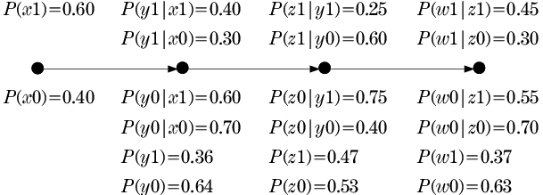
We can calculate the other probabilities
x
y
z
w
Example: p(y₁):
P( y1) = ∑ P( y1, x) = P( y1, x1) + P( y1, x0)
x

Slide 17
We can calculate the other probabilities
x
y
z
w

Slide 18
Given this info, we can answer any probabilistic query:
x
y
z
w
If x is measured to be x=1 (x1), compute P(z1|x1) and P(w0|x1).
If w is measured to be w=1 (w1) compute P(z1|w1)].

Slide 19
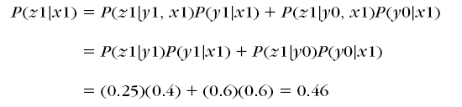
a) If x is measured to be x=1 (x1), compute P(z1|x1) and
P(w0|x1).
x
y
z
w
Notes:
একবার y এর value জানা গেলে, x এর আর কোন প্রভাব নেই z এর উপর
এটাকে বলে Conditional Independence
মানে: y জানা থাকলে, z শুধু y এর উপর depend করে, x এর উপর না
P(x1)=0.60 কেন ব্যবহার হয়নি?
P(x1) হল prior probability। কিন্তু এখানে আমরা conditional probability P(z1|x1) বের করছি।
এর মানে হল আমরা ইতিমধ্যে জানি যে x=1
তাই P(x1) এর আর দরকার নেই এই calculation এ
P(x1) দরকার হবে যদি আমরা joint probability P(z1,x1) বের করতাম
সহজ উদাহরণ: ধরুন আপনি জানেন আজকে বৃষ্টি হচ্ছে। এখন ছাতা নেওয়ার probability কত? এখানে "আজকে বৃষ্টি হওয়ার probability" (prior) আর দরকার নেই, কারণ আপনি ইতিমধ্যে জানেন বৃষ্টি হচ্ছে।
এভাবে বুঝতে পারলেন?

Slide 20
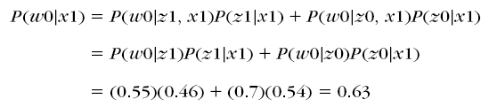
a) If x is measured to be x=1 (x1), compute P(z1|x1) and
P(w0|x1).
x
y
z
w

Slide 21

b) If w is measured to be w=1 (w1) compute P(z1|w1|)].
x
y
z
w

Slide 22
What’s about more complex networks?

Slide 23
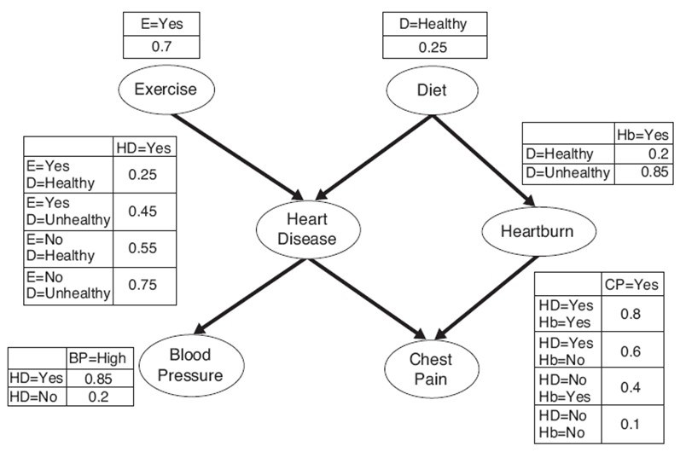
What’s about more complex networks?

Slide 24
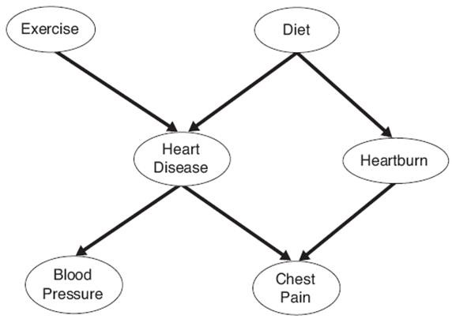
We will study this graph
We can show:
P(D|E)=P(D)
P (Hb|HD, E, D)= P (Hb|D)
P (CP|Hb, HD, E, D)= P (CP|Hb, HD)
P (BP|CP, Hb, HD, E, D)= P (BP|HD)
However, P (HD|E,D) cannot be implified

Slide 25
Exercise:
P (CP|HD, BP, E, D)= ?

Slide 26
Exercise:
P (CP|HD, BP, E, D)= No simplification

Slide 27
Calculate P(HD=yes) ?

Slide 28
Calculate P(HD=yes) ?
P(HD = Yes) = ∑∑ P(HD = yes | E = α , D = β )P(E = α , D = β )
α β
where,
α = Set of Values of Exercise(E) = {Yes, No}
β = Set of Values of Diet(D) = {Healthy, Not Healthy}

Slide 29
Calculate P(HD=yes) ?
P(HD = Yes) = ∑∑ P(HD = yes | E = α , D = β )P(E = α , D = β )
α β
= ∑∑ P(HD = yes | E = α , D = β )P(E = α )P(D = β )
α β
= 0.25× 0.7 × 0.25 + 0.45× 0.7 × 0.75 + 0.55× 0.3× 0.25
+ 0.75× 0.3× 0.75
= 0.49

Slide 30
Calculate P(HD=yes|BP=High)?

Slide 31
Calculate P(HD=yes|BP=High)
can be written as
P(BP = High | HD = yes)P(HD = yes)
P(BP = High)
P(HD = yes | BP = High)

Slide 32
Calculate P(HD=yes|BP=High)
P(BP = High) = ∑ P(BP = high | HD = γ )P(HD = γ )
γ
where,
γ = Set of Values of Heart Disease (HD) = {Yes, No}

Slide 33
Calculate P(HD=yes|BP=High)
P(BP = High) = ∑ P(BP = high | HD = γ )P(HD = γ )
γ
= 0.85× 0.49 + 0.2 × 0.51 = 0.5185

Slide 34
Calculate P(HD=yes|BP=High)
_{P(HD = yes | BP = High) =} P(BP = High | HD = yes)P(HD = yes)
P(BP = High)
₌ 0.85× 0.49 _{= 0.8033}
0.5185

Slide 35
Calculate P(HD=yes|BP=high, D=Healthy, E=yes)?

Slide 36
Calculate P(HD=yes|BP=high, D=Healthy, E=yes) ?
P(HD = yes | BP = high, D = Healthy, E = Yes)
₌ P(BP = high | HD = yes, D = Healthy, E = Yes) × P(HD = yes | D = Healthy, E = Yes) P(BP = high | D = Healthy, E = Yes)

Slide 37
How is this formula true?
P(HD = yes | BP = high, D = Healthy, E = Yes)
₌ P(BP = high | HD = yes, D = Healthy, E = Yes) × P(HD = yes | D = Healthy, E = Yes) P(BP = high | D = Healthy, E = Yes)
Let
P( X | Y ) = ^{P(Y | X )} × P( X )
P(Y )
Now add Z and W as condition
P( X | Y , Z ,W ) = ^{P(Y | X , Z ,W )} × P( X | Z ,W )
P(Y | Z ,W )
Similarly,
P(HD = yes | BP = high) = ^{P(BP = high | HD = yes)} × P(HD = yes)
P(BP = high)
Now add conditions D= Healthy and E= Yes to above formula

Slide 38
Similarly,
P(BP = high | D = Healthy, E = Yes)
= ∑ P(BP = high | HD = γ , D = Healthy, E = Yes) × P(HD = γ | D = Healthy, E = Yes)
γ
Proof:
P(BP = high) = ∑ P(BP = high | HD = γ ) × P(HD = γ )
γ
Adding conditions D= Healthy and E= Yes
we get,
P(BP = high | D = Healthy, E = Yes)
= ∑ P(BP = high | HD = γ , D = Healthy, E = Yes) × P(HD = γ | D = Healthy, E = Yes)
γ
= ∑ P(BP = high | HD = γ ) × P(HD = γ | D = Healthy, E = Yes)
γ

Slide 39
P(HD = yes | BP = high, D = Healthy, E = Yes)
₌ P(BP = high | HD = yes, D = Healthy, E = Yes) × P(HD = yes | D = Healthy, E = Yes) P(BP = high | D = Healthy, E = Yes)
P(BP = high | HD = yes)
=
× P(HD = yes | D = Healthy, E = Yes)
P(BP = high | D = Healthy, E = Yes)
P(BP = high | HD = yes)
∑ P(BP = high | HD = γ )P(HD = γ | D = Healthy, E = Yes)
=
× P(HD = yes | D = Healthy, E = Yes)
γ
0.85× 0.25
=
= 0.5862
56
0.85× 0.25 + 0.2 × 0.75

