Slide 1
SPL (Introduction)
Rakib Mahmud

Slide 2
Language
Language is a mode of communication that is used to share ideas, opinions with each other.

Slide 3
Programming Language
A programming language is a computer language that is used by programmers to communicate with computers.
It is a set of instructions written in any specific language ( C, C++, Java, Python) to perform a specific task.
A programming language is manily used to develop desktop applications, web applications and mobile applications.

Slide 4
Computer
The word computer comes from the word “compute” which means, “to calculate”
Thereby, a computer is an electronic device that can perform arithmetic and logical operations at high speed.

Slide 5
Types of computer languages
Low level language
Machine Language.
Assembly language.
High level language

Slide 6
Machine Language
Only language computer directly understands
“Natural language” of computer
Defined by hardware design
Machine-dependent
It is made up of binary bits 0 and 1.
Not understandable by human.
Example:
01100101 00001000 (Machine Language)
ADD 8 Assembly Language

Slide 7
Assembly Language
English-like abbreviations representing elementary computer operations
Clearer to humans.
Incomprehensible to computers
Translator programs (assemblers)
Convert to machine language
Like machine language it is also machine dependent.
Example:
01100101 00001000 (Machine Language)
ADD 8 Assembly Language

Slide 8
High level language
It gives the format close to English Language.
Easy to read, write, and understand
Single statements accomplish substantial tasks.
Assembly language requires many instructions to accomplish simple tasks.
It does not depend on machines.
Translator programs
Compiler .
Interpreter.

Slide 9
High level language (Cont’d)
CPU
CPU
Interpreter
Compiler
Main Memory
New.js
Hard Disk Drive
New.c
New.exe

Slide 10
High level language (Cont’d)
Compiler | Interpreter
Compiler reads the full program. | Interpreter reads line by line.
It generates .exe file. | It doen’t generate .exe file.
Compiled codes run faster than Interpreter. So, it required less time. | Interpreted codes run slower than Compiler. So, it required more time
It does not require source code for later execution. | It requires source code for later execution.
It takes more space. | It takes less space.
Debugging is difficult here. | Debugging is easy here.

Slide 11
High level language (Cont’d)
Types of high level languages:
Structured programming language
Example: C, Pascal etc.
Object oriented programming language
Example: C++, Java, Python etc.
Visual Programming Language etc.
Example: Scratch, LabView etc.

Slide 12
Structured programming language
A structured programming language organizes code into smaller, reusable, and manageable blocks or modules, making programs easier to write, understand, and maintain.
It follows a top-down approach, focusing on breaking a program into smaller sub-tasks or functions.

Slide 13
What Are the Rules for Writing a Structured Program?
3 basic structures
Sequence (Steps are executed in sequence with no instruction changing the order)
Decision (selection)
Repetition (looping or iteration)

Slide 14
Why C is called Structured programming language
Because while solving large and complex problem, C programming languages divides the problem into smaller modules called functions.
Each of these functions has specific job.
It is executed when main program calls it.
Example:
Matrix subtraction program, which is divided into these sub procedures - input matrix, display matrix, subtract matrix, save result matrix to file.

Slide 15

C - History
Developed between 1969 and 1973.
Due mostly to Dennis Ritchie

Slide 16
Structure of a C program
There are 6 basic sections. They are:
Document section.
Link section.
Definition section.
Global declaration section
Main function
Sub programs

Slide 17
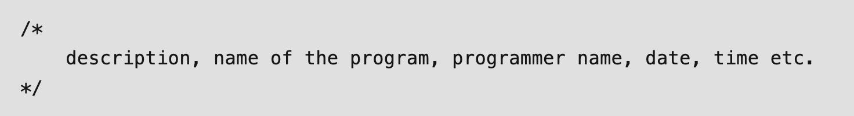
Document Section
This section consists of the description of the program, the name of the program, and the creation date and time of the program.
It is specified in the form of comments.
For single line comment:
For multiple line comment:
Basically, it gives an overview to the reader of the program.

Slide 18
Link Section
All the header files of the program will be declared in this section of the program.
Header files help us to access other’s improved code into our code.
A copy of these multiple files is inserted into our program before the process of compilation.
Example:
#include<stdio.h>
#include<math.h>

Slide 19

Definition Section
All the symbolic constants are defined here which are named as macros.
The macros are the identifiers defined by # define which are replaced by their value before compilation.
Syntax:
Example:
#define pi 3.1416

Slide 20
Global Declaration Section
It will be defined before the main function.
Contains global variables, function declaration.
These can be used anywhere in the program.
int x,y;
int main( )
{
int z;
}

Slide 21
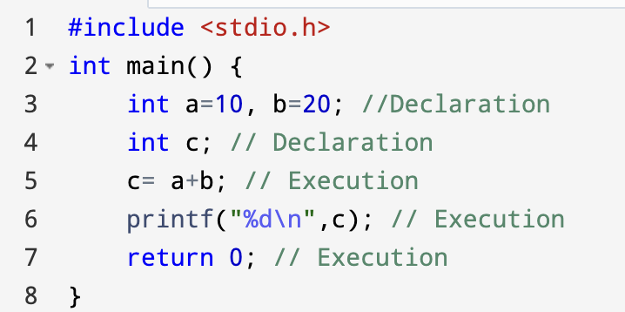
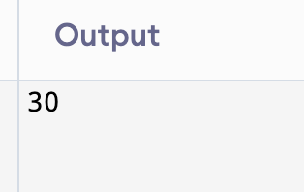
Main Function
It has two parts.
Decleration section
Execution section

Slide 22
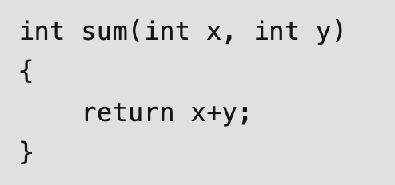
Sub Programs
User-defined functions are called in this section of the program.
These are specified as per the requirements of the programmer.
Example:

Slide 23

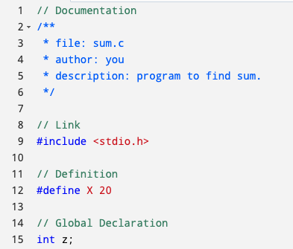
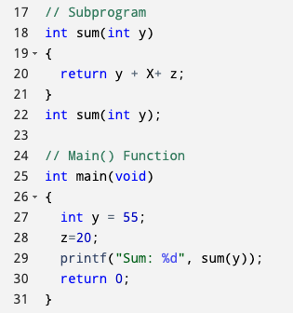
Structure of C Program with example

Slide 24
Some Key Terms
Source Program
printable/Readable Program file
Object Program
nonprintable machine-readable file
Executable Program
nonprintable executable code
Syntax errors
reported by the compiler

Slide 25
Some Key Terms (Cont’d)
Linker errors
it means that your code compiles fine, but that some function or library that is needed cannot be found.
Execution/Run-time errors
reported by the operating system

Slide 26
Integrated Development Environments
An integrated development environment (IDE) is a software package that makes it possible to edit, compile, link, execute, and debug a program without leaving the environment.
Example:
CodeBlocks, Turbo C

Slide 27
Thank You

