Slide 1



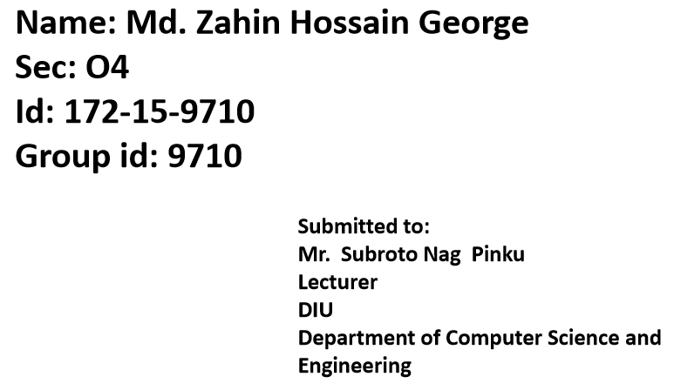

Slide 2
Smart BMI Calculator

Slide 3
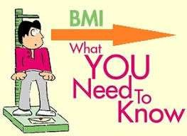



It is a measure of body fat based on your weight in relation to your height.
It is more of an indicator than a direct measurement of a person’s total body fat.
As the BMI score increases, so does the person’s total body fat increases.

Slide 4
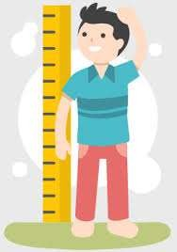

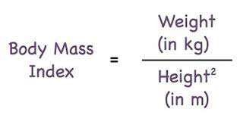
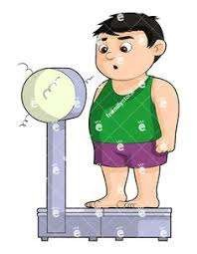
· Formula –
Eg- For an adult with height of 180 cm and weight of 75 kg.
First step is to convert the height into meters. As there are 100cm in a meter, we divide our figure by 100. This gives us 1.8m.
BMI = 75 ÷ (1.8 x 1.8)
BMI = 75 ÷ 3.24
BMI = 23.15

Slide 5

Weight Status | Body Mass Index kg/m²
Under weight | <18.5
Normal range | 18.5-24.9
Over weight | 25.0-29.9
Obese | ≥30
Obese class - 1 | 30.0-34.9
Obese class - 2 | 35.0-39.9
Obese class - 3 | ≥40

Slide 6
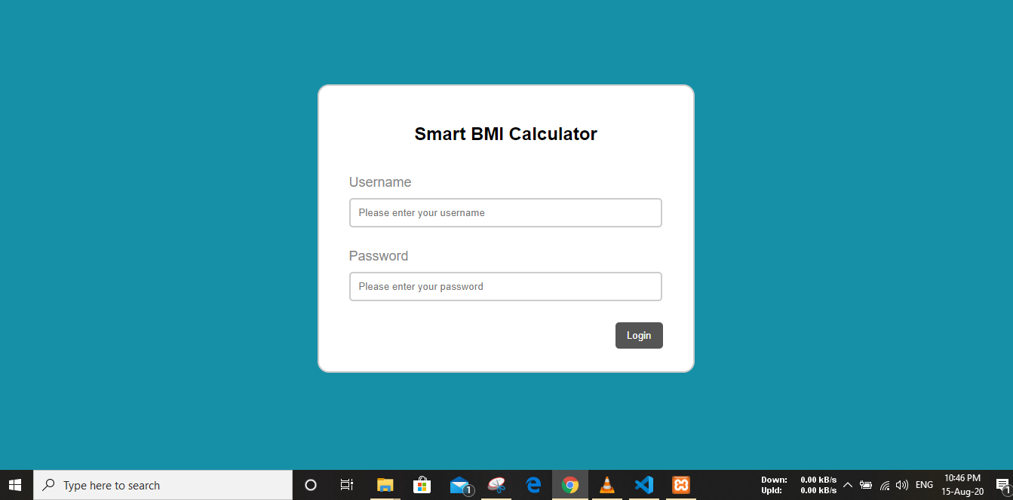

Slide 7
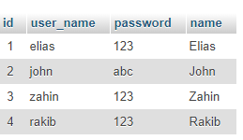

Slide 8
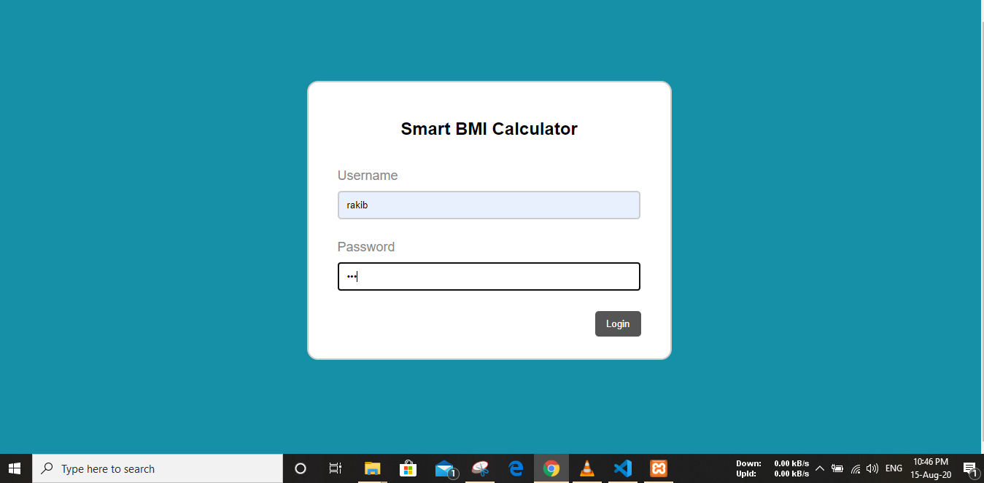

Slide 9
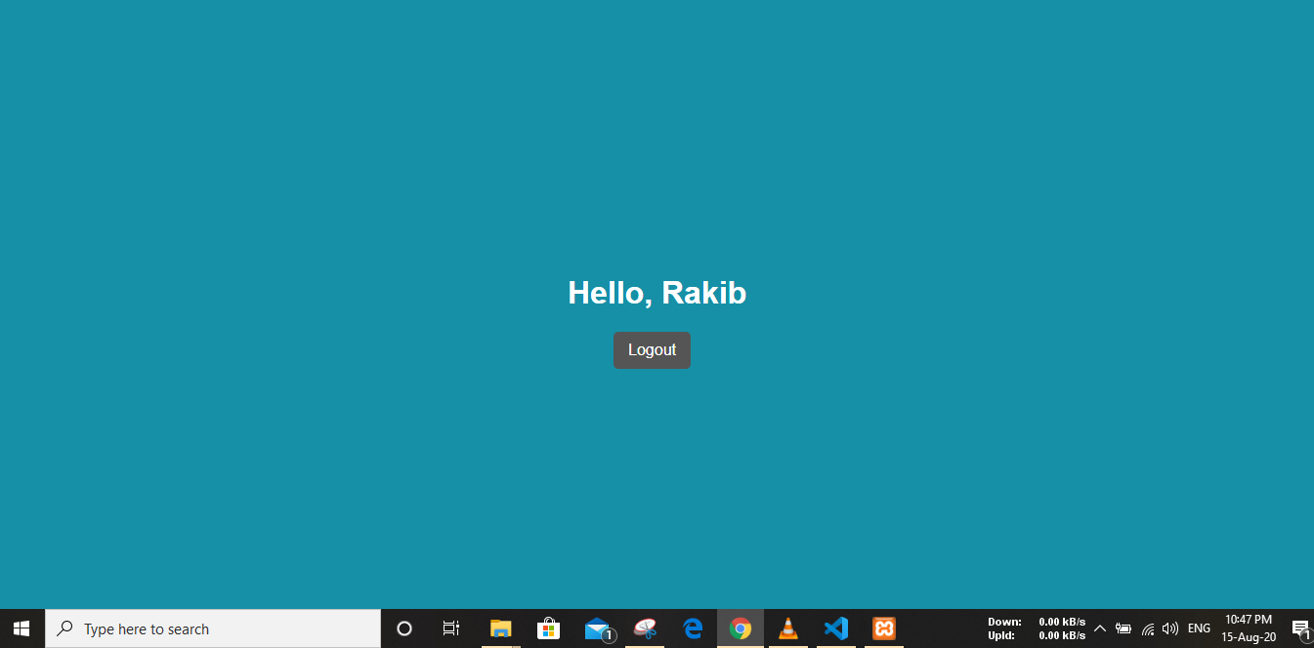

Slide 10
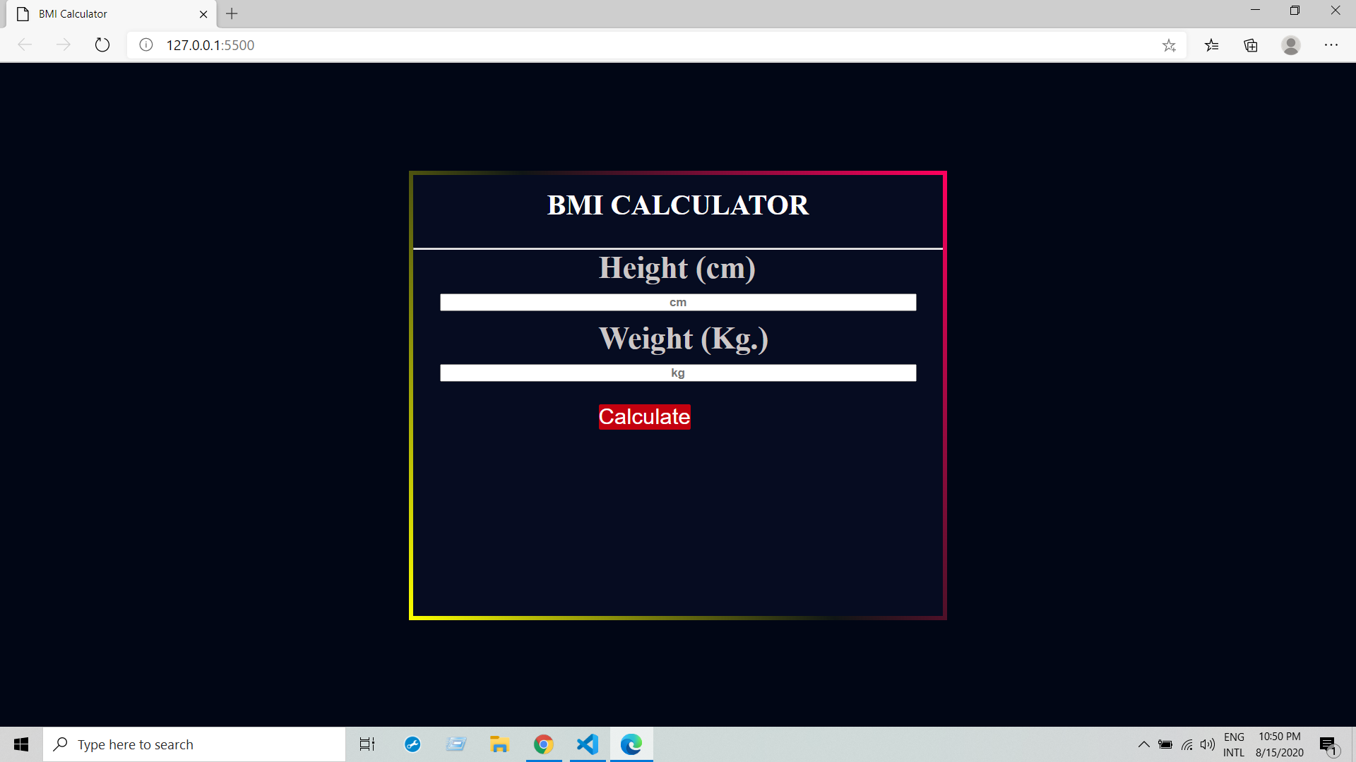

Slide 11
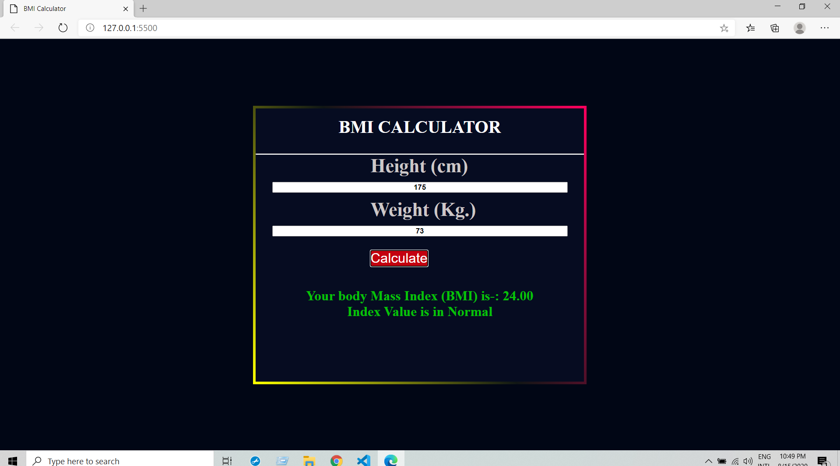

Slide 12




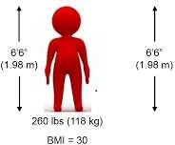
BMI = 118 ÷ (1.98 x 1.98)
BMI = 118 ÷ 3.92
BMI = 30.10

Slide 13

· 24
· 35
· 17
· 28
Over weight
Under weight
Obese
Normal weight

Slide 14





Genetic Factor
Psycho- logical Factor
Lifestyle Factor
BMI
Economic al Factor

Slide 15
Many studies have identified a specific defect in
genes that control body weight.
A defect in the gene that synthesizes leptin, which is a crucial hormonal substance produced by fat and released into the bloodstream that acts on hypothalamus to regulate body weight.
Congenital absence of leptin produces continual
hunger and marked obesity in childrens.

Slide 16
The second genetic defect observed is the body’s
response to the signal leptin provided.
This signal largely determines how much one eats, how much energy one expends and ultimately one’s body weight.

Slide 17
Studies have shown that obese people are about 25 percent more likely to experience a mood disorder like depression compared with those who are not obese.
Many obese people eat in response to negative emotions such as boredom, sadness or anger.
As eating soothe fears, sadness and worry for some.

Slide 18
Level of physical activity- sedentary lifestyle can lead to obesity and so active lifestyle can overcome such problems.
Dietary habits- A large consumption of foods high in sugar and fat increases the likelihood of weight gain. Consequently, the total energy intake rises, which causes problems of overweight and vice versa.
Sleeping hours- Insomnia or lack of sleep can cause hormonal imbalance that increase your appetite or craving for foods high in calories and carbohydrates.

Slide 19


Economic constraints contribute to unhealthy food choices.
Among low socioeconomic groups they tend to buy product which are cheaper to reduce their food budgets while maintaining diets similar to the average population diet.
And so the proportion of energy by meat, dairy products, vegetables, and fruits decreases, but the proportion by sweets, added fats, and cereals increases which can lead to obesity.

Slide 20
