Slide 1
Network Models
Course Code: COE 3201
Course Title: Data Communication
Dept. of Computer Science
Faculty of Science and Technology
Lecture No: | 2 | Week No: | 2 | Semester:

Slide 2
Lecture Outline
Layered Tasks
Introduction to OSI Model
Introduction to TCP/IP Model
Data Encapsulation

Slide 3
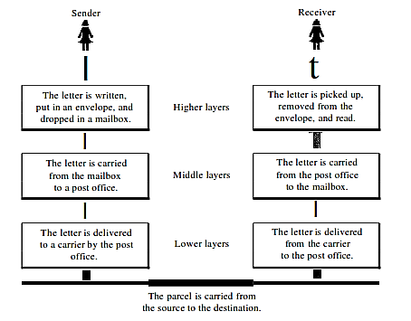
Layered Tasks
We use the concept of layers in our daily life. As an example, let us consider two friends who communicate through postal mail The process of sending a letter to a friend would be complex if there were no services available from the post office.
Fig: Tasks involved in sending a letter

Slide 4
Importance of Layering
Troubleshooting: The protocols, actions, and data contained in each layer of the model relate only to the purpose of that layer. This enables troubleshooting efforts to be pinpointed on the layer that carries out the suspected cause of the problem.
Standards: The most important reason for using a layered model is that it establishes a prescribed guideline for interoperability between the various vendors developing products that perform different data communications tasks.
Change: When changes are made to one layer, the impact on the other layers is minimized. If the model consists of a single, all-encompassing layer, any change affects the entire model.

Slide 5


Introduction to OSI Model
The Open System Interconnection Reference Model (OSI Reference Model or OSI Model) is an abstract description for layered communications and computer network protocol design.
It divides network architecture into seven layers which, from top to bottom, are the Application, Presentation, Session, Transport, Network, Data Link, and Physical Layers. It is therefore often referred to as the OSI Seven Layer Model.
In 1978, the International Standards Organization (ISO) began to develop its OSI framework architecture.

Slide 6
Introduction to OSI Model
OSI Model
Data unit | Layer | Function
Data | 7. Application | Network process to application
 | 6. Presentation | Data representation, encryption and decryption
 | 5. Session | Interhost communication
Segments | 4. Transport | End-to-end connections and reliability, Flow control
Packet | 3. Network | Path determination and logical addressing
Frame | 2. Data Link | Physical addressing
Bit | 1. Physical | Media, signal and binary transmission

Slide 7
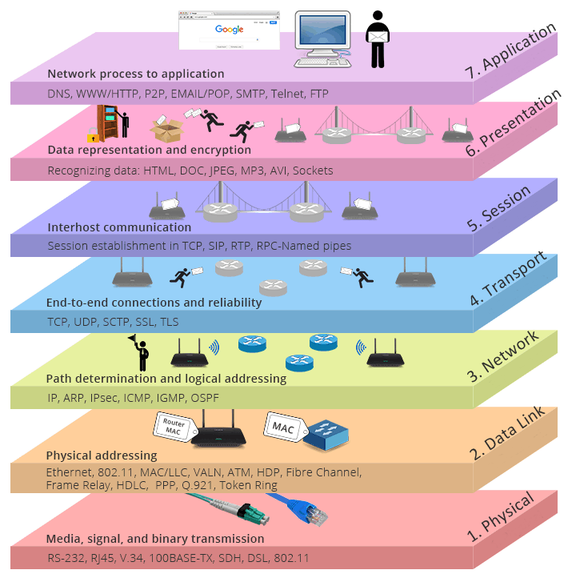
Introduction to OSI Model

Slide 8
Physical Layer
Bit synchronization: The physical layer provides the synchronization of the bits by providing a clock. This clock controls both sender and receiver thus providing synchronization at bit level.
Bit rate control: The Physical layer also defines the transmission rate i.e. the number of bits sent per second.
Physical topologies: Physical layer specifies the way in which the different, devices/nodes are arranged in a network i.e. bus, star or mesh topology.
Transmission mode: Physical layer also defines the way in which the data flows between the two connected devices. The various transmission modes possible are: Simplex, half-duplex and full-duplex.

Slide 9
Data Link Layer
The data link layer is responsible for the node to node delivery of the message. The main function of this layer is to make sure data transfer is error free from one node to another, over the physical layer. The data link layer is divided into two sub-layers -
Media Access Control (MAC)
Logical Link Control (LLC).
Mac is lower sub-layer, and it defines the way about the media access transfer, such as CSMA / CD /CA (Carrier Sense Multiple Access /Collision Detection /Collision Avoidance)
LLC controls the synchronization, flow control, and error checking functions of the data link layer

Slide 10
Services of Data-Link Layer
Framing: The data link layer divides the stream of bits received from the network layer into manageable data units called frames.
Physical addressing: The Data Link layer adds a header to the frame in order to define physical address of the sender or receiver of the frame.
Flow control: If the rate at which the data are absorbed by the receiver is less than the rate at which data are produced in the sender, the data link layer imposes a flow control mechanism to avoid overwhelming the receiver.

Slide 11
Services of Data-Link Layer
Contd.
Error control: The data link layer adds reliability to the physical layer by adding mechanisms to detect and retransmit damaged or lost frames. It also uses a mechanism to recognize duplicate frames. Error control is normally achieved through a trailer added to the end of the frame.
Access control: When two or more devices are connected to the same link, data link layer protocols are necessary to determine which device has control over the link at any given time.

Slide 12
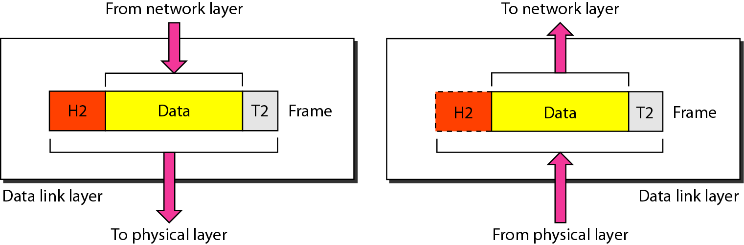
Data Link Layer - Frame
The data link layer is responsible for moving frames from one hop (node) to the next

Slide 13
Network Layer
Routing: The network layer protocols determine which route is suitable from source to destination. This function of network layer is known as routing.
Logical Addressing: In order to identify each device on internetwork uniquely, network layer defines an addressing scheme. The sender & receiver’s IP address are placed in the header by network layer. Such an address distinguishes each device uniquely and universally.

Slide 14
Transport Layer
Purpose of this layer is to provide a reliable mechanism for the exchange of data between two processes in different computers.
Ensures that the data units are delivered error free.
Ensures that data units are delivered in sequence.
Ensures that there is no loss or duplication of data units.
Provides connectionless or connection-oriented service.
Provides for the connection management.
Multiplex multiple connection over a single channel.

Slide 15
Session Layer
Session layer provides mechanism for controlling the dialogue between the two end systems. It defines how to start, control and end conversations (called sessions) between applications.
Any necessary log-on or password validation is also handled by this layer.
Session layer is also responsible for terminating the connection.

Slide 16
Presentation Layer
Before being transmitted, information in the form of characters and numbers should be changed to bit streams. The presentation layer is responsible for interoperability between encoding methods as different computers use different encoding methods. It translates data between the formats the network requires and the format of the computer.
This layer provides independence from differences in data representation, such as – Encryption, Compression

Slide 17
Application Layer
The application layer is the OSI layer closest to the end user, which means that both the OSI application layer and the user interact directly with the software application.
Some examples of application layer implementations include
  Hypertext Transfer Protocol (HTTP)
  File Transfer Protocol (FTP)
  Simple Mail Transfer Protocol (SMTP)

Slide 18
Introduction to TCP/IP Model
The Internet Protocol Suite (commonly known as TCP/IP) is the set of communications protocols used for the Internet and other similar networks.
It is named from two of the most important protocols in it:
  the Transmission Control Protocol (TCP) and
  the Internet Protocol (IP), which were the first two networking protocols defined in this standard.

Slide 19
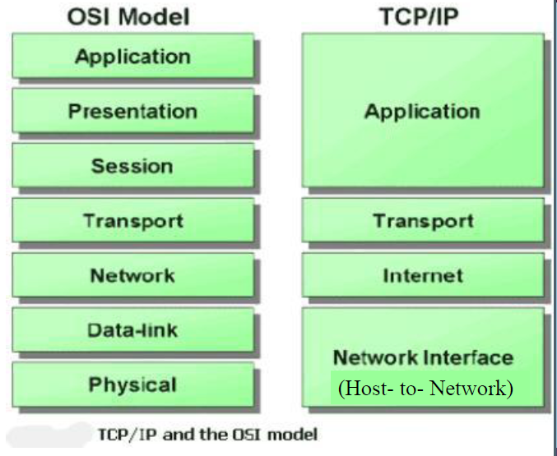
TCP/IP Model in relation to OSI Model:

Slide 20
Data Encapsulation
The term encapsulation is used to describe a process of adding headers and trailers around some data. This process can be explained with the four-layer TCP/IP model, with each step describing the role of the layer.
For example, here is what happens when you send an email using your favorite email program (such as Outlook or gmail):
The email is sent from the Application layer to the Transport layer.
The Transport layer encapsulates the data and adds its own header with its own information, such as which port will be used and passes the data to the Internet layer
The Internet layer encapsulates the received data and adds its own header, usually with information about the source and destination IP addresses. The Internet layer than passes the data to the Network Access layer
The Network Access layer is the only layer that adds both a header and a trailer. The data is then sent through a physical network link.

Slide 21
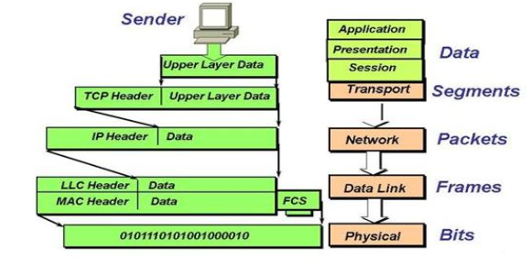
Figure: Data Encapsulation

Slide 22
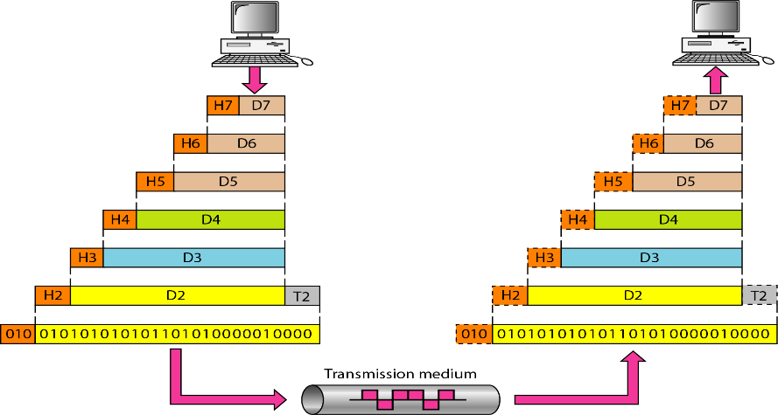
An exchange using the OSI model

Slide 23
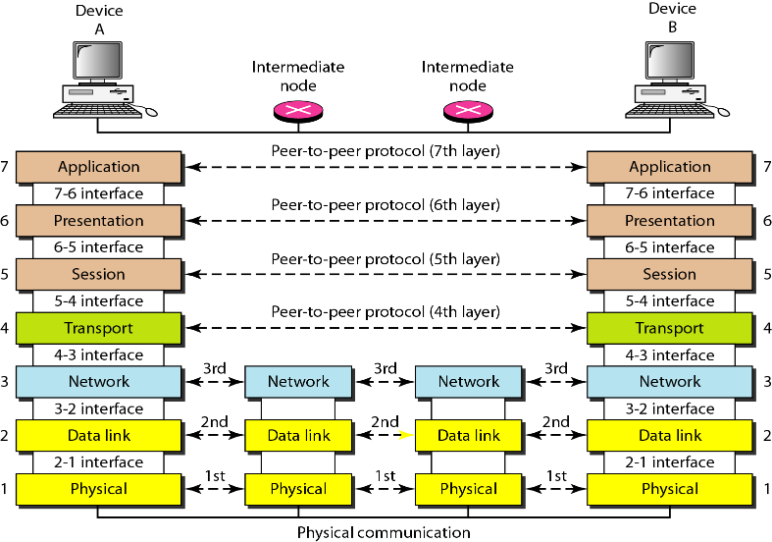

Slide 24
Books
Forouzan, B. A. "Data Communication and Networking. Tata McGraw." (2005).

Slide 25
References
1. Prakash C. Gupta, “Data communications”, Prentice Hall India Pvt.
2. William Stallings, "Data and Computer Communications”, Pearson
3. Forouzan, B. A. "Data Communication and Networking. Tata McGraw." (2005).

