Slide 1

The NULLx Learning Kit
Presented by:
Members: Meshu Deb Nath
Diwakar Dangal
Rakibul Islam

Slide 2



AGENDA
Who We Are
Purpose
Problem Definitions
Survey and their Results
Solution
Product
Demonstration

Slide 3

Who we Are?
We NULLx are an online Teaching and learning platform that is dedicated to delivering the best teaching solution to our customers based on Microservice patterns.
We are providing education on Microservices pattern and supporting procedures through a WebShops (microservice demonstration) for using it as a teaching materials.

Slide 4
Our company

Slide 5

Purpose
Our purpose is to make the learning curve easier for the microservice patterns.

Slide 6


Problem
Complexity and Long Learning Curve
No step by step learning Process
Lack of Support
‹#›

Slide 7
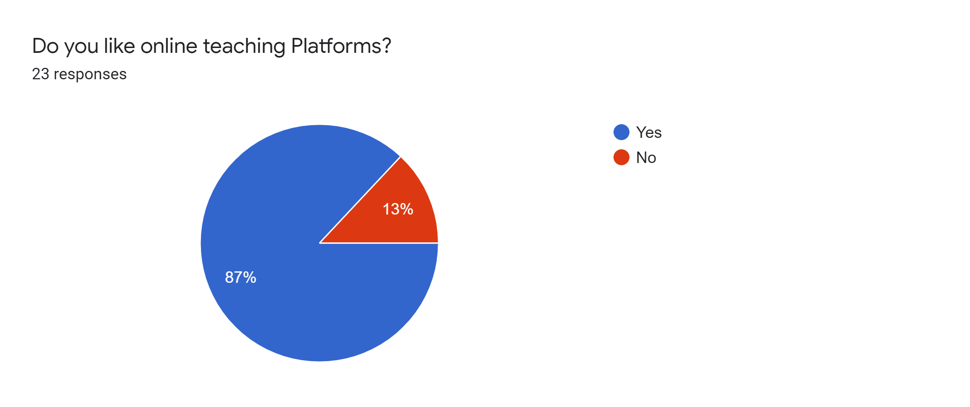
Survey
https://bit.ly/2NQxc02

Slide 8
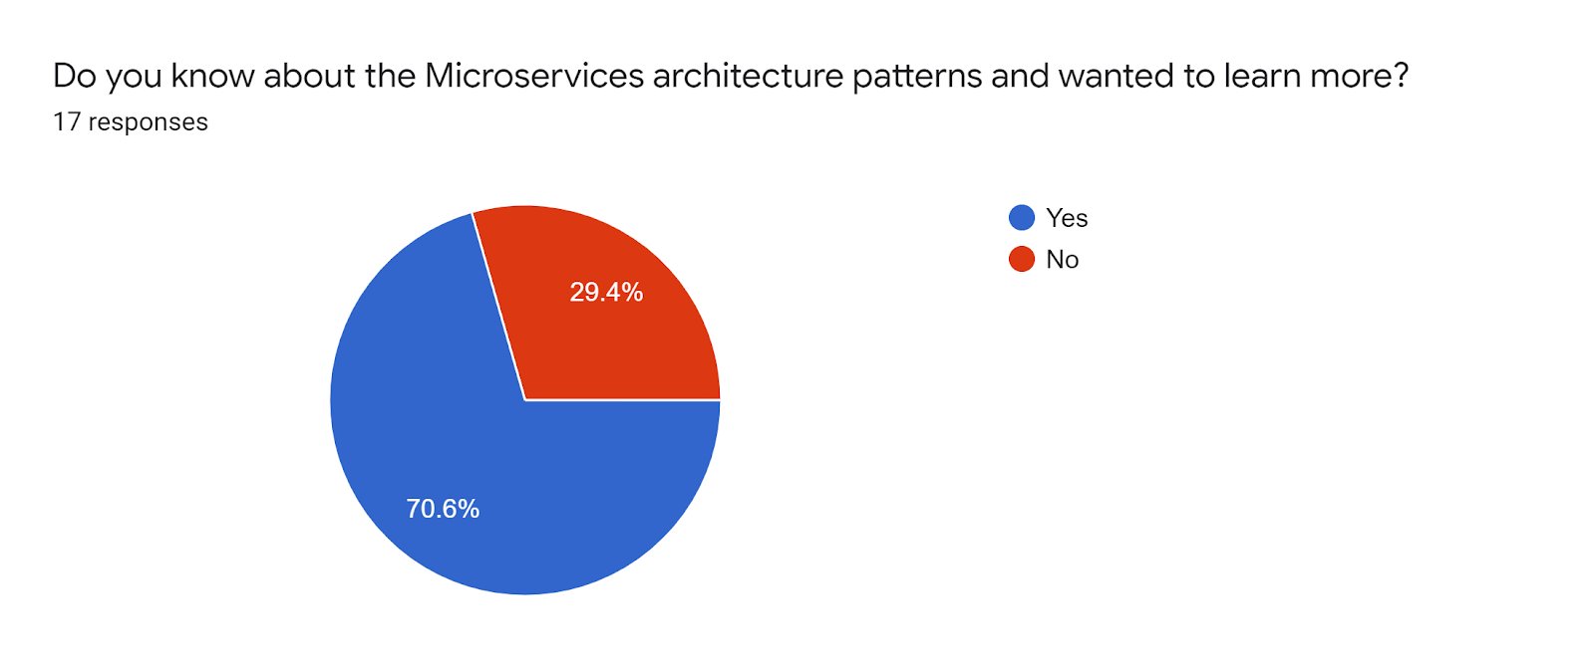
Survey Result
Topic: Information of the topic ?

Slide 9
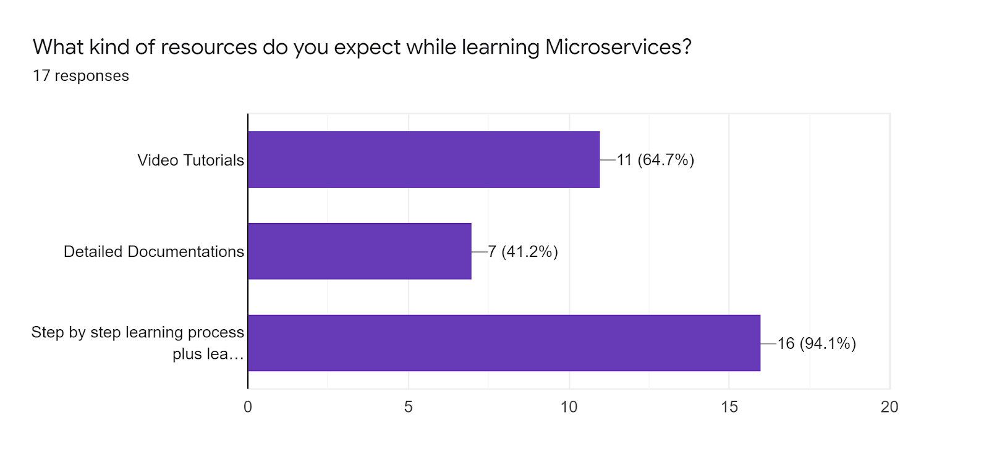
Survey Result
Topic: What they expect from education provider?
https://bit.ly/2NQxc02

Slide 10

Solution
Step by step learning process
Demonstrator
Interactive Learning tools

Slide 11
Product

Slide 12
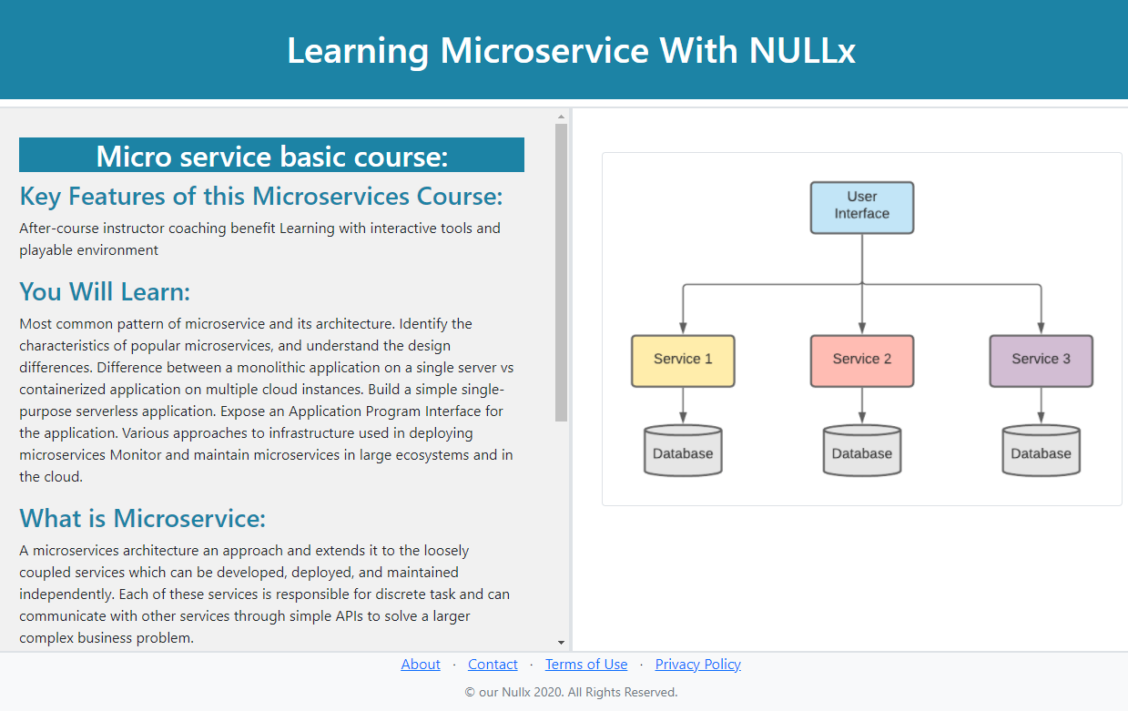
NULLx Learning Kit
Homepage
Live at
www.nullx-de.github.io/home/NULLxUI

Slide 13
Demonstration
(WebShop)

Slide 14
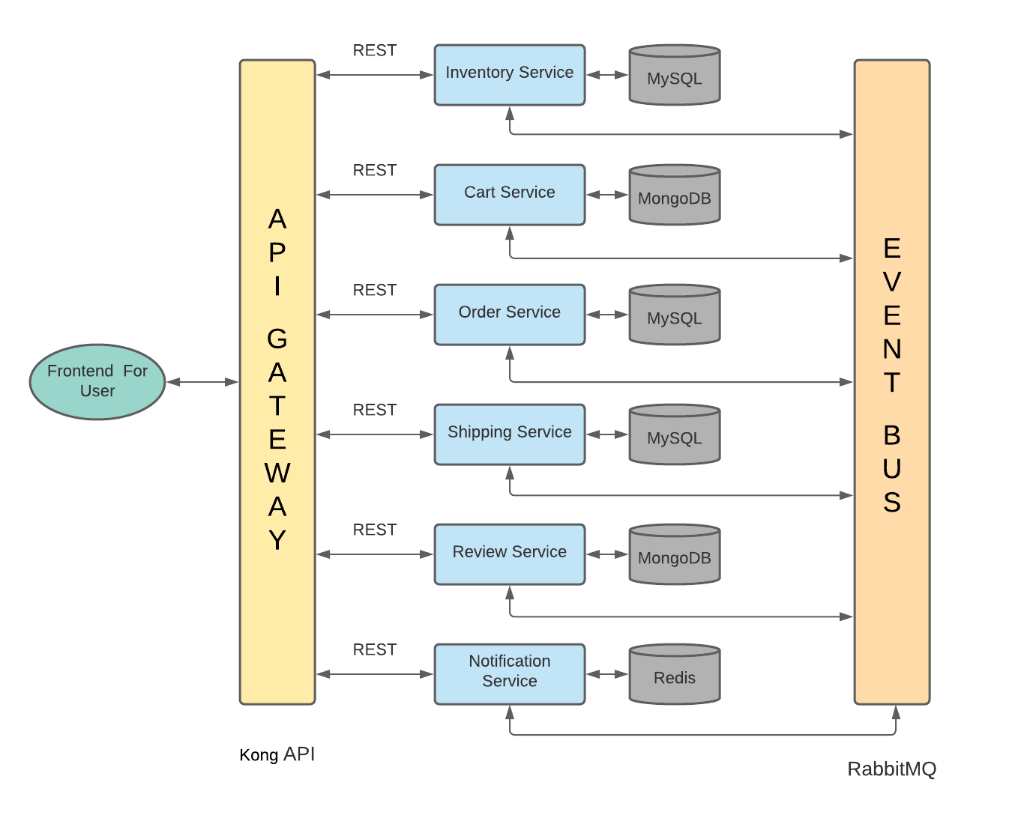
Architecture

Slide 15
Microservice Patterns
Domain-Driven Design Pattern Define services corresponding to Domain-Driven Design (DDD) subdomains microservice pattern.
Database per service Pattern Most services need to persist data in some kind of database.
Saga Pattern A saga is a sequence of local transactions. Each local transaction updates the database and publishes a message or event to trigger the next local transaction in the saga.
API Gateway / Backends for Frontends Pattern To give the clients of a Microservices-based application access the individual services.
Service Instance per container pattern All the services as a (Docker) container image and deploy each service instance as a container in the Kubernetes.

Slide 16
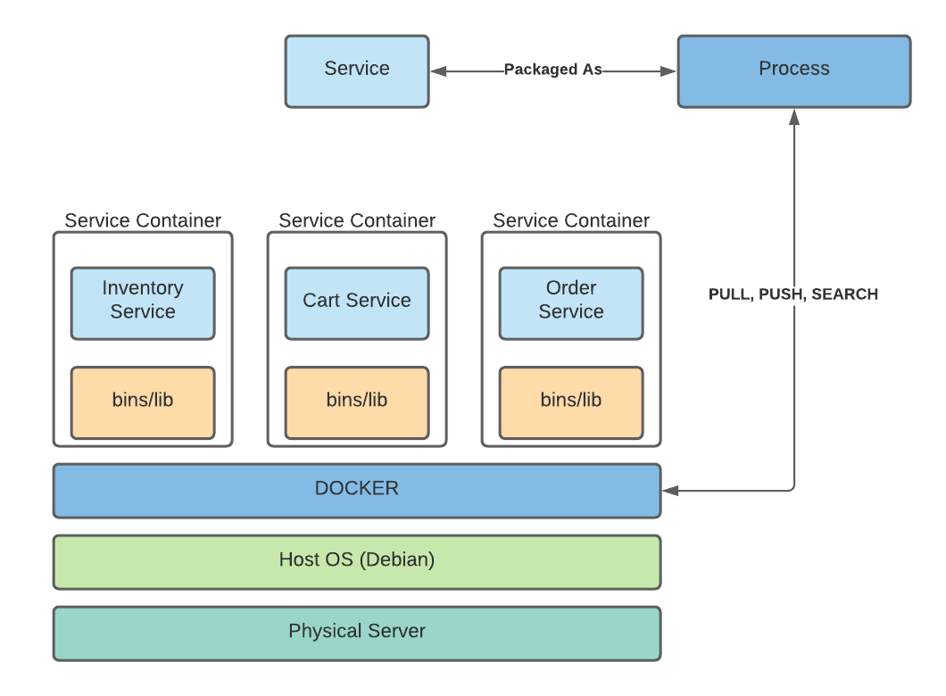
Service Instance Per Container Pattern

Slide 17
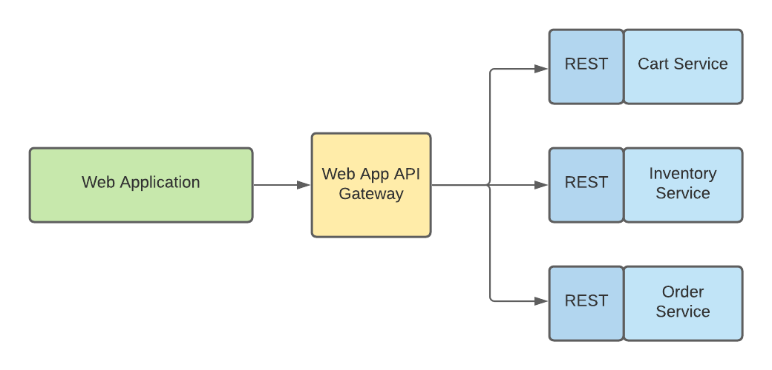
Implementing API Gateway Pattern

Slide 18
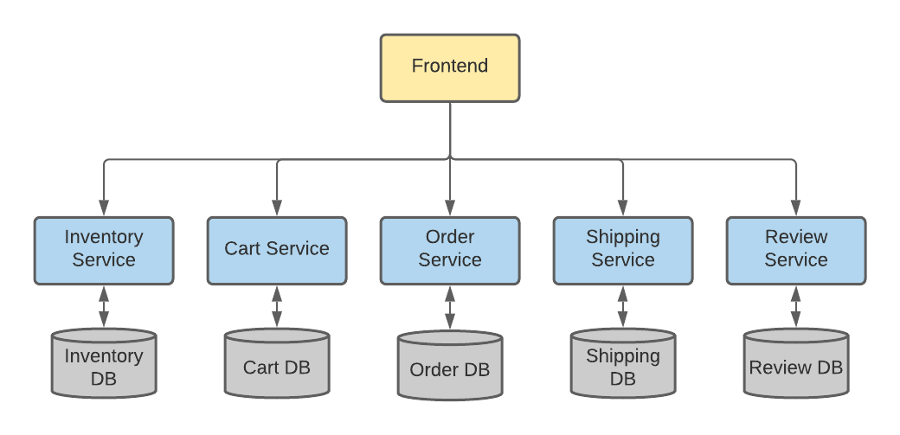
Implementing Database per Service Pattern
Single Server Instance
Multiple Database per microservice

Slide 19
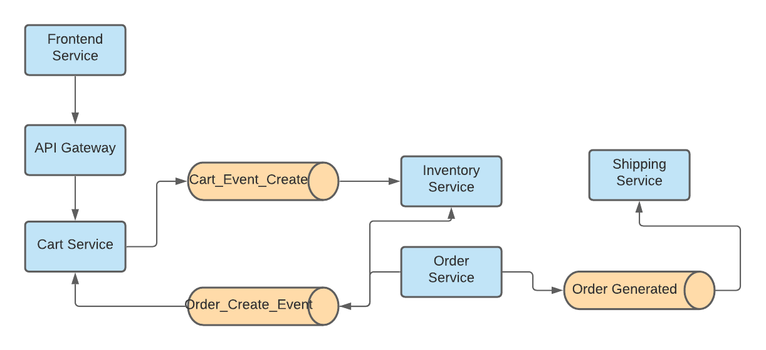
Implementing SAGA Pattern
Updating loosely coupled Database:
Updating Inventory database without ACID transaction by event command.
Error handling:
A product stock out (quantity changed)
handled by SAGA choreography.

Slide 20
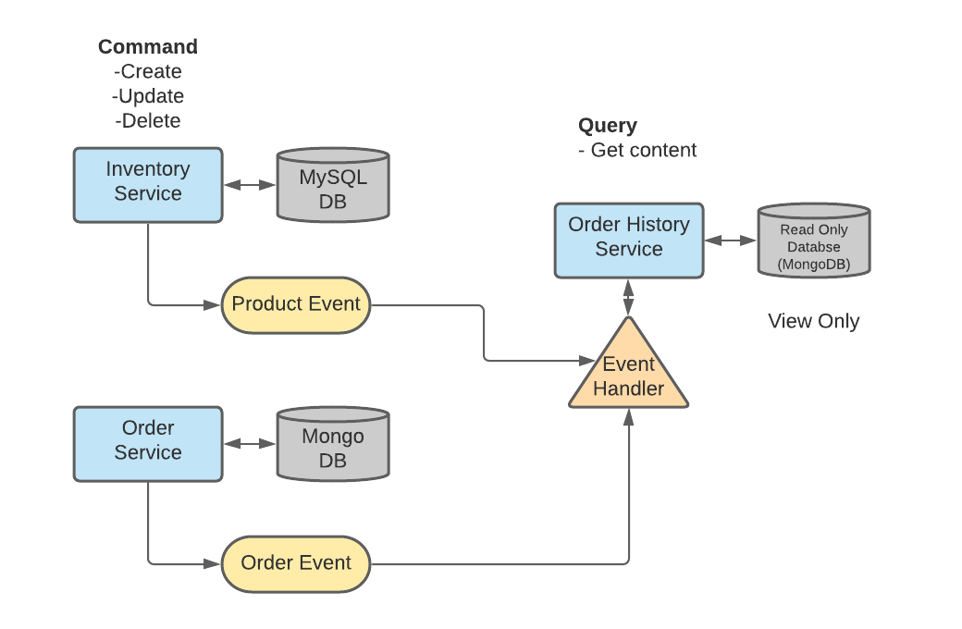
Implementing Command Query Responsibility Segregation (CQRS) Pattern

Slide 21
Live Demonstration
(WebShop)
http://vsr-kub005.informatik.tu-chemnitz.de:30002/

Slide 22
Gitlab CI/CD

Slide 23



THANK YOU!
Any Questions ?
DIWAKAR DANGAL
MESHU DEB NATH
RAKIBUL ISLAM

Slide 24
Appendix

Slide 25
Survey link : https://bit.ly/2NQxc02

Slide 26



Target Market
Students
Professionals
Educational Institutions

Slide 27
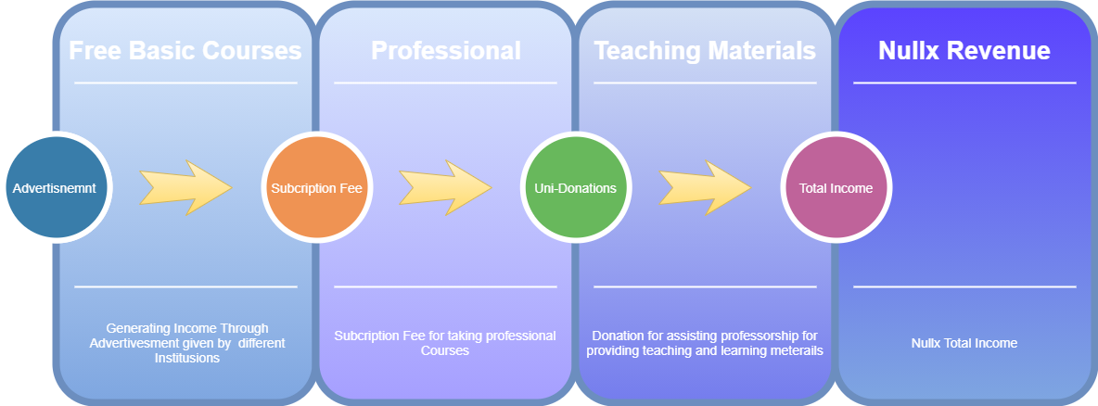
Revenue Stream

Slide 28

Advertisement
Course subscription
Teaching and learning material charges

