Slide 1
Digital Logic Design
Instructor: Partha Guturu
EE Department

Slide 2
How will you master Digital Logic?
Teaching philosophy-
“I do not teach my pupils. I provide conditions in which they can learn”-
Albert Einstein
“I hear and I forget. I see and I remember. I do and I understand” - Chinese proverb
"Give a man a fish and you feed him for a day. Teach a man to fish and you feed him for a lifetime." -- Chinese proverb

Slide 3
What does the data say?
  Even if you are fascinating…..
  People only remember the first 15 minutes of what you say
100
Percent of Students Paying Attention
50
0
0 10 20 30 40 50 60
Time from Start of Lecture (minutes)

Slide 4
What’s so good about our approach to learning Digital Logic?
Learner-Centric Approach
Life-long learning
Support from Bloom’s Work

Slide 5

Learning by Doing
Practice, Practice and Practice! Need not be afraid of failures
  No hostile spectators
  “MIT graduates and light bulb” episode
We never forget riding a bike- because we learn after many failures.
I've missed more than 9000 shots in my career. I've lost almost 300 games. 26 times, I've been trusted to take the game winning shot and missed. I've failed over and over and over again in my life. And that is why I succeed - Michael Jordan, American Living Basketball Legend

Slide 6
Digital Logic Design- What is it?
Explain the Three Terms
Digital
Logic
Design

Slide 7
Analog Versus Digital Systems
Continuous Versus Discrete
Which is more accurate?
Design an electronic and a mechanical system to perform arithmetic
What does a digital computer do?

Slide 8

Number Systems
Why do you count in terms of ten?
How will this cat count?
Positional Notation
Arithmetic
Conversion from one system to another
Negative number representation
Representing fractions

Slide 9

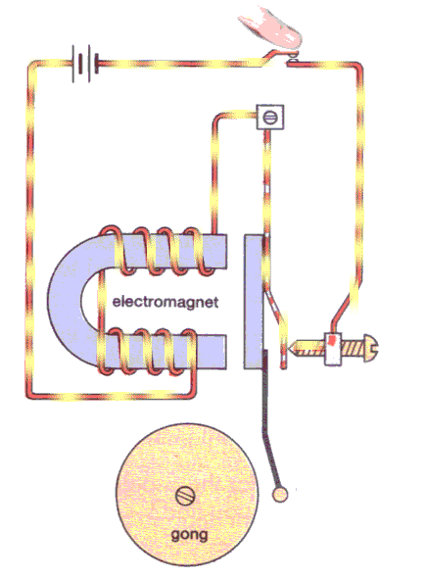
Switching Logic
Why binary?
How to design an 1-bit binary adder with electro-magnetic and mechanical components?
Hint: Use RC-Circuits and ON-OFF Switches (Relays)
Design the switch configuration for sum
Design the switch configuration for carry

Slide 10
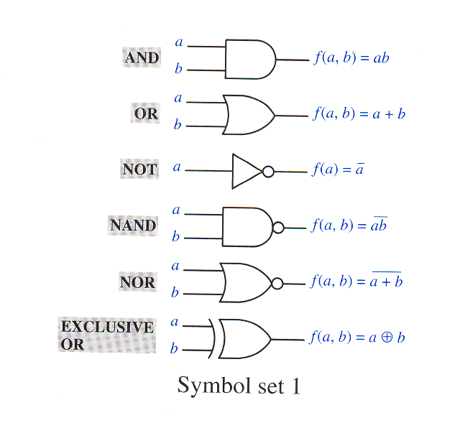
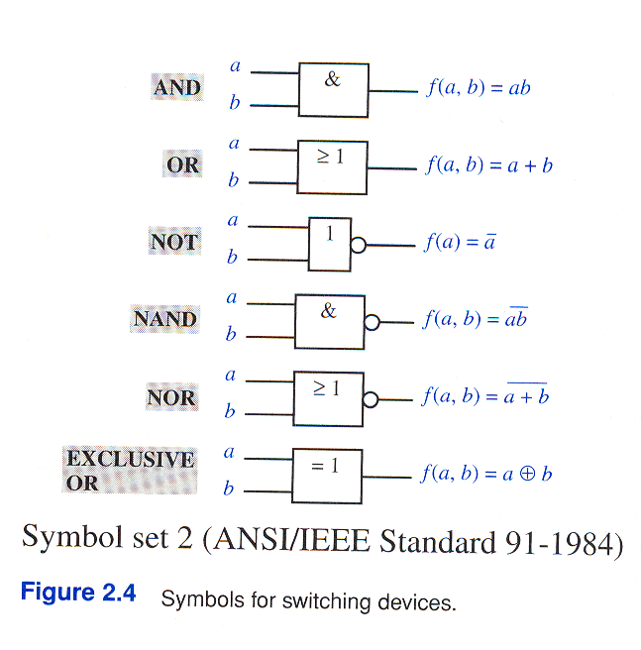
Logic Gates & Symbols

Slide 11
Adder Design
S₁
S₀
A₁
A₀
*Black-box functionalities are specified by truth tables
A
C_{i+1}
Half Adder
C
A_{i}
Full Adder
FA
HA
B
B_{i}
S
C_{i}
C₁
C₀
S_{i}
B₁
B₀
System and Register Level
Half Adder
Full Adder
C
C_{i}
AND
C
A_{i}
Half Adder
OR
B_{i}
S
Half Adder
C
A
S
XOR
C_{i-1}
S_{i}
B
A
f
A
f
A
f
B
B
B
AND Gate
OR Gate
XOR Gate
Gate Level
A
A
B
f
f
B
B
f
A
Physical Design Level

Slide 12
Physical Design of Switches (Relays)
Normally Open Switch closing on Excitation i.e. Input = 1 (High)
Normally Closed Switch opening on Excitation i.e. Input = 1 (High)
Design
V
V
Spring
Spring
Symbol

Slide 13
History
Till 1600 Abacus
John Napier’s Slide Rule (1600)
Blaise Pascal (1642)- Adding Machine
Charles Babbage (1820)- Mechanical Computer
Howard Aiken (Harvard) & George Slibitz (Bell labs)- Caculator using relays (1930)
John Mauchly & Presper Eckert Jr. (Univ. of Pennsylvania)- ENIAC (Vacuum Tube Computer) 1950
Stored Program Concept (John Von Neumann) and discovery of transistor (John Bardeeen, Walter H. Brittain and William Shockley)
Magnetic Core Memory (J. W. Forrester of MIT)
Four generations of computers (late 1940s – late 1970s)

Slide 14
Course Objectives
The main objectives of the course are to facilitate you to achieve the highest levels in the Bloom’s 6-level Learning Taxonomy so that at you, the end of the course, will be able to-
Know what the digital systems are, how they differ from analog systems and why it is advantageous to use the digital systems in many applications.
Comprehend different number systems including the binary system and Boolean algebraic principles
Apply Boolean algebra to switching logic design and simplification.
Analyze a given digital system and decompose it into logical blocks involving both combinational and sequential circuit elements.
Synthesize a given system starting with problem requirements, identifying and designing the building blocks, and then integrating blocks designed earlier
Validate the system functionality and evaluate the relative merits of different designs.

Slide 15
Course Information
Provided on the main webpage for the course i.e. Current Teaching link on
http://www.ee.unt.edu/~guturu/

Slide 16
Boolean Algebra
Algebra of logical thought and reason, introduced by George Boole in 1849.
Used for simplifications of logical functions
Postulates-
  Set K of 2 or more elements, closed under 2 binary operations +, and .
  Existence of 0 and 1 elements
  Commutative with respect to + and .
  Associative
  Existence of Complement
  Distributive over + and . a+(b.c) = (a+b).(a+c); a.(b+c) = (a.b) + (a.c)

Slide 17
Principle of Duality
If an expression is valid, then dual expression is also valid. Dual expression is obtained by
  Replacing all .’s by +’s and vice versa
  All 1’s by 0’s and vice versa
  without changing the position of the brackets, if any.
  Exercise 1: See whether it holds for all postulates.
  Exercise 2: One does not verify the postulates, but you can understand their implication using Venn Diagrams. You can also check whether the postulates of Boolean algebra indicate alternate ways to design the same switching functionality.
  Hint: Use truth tables

Slide 18
Fundamental Theorems
Idempotency a + a = a; a.a = a
Null elements for “+” and “.” a+1=1; a.0=0
Involution a’’ = a where a’ is a complement
Absorption a+ab = a and a(a+b) = a
a + a’b = a + b and its dual
ab + ab’ = a and its dual
ab + ab’c = ab + ac and its dual
DeMorgan’s Theorems: (a+b)’ = a’.b’ and dual. You can generalize it for more variables
Consensus: ab+a’c+bc = ab + a’c and dual

Slide 19
Exercises using Theorems
Simplify the Boolean functions:
ab’(ab’+b’c)
y’(x+y+z)
(w’+x’+y’+z’)(w’+x’+y’+z)(w’+x’+y+z’) (w’+x’+y+z)
wy’+wx’y+wxyz+wxz’
{a(b+c)+a’b}’
abc+a’d+b’d+cd
Write switching function of full adder and simplify algebraically.

Slide 20
More Exercises
AD’+A’B’+C’D+A’C’+B’D = AD’+(BC)’
XY’+Z(X’+Y+W)=Z+XY’
X’Z’+YZ+XY’=Y’Z’+X’Y+XZ

Slide 21
Switching Functions
Can be generated from truth tables
Two Forms
  Sum of Products (SOP)
  Product of Sums (POS)
Canonical SOP and POS and Min & Max Term Definitions
Challenge- Find why the POS are constructed using 0 output rows and variable represented in true form when they assume zero values as opposed to the intuitive SOP convention.

Slide 22
Shannon’s Expansion Theorem
f(x1, x2, … , xn) = x1.f(1, x2, …, xn) + x1’.f(0,x2, … , xn)
Outline of Proof: Put the two values of X1 in both L.H.S and R.H.S.

Slide 23
Shannon’s Expansion Theorem (Dual)
f(x1, x2, … , xn) = ( x1 + f(0, x2, …, xn) ). ( x1’ + f(1,x2, … , xn) )
Outline of Proof: Put the two values of X1 in both L.H.S and R.H.S.

Slide 24
Application of Shannon’s Expansion Theorems
Expanding arbitrary switching functions into corresponding canonical forms
Ex: f(A, B, C) = AB + AC’ + A’C
f(A, B, C) = A (A + C’)
However, a simpler approach is to use the following dual assertions of Fundamental Theorem 6 (mainly based on the distributivity postulates):
  AB + AB’ = A
  (A + B)(A + B’) = A

Slide 25

Concept of Incompletely Specified Functions
Hypothetical Digital Design for Mario, the Jump-man
  Key pad with 0-9 digits
  Pressing a prime number
  will make Mario move a step
  Pressing any other digit will
  make Mario jump up a step
Design a switching function with output as 1 or 0 depending upon the 4-bit input corresponding to the digits 0-9 in BCD (Binary Coded Decimals).
How about the 4-bit BCD numbers corresponding to 10-15? (“Don’t care term” concept)

Slide 26
Function Minimization using Karnaugh Maps
Relationship between Truth tables, Venn Diagrams and Karnaugh maps- a two variable example
Three variable Karnaugh maps
Extension of Kanaugh maps to 4 variables
Application of 4 variable maps to the 7-segment display problem (use don’t care terms!)
5 and 6 variable maps

Slide 27
Karnaugh Maps (contd.)
Terminology- Implicants, prime Implicants, essential prime implicants and cover
POS form realization Ex: ΠΜ(0,1,2,3,6,9,14)
5 and 6 variable maps (stacking concept)
Design constraints other than cost (Read 2.4.2)-
  Propagation Delay
  Gate Fan-in and Fan-out
  Power Consumption
  Size and Weight
Hazard prevention using the consensus theorem in the reverse direction (Read 2.4.2 & 3.8)

Slide 28
Quine-McCluskey Tabular Method
Example Problem: f(A,B,C,D) = Σm(2,4,6,8,9,10,12,13,15)
4 steps
  Table Formation separating min-terms based on number of 1’s
  Succesively forming lists by combining adjacent terms
  Determining essential prime implicants
  Finding the minimal cover using a combination of the prime implicants (including necessarily the essential).

Slide 29
Quine-McCluskey’s Method (Contd.)
Covering Procedure
  Dominated row and Dominant colum removal
  Ex: f (A, B, C, D)= Σm(0,1,5,6,7,8,9,10,11,13,14,15)
  Cyclic PI (Prime Implicant) chart reduction
  Ex: f(A,B,C) = Σm(1,2,3,4,5,6)

Slide 30
Modular Design of Combinational Logic
Building Blocks-
Decoders (e.g. n-to-2^{n} decoder)
  Commercial (TI) MSI decoders (74138: 3-to-8 and 74154: 4-to-16 both active low outputs).
  Minimal Design
  Design with Fan-in considerations (Tree-type)
Decoders Applications:
  Logic Design: 4 Alternatives with Active High and Low types EX: f (Q, X, P) = Σm(0,1,4,6,7) = ΠΜ(2,3,5)
  Other Examples: BCD to Decimal conversion, 7 Segment Display (Common cathode and anode Configurations)
  Address Decoding
Many decoders have enable input also. (Usage Example: Realization of larger decoders)

Slide 31
Encoder
Another building block opposite of the decoder
Constraint on #inputs (n) and #outputs (S): 2^{S} >= n
4 input examples:
  One-and-only one input line active i.e. 4-to-2 encoder (incoming mail)
  Output 1 if one and only one of the inputs is 1, otherwise 0. i.e. 4-to-3 encoder.
  Priority Encoders (EX: TI’s 74147 10-to-4 encoder has to outputs indicating which active line has highest priority, TI’s 74148 8-to-3 encoder with 2 additional outputs EO and GS=EO’ and input EI)

Slide 32
Multiplexers and Demultiplexers
Multiplexer
  Data selector
  Takes in the data from only one of the multiple inputs)
Demultiplexers
  Data Distributor (opposite of Multiplexer)
  Sends data out on only one of the output lines.
Can we use a multiplexer to implement a switching function? (Hint: Use it as a decoder)

Slide 33
Adders
Ripple Carry Adder- the very first design
Carry Look Ahead Adder-
  C₀ = X₀.Y₀ = G₀
  C₁ = X₁.Y₁ +C₀ .(X₁ Y₁ ) = G₁ + G₀.P₁
  C₂ = G₂ + C₁.P₂ ₌ G₂ + G₁.P₂ + G₀ .P₂.P₁
  G above refers to generation term and P refers to propagation term. You know:
  S_{i} = .(X_{i} Y_{i} ) C_{i-1} = P_{i} C_{i-1}

Slide 34
Adder Cum Subtracter
MUX (74157)
Subtract
A-Bits
B-Bits
ADDER (7483)
C₄
C₀

Slide 35
Logic Circuits- A Taxonomy
Logic Circuit
Combinational Logic
Sequential Logic
Synchronous
Asynchronous

Slide 36
Sequential Logic
Z₁
X₁
Combinational
Logic
X_{N}
Z_{M}
y₁
Y_{L}
Y₁
y_{L}
Memory

Slide 37
State Model: Two Forms of Representation
Input
X
Present State
Input/Output
Y
X/Z
y
y
Y/Z
Next State/ output
State Diagram
State Table

Slide 38
Small Class Room Project
Required to design a two state Memory device called S-R latch which has two inputs S (Set) and R (Reset) such that
When S is 1 and R = 0, the device output will become 1, irrespective of what was before.
Similarly, when R=1 and S=0, it will be 0
No change for S=R=0
S = R = 1 is not allowed, hence output can be unpredictable in such a situation.
Inputs? State Diagram?

Slide 39
Project Extensions
Gated SR Latch (One more input)
Delay latch or D-latch
Master-slave SR Flip-flops
Master-slave D-Flip-flop
Master slave J-K Flip-flop
(Note: Flip-flop differs from latch in that the clock input triggers state change, though the new state depends on the excitation inputs at the clock time. Clock here is the control signal)

Slide 40
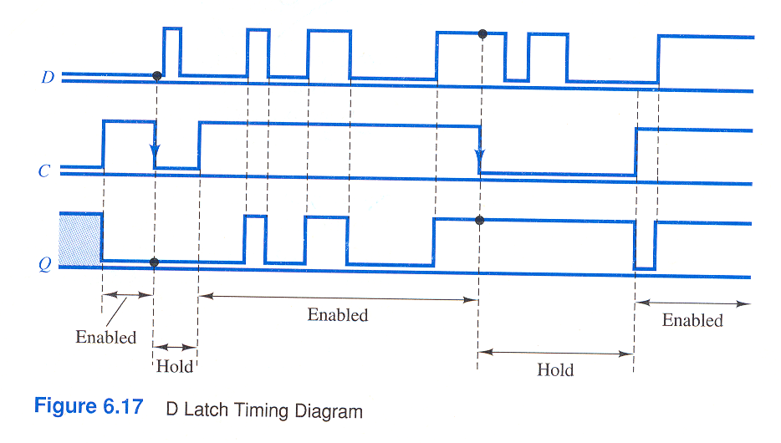
D-Latch Timing Diagram

Slide 41
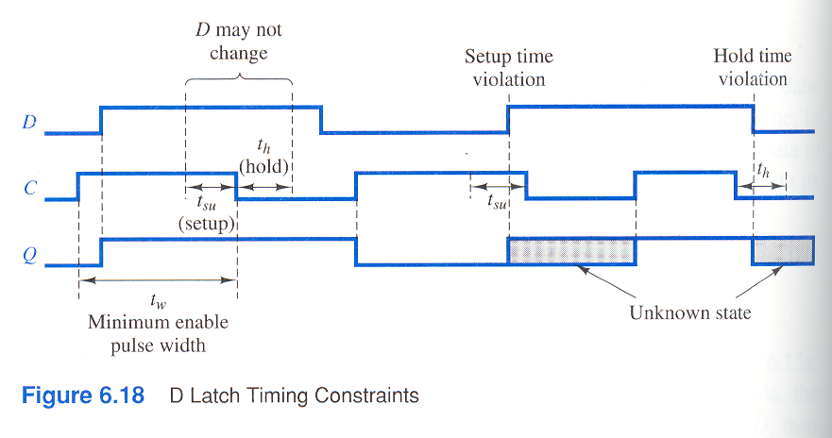
D-Latch Timing Constraints

Slide 42
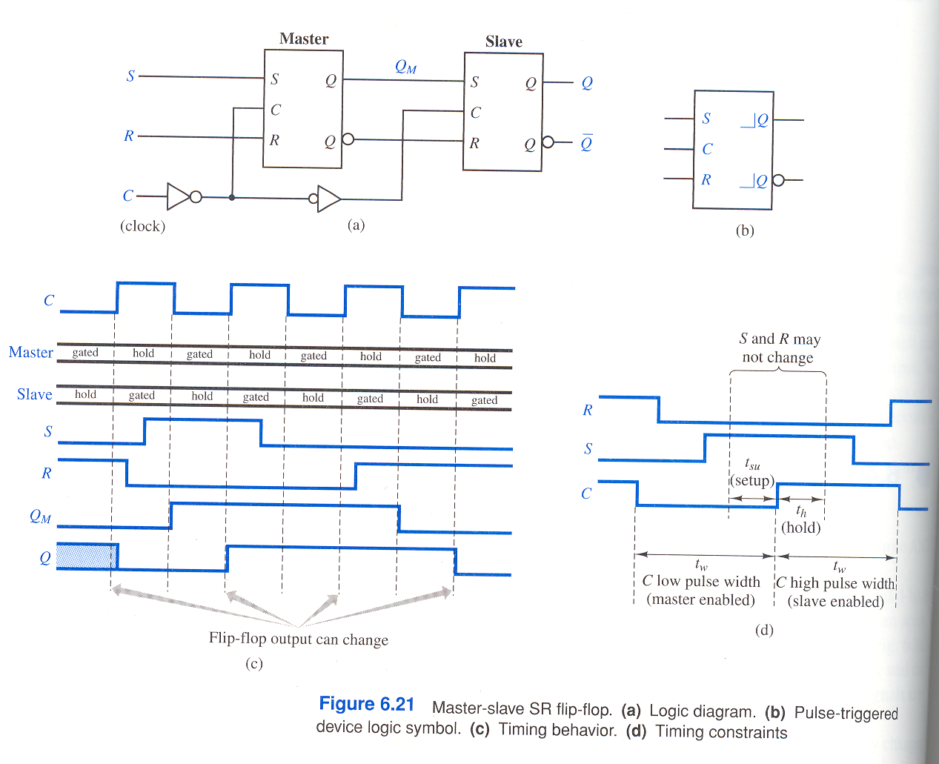
Master-Slave SR Flip-flop

Slide 43
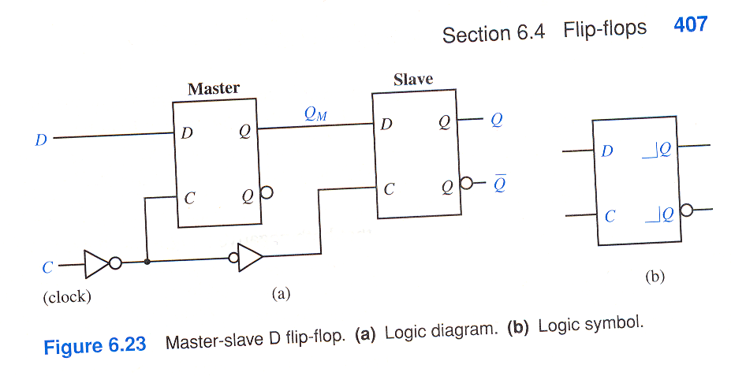
Master-Slave D Flip-flop

Slide 44
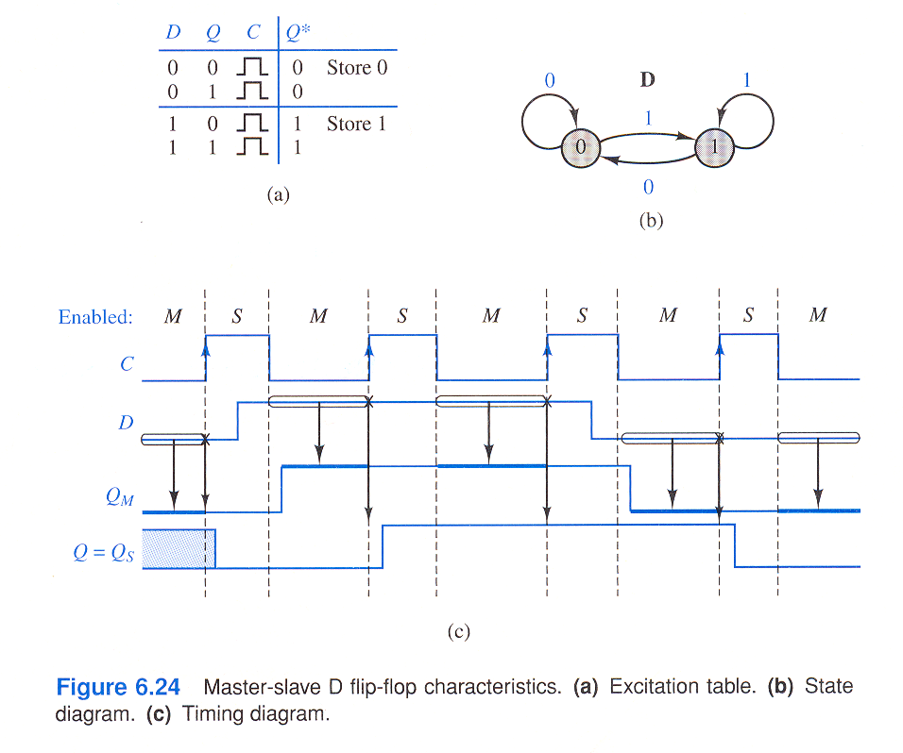
Master-Slave D Flip-flop

Slide 45
JK and T-Flip Flops
JK addresses the restrictions in SR
T (toggle flip-flop) can be constructed from JK (How?)

Slide 46
Sequential Logic Design
Typical applications
Shift Registers
  Design (SN 74194)
    Equations:
    CK = clock + s0’ s1’
    S_{B} = Q_{C}.s0’ + Q_{A}. s1’ + B.s0.s1
  Applications
Counters
  Design
  Applications
General approach to Sequential logic Design (Sequence Detector Example).

Slide 47
Steps in Sequential Logic Synthesis
State Modeling from verbal description of the problem (State diagram and Table)
Minimization of States (Partitioning Method)
State Assignment
Transition and output tables
Decide on memory devices (flip-flops) to use and get excitation and output functions (logic equations) for each memory element and output.
Draw the circuit diagram with basic logic gates and flip-flops
Machine M
NS, Z
PS x=0 x=1
A E,0 D,1
B F,0 D,0
C E,0 B,1
D F,0 B,0
E C,0 F,1
F B,0 C,0

Slide 48
Steps in Incompletely Specified Sequential Machine Synthesis
State Modeling from verbal description of the problem (State diagram and Table)
Minimization of States (Merger graphs/Tables, Compatibility/ Implication graphs)
State Assignment
Transition and output tables
Decide on memory devices (flip-flops) to use and get excitation and output functions (logic equations) for each memory element and output.
Draw the circuit diagram with basic logic gates and flip-flops
Machine M
NS, Z
PS I1 I2 I3 I4
A - - E,1 -
B C,0 A,1 B,0 -
C C,0 D,1 - A,0
D - E,1 B,- -
E B,0 - C,- B,0

Slide 49
Minimization of Incompletely Specified Sequential Machines
Find the compatible pairs using implication/compatibility table/graph.
Find the maximum compatibles
Find by trial and error the minimal set of compatibility classes that cover all the states, and are closed with respect to transitions.
Machine M
NS, Z
PS x=0 x=1
A A/- -/-
B C/1 B/0
C D/0 -/1
D - /- B/-
E A/0 C/1

Slide 50
Asynchronous Sequential Circuits
A Small Project/Problem
involving Pulse Mode Circuits
You are required to design an automatic toll-collecting machine accepting nickels, dimes, and quarters only. Toll is 35 cents. An electro-mechanical system, already available, accepts the coins sequentially (even if they are all dropped in simultaneously) and generates a pulse on one of the three output lines (x₅, x₁₀, and x₂₅) corresponding to the three types of the coins received. A reset pulse x_{r} is also produced by a sensor which senses the passing of the car through the toll gate. Your machine should produce a level output that turns a green light ON whenever 35C or more is received. After the car is passed, the machine should turn the light off and resets your machine to initial state. All overpayments are profit for the toll-collecting authority.
Asynchronous Sequential Circuits
Pulse Mode Circuits
Fundamental Mode Circuits
What is the difference?

Slide 51
Fundamental Mode Circuits
Example Problem: An asynchronous sequential circuit has two inputs x1 and x2. Initial input state is x1 = x2 = 0. The circuit output is 1 if and only if the input state is x1 = x2 = 1 and the preceding input state is x1 = 0, x2 = 1.
X1
X2
Z
1
2
4
5
2
3

